Slide 1
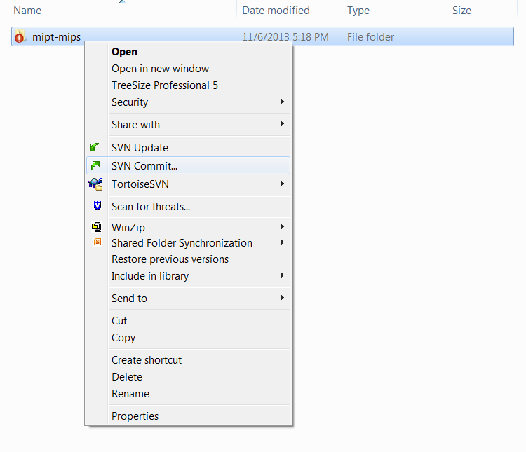
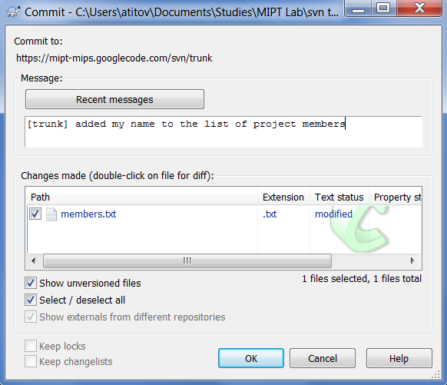
1
Right click on the folder that you want to commit
Check that you commit to the right URL
3
2
Click here
4
Enter the message describing your changes

