Slide 1
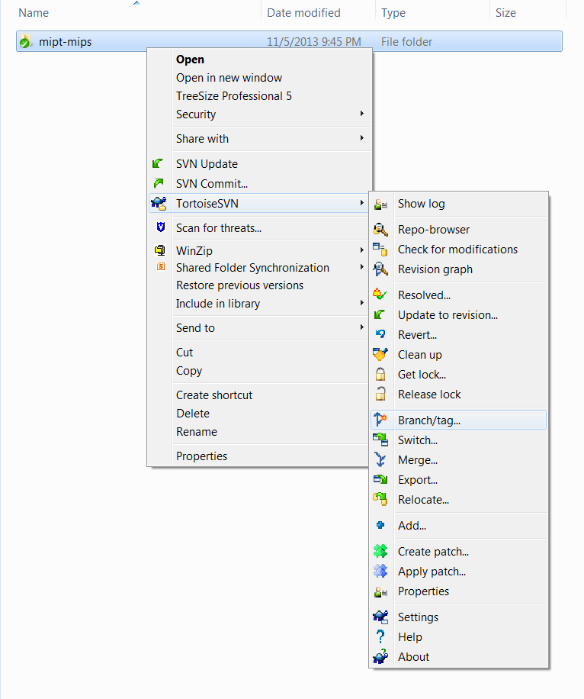
1
Select and right click on the folders that you want to copy to your branch
2
Click here

Slide 2
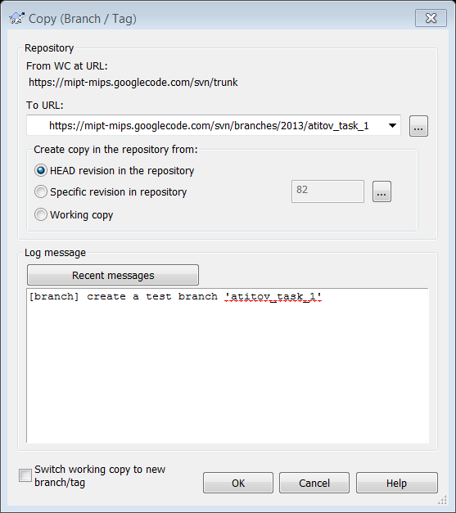
URL of the svn folder that will be copied to your branch
Enter URL for your branch
(“atitov_task_1” here)
3
4
Select to copy from the HEAD revision
5
Add the comment explaining what changes you did

