Slide 1
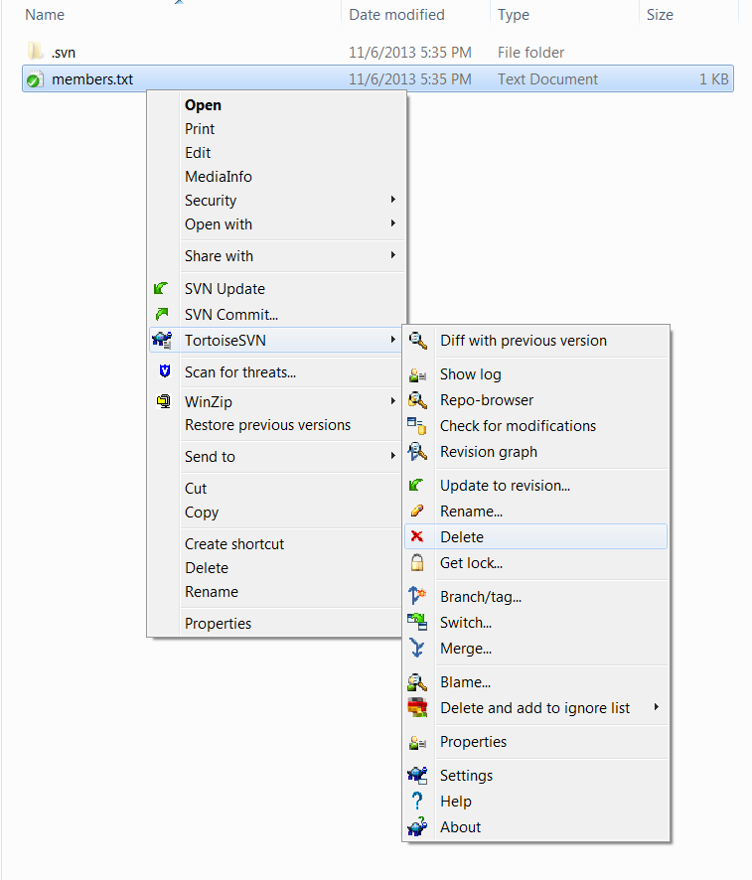
1
Select files or folders that you want to delete and right click them
2
Click here

