Slide 1
ECS 153: Bar
Blockchain Web-Based Encrypted Instant Messaging Application
Members
Sheng Yee Siow
Brandon Jones Gunaman
Tianyang Zhan
Vsevolod Moskaev

Slide 2
The Problem
Scripts and Bots impersonating people to interact with users
Major Tech Corporation monetizing private messaging data

Slide 3
Proposed Solution
Email verification and reliable authentication upon sign up: Firebase Authentication
Decentralization of data storage: Blockchain

Slide 4
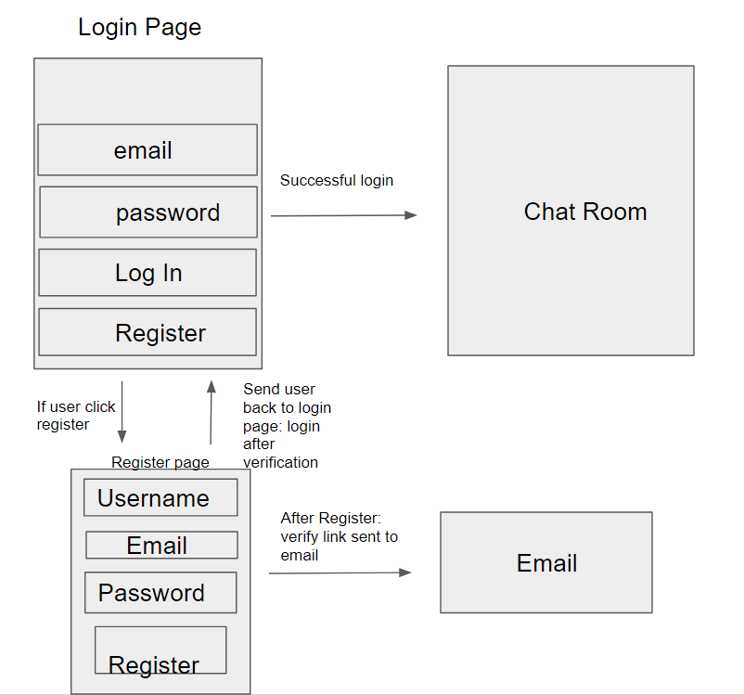
Sign Up and Login Flowchart

Slide 5






Collection of Ethereum accounts
Ganache
Ethereum Accounts
Link Ethereum account to web browser via web3
Send transactions for approval
Metamask
Write Data
Client
Confirm and approve transactions
Blockchain
Display updated data
Schema and Functions
Truffle Contract

