Slide 1
Implementing Port Security
Notes:
11 – Switch Security Configuration
11.1 – Implement Port Security

Slide 2
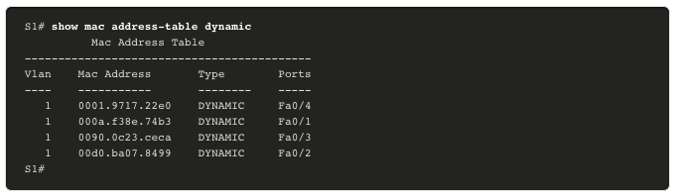
MAC Address Table Attack Switch Operation Review
Recall that to make forwarding decisions, a Layer 2 LAN switch builds a table based on the source MAC addresses in received frames. This is called a MAC address table. MAC address tables are stored in memory and are used to more efficiently switch frames.
Notes:
10 – LAN Security Concepts
10.4 – MAC Address Table Attack
10.4.1 – Switch Operation Review

Slide 3
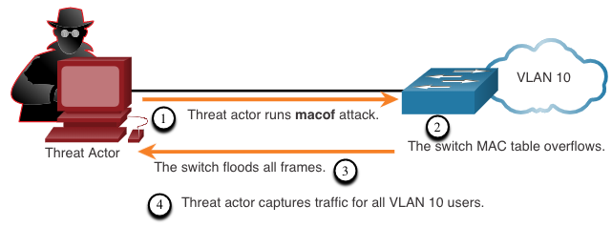
MAC Address Table Attack MAC Address Table Flooding
The CAM (content addressable memory) table stored on the switch, holds MAC addresses mapped to a port
The CAM table is a fixed size
The switch can run out of resources to store MAC addresses in the CAM.
MAC address flooding attacks bombard the CAM with fake source MAC addresses until the table is full
Results in the switch flooding all subsequent future frames received to be broadcast out all ports that belong to the same VLAN,
Enabling attacker to potentially overrun switch as a denial of service (DOS) attack
Ensuring all other hosts are now also broadcasting their traffic that was meant for uni-cast also enables the attacker to eavesdrop on all the traffic within that VLAN
Notes:
10 – LAN Security Concepts
10.4 – MAC Address Table Attack
10.4.2 – MAC Address Table Flooding

Slide 4
MAC Address Table Attack MAC Address Table Attack Mitigation
What makes tools such as macof so dangerous is that an attacker can create a MAC table overflow attack very quickly. For instance, a Catalyst 6500 switch can store 132,000 MAC addresses in its MAC address table. A tool such as macof can flood a switch with up to 8,000 bogus frames per second; creating a MAC address table overflow attack in a matter of a few seconds.
Another reason why these attack tools are dangerous is because they not only affect the local switch, they can also affect other connected Layer 2 switches. When the MAC address table of a switch is full, it starts flooding out all ports including those connected to other Layer 2 switches.
To mitigate MAC address table overflow attacks, network administrators must implement port security. Port security will only allow a specified number of source MAC addresses to be learned on the port. Port security is further discussed in another module.
Notes:
10 – LAN Security Concepts
10.4 – MAC Address Table Attack
10.4.3 – MAC Address Table Attack Mitigation
10.4.4 – Check Your Understanding – MAC Address Table Attacks

Slide 5
Implement Port Security Secure Unused Ports
Layer 2 attacks are some of the easiest for hackers to deploy but these threats can also be mitigated with some common Layer 2 solutions.
All switch ports (interfaces) should be secured before the switch is deployed for production use. How a port is secured depends on its function.
A simple method that many administrators use to help secure the network from unauthorized access is to disable all unused ports on a switch. Navigate to each unused port and issue the Cisco IOS shutdown command. If a port must be reactivated at a later time, it can be enabled with the no shutdown command.
To configure a range of ports, use the interface range command.
Switch(config)# interface range type module/first-number – last-number
Notes:
11 – Switch Security Configuration
11.1 – Implement Port Security
11.1.1 – Secure Unused Ports

Slide 6
Implement Port Security Mitigate MAC Address Table Attacks
The simplest and most effective method to prevent MAC address table overflow attacks is to enable port security.
Port security limits the number of valid MAC addresses allowed on a port. It allows an administrator to manually configure MAC addresses for a port or to permit the switch to dynamically learn a limited number of MAC addresses. When a port configured with port security receives a frame, the source MAC address of the frame is compared to the list of secure source MAC addresses that were manually configured or dynamically learned on the port.
By limiting the number of permitted MAC addresses on a port to one, port security can be used to control unauthorized access to the network.
Notes:
11 – Switch Security Configuration
11.1 – Implement Port Security
11.1.2 – Mitigate MAC Address Table Attacks

Slide 7
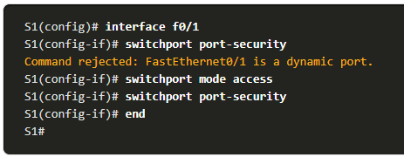
Implement Port Security Enable Port Security
Port security is enabled with the switchport port-security interface configuration command.
Notice in the example, the switchport port-security command was rejected. This is because port security can only be configured on manually configured access ports or manually configured trunk ports. By default, Layer 2 switch ports are set to dynamic auto (trunking on). Therefore, in the example, the port is configured with the switchport mode access interface configuration command.
Note: Trunk port security is beyond the scope of this course.
Notes:
11 – Switch Security Configuration
11.1 – Implement Port Security
11.1.3 – Enable Port Security

Slide 8
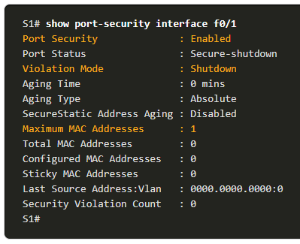
Implement Port Security Enable Port Security (Cont.)
Use the show port-security interface command to display the current port security settings for FastEthernet 0/1.
Notice how port security is enabled, the violation mode is shutdown, and how the maximum number of MAC addresses is 1.
If a device is connected to the port, the switch will automatically add the device’s MAC address as a secure MAC. In this example, no device is connected to the port.
Note: If an active port is configured with the switchport port-security command and more than one device is connected to that port, the port will transition to the error-disabled state.
Notes:
11 – Switch Security Configuration
11.1 – Implement Port Security
11.1.3 – Enable Port Security (Cont.)

Slide 9
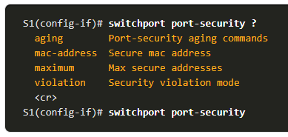
Implement Port Security Enable Port Security (Cont.)
After port security is enabled, other port security specifics can be configured, as shown in the example.
Notes:
11 – Switch Security Configuration
11.1 – Implement Port Security
11.1.3 – Enable Port Security (Cont.)

Slide 10
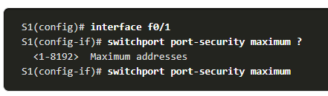
Implement Port Security Limit and Learn MAC Addresses
To set the maximum number of MAC addresses allowed on a port, use the following command:
The default port security value is 1.
The maximum number of secure MAC addresses that can be configured depends the switch and the IOS.
In this example, the maximum is 8192.
Switch(config-if)# switchport port-security maximum value
Notes:
11 – Switch Security Configuration
11.1 – Implement Port Security
11.1.4 – Limit and Learn MAC Addresses

Slide 11
Implement Port Security Limit and Learn MAC Addresses (Cont.)
The switch can be configured to learn about MAC addresses on a secure port in one of three ways:
1. Manually Configured: The administrator manually configures a static MAC address(es) by using the following command for each secure MAC address on the port:
Switch(config-if)# switchport port-security mac-address mac-address
2. Dynamically Learned: When the switchport port-security command is entered, the current source MAC for the device connected to the port is automatically secured but is not added to the running configuration. If the switch is rebooted, the port will have to re-learn the device’s MAC address.
3. Dynamically Learned – Sticky: The administrator can enable the switch to dynamically learn the MAC address and “stick” them to the running configuration by using the following command:
Switch(config-if)# switchport port-security mac-address sticky
Saving the running configuration will commit the dynamically learned MAC address to NVRAM.
Notes:
11 – Switch Security Configuration
11.1 – Implement Port Security
11.1.4 – Limit and Learn MAC Addresses (Cont.)

Slide 12
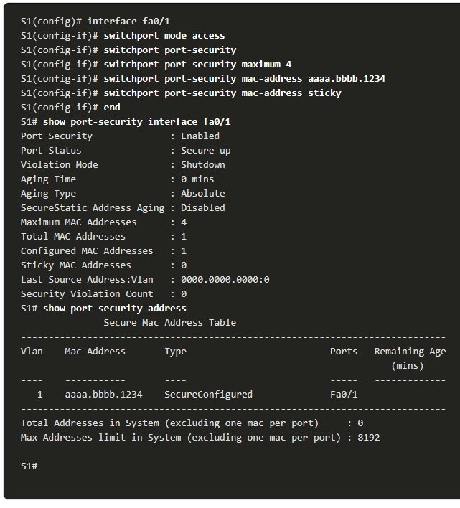
Implement Port Security Limit and Learn MAC Addresses (Cont.)
The example demonstrates a complete port security configuration for FastEthernet 0/1.
The administrator specifies a maximum of 4 MAC addresses, manually configures one secure MAC address, and then configures the port to dynamically learn additional secure MAC addresses up to the 4 secure MAC address maximum.
Use the show port-security interface and the show port-security address command to verify the configuration.
Notes:
11 – Switch Security Configuration
11.1 – Implement Port Security
11.1.4 – Limit and Learn MAC Addresses (Cont.)

Slide 13
Implement Port Security Port Security Aging
Port security aging can be used to set the aging time for static and dynamic secure addresses on a port and two types of aging are supported per port:
Absolute - The secure addresses on the port are deleted after the specified aging time.
Inactivity - The secure addresses on the port are deleted if they are inactive for a specified time.
Use aging to remove secure MAC addresses on a secure port without manually deleting the existing secure MAC addresses.
Aging of statically configured secure addresses can be enabled or disabled on a per-port basis.
Use the switchport port-security aging command to enable or disable static aging for the secure port, or to set the aging time or type.
Switch(config-if)# switchport port-security aging {static | time time | type {absolute | inactivity}}
Notes:
11 – Switch Security Configuration
11.1 – Implement Port Security
11.1.5 – Port Security Aging

Slide 14
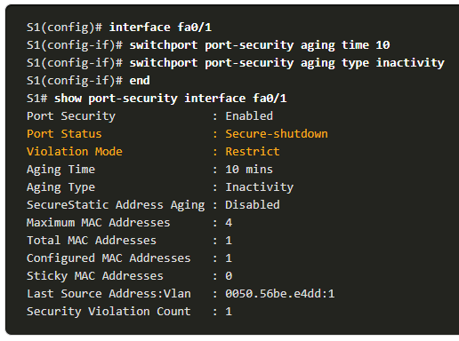
Implement Port Security Port Security Aging (Cont.)
The example shows an administrator configuring the aging type to 10 minutes of inactivity.
The show port-security command confirms the changes. interface command to verify the configuration.
Notes:
11 – Switch Security Configuration
11.1 – Implement Port Security
11.1.5 – Port Security Aging (Cont.)

Slide 15
Implement Port Security Port Security Violation Modes
If the MAC address of a device attached to a port differs from the list of secure addresses, then a port violation occurs and the port enters the error-disabled state.
To set the port security violation mode, use the following command:
Switch(config-if)# switchport port-security violation {shutdown | restrict | protect}
The following table shows how a switch reacts based on the configured violation mode.
Mode | Description
shutdown (default) | The port transitions to the error-disabled state immediately, turns off the port LED, and sends a syslog message. It increments the violation counter. When a secure port is in the error-disabled state, an administrator must re-enable it by entering the shutdown and no shutdown commands.
restrict | The port drops packets with unknown source addresses until you remove a sufficient number of secure MAC addresses to drop below the maximum value or increase the maximum value. This mode causes the Security Violation counter to increment and generates a syslog message.
protect | This is the least secure of the security violation modes. The port drops packets with unknown MAC source addresses until you remove a sufficient number of secure MAC addresses to drop below the maximum value or increase the maximum value. No syslog message is sent.
Notes:
11 – Switch Security Configuration
11.1 – Implement Port Security
11.1.6 – Port Security Violation Modes

Slide 16
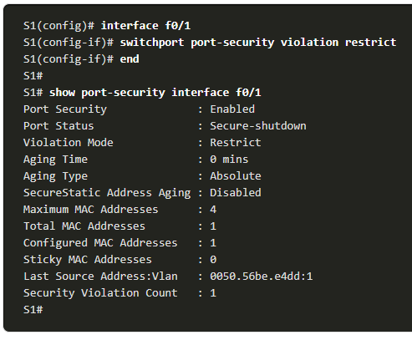
Implement Port Security Port Security Violation Modes (Cont.)
The example shows an administrator changing the security violation to “Restrict”.
The output of the show port-security interface command confirms that the change has been made.
Notes:
11 – Switch Security Configuration
11.1 – Implement Port Security
11.1.6 – Port Security Violation Modes (Cont.)

Slide 17
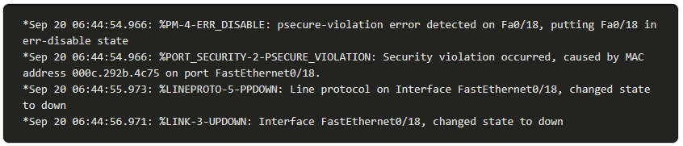
Implement Port Security Ports in error-disabled State
When a port is shutdown and placed in the error-disabled state, no traffic is sent or received on that port.
A series of port security related messages display on the console, as shown in the following example.
Note: The port protocol and link status are changed to down and the port LED is turned off.
Notes:
11 – Switch Security Configuration
11.1 – Implement Port Security
11.1.7 – Ports in error-disabled State

Slide 18
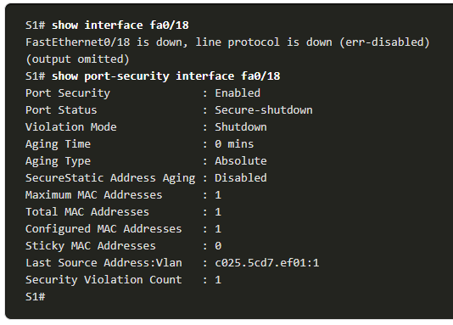
Implement Port Security Ports in error-disabled State (Cont.)
In the example, the show interface command identifies the port status as err-disabled. The output of the show port-security interface command now shows the port status as secure-shutdown. The Security Violation counter increments by 1.
The administrator should determine what caused the security violation If an unauthorized device is connected to a secure port, the security threat is eliminated before re-enabling the port.
To re-enable the port, first use the shutdown command, then, use the no shutdown command.
Notes:
11 – Switch Security Configuration
11.1 – Implement Port Security
11.1.7 – Ports in error-disabled State (Cont.)

Slide 19
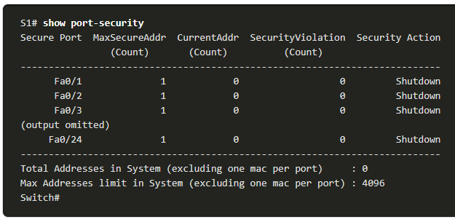
Implement Port Security Verify Port Security
After configuring port security on a switch, check each interface to verify that the port security is set correctly, and check to ensure that the static MAC addresses have been configured correctly.
To display port security settings for the switch, use the show port-security command.
The example indicates that all 24 interfaces are configured with the switchport port-security command because the maximum allowed is 1 and the violation mode is shutdown.
No devices are connected, therefore, the CurrentAddr (Count) is 0 for each interface.
Notes:
11 – Switch Security Configuration
11.1 – Implement Port Security
11.1.8 – Verify Port Security

Slide 20
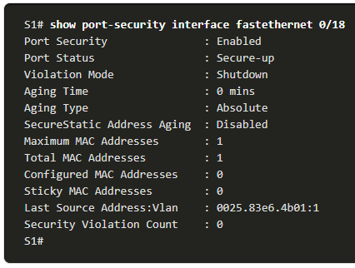
Implement Port Security Verify Port Security (Cont.)
Use the show port-security interface command to view details for a specific interface, as shown previously and in this example.
Notes:
11 – Switch Security Configuration
11.1 – Implement Port Security
11.1.8 – Verify Port Security (Cont.)

Slide 21
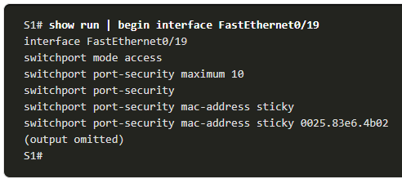
Implement Port Security Verify Port Security (Cont.)
To verify that MAC addresses are “sticking” to the configuration, use the show run command as shown in the example for FastEthernet 0/19.
Notes:
11 – Switch Security Configuration
11.1 – Implement Port Security
11.1.8 – Verify Port Security (Cont.)

Slide 22
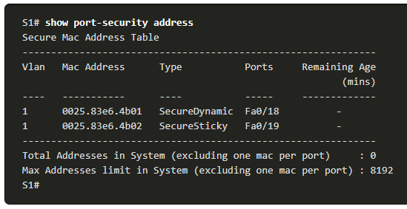
Implement Port Security Verify Port Security (Cont.)
To display all secure MAC addresses that are manually configured or dynamically learned on all switch interfaces, use the show port-security address command as shown in the example.
Notes:
11 – Switch Security Configuration
11.1 – Implement Port Security
11.1.8 – Verify Port Security (Cont.)
11.1.9 – Syntax Checker – Implement Port Security

