Slide 1

IBM Internet of Things platform
Connecting things that Matter
@jeffreydare

Slide 2
IoT is revolutionizing the market and a tremendous growth opportunity
Top 3 ways IoT will change how business operates
1
Unlock new revenue from existing products/service
2
Inspire new working practices or processes
3
Change or create new business model or strategy
75%
of Companies are exploring IoT
36%
Growth in sensing, communicating devices
62%
Of C-suite execs believe failure to adopt IoT will mean getting left behind
400%
Growth in Google search interest
Notes:
We are often asked to defend if IoT is ‘real’ – anything more than hype.
The question itself is interesting – there is a lot of hype. But there is hard evidence, from organizations spanning all industries, that clearly illustrate the benefits and differentiation and improved client experience enabled by the IoT
I’ll share some examples in a few minutes, but first….
Recent surveys and market data tell us.
Three ways IoT is changing… Unlock new revenue from existing product/service (connected product). New working practices/processes (asset maintenance). Create/change business model (insurance industry).
Perhaps the most interesting survey response – 62% believe that orgs slow to adopt IoT will fall behind competition.
References:
400% - Google Trends analysis using the search term “IoT” for the date range Jan. 2010-15
75% - Economist Intelligence Unit, “The Internet of Things business index: A quiet revolution gathers pace”, 2013 - http://www.arm.com/files/pdf/eiu_internet_business_index_web.pdf
62% - Economist Intelligence Unit, “The Internet of Things business index: A quiet revolution gathers pace”, 2013 - http://www.arm.com/files/pdf/eiu_internet_business_index_web.pdf
36% - Gartner, “Hype Cycle for the Internet of Things”, July, 2013

Slide 3

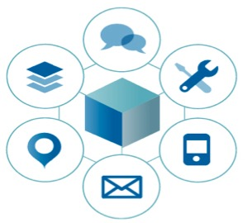
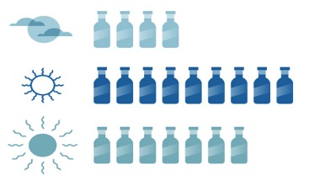
Disruptors are utilizing the Internet of Things and recomposing their businesses by digital transformation
New channels
and business models
Real time insight
driven processes
Digital Innovation
New apps are consolidating data and capabilities to engage new audiences
Insight from nontraditional sources of data are being infused in business processes to create new business moments
New innovations are composed leveraging digital services from a broad ecosystem

Slide 4

IoT value is realized in four foundational areas
Representative Products
Industry Transformation
Evolving new business
models
IoT for Electronics
Applications & Solutions
Optimizing operations and enhancing performance
Maximo, TRIRIGA, PMQ
Platforms
Building and managing IoT solutions
Continuous Engineering,
IoT Foundation, IoT Real-time Insights
Devices & Networks
Connecting what matters

Slide 5
The IBM IoT platform - The first step to transforming with the Internet of Things
Connect any devices
Pull your data into the cloud…..shared, dedicated, or even on premise
Integrate your data with all forms of external and internal data
Use powerful analytics on this data to create insights that matter to you
Build applications to use those insights to engage with your things and your clients
IBM is bringing the power of our cloud, analytics, transformation, and ecosystem through the IBM IoT platform to help clients to leverage The Internet of Things to create new value and new ways of working.
We are using our industrial strength capabilities and services to bring together people, process and now things in amazing new ways.

Slide 6
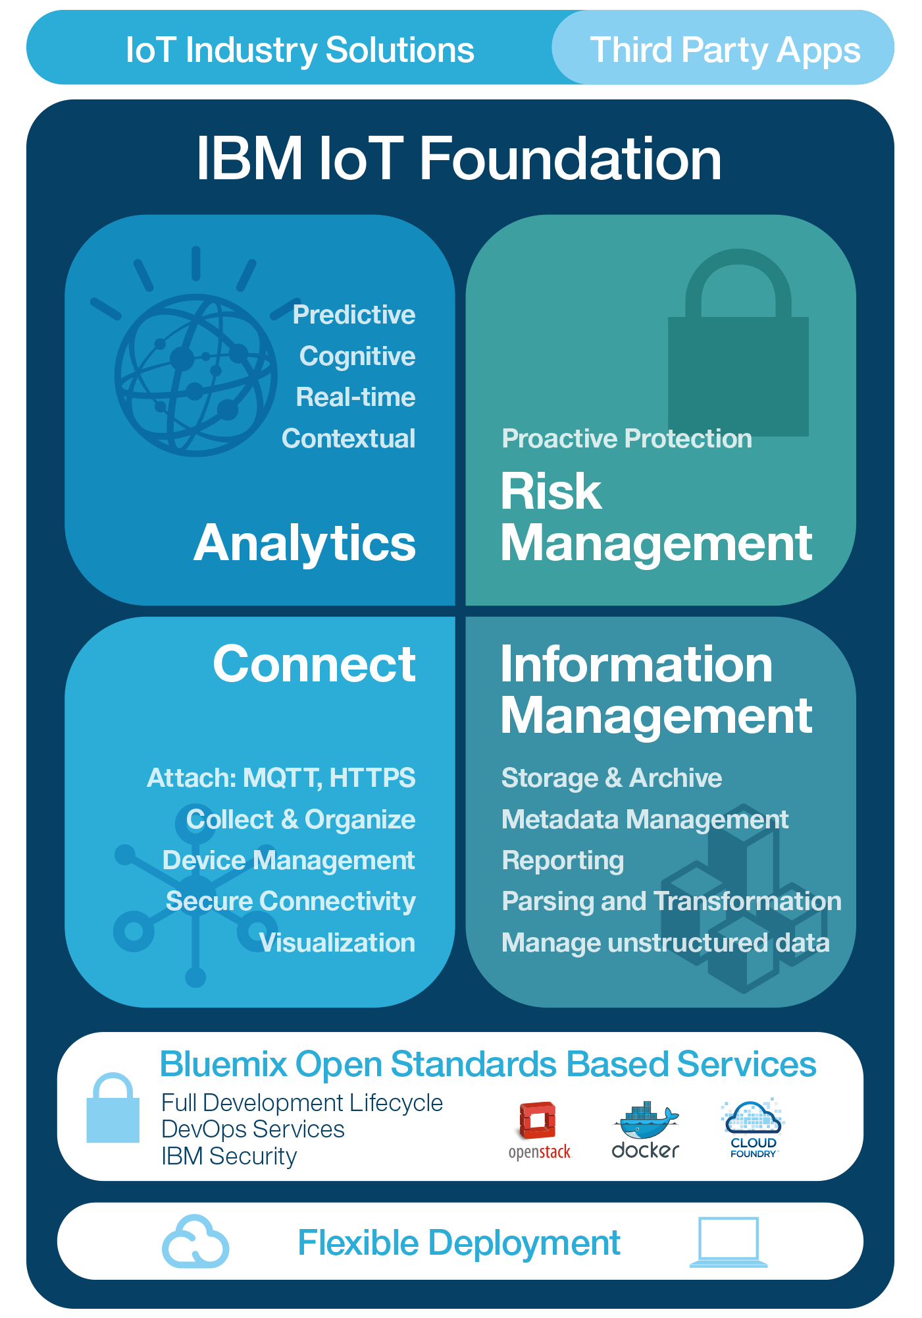
The IBM IoT Foundation - Everything you need to Innovate with IoT
Third Party Apps
Third Party Apps
IBM IoT Foundation Offerings
IBM IoT Foundation Connect
Attach, Collect & Organize, Device Management, Secure Connectivity, Visualization
IBM IoT Foundation Information Management
Storage & Archive, Metadata Management, Reporting, Streaming data, Parsing and Transformation, Manage unstructured data
IBM IoT Foundation Analytics
Predictive, Cognitive, Real-time, and Contextual
IBM IoT Foundation Risk Management
Security Analytics, Data Protection, Auditing/Logging, Firmware Updates, Key/Cert Mgmt, Org Specific Security

Slide 7
IBM IoT Foundation Connect & Information Management expand capabilities
Today …
Composable services
Rapid innovation with Bluemix
Dashboard/console for each service
Pricing per service
Integrate at the application level
Focused on device connectivity & data storage
Tomorrow …
Pre-integrated services
Single console
Simple predictable pricing
Support for consuming other IoT platform data
Integrate at the business services level
Focused on device connectivity, management & data storage, caching & transformation

Slide 8
IBM IoT Foundation Connect & Information Management
IBM IoT Foundation
Connect
Device connectivity
Device management
Data cache
Device metadata repository
User management services
Information Management
Choice of Cloudant, TimeSeries,
HDFS & other storage options
Data offload capability
Data Archive capability
Graphical Data Management
Parsing and transformation

Slide 9
Extend insight with IBM IoT Foundation Analytics
Today …
IoT Real-Time Insights (individual service)
Real-time dashboards
Other services from IBM, e.g. Hadoop Big Insights, Streams
Maximo integration
Tomorrow …
Pre bundled set of Analytics capabilities by use case
Real-Time
Descriptive analytics – reporting, BI, and discovery
Predictive analytics, trending, & machine learning
TRIRIGA Integration
Multiple deployment options – local/dedicated/public

Slide 10
IBM IoT Foundation Analytics Contextually link IoT data with systems of record and other rich data sources to gain insight, take appropriate automated actions and resolve issues
IBM IoT Foundation
Analytics
Predictive
Trending
Forecasting
Optimization
Prescriptive
Cognitive
Machine learning
Correlation & pattern discovery
Advanced visualization tools
Real-Time
Data augmentation
Rules processing
Dashboards & visualization
Action engine

Slide 11
Enhanced security with IBM IoT Foundation Risk Management
Today …
Device-Cloud communication security
Device-Cloud authentication
App authentication
Underlying cloud infrastructure security
Different across each IoT related service
Tomorrow …
Base level security in the IoT Foundation with consistent approach across all elements
Extra level of proactive security purchasable

Slide 12
IBM IoT Foundation Risk Management –
Protect, Detect, Correct
IBM IoT Foundation
Risk Management
Proactive Protection
Server-side anomaly detection and response triggering
More advanced auditing, logging and reporting
Data segregation and encryption
Dedicated security dashboard
Device-side secure firmware update agents and additional device-side security code
Automated security rules checking
Bespoke security schemes (e.g. X.509 certificates

Slide 13


We’re helping to create electronics industry leaders
They’re building new and better products
that capitalize on our increasingly instrumented, interconnected and intelligent world.
They’re optimizing operations
across complex, interconnected systems to continually improve production, quality and safety.
And they’re engaging customers
and colleagues
in new ways to more effectively establish and nurture relationships and foster rich collaboration.

Slide 14

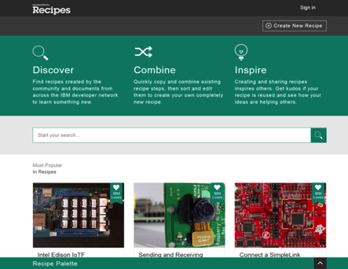

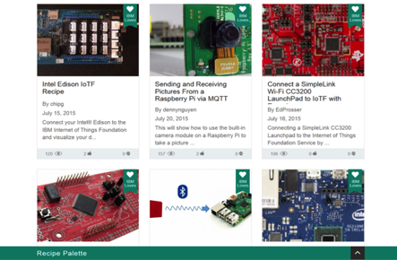




Ecosystem & partnership strategy extend the IBM IoT platform
Derive IoT value on the Cloud through strong industry partnerships and open ecosystem
Connecting Devices to the IBM IoT platform:
Wide variety of supported devices
Self Service
Open ecosystem
Simple tutorials
Connect in moments
Examples:
IBM Confidential

Slide 15
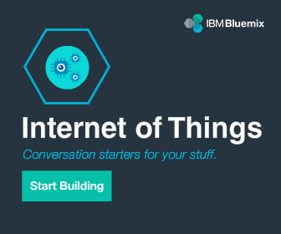
IBM IoT – Get started today
Learn more about IBM’s point of view on the Internet of Things
ibm.com/IoT
Try out Internet of Things on Bluemix ibm.biz/try_iot
Join us in our IoT conversations
@IBMIoT
15

Slide 16
Backup

Slide 17


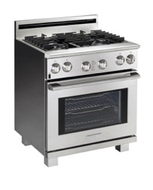
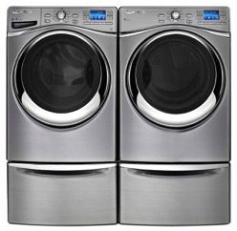
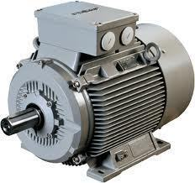


IBM IoT For Electronics
Manufacturing
Supply Fleet Operators
End Users
Applications
Connected Products
After Market Sales and Services
Infrastructure Insights
Asset Management
Asset Performance
Requirements Management
Connected Devices
Owner Services
Product Line Engineering
Requirements Management
Value Add Data
Command & Control
Application Lifecycle
Maintenance
Weather
Crowd
Social
Analytics
Privacy & Security
Real Time
Predictive
Learning
Business Systems
Factory Optimization
IoT Foundation (PaaS / Bluemix)
Supply Chain
CRM
Payment
IBM Cloud (IaaS)
IBM IoT For Electronics

