Slide 1



Welcome
Global City Teams Challenge
Bangalore Kick-off
#GCTC2016
Notes:
1

Slide 2

Agenda
09:00 – 9:10 | Welcome
9:10 – 9:50 | GCTC Introduction(IBM)
9:50 – 10:20 | Local City official guest speaker – Mr.Maheshwar Rao IAS
10:20 – 10:40 | Smart City demonstration (IBM)
10:40 - 11:00 | Break
11:00– 12:00 | Tools and Platform Part 1 : Intel IoT Edison (Intel)
12:00 – 1PM | Tools and Platform Part 2 : Introduction to IoTF and Bluemix (IBM)
1PM-2PM | Break
2PM -2.45PM | Team Building , Bluemix registration, Kit distribution
2:45 – 3.45PM | Lab 1 -Intel Edison XDK– data quick view
3:45 – 5.00PM | Lab 2 – Intel Edison –IoTF Device registration-Bluemix Nodered,cloudant data exploration
5.00-5.15PM | Closing out
#GCTC2016

Slide 3
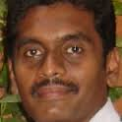
GCTC Introduction
Rajesh K Jeyapaul
Cloud Solution Architect
IBM
@[tuticorinrajesh]
@IBMecosystem #GCTC2016
Notes:
3

Slide 4
GCTC Introduction
GCTC 2016 is organized by National Institute of Standards and Technology (NIST) and US Ignite.
The challenge is to build, deploy and scale IoT applications used to help a smart city/smart community issue
Anyone can form a team; Teams consists of at least two entities. i.e. public sector (university) and private sector (hospital, private company, startup)
Challenge is in two phases Phase 1: November 2015 – June 2016 Phase 2: June 2016 – June 2017
More information on GCTC: www.globalcityteams.org
@IBMecosystem #GCTC2016
Notes:
4

Slide 5
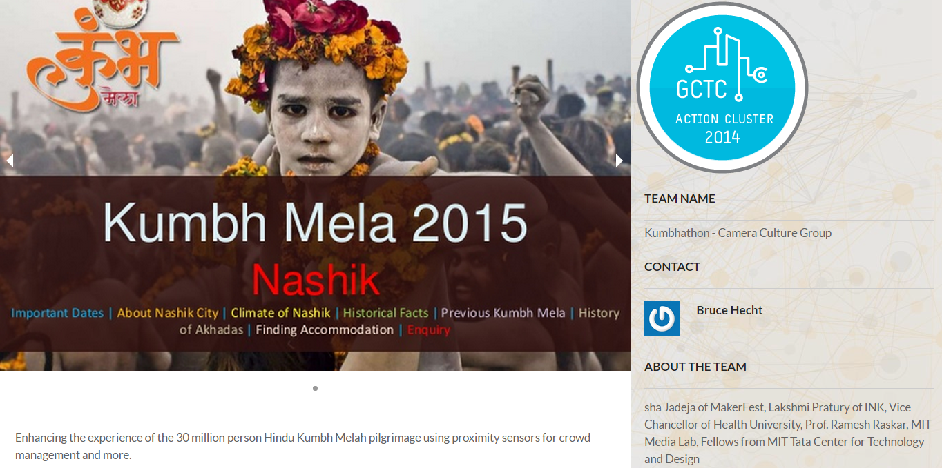

Slide 6
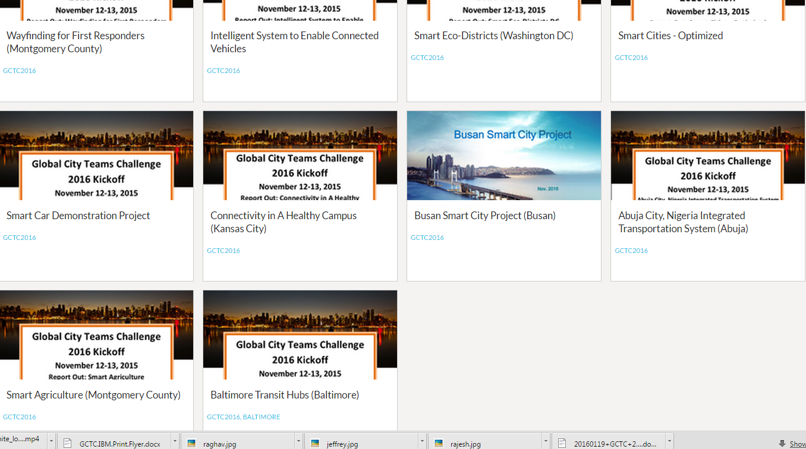
cluster - https://www.us-ignite.org/globalcityteams/actioncluster/
IBM contact – Robin Elaiho – rlelaiho@us.ibm.com

Slide 7
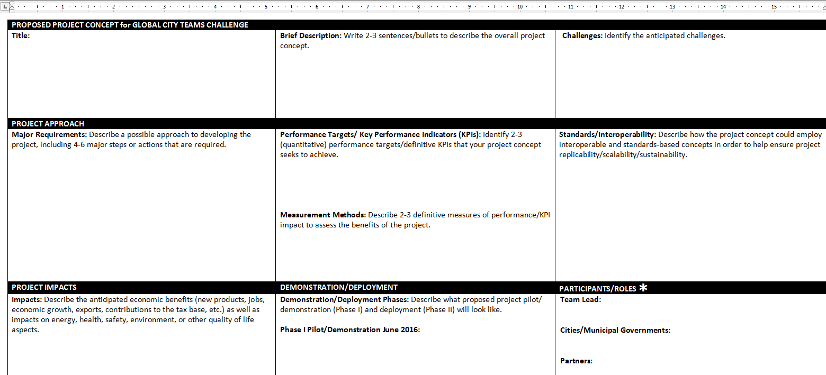
GCTC 2016 – Project worksheet
Send only to Robin to get IBM prizes

Slide 8
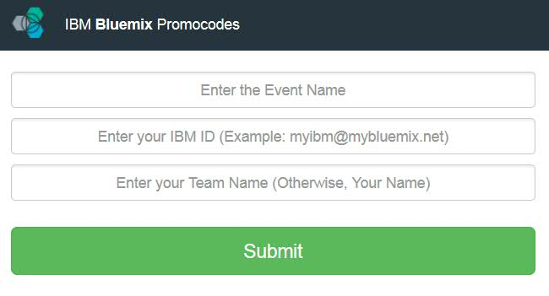
Extended Free Bluemix Trial
Sign up for your free Bluemix 30 day trial - www.ibm.biz/gctc2016
Visit website http://promocodes.mybluemix.net/ to extend your trial to June 30, 2016
Enter “GCTC” as Event Name, email address and Team Name
Email will be sent to you with promo code
@IBMecosystem #GCTC2016
Notes:
8

Slide 9

Most Innovative Use of Bluemix Award
GCTC Participants that use Bluemix to develop their IoT app will be eligible for the Most Innovative Use of Bluemix Award:
Entrepreneur and start-up winners will get access to the IBM Global Entrepreneur Program for Cloud Start-ups with $12K in Cloud Credit and will be eligible for up to $120,000 of free IBM Cloud credit.
Visit www.ibm.biz/gctcinfo for more information
@IBMecosystem #GCTC2016
Notes:
9

Slide 10
Summary – your next step for GCTC 2016
Register with Bluemix and get it extended till June 2016
Work with your extended team and Form an action cluster
Update the worksheet and send it to Robin (by March end)

Slide 11
Smarter City Demonstration
#GCTC2016
Notes:
11

Slide 12
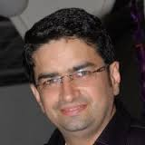
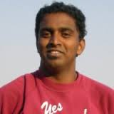
Tools and Platform
#GCTC2016
Notes:
12

Slide 13
IoT and Intel Edison Demo
Raghavendra K Ural
IoT Developer
Intel
@IBMecosystem #GCTC2016
Notes:
13

Slide 14
IoT and Bluemix Demo
Jeffrey Is Dare
IoT Developer
IBM
@IBMecosystem #GCTC2016
Notes:
14

Slide 15
Brainstorm and Team Building
#GCTC2016
Notes:
15

Slide 16
Reference links
GCTC wiki:
https://www.ibm.com/developerworks/community/wikis/home?lang=en#!/wiki/W75879fa4a3b5_4be8_956d_7ae078a2358c
Promo code :
https://www.ibm.com/developerworks/community/wikis/home?lang=en#!/wiki/W75879fa4a3b5_4be8_956d_7ae078a2358c/page/Bluemix%20Registration%20and%20Promo%20Code
IBM smarter city videos:
https://www.youtube.com/user/SmarterCities
GCTC contents
https://github.com/EcodIndia/gctcfeb16

Slide 17
Thank You!
#GCTC2016
Notes:
17

