Slide 1

IBM Internet of Things platform
Connecting things that Matter
@jeffreydare

Slide 2
IoT is revolutionizing the market and a tremendous growth opportunity
Top 3 ways IoT will change how business operates
1
Unlock new revenue from existing products/service
2
Inspire new working practices or processes
3
Change or create new business model or strategy
75%
of Companies are exploring IoT
36%
Growth in sensing, communicating devices
62%
Of C-suite execs believe failure to adopt IoT will mean getting left behind
400%
Growth in Google search interest
Notes:
We are often asked to defend if IoT is ‘real’ – anything more than hype.
The question itself is interesting – there is a lot of hype. But there is hard evidence, from organizations spanning all industries, that clearly illustrate the benefits and differentiation and improved client experience enabled by the IoT
I’ll share some examples in a few minutes, but first….
Recent surveys and market data tell us.
Three ways IoT is changing… Unlock new revenue from existing product/service (connected product). New working practices/processes (asset maintenance). Create/change business model (insurance industry).
Perhaps the most interesting survey response – 62% believe that orgs slow to adopt IoT will fall behind competition.
References:
400% - Google Trends analysis using the search term “IoT” for the date range Jan. 2010-15
75% - Economist Intelligence Unit, “The Internet of Things business index: A quiet revolution gathers pace”, 2013 - http://www.arm.com/files/pdf/eiu_internet_business_index_web.pdf
62% - Economist Intelligence Unit, “The Internet of Things business index: A quiet revolution gathers pace”, 2013 - http://www.arm.com/files/pdf/eiu_internet_business_index_web.pdf
36% - Gartner, “Hype Cycle for the Internet of Things”, July, 2013

Slide 3
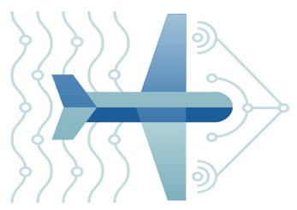
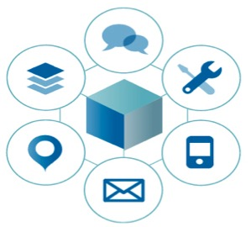
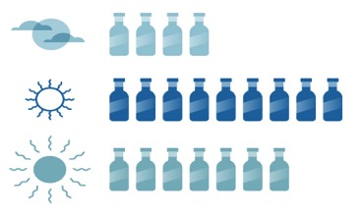
Disruptors are utilizing the Internet of Things and recomposing their businesses by digital transformation
New channels
and business models
Real time insight
driven processes
Digital Innovation
New apps are consolidating data and capabilities to engage new audiences
Insight from nontraditional sources of data are being infused in business processes to create new business moments
New innovations are composed leveraging digital services from a broad ecosystem

Slide 4
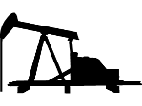
IoT value is realized in four foundational areas
Representative Products
Industry Transformation
Evolving new business
models
IoT for Electronics
Applications & Solutions
Optimizing operations and enhancing performance
Maximo, TRIRIGA, PMQ
Platforms
Building and managing IoT solutions
Continuous Engineering,
IoT Foundation, IoT Real-time Insights
Devices & Networks
Connecting what matters

Slide 5

IoT Value Creation is Being Led by Makers and Operators
makers
operators
The creation of smarter, connected products will redefine every industry with new capabilities that improve functionality, reduce costs, and deliver new value
The operation of old and new systems, now integrated with intelligent things, can become interactive, reactive, and adaptive; to each other, people and places
INSIGHT
changes the way we
design, secure, and operate
Powered
Analytics
Enabled
by Cloud
by

Slide 6
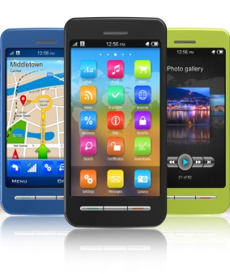
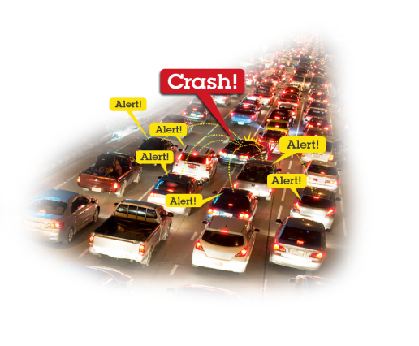











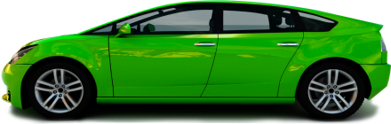



Key Internet of Things Use Case
Connected Vehicle
Mobile Applications
Connected City
Manufacturer
Real-time Telematics
Live engine diagnostics for predictive service
Fleet Operator
Standardized Logistics
Insurance and Vehicle Rental
Pay As You Drive (PAYD)
Pay How You Drive (PHYD)
Owner (mobile integration)
Find my car
Unlock/start my car
Pick me up
Online Banking
Real-time stock information
Reliable Transactions
Healthcare/Medical Devices
Senior health/home monitoring
Pacemakers, medical injection pumps, heart monitors
Mobile-enabling Enterprise Apps
Bridge enterprise applications directly to mobile without server build out
Public Services
Instrumented emergency services vehicles
Traffic/Telematics
Collision detected, emergency services notified
Surrounding vehicles notified
Public Safety
Traffic lights controlled
City services integration with telematics for weather and traffic alerts

Slide 7
Client/Industry: Durable Goods Manufacturers
Business Pain: No post-sales insight into products deployed in the field
Collect/Analyze product performance
Tune/Optimize Deployed Products Remotely
Optimize Servicing Costs
Enhance Customer Value Perception
Drive Customer Loyalty at End-of-Life
Sell parts performance data to supply chain
Mine usage data for re-sale
It’s about Insights:
Manufactures often have limited or no insight into their products once they leave the factory/showroom floor

Slide 8

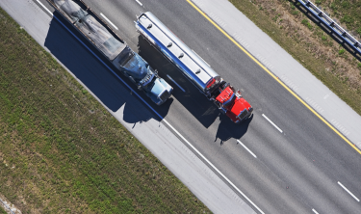
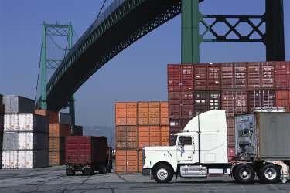
Automotive: Trucks with group chat
Uses Internet of Things Foundation (MessageSight) capabilities to enable Instant Messaging between cabs
Topics enable group chat
Saves cost, enables community
Uses a mobile application built in WorkLight
Uses WorkLight push notification to wake inactive devices
Enables a Connected Truck platform for the future
Notes:
See reference details at:
http://w3-01.ibm.com/sales/ssi/cgi-bin/ssialias?appname=crmd&subtype=NA&infotype=CR&htmlfid=0CRDD-9LCEWM
The client has agreed to be a reference for sales situations. The status of any installation or implementation can change, so you should always contact the Primary Contact or Additional Contact named in the reference prior to discussing it with your client. Any public use, such as in marketing materials, on WWW sites, in press articles, etc., requires specific approval from the client. It is the responsibility of the person or any organization planning to use this reference to make sure that this is done. The IBM representative will, as appropriate, contact the client for review. You should not contact the client directly.

Slide 9
Challenges to leveraging the Internet of Things
1
How to connect with plethora of devices Overcoming differences and limitations
Massive volume of device data Real-time capture without thrashing networks or polling
Understanding where things are Comparing with maps, spaces and other things
Making sense of device data at speed Analyzing data when it happens
Acting on device data Wire device logic together without complex coding
Sharing device services with others Using insights from data to change business
2
3
4
5
6

Slide 10
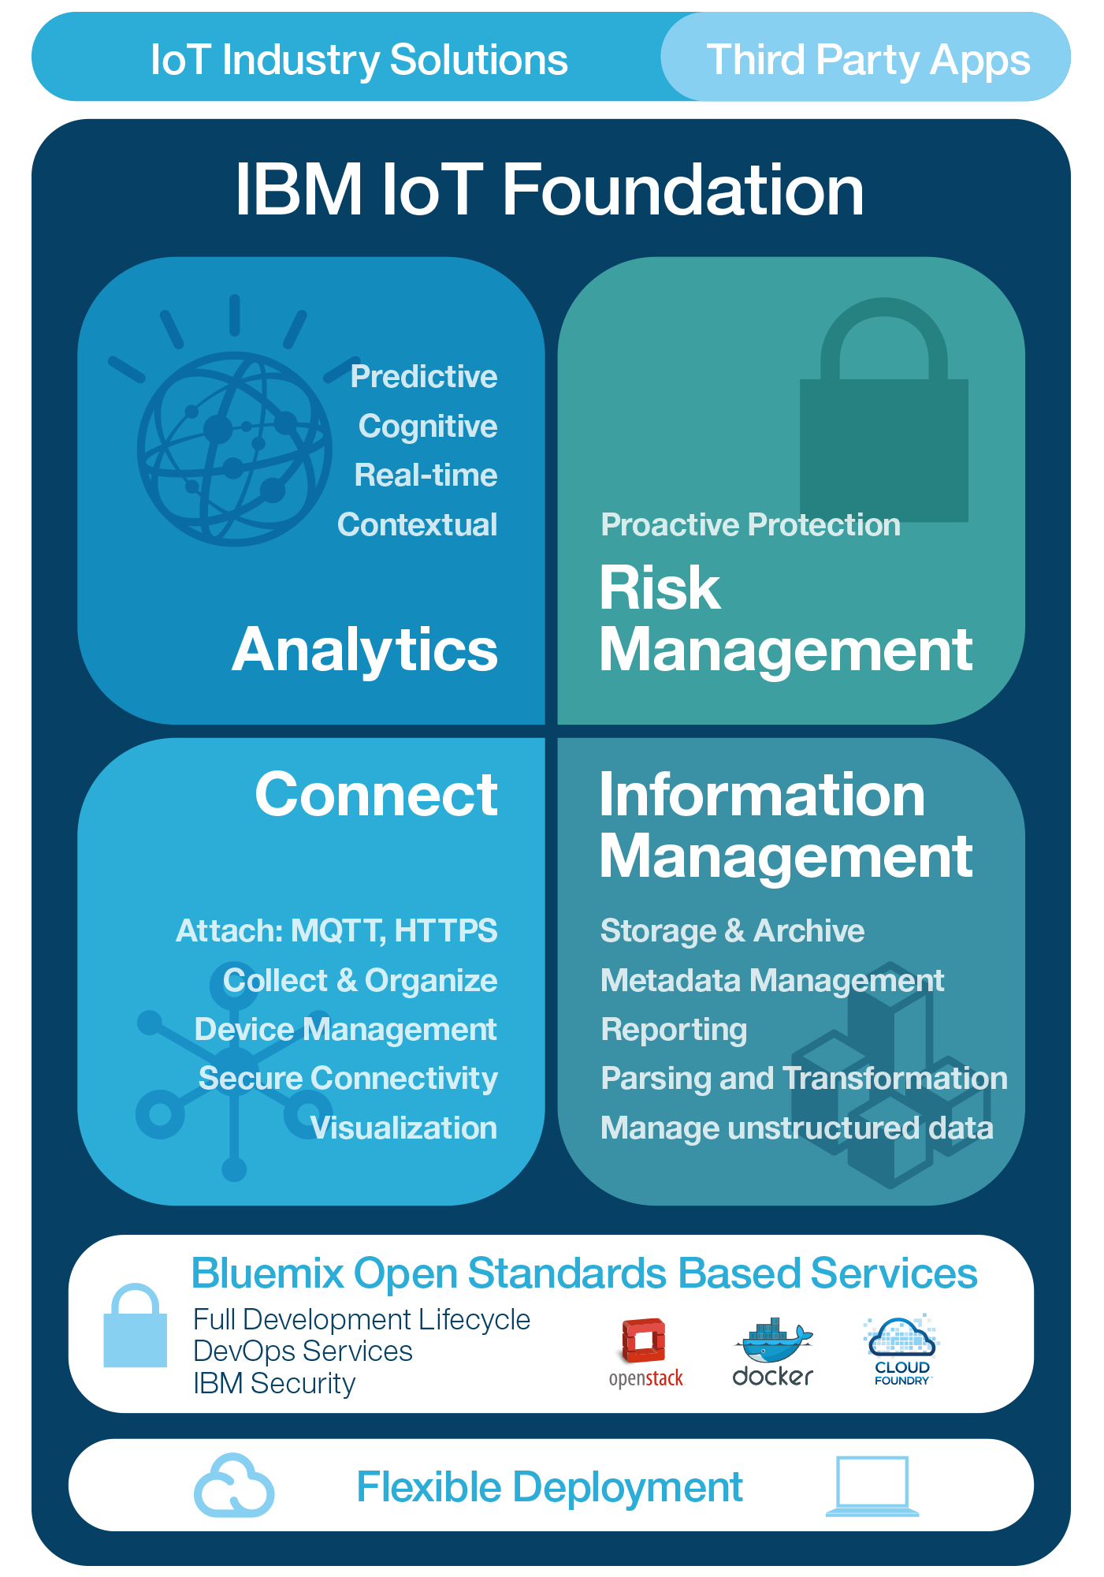
The IBM IoT Foundation - Everything you need to Innovate with IoT
Third Party Apps
Third Party Apps
IBM IoT Foundation Offerings
IBM IoT Foundation Connect
Attach, Collect & Organize, Device Management, Secure Connectivity, Visualization
IBM IoT Foundation Information Management
Storage & Archive, Metadata Management, Reporting, Streaming data, Parsing and Transformation, Manage unstructured data
IBM IoT Foundation Analytics
Predictive, Cognitive, Real-time, and Contextual
IBM IoT Foundation Risk Management
Security Analytics, Data Protection, Auditing/Logging, Firmware Updates, Key/Cert Mgmt, Org Specific Security

Slide 11
IBM IoT Foundation Connect & Information Management
IBM IoT Foundation
Connect
Device connectivity
Device management
Device metadata repository
User management services
Information Management
Choice of Cloudant, TimeSeries,
HDFS & other storage options
Data offload capability
Data Archive capability
Graphical Data Management
Notes:
Composable services
Rapid innovation with Bluemix
Dashboard/console for each service
Pricing per service
Integrate at the application level
Focused on device connectivity & data storage

Slide 12
Device Management
Support for managed devices
Set of contracts that the device implements the IoTF DM protocol
Location, metadata, device information, firmware version
Support for error codes, Diagnostic logs
Supports actions
Reboot
Factory Reset
Firmware Update

Slide 13
IBM IoT Foundation Analytics Contextually link IoT data with systems of record and other rich data sources to gain insight, take appropriate automated actions and resolve issues
IBM IoT Foundation
Analytics
Predictive
Trending
Forecasting
Optimization
Prescriptive
Cognitive
Machine learning
Correlation & pattern discovery
Advanced visualization tools
Real-Time
Data augmentation
Rules processing
Dashboards & visualization
Action engine
Notes:
IoT Real-Time Insights (individual service)
Real-time dashboards
Other services from IBM, e.g. Hadoop Big Insights, Streams
Maximo integration
Pre bundled set of Analytics capabilities by use case
Real-Time
Descriptive analytics – reporting, BI, and discovery
Predictive analytics, trending, & machine learning
TRIRIGA Integration
Multiple deployment options – local/dedicated/public

Slide 14
IBM IoT Foundation Risk Management –
Protect, Detect, Correct
IBM IoT Foundation
Risk Management
Proactive Protection
Server-side anomaly detection and response triggering
More advanced auditing, logging and reporting
Data segregation and encryption
Dedicated security dashboard
Device-side secure firmware update agents and additional device-side security code
Automated security rules checking
Bespoke security schemes (e.g. X.509 certificates
Notes:
Device-Cloud communication security
Device-Cloud authentication
App authentication
Underlying cloud infrastructure security
Different across each IoT related service
Base level security in the IoT Foundation with consistent approach across all elements
Extra level of proactive security purchasable

Slide 15

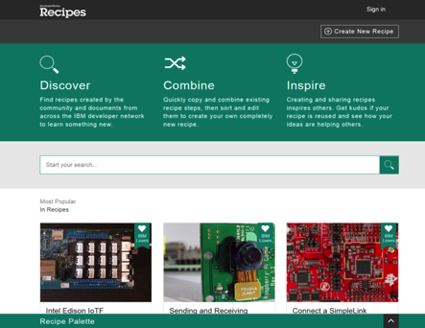

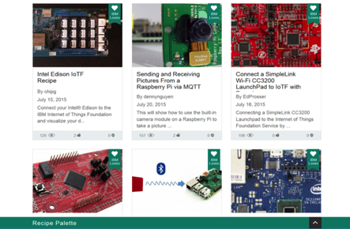




Ecosystem & partnership strategy extend the IBM IoT platform
Derive IoT value on the Cloud through strong industry partnerships and open ecosystem
Connecting Devices to the IBM IoT platform:
Wide variety of supported devices
Self Service
Open ecosystem
Simple tutorials
Connect in moments
Examples:
IBM Confidential

Slide 16
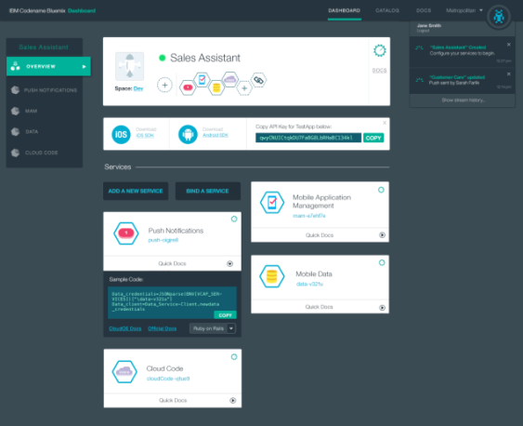


























IBM Internet of Things Foundation
IBM’s service offering on Bluemix & SoftLayer that allows embedded device developers to rapidly connect their devices to the cloud, visualize the data coming from them; and build Business Applications using their data, analytics and other powerful capabilities
Real-time messaging
& Managed REST APIs
Compose Applications
Manage
Assemble
Collect
Connect
Secure Device Registration
Reliable Bi-directional Device & Gateway Connectivity
Data Historian
Data Orchestration
Internet-enabled Devices, Gateways, & Mobile Apps

Slide 17




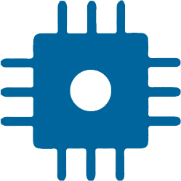


Connecting the Device
Connect
Low bandwidth
Varying Qualities of Service
Publish Subscribe
Always on connectivity
TLS encryption for traffic
Industry standard MQTT protocol
Lightweight & low footprint client
Device specific Client Code
Connect quickly using Device “Recipes”
Open source MQTT based client
Device Registration
Device Access control

Slide 18
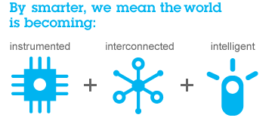
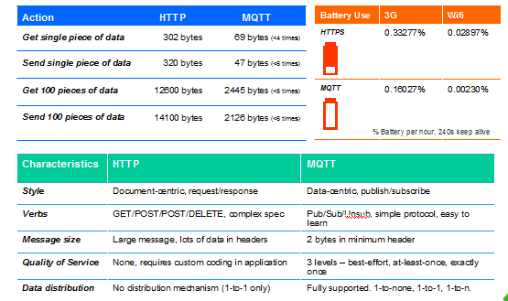
Optimizing network with event-driven notification

Slide 19




Reliably and quickly deliver IoT data with MQTT
Open royalty-free spec
Wide variety of clients and servers
Hobbyist to enterprise
Open source to commercial
MQTT
Open
Lean
Simple
Reliable
Minimized on-the-wire format
Smallest packet size 2 bytes
Scalable
Low footprint
Clients: C=30Kb; Java=100Kb
Minimal pub/sub messaging semantics
Asynchronous (“push”) delivery
Simple set of verbs -- connect, publish, subscribe and disconnect
Three qualities of service
0 – at most once delivery
1 – assured delivery dups ok
2 – once and once only delivery
Copes with loss of contact between client and server.
“Last will and testament” to publish a message if the client goes offline.

Slide 20



Connecting the Application
Connect
Publish the same data to many applications with MQTT
Access control with Application Registration & Keys
Compose with other IoT Services in Bluemix using “App tips”

Slide 21
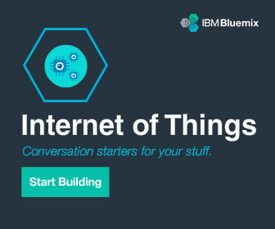
IBM IoT – Get started today
Learn more about IBM’s point of view on the Internet of Things
ibm.com/IoT
Try out Internet of Things on Bluemix ibm.biz/try_iot
Join us in our IoT conversations
@IBMIoT
21

Slide 22
Connected Car Demo

Slide 23

Car Events
Did you think that the numbers you get will be confusing like this???

Slide 24
Surprise Surprise!!!
Events :
{"timestamp":1438845671000,"VEHICLE_SPEED":1,"ENGINE_SPEED":901}
{"timestamp":1438845676000,"GEAR_POSITION_STATUS":78,"VEHICLE_SPEED":0,"ENGINE_SPEED":954}
In a easy readable form – JSON
Integrate
Node-RED
Real Time Insights
Notes:
Can be easily parsed

Slide 25
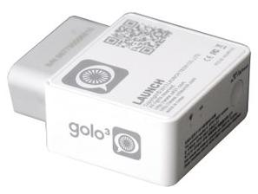
Launch GOLO Device
Manufactured by LaunchTech
Provides a wide range of parameters
Vehicle Speed, Engine RPM
Current Mileage, remaining Mileage
Gear, Brake, door, seatbelt, key status
Coolant Temperature, Vehicle DTCs
GPS Data*
Communicates using 3G module or WiFi

Slide 26
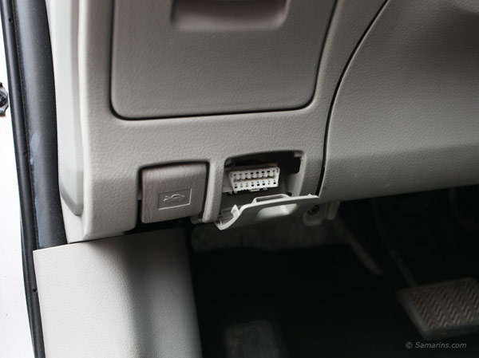
Launch GOLO Device (Contd)
Plug n Play
Plug it to the Car’s On Board Diagnostic port – OBD2
Connects to Internet of Things Foundation and starts to emit data.
Auto registers to the IoT Foundation cloud

Slide 27
Node-RED
Play with the Car Data
Can easily parse the car data.
Node-RED directly understands the data that comes from your car
Create simple Rules
Create a Rule if you overspeed
Action – Tweet, Email, SMS, Push Notification.
Build a quick working solution in minutes.

Slide 28
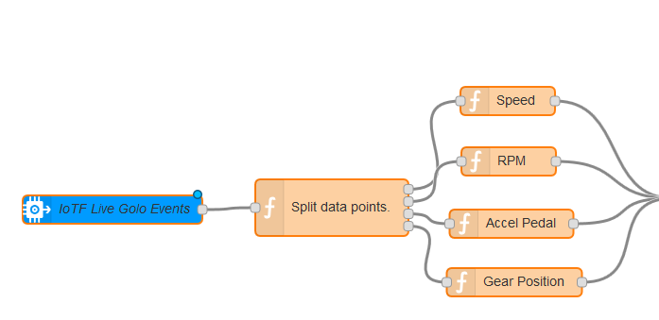
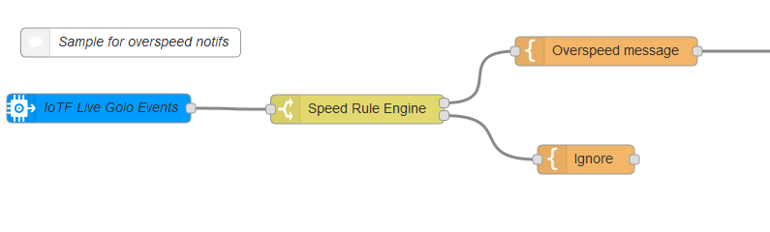
Node-RED

Slide 29
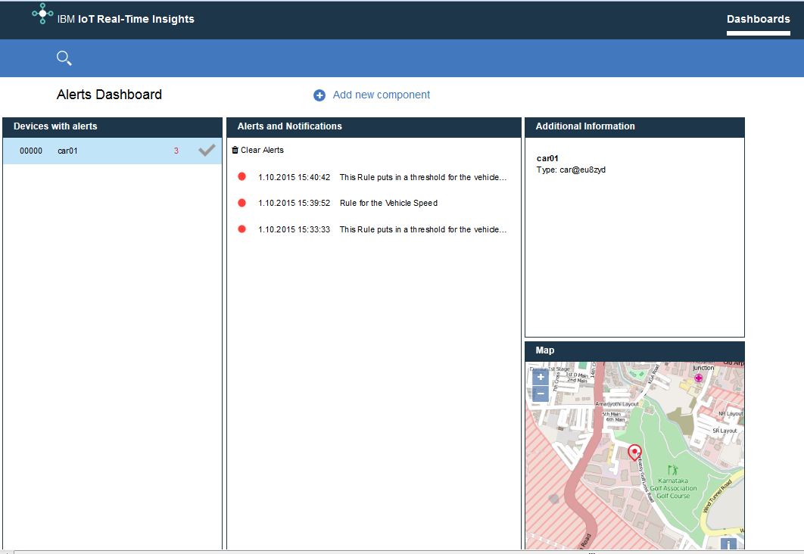
IoT - Real Time Insights
IBM® IoT Real-Time Insights enables you to perform analytics on real-time data from your IoT devices to gain insights about their health and the overall state of your operations
Add Car schema
Create Rules
Create Alerts

Slide 30
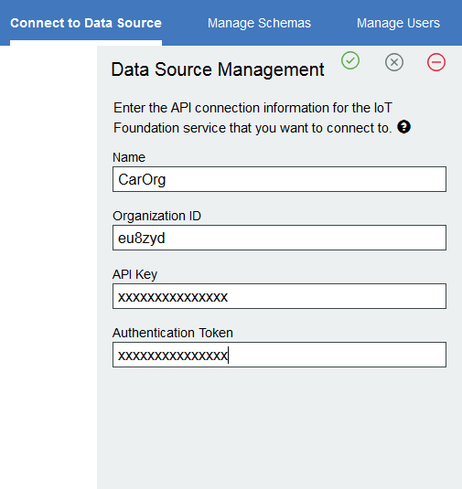
RTI – Configuring Data Source
Configure the Data Source with IoT Data
IoT Foundation Connect can be connected
Provide the API-Key and Auth-Token

Slide 31
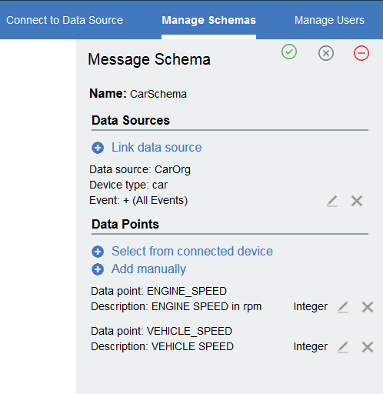
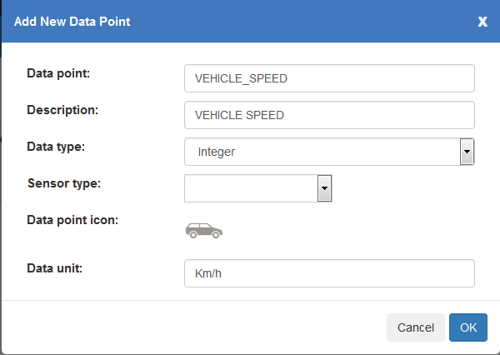
RTI – Manage Data Schema
Add new Data points
Map it with the IoT Data
Add more context to the data
Eg: Vehicle_Speed

Slide 32
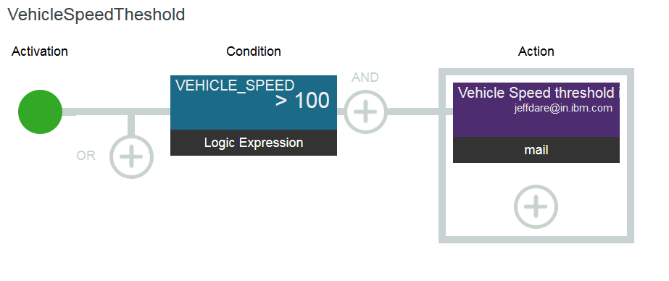
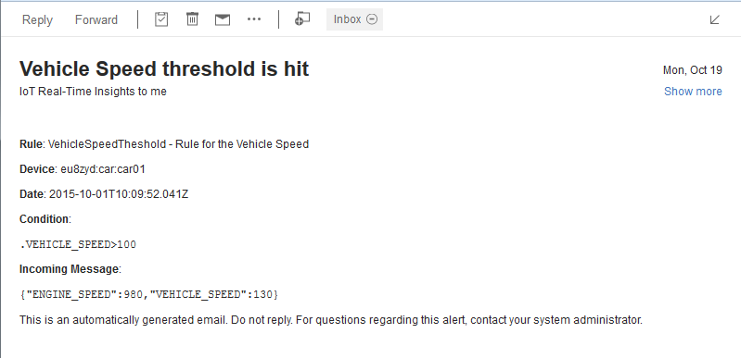
RTI – Create Rules
Add rules to the IoT Data
Add the conditions
Add Actions
Email
SMS
Maximo Workorder

