Slide 1
WATSON VISUAL RECOGNITION

Slide 2
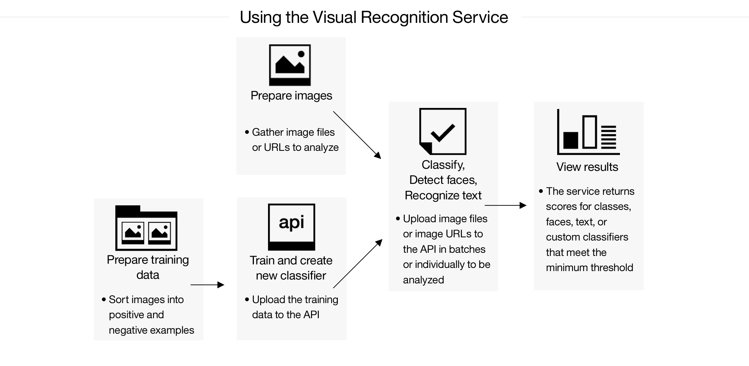

Slide 3
Classifying an image
curl -X POST -F "images_file=@fruitbowl.jpg" https://gateway-a.watsonplatform.net/visual-recognition/api/v3/classify?api_key={api-key}&version=2016-05-20

Slide 4
RESPONSE:
{ "custom_classes": 0,
"images":
[ { "classifiers":
[ { "classes":
[ { "class": "banana", "score": 0.81, "type_hierarchy": "/fruit/banana" }, { "class": "fruit", "score": 0.922 },
{ "class": "mango", "score": 0.554, "type_hierarchy": "/fruit/mango" }, { "class": "olive color" "score": 0.951 },
{ "class": "olive green color" "score": 0.747 } ], "classifier_id": "default", "name": "default" } ],
"image": "fruitbowl.jpg" } ],
"images_processed": 1 }

Slide 5
Detecting faces in an image
curl -X POST -F "images_file=@prez.jpg" https://gateway-a.watsonplatform.net/visual-recognition/api/v3/detect_faces?api_key={api-key}&version=2016-05-20

Slide 6
Response
{ "images":
[ { "faces":
[ { "age": { "max": 54, "min": 45, "score": 0.364876 }, "face_location": { "height": 117, "left": 406, "top": 149, "width": 108 }, "gender": { "gender": "MALE", "score": 0.993307 }, "identity": { "name": "Barack Obama", "score": 0.982014 "type_hierarchy": "/people/politicians/democrats/barack obama" } } ],
"image": "prez.jpg" } ],
"images_processed": 1 }

Slide 7
Creating a custom classifier
curl -X POST -F "beagle_positive_examples=@beagle.zip" -F "husky_positive_examples=@husky.zip" -F "goldenretriever_positive_examples=@golden-retriever.zip" -F "negative_examples=@cats.zip" -F "name=dogs" https://gateway-a.watsonplatform.net/visual-recognition/api/v3/classifiers?api_key={api-key}&version=2016-05-20
The prefix that you specify for each positive example parameter is used as the class name within the new classifier. The "_positive_examples" suffix is required. There is no limit on the number of positive example files you can upload in a single call.

Slide 8
Response:
{ "classifier_id": "dogs_1941945966",
"name": "dogs",
"owner": "xxxx-xxxxx-xxx-xxxx",
"status": "training",
"created": "2016-05-18T21:32:27.752Z",
"classes": [ {"class": "husky"}, {"class": "goldenretriever"}, {"class": "beagle"} ]
}

Slide 9
Query the classifier
curl -X GET https://gateway-a.watsonplatform.net/visual-recognition/api/v3/classifiers/{classifier_id}?api_key={api-key}&version=2016-05-20

Slide 10
Updating an existing custom classifier
curl -X POST -F "dalmatian_positive_examples=@dalmatian.zip" -F "negative_examples=@more-cats.zip" "https://gateway-a.watsonplatform.net/visual-recognition/api/v3/classifiers/{classifier_id}?api_key={api-key}&version=2016-05-20"

Slide 11
Response:
{ "classifier_id": "dogs_1941945966",
"name": "dogs",
"owner": "xxxx-xxxxx-xxx-xxxx",
"status": "retraining",
"created": "2016-05-18T21:32:27.752Z",
"classes": [ {"class": "dalmatian"}, {"class": "husky"}, {"class": "goldenretriever"}, {"class": "beagle"} ]
}

Slide 12
Classifying an image with a custom classifier
curl -X POST -F "images_file=@dogs.jpg" -F "parameters=@myparams.json" "https://gateway-a.watsonplatform.net/visual-recognition/api/v3/classify?api_key={api-key}&version=2016-05-20"

Slide 13
{ "images":
[ { "classifiers":
[ { "classes":
[ { "class": "animal", "score": 1.0, "type_hierarchy": "/animals" },
{ "class": "mammal", "score": 1.0, "type_hierarchy": "/animals/mammal" },
{ "class": "dog", "score": 0.880797, "type_hierarchy": "/animals/pets/dog" } ], "classifier_id": "default", "name": "default" },
{ "classes": [ { "class": "goldenretriever", "score": 0.610501 } ], "classifier_id": "dogs_2084675858", "name": "dogs" } ],
"image": "dogs.jpg" } ],
"images_processed": 1 }
By default, scores below 0.5 are not reported in the results of /classify .The API will classify for all classes in the classifier, but you can adjust the threshold to only return results above a certain confidence score.

Slide 14
Deleting your custom classifier
curl -X DELETE https://gateway-a.watsonplatform.net/visual-recognition/api/v3/classifiers/{classifier_id}?api_key={api-key}&version=2016-05-20
Free account can only create 1 Classifier ID.

Slide 15
CURL COMMANDS TO CREATE A CUSTOM CLASSIFIER
curl -X POST -F "riya_positive_examples=@riya.zip" -F "negative_examples=@Hansika.zip" -F "name=riya" "https://gateway-a.watsonplatform.net/visual-recognition/api/v3/classifiers?api_key=14bf964173b65cf2fea8c6b348dec6a7093281c9&version=2016-05-20"
curl -X GET "https://gateway-a.watsonplatform.net/visual-recognition/api/v3/classifiers/riya_753549970?api_key=16bf964173b65cf2fea8c6b348dec6a7093281c9&version=2016-05-20"
curl -X POST -F "images_file=@riya.jpg" -F "parameters=@myparams.json" "https://gateway-a.watsonplatform.net/visual-recognition/api/v3/classify?api_key=16bf964173b65cf2fea8c6b348dec6a7093281c9&version=2016-05-20"

