Slide 1

Emily’s TDEE

Slide 2
TDEE? – What is it? Why is it important?

Slide 3
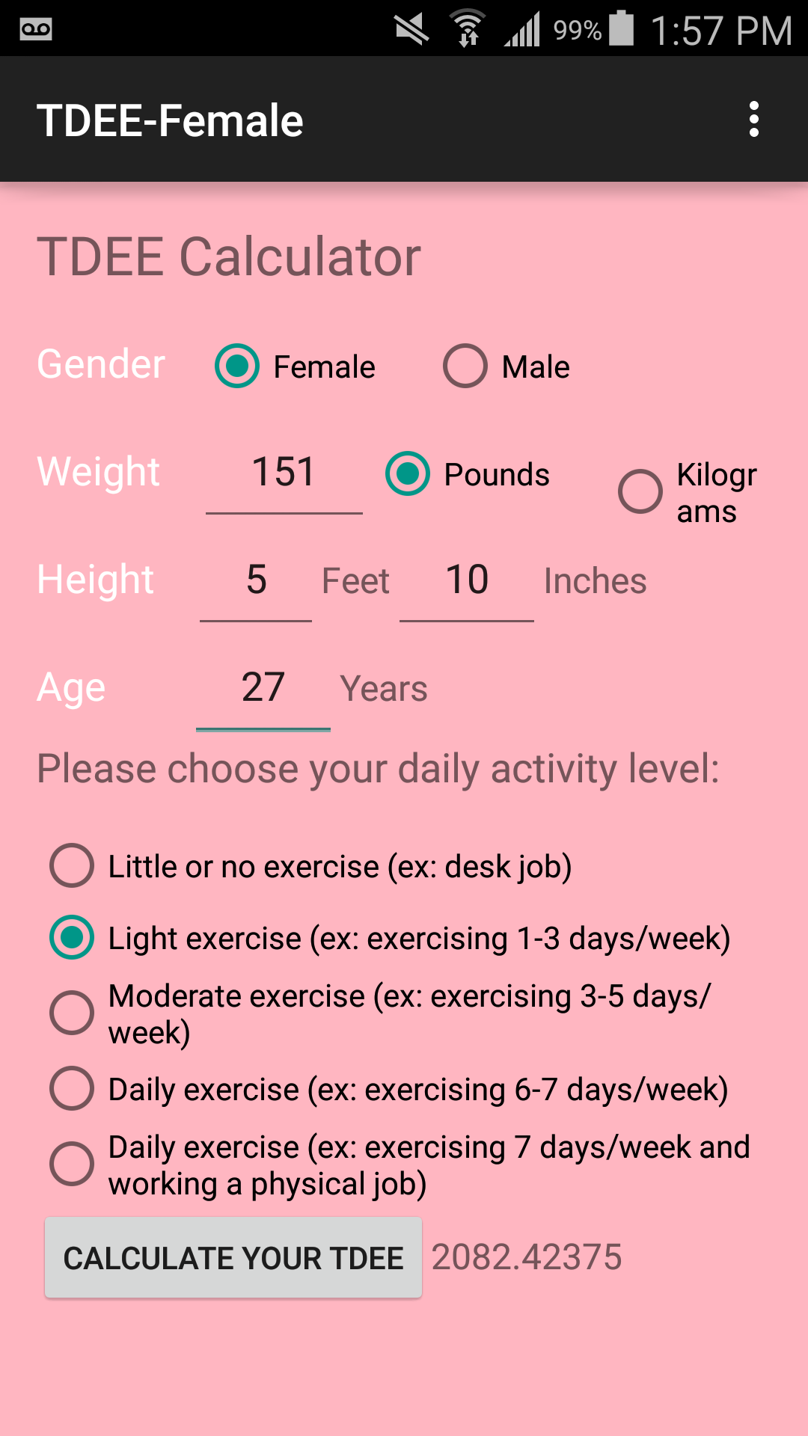
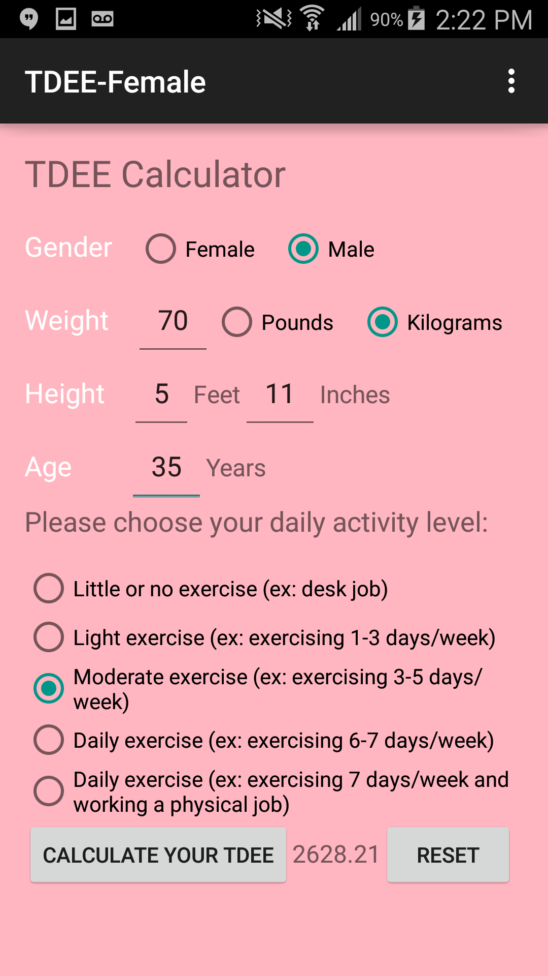
App Initially
Features to improve:
Make it both metric and US measurements
Improve UI design

Slide 4
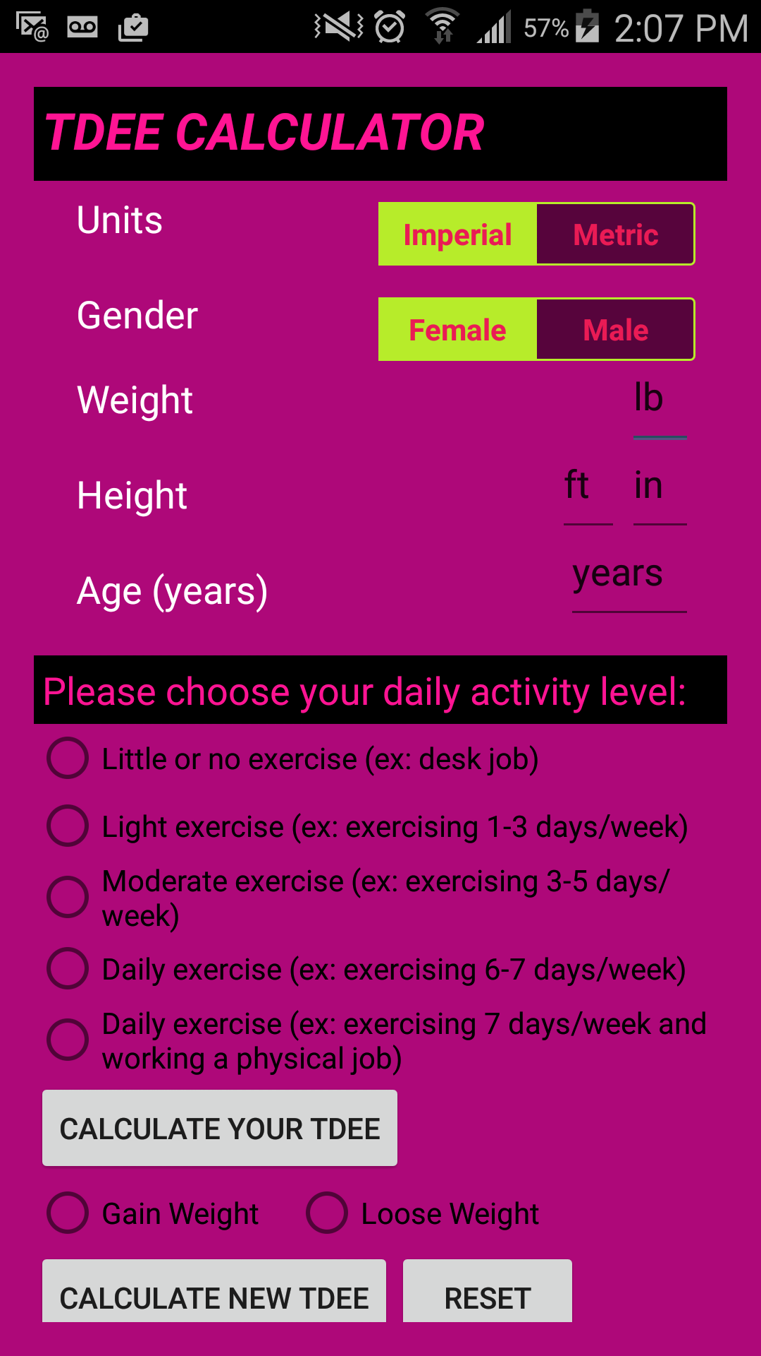
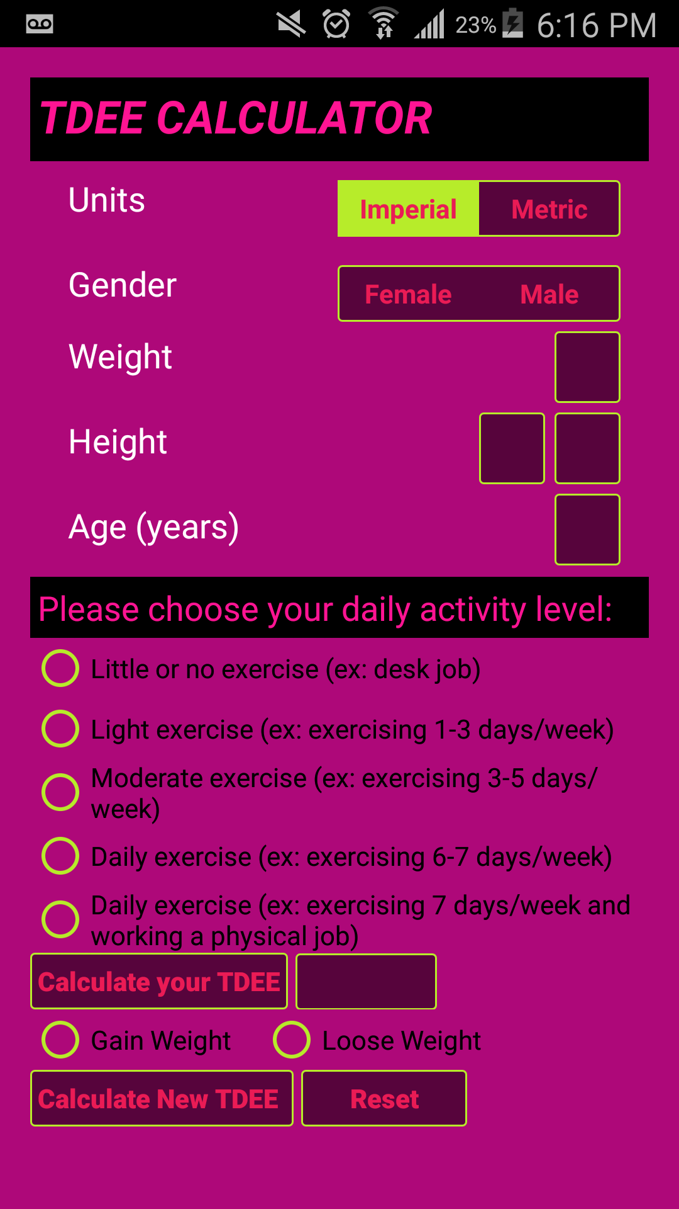
App Progress
Features improved:
Now metric and US measurements
Improve UI design
Buttons for US/metric
Buttons gender
Challenges
Switch
Detecting error after changing input box
Scrollview within a ViewFlipper

Slide 5
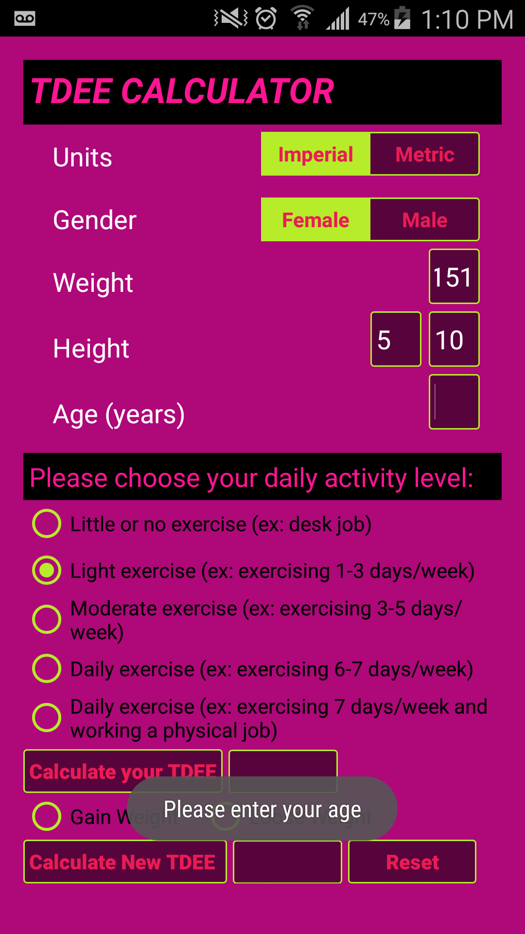
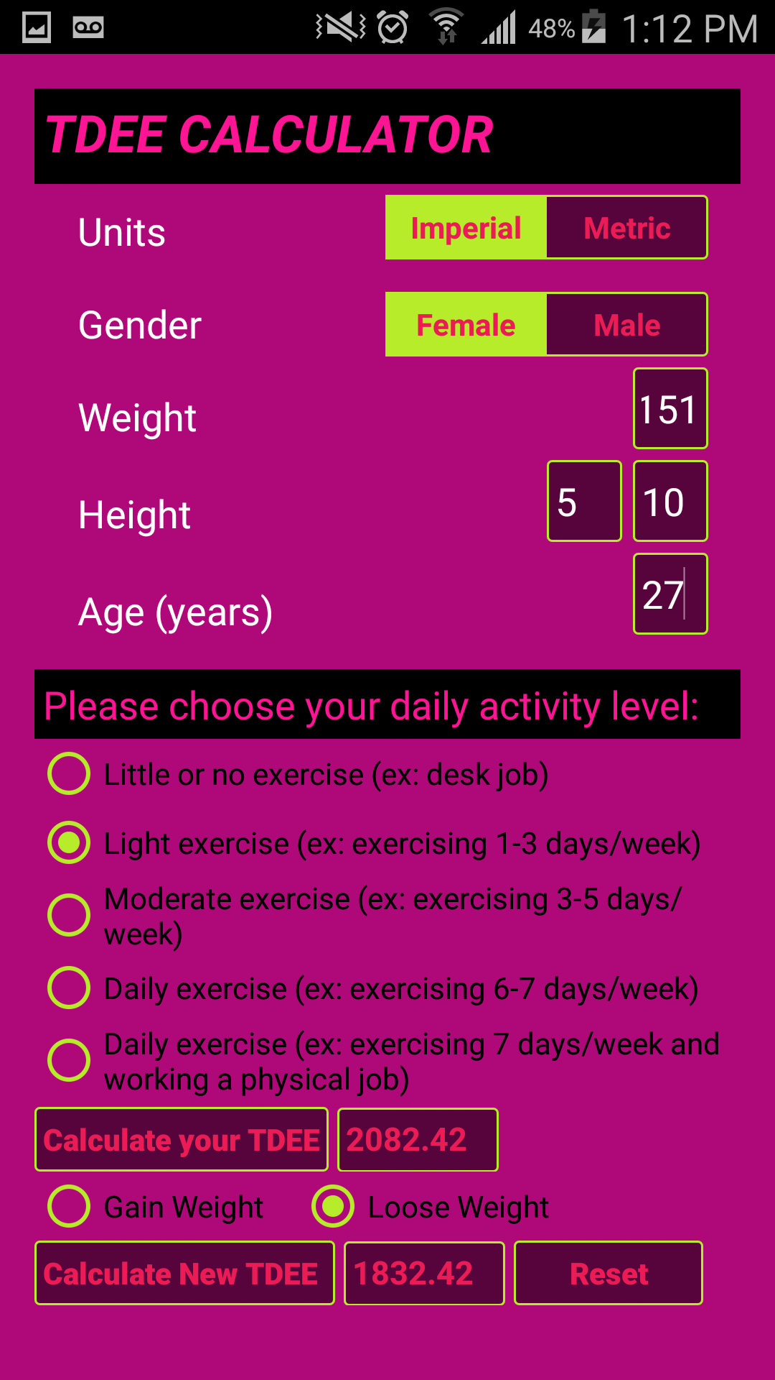
App Beta
Checking for empty text boxes
Imperial

Slide 6
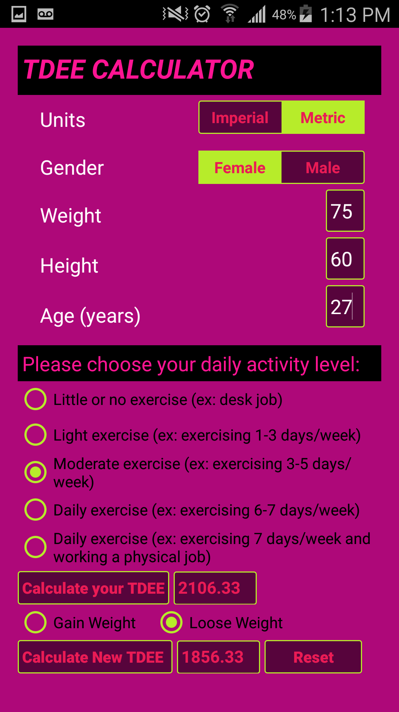
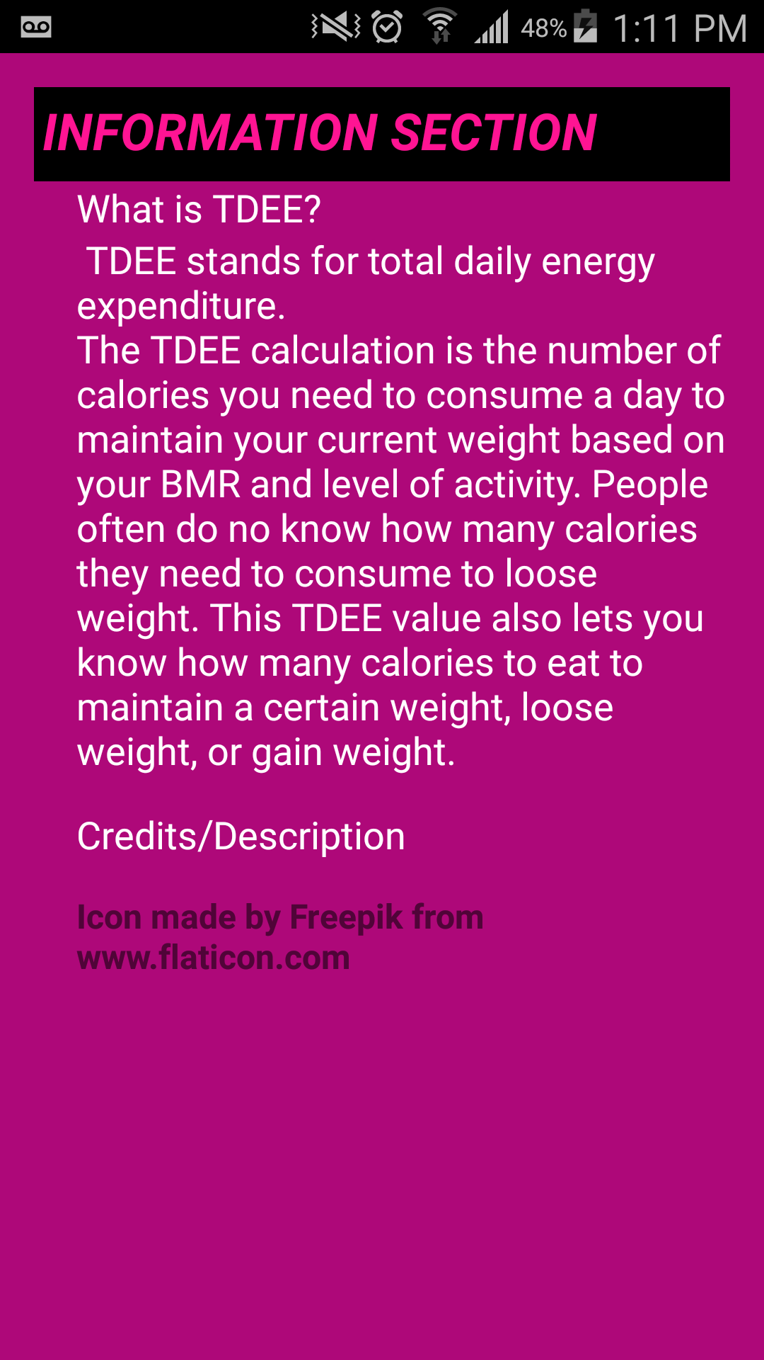
App Beta
Checking for empty text boxes
Metric side
Information Section
Explain why app simple
Because the feature is supposed to be straightforward per purpose of the app

