Slide 1
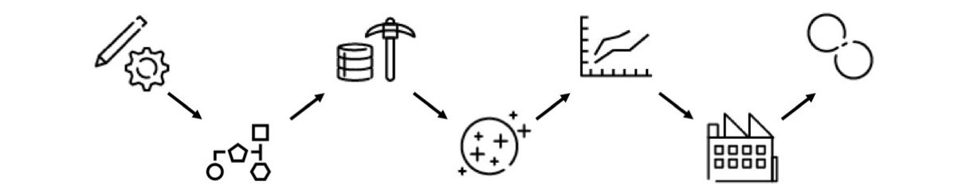
DEVELOP & DEPLOY API
Covid 2021 Group A
18 January 2021
25 January 2021
PLAN & ORGANIZE
CLEAN THE DATA
FIND INSIGHTS AND VIZUALIZE
PRESENT
EXTRACT THE DATA (JSON)
GET THE DATA

Slide 2
C2 It is mandatory to get the last updated data
API workfloow
Devellop the code
Console file OOP
Prepare the speach
Review
Get the data for Group A in a separate dataframe
Implement
Test
Debbuging
Presentation
A file that returns the team json
If error returns a error message
Receives an argument –j 18
Plan & Organize
C.9 Create a Git for the Project and share it with the team
Create and assign tasks in Trello
Document all the steps in the requested document
C7 Draw the workflow
Create the power point presentation
C7 Draw the workflow of the API
C1Document all steps in the main.ipybn, functions and each line what it does
Choose a person that will do the presentation
Get the data
Clean the data
C3 Check all data
See what columns we will not use
10Cc Check if it has outliers
10Cc Remove outliers
Drop the columns that we are not using
Change when needed the column data type
Analisys, Insights and visualization
C.8.Per country, which are the columns that are more related? Draw a correlation matrix
C.10a What position do your countries occupe respect to the number of total infected, total deaths and total recoveries?
B2 Create with bars, lines, points and pie charts the daily deaths and infected
B3 Research to save each plot in local files. Save them on different folders for each country.
B4 When are the worst moments to go to the countries? Answer this referring to the “per_million” columns.
C.6.Show different tendencies for each column in your dataset. Show, vertically, the start date and end date of the alarm state in each plot. If there is no alarm state, then show only the start date.
C10.b What can you conclude about your data study?
B1 Draw, in different colors and vertically, the moments when the daily death curve increases and decreases.
C4 API
C4Add a column called the“n_c_averages” that represents the mean of the “new_cases” per day of all of your countries. Export the column to a json for the team B
C5.Get the jsons generated from your annexed group and plot it. First, try to connect to the private ip of your annexed group.

Slide 3
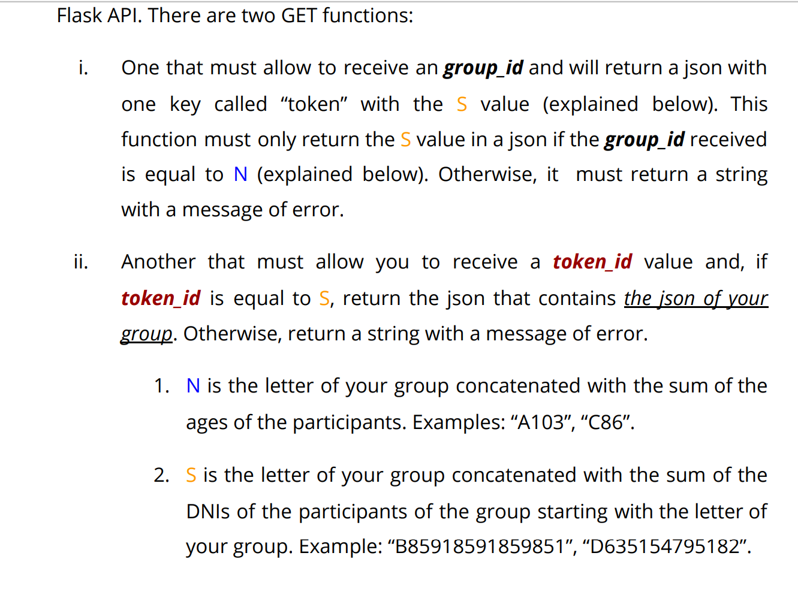
API Develop &Deploy
FLASK API
Token_ID/Group_ID
GET
tocken_id
GET
group_id
no
yes
no
yes
RETURNS:
Error mesage
RETURNS:
Group json
RETURNS:
Error mesage
RETURNS:
{ “Token: S value } (json)

