Slide 1




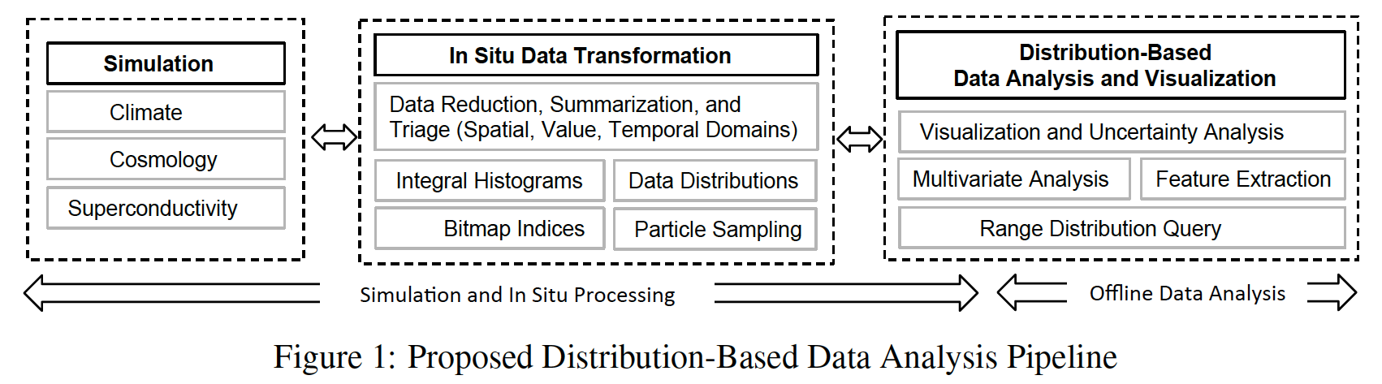
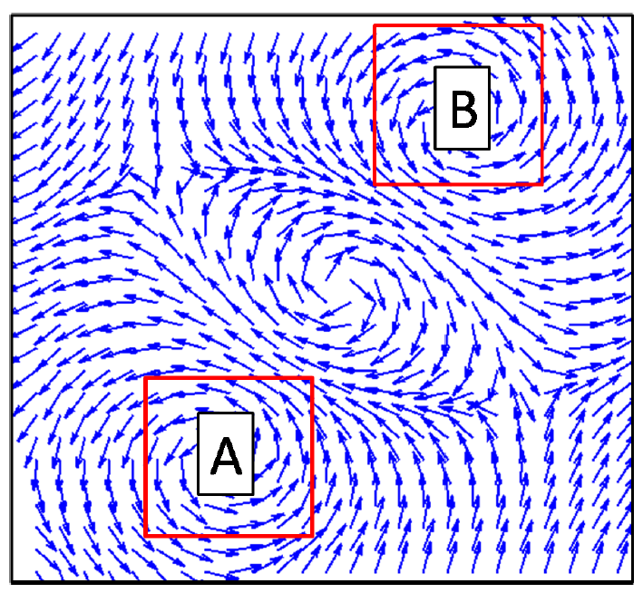
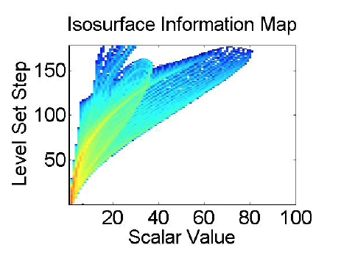
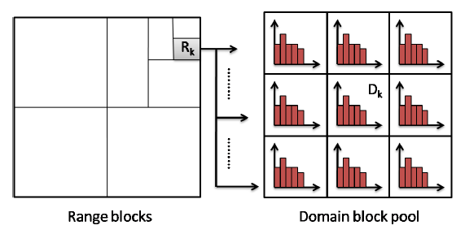
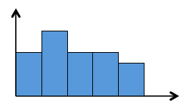
IMD
Extreme-Scale Distribution Based Data Analysis
Novel Ideas
Compact representations for distribution data
- integral histogram compression and indexing
- interactive range distribution query
Data reduction and summarization
- Histogram spectra
- Isosurface information map
Distribution-based Visual Analytics
- Uncertainty modeling of pathlines
- Information aware multivariate data analysis
Impact
Milestones/Dates/Status
Scheduled
In situ distribution construction Apr 2015
Particle sampling and PDF Apr 2015
Uncertainty flow path modeling June 2015
Interactive range distribution query Aug 2015
Identify application needs June 2015
In situ LOD data reduction Dec 2015
Time-varying data reduction Dec 2015
Distribution data visualization Dec 2015
Transform simulation output into compact distribution-based representations
Support In situ data reduction while preserving salient data statistics at multiple levels of detail
Allow interactive query of data distributions in arbitrary spatial and temporal regions
Uncertainty visualization and analytics of multivariate time-varying scalar and vector data
Make available software suite for distribution-based data visualization
Investigators: Han-Wei Shen (PI), Gagan Agrawal, and Huamin Wang (OSU); Tom Peterka (ANL); Jonathan Woodring and Joannne Wendelberger (LANL)
1/5/2015

