Slide 1

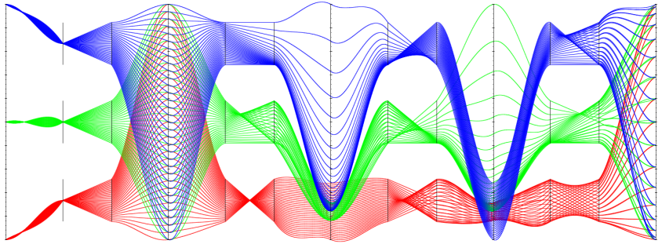
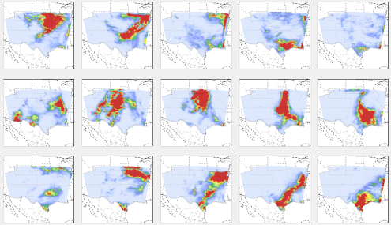

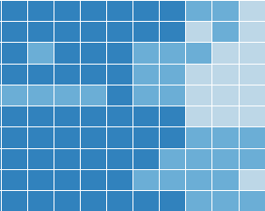
Multi-Resolution Climate Ensemble Parameter Analysis with Nested Parallel Coordinates Plot (NPCP) Ohio State University (Shen)
Problem:
Visualize intra/inter-resolution correlations in multi-resolution high-dimensional parameter space.
Establish the connection between multi-resolution convective parameter settings with large spatial temporal climate ensembles.
Solution:
NPCP = conventional PCP + (superimposition design + juxtaposition design + curve bundling).
Integrated ensemble visualization system = NPCP (parameter visualization) + heat map/dendrogram (ensemble overview) + small multiple geographic views (on-demand ensemble details).
A: NPCP integrates superimposed PCP and juxtaposed PCPs into one view to visualize multi-resolution convective parameters
B1: Ensemble overview
B2: Detailed geographic views
Notes:
Problem: This work studies the input parameters (multi-resolution convective parameters) of multi-resolution climate simulations. Domain experts are specifically interested in: the correlations between parameters in the same resolution (intra-resolution correlation visualization) and the difference between parameters’ correlations in different resolutions (inter-resolution correlation comparison). It is also critical to build the connection between the multi-resolution convective parameters and the large spatial-temporal climate ensemble outputs.
Proposed Solution: Based on the requirements from domain experts, we propose an augmented design of parallel coordinates plots, called Nested Parallel Coordinates Plot (NPCP), to visualize the multi-resolution convective parameters in climate modeling. This new design of PCP has been integrated into a visual analytics system, which is equipped with multiple coordinated views, to help domain scientists build the connection between complex input parameter settings and spatial temporal ensemble outputs.
Figure A: Nested Parallel Coordinates Plots
Multi-resolution convective parameters are separated by resolution in NPCP. This figure shows a synthetic three-resolution (blue, green and red) five-dimension (five axes) parameter set. The nested juxtaposed PCPs show the relational pattern between any two dimensions and enable effective side-by-side comparison of patterns from different resolutions.
Figure B: Overview + detail ensemble exploration and examination
B1: a linked visualization of a heat map and a dendrogram has been used to provide an overview of the large spatial temporal ensembles. The colors in heat map reflect the quality of different ensemble members. Similar ensemble members are grouped into the same branch of the dendrogram. Users can interact with the linked visualization to select a particular ensemble member and examine its spatial details in the on-demand small multiple geographic views (B2).

