Slide 1

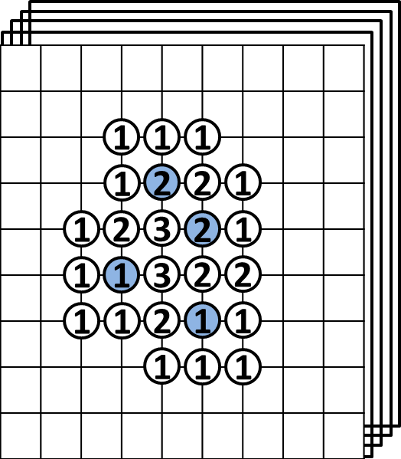
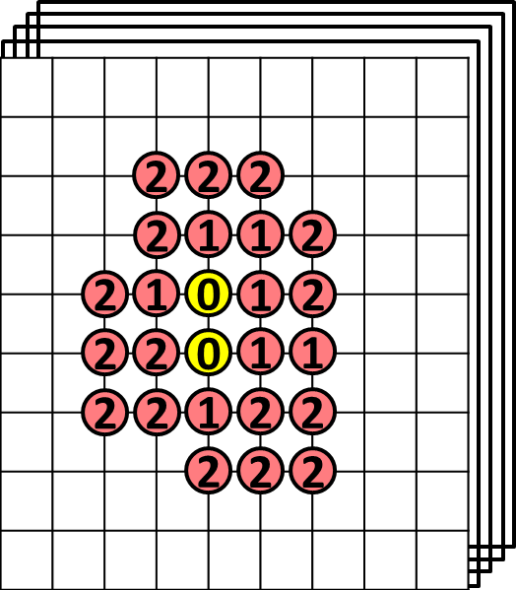
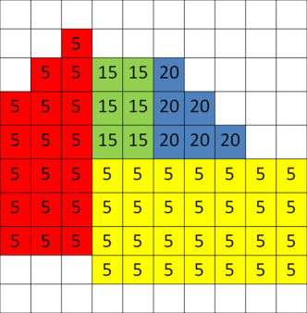
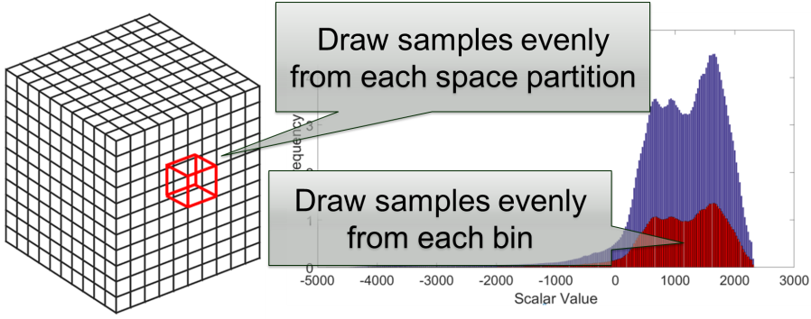
Efficient Distribution-based Feature Search in Multi-field Datasets Ohio State University (Shen)
Problem:
How to efficiently search for distribution-based (histogram-based) features in multi-field datasets without scanning through the entire data space?
How to overcome the curse of dimensionality when searching for the feature defined by a joint histogram?
How to efficiently search for large-sized features defined by local histograms with large spatial neighborhoods?
Solution:
Utilize bitmap indexing to reduce the search space and apply local voting scheme to construct a local histogram in an inverse way.
Compare multiple bins between two histograms in one pass, instead of comparing individual bins iteratively.
Apply stratified sampling to quickly approximate initial result and use a low-cost refinement to get final result.
A: An example of local deposit procedure
B. An example of group selection for MBC
C. An example of stratified sampling
Notes:
Problem: Distribution-based (histogram-based) features has been utilized in many volume analysis and visualization applications. However, local histogram computation and matching is difficult in multi-field dataset due to the high computational cost. 1. It’s infeasible to scan through the entire data space and compute and compare local histogram in each location. 2. The number of histogram bins increases exponentially as the number of fields or dimensions increases, which requires a large amount of bin-by-bin comparison. 3. The high computation cost when searching for large-sized feature, which is defined by a large neighborhood-sized histogram.
Proposed Solution: We utilizing bitmap indexing to reduce the search space from the entire space domain to the voxels whose values fall into the user-defined value range and their neighborhood voxels. Then apply the local deposit approach to construct a local histogram in an inverse way. In the multi-field feature search cases, we proposed two complementary algorithms for accelerating local distribution searches. Both algorithms first approximate a search result, and then use a low-cost refinement step to generate the final search result. The first approach is merged-bin comparison (MBC). Instead of comparing individual bins iteratively, we compare multiple histogram bins between two histograms in one pass. Utilizing a property of distance measures, our approximate search result from MBC has no false negatives so that the refinement process only needs to remove the false positives to generate the final result. The second approach is called sampled-active-voxels (SAV). This utilizes stratified sampling to quickly generate approximate initial results, which are close to the final results when compared to simple random sampling. So the cost of refinement can thus be reduced.
Figure A shows an example of local deposit procedure with setting neighborhood size to 3×3. In the left figure, the blue points represent the voxels within the user-defined value range. Each blue point deposits one count to its neighborhood deposit buffer. The number label on each voxel represents the accumulated deposit counts after performing local deposit. Voxels without numbers mean that the count is zero. Right figure shows the distance of bin_{k} between the target histogram with frequency 3 and the local histogram in the search region (red circles).
Figure B shows an example of group selection for MBC algorithm. All grids represent the 2D joint histogram of a target feature. The number in each cell is the value frequency for that bin. Bins of the same color have been grouped together. We group bins by target frequency first (for frequency 5, 15, 20) and then separate the group with large number of bins (the group with frequency 5 in this example ) into two groups by bin indices.
Figure C shows the concept of the stratified sampling, which draws samples evenly from each space partition and draws samples evenly from each bin.

Slide 2
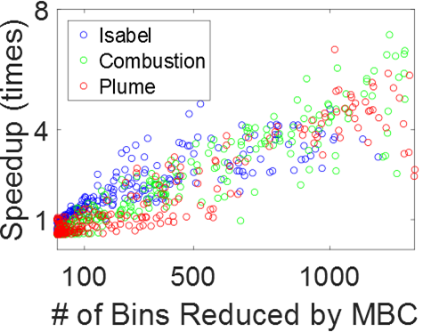
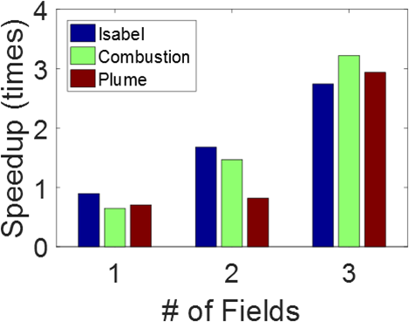
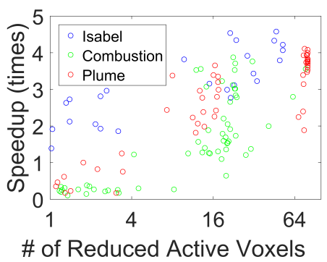
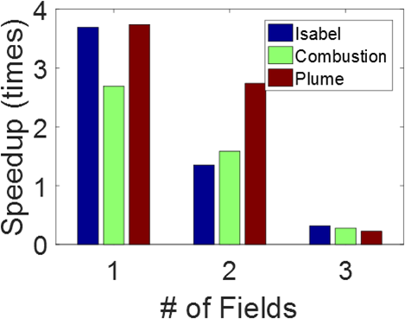
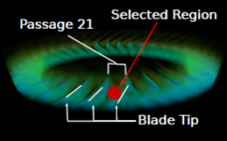
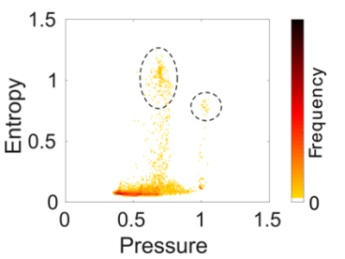
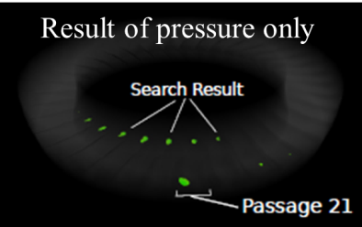
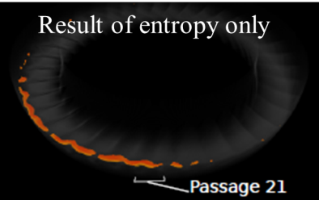
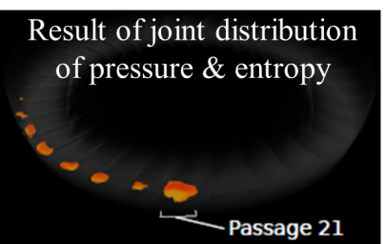
D: The performance speedup gained by our MBC approach
E: The performance speedup gained by our SAV approach
(a)
(b)
(c)
(d)
(e)
F: Local distribution searches for turbine flow stability analysis
Notes:
Figure D shows the performance speedup gained by our MBC approach. The left figure shows the individual performance speed-up for all test cases, where the x-axis is the number of bins reduced by MBC. The right figure shows the average performance gain after grouping the test cases by data set and by the number of fields searched.
Figure E shows the performance speedup gained by our SAV method using 20% sampling. The left figure shows all test cases where the x-axis is the percentage of total data points of the corresponding dataset. The right figure shows the average performance after grouping the test cases by dataset and the number of fields.
Figure F shows an usage scenario - applying local distribution searches for turbine flow stability analysis. (a) Selection of a stall cell region (the red sphere) close to the blade tip of passage 21. (b) Joint distribution of pressure and entropy of the selected region. (c) Search result with only the pressure distribution. (d) Search result with only the entropy distribution. (e) Search result of the joint distribution of pressure and entropy.

