Slide 1

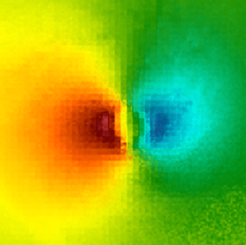
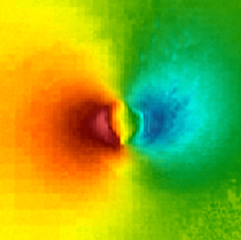
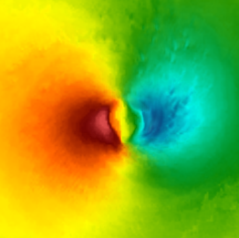
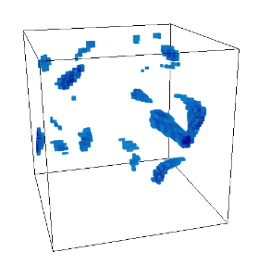
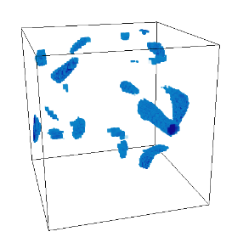
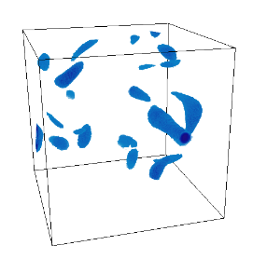
Homogeneity Guided Probabilistic Data Summaries for Analysis and Visualization of Large-Scale Data Sets Ohio State University (Shen)
Problem:
Existing region-based statistical data summaries rely upon regular partitioning that results in partitions with high data value variation and uncertainty leading to increased sampling error is analysis
Visualizations produced from these statistical data summarizations introduce artifacts and distortions making visual analysis less effective
Solution:
We propose a homogeneous region guided data partitioning which employs a fast clustering algorithm SLIC for in situ partition generation
SLIC based homogeneous partitions are summarized using a hybrid distribution scheme of either a single Gaussian or mixture of Gaussians per partition
Extensive quantitative and qualitative comparisons of our method with regular partitioning and k-d tree based partitioning reveal that our method is superior in quality vs storage trade-off and can be performed in situ in a scalable way
Reconstruction using regular partition
Reconstruction using k-d tree partition
Reconstruction using SLIC based partition
Feature search using regular partition
Feature search using k-d tree partition
Feature search using SLIC based partition
Results of sampling based reconstruction
Results of distribution based feature search

Slide 2
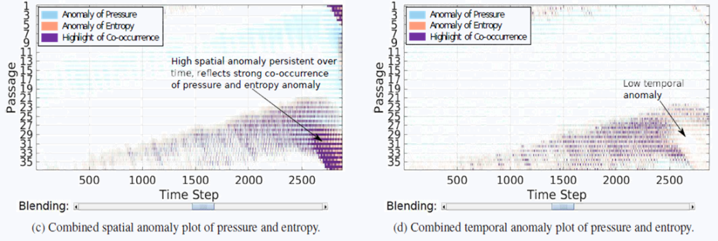
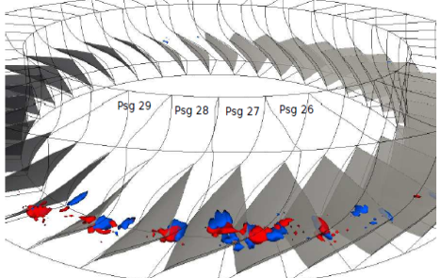
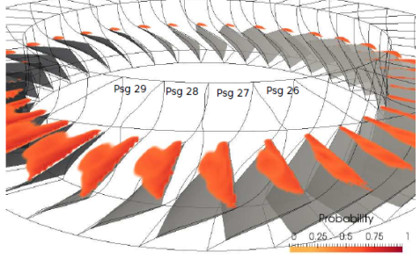
In Situ Distribution Guided Analysis and Visualization of Transonic Jet Engine Simulations Ohio State University (Shen)
Problem:
Effective analysis and early detection of rotating stall in jet engines is imperative for engine’s safe operation
How to provide efficient and scalable stall analysis and visualization capability to scientists ?
Solution:
Summarize large simulation data using mixture of Gaussians and preserve statistical data properties
Perform post-hoc spatial and temporal anomaly based stall analysis on reduced distribution data to gain insights and achieve scalable exploration
Visualize detected anomalous regions and verify their correspondence to rotating stall inception. Use uncertain isosurface rendering for investigating data properties in detected regions
B. Detected anomalous regions.
Pressure (blue), Entropy (red)
C. Uncertain isosurface of Pressure for verification
A. Spatial and temporal anomaly chart of Pressure and Entropy variable

