Slide 1




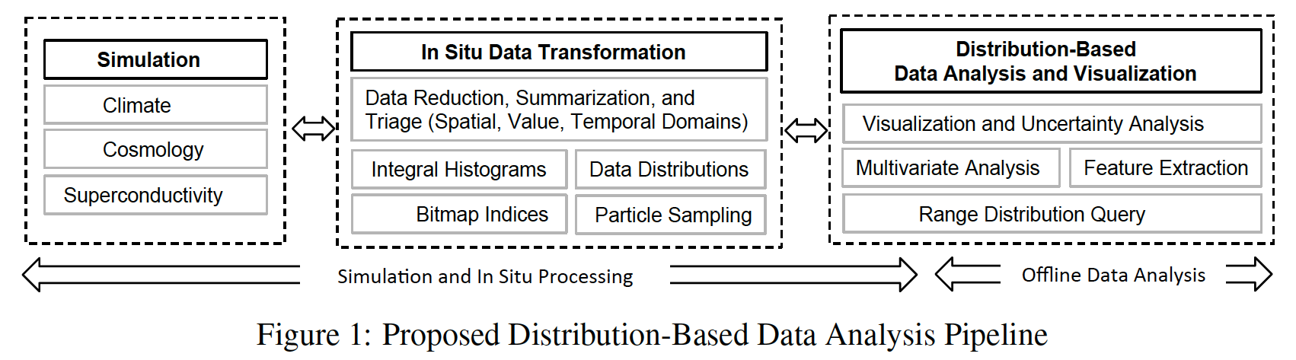
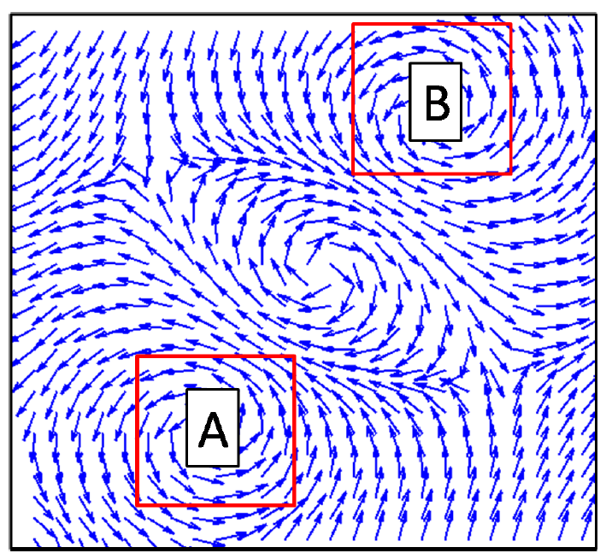
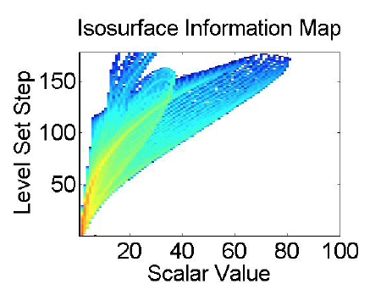
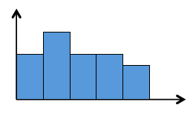
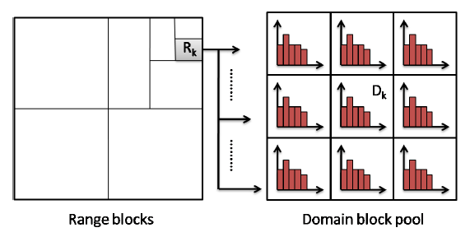
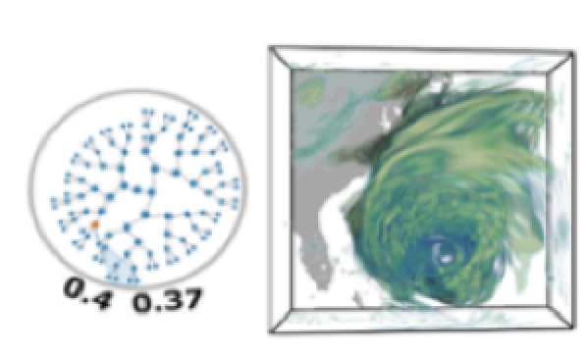
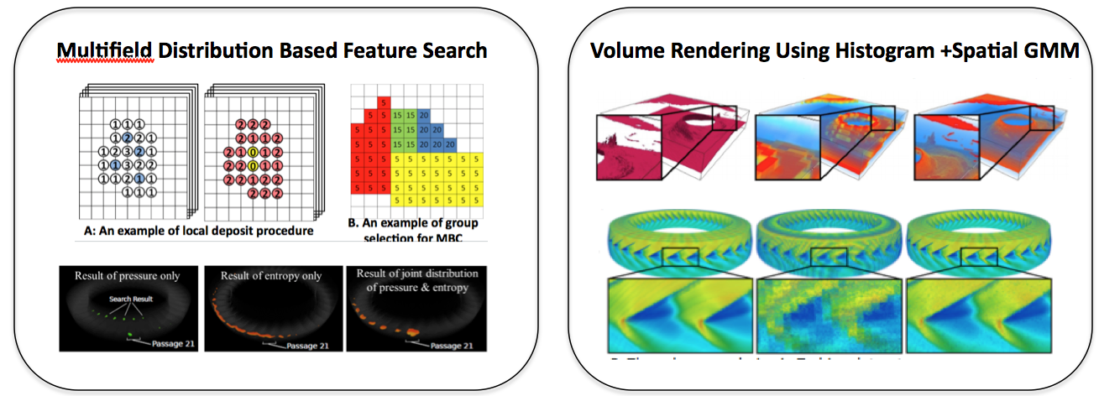
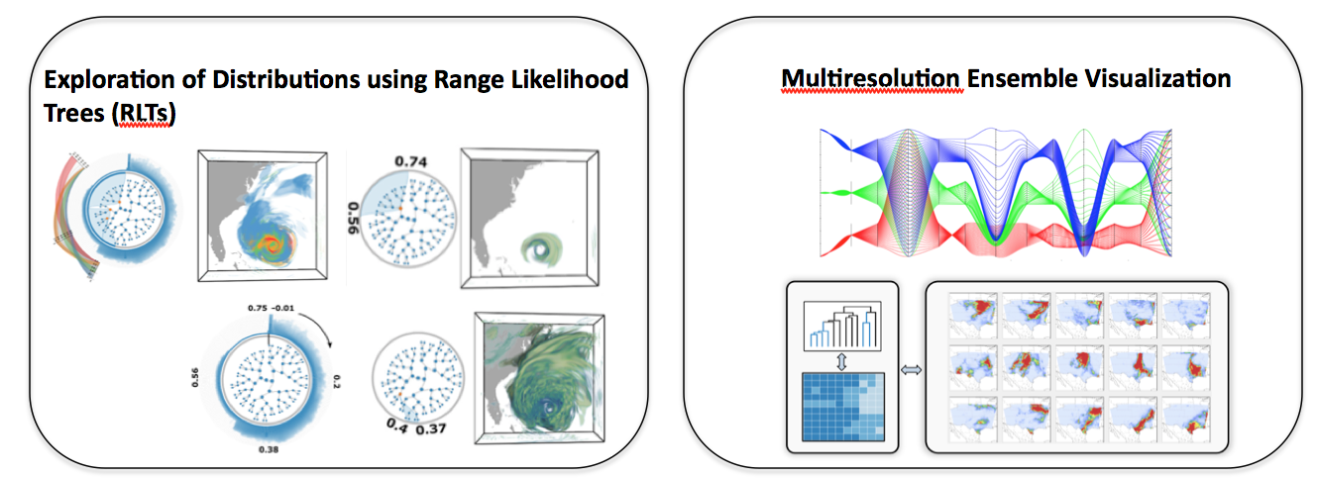
IMD
Extreme-Scale Distribution Based Data Analysis
Novel Ideas
Feature tracking based Gaussian Mixture Model (GMM) (IEEE SciVis 15, 16)
Compact and accurate distribution representations (IEEE SciVis’16, Pacific Vis’17)
Uncertainty analysis for ensemble data (IEEE SciVis’16, VAST’16)
Flexible User Interface
Error analysis for uncertain
visualization algorithms
Impact
Milestones/Status
Compact representation of data/feature with GMM
Efficient search of statistical features
Flexible exploration of distribution fields
Accurate recovery of spatial information from distributions
Statistics based in situ feature tracking
Completed Tasks
Distribution representation and construction
Distribution-based feature identification and tracking
Local distribution feature search
Exploration interface for distributions
In situ feature extraction and tracking
Uncertainty analysis for distribution data
Tasks To Be Completed
Distribution processing, analysis, and visualization software
Investigators: Han-Wei Shen (PI), Gagan Agrawal, and Huamin Wang (OSU); Tom Peterka (ANL); Jonathan Woodring and Joannne Wendelberger (LANL)
3/14/2017

