Slide 1

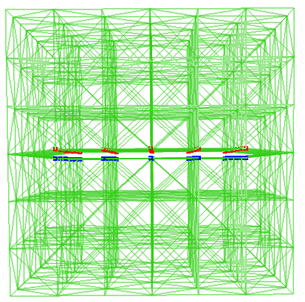
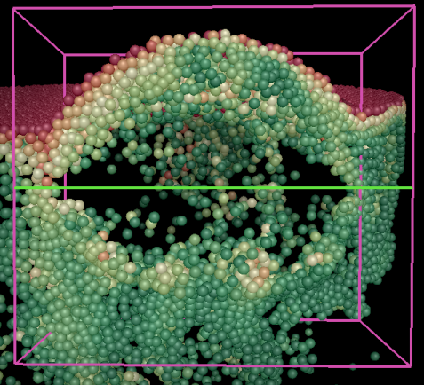
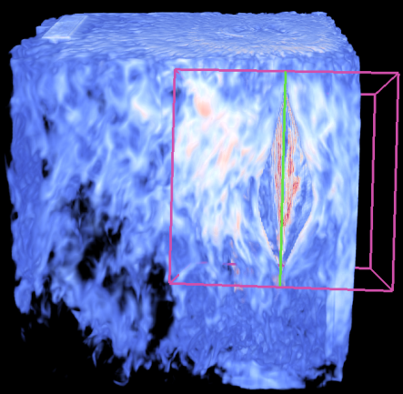
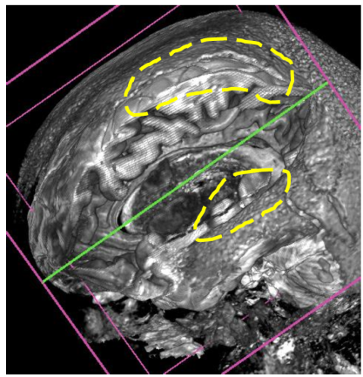
Virtual Retractor: An Interactive Data Exploration System Using Physically Based Deformation Ohio State University (Shen)
Problem:
Deformation is an effective method for occlusion management and data manipulation
Feature preservation is important during the deformation, but might be compromised
Solution:
Create a tetrahedral mesh with split in the middle, and deform it using physically based method.
The stiffness of the mesh tetrahedrons are decided by interesting local data properties selected by users.
During deformation, regions with rich properties will be deformed less, so the feature can be preserved
A. The applied tetrahedral mesh
B. Deform a particle dataset of viscous fluid
C. Deform the vector magnitude of NEK dataset
D. Deform a MRI head dataset
Notes:
Problem: Interactive data exploration plays a fundamental role in analyzing three dimensional scientific data. Occlusion management and feature preservation are among the key factors to ensure effective identification and extraction of three-dimensional features. Existing methods may not able to combine the occlusion removal task, together with preserving features flexibly defined by data properties, while providing interactions with real-time performance.
Proposed Solution: we propose a new data exploration system that allows direct manipulation of data with cutting and splitting capabilities. The procedure is carried out by deforming a tetrahedral mesh that has a void in the middle to simulate the incision created by the cut. The splitting operation enlarges the void to allow users to observe the inner structure which was originally occluded. Our mesh is constructed with the local data properties taken into account, such as local data density or gradient. Therefore the deformation will affected by the selected data property. Regions with high data property values are more solid and harder to be deformed, while regions with lower property values will be deformed more. Therefore the deformation can keep interesting features of the data.
Figure A shows the tetrahedral mesh applied by our method. It has split nodes in the middle, which simulates a cut, and can be enlarged to open up the dataset.
Figure B shows using our Virtual Retractor to deform a particle dataset, which is the simulation of the viscous fluid. By opening up the data, a hidden viscous finger is revealed.
Figure C shows deformation applied on the NEK dataset. The stiffness of mesh tetrahedrons are set as a transfer function, which gives high weight to the either very high magnitude values, or very low magnitude values. Therefore, the tetrahedrons on the surface whose magnitude is in the middle range, will be deformed more to give better view of the area pointed by white arrows.
Figure D shows deformation applied on a MRI head dataset. The stiffness of mesh tetrahedrons are set by the magnitude of the gradient. Therefore features with fierce value change will be better preserved, as the part circled by yellow dashes.
Problem: Interactive data exploration plays a fundamental role in analyzing three dimensional scientific data. Occlusion management and feature preservation are among the key factors to ensure effective identification and extraction of three-dimensional features. Existing methods may not able to combine the occlusion removal task, together with preserving features flexibly defined by data properties, while providing interactions with real-time performance.
Proposed Solution: we propose a new data exploration system that allows direct manipulation of data with cutting and splitting capabilities. The procedure is carried out by deforming a tetrahedral mesh that has a void in the middle to simulate the incision created by the cut. The splitting operation enlarges the void to allow users to observe the inner structure which was originally occluded. Our mesh is constructed with the local data properties taken into account, such as local data density or gradient. Therefore the deformation will affected by the selected data property. Regions with high data property values are more solid and harder to be deformed, while regions with lower property values will be deformed more. Therefore the deformation can keep interesting features of the data.
Figure A shows the tetrahedral mesh applied by our method. It has split nodes in the middle, which simulates a cut, and can be enlarged to open up the dataset.
Figure B shows using our Virtual Retractor to deform a particle dataset, which is the simulation of the viscous fluid. By opening up the data, a hidden viscous finger is revealed.
Figure C shows deformation applied on the NEK dataset. The stiffness of mesh tetrahedrons are set as a transfer function, which gives high weight to the either very high magnitude values, or very low magnitude values. Therefore, the tetrahedrons on the surface whose magnitude is in the middle range, will be deformed more to give better view of the area pointed by white arrows.
Figure D shows deformation applied on a MRI head dataset. The stiffness of mesh tetrahedrons are set by the magnitude of the gradient. Therefore features with fierce value change will be better preserved, as the part circled by yellow dashes.

Slide 2
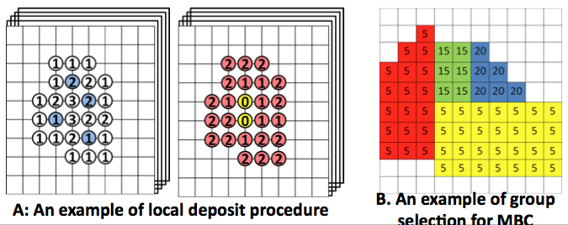
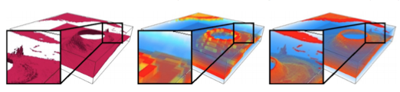
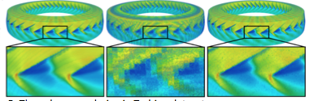
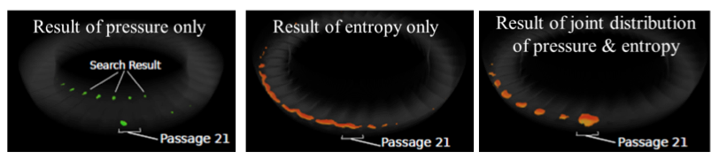
Multifield Distribution Based Feature Search
Volume Rendering Using Histogram +Spatial GMM

Slide 3
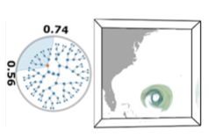
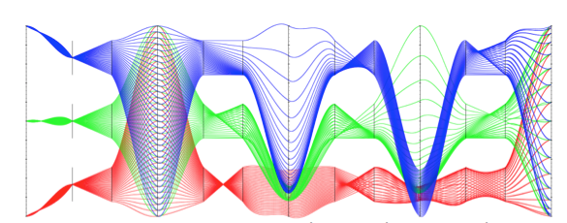
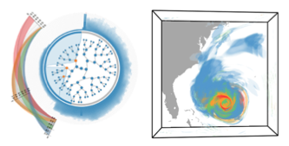
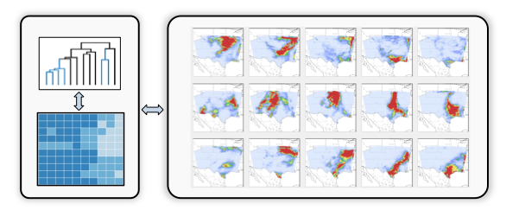
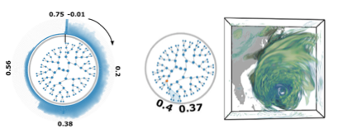
Exploration of Distributions using Range Likelihood
Trees (RLTs)
Multiresolution Ensemble Visualization

Slide 4
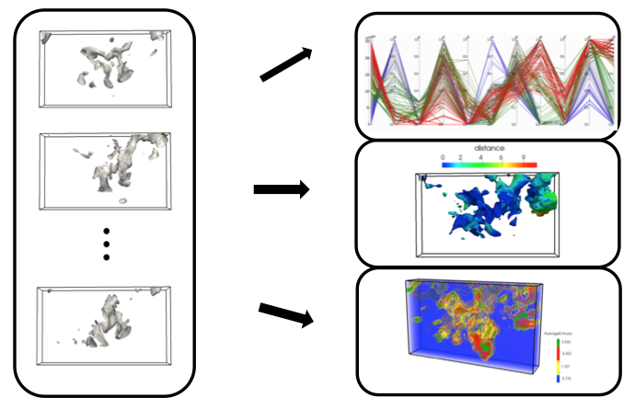
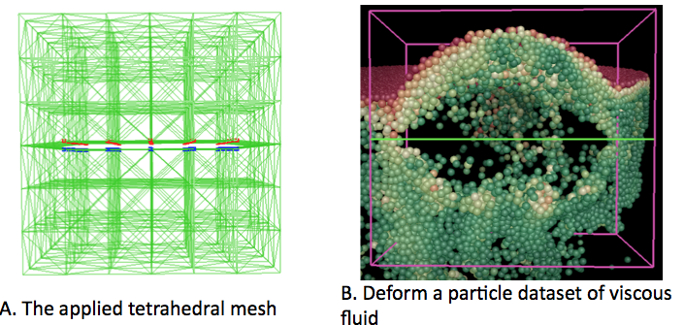
Occlusion Free User Interaction
Ensemble Isosurfaces Visualization

Slide 5
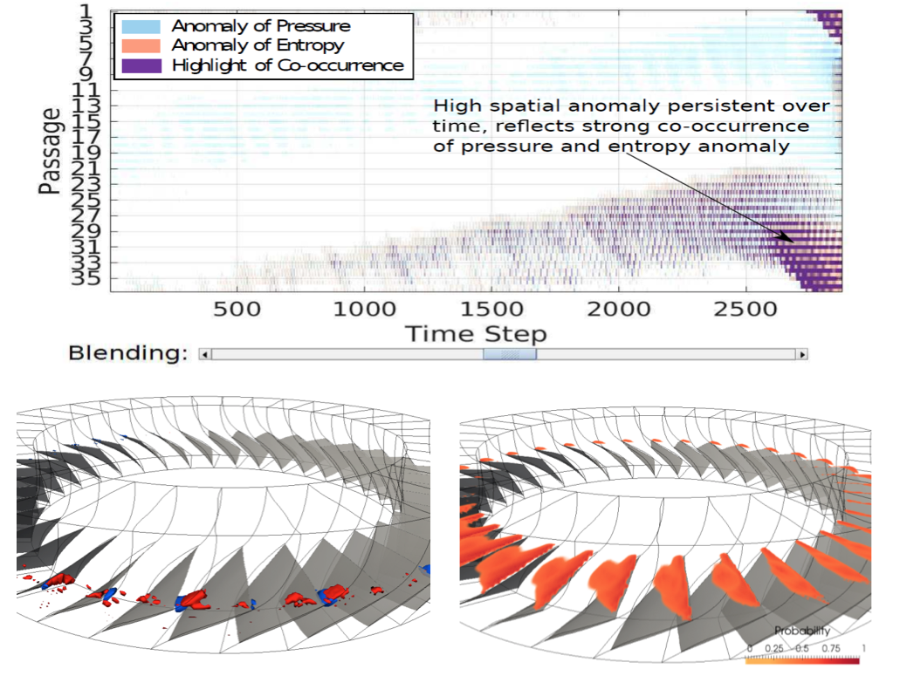
Distribution-Based In Situ Feature Extraction
Ensemble Isosurfaces Visualization

