Slide 1
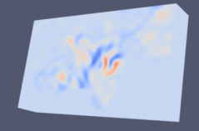
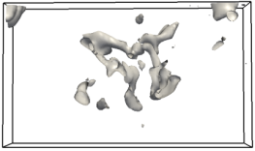
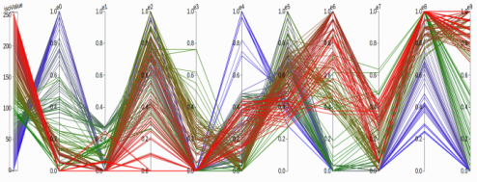
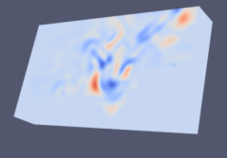
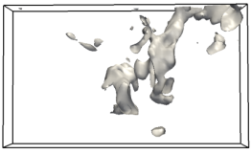
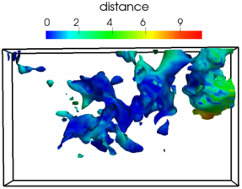
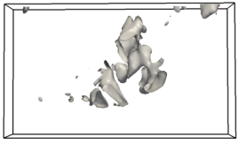
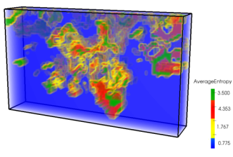
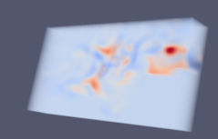


Visualizing the Variations of Ensemble Isosurfaces (Pvis 2016)
Goal: To visualize the variation of ensemble surfaces for a range of isovalues.
Implementation:
Visualize the isosurface order statistics using interactive PCP
Color mapped surface visualization showing the distance of a member from the median surface.
Volume rendered image of the distance of each point to the median surface.
$$⋮$$
$$⋮$$

