Slide 1
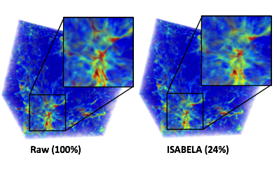
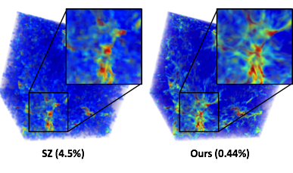

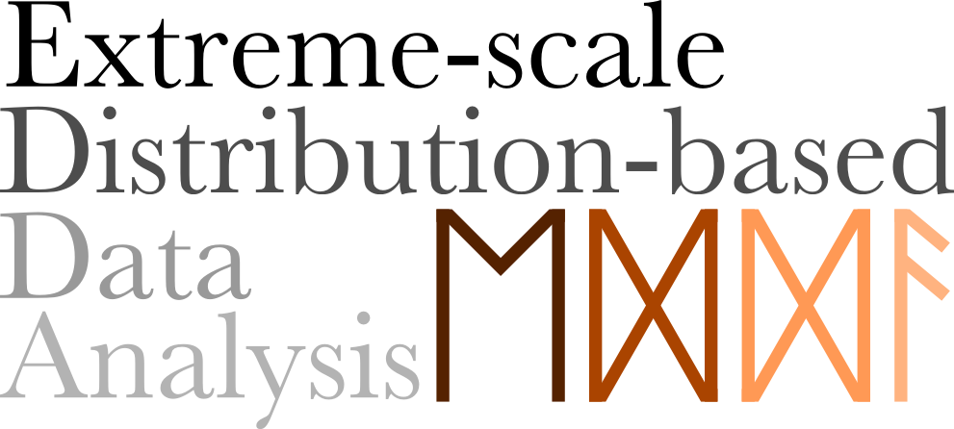


Statistical Super Resolutions for Large Scale Ensemble Cosmological Simulations
Scientific Achievement
Enable scientists to reduce the storage space requirement when running large ensemble simulations, while still make it possible to perform full scale simulation parameter exploration for post-hoc analysis
Significance and Impact
With the statistical signatures, it is now possible to reconstruct simulation output of novel parameters that was not saved during simulations. The space saving can be more than 99%
Research Details
Store a small number of simulation results at full resolutions into a code book as prior knowledge
Down sample the remaining data into GMMs as the statistical signatures
Data at an arbitrary parameter configuration can be reconstructed from the prior knowledge and the statistical signatures
The priori knowledge only takes 0.44% of the original data for a cosmology simulation using Nyx
Images produced by our
super resolution representations
Notes:
In this work, we present a super resolution method that allows scientists to explore the immense parameter space for ensemble cosmology simulations. Ensemble simulations have become a popular approach for scientists to model the uncertainty of the simulation model and identify proper initial conditions. Analyzing the output of ensemble simulations, however, can be very challenging since it requires a huge amount of storage space for all the data with different simulation conditions. In our method, we choose a small amount of parameter configurations based on the Latin hypercube method and store the results from those configurations at full resolution into a code book. Then for the data generated from the remaining parameter configurations we reduce the data only into statistics signatures. In the post-hoc analysis stage, when the scientists decide to analyze the results from the reduced data, we can reconstruct them into full resolutions using the statistics signatures of the block neighborhood and the code book. Using the Nyx simulation as an example, we show that the quality of the reconstructed data is comparable to the ground truth and the size of the code book constitutes less than 1% of the original data.

Slide 2
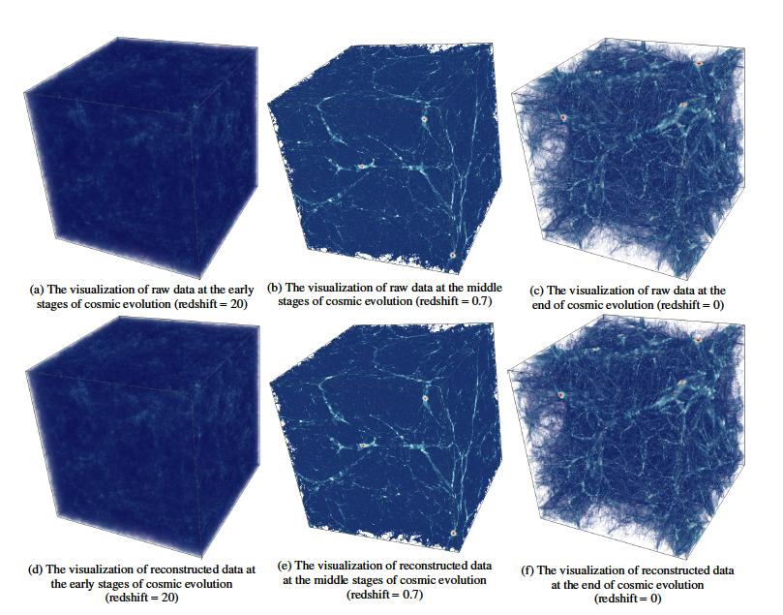
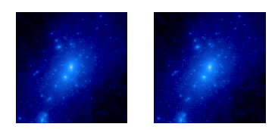
Gaussian Mixture Models (GMMs) Based Particle Compression for N-body Cosmological Simulations
Scientific Achievement
Enable scientists to compress particle data from large scale N-Body cosmological simulations at a controllable space-quality tradeoff while preserving essential domain specific features
Significance and Impact
GMMs are shown to be effective to represent particle clusters in cosmological simulations. The reconstructed data from GMMs show very high accuracy in domain specific metrics such as Halo Mass Functions and Power Spectrum, when data are compressed to 1/200 of their original size.
Research Details
A k-D partitioning is employed based on the GMM quality requirement and the desired final space consumption
Spatial GMMs are used to transform the particle data into Gaussian Mixtures. Domain specific metrics are used to verify the quality, and an iterative refinement algorithm is used to adjust the paritions of particles and number of Gaussians.
Above: comparisons between the raw data (top row) and GMM reconstructed data (bottom row).
Below: comparisons of rendering from raw data (left) and our method (right). The space saving is 200 times.
Notes:
In this work, we show that spatial Gaussian Mixture Models (GMMs) can be effectively used as a reduced data representation for dark matter particles produced by N-body cosmology simulations. The data in question in our study is unstructured particle positions without any embedded mesh. To separate the particles into different Gaussians, we perform a three dimensional K-D partitioning based on the available storage and quality threshold. Within each KD block, we fit a three dimensional spatial Gaussian Mixtures that can effectively cluster the particles into important cosmology features such as halos and filaments. We use domain specific quality metrics such as power spectrum and halo mass function to evaluate our model. It is shown that at a level of 200 times storage reduction, we are still able to reconstruct the data and achieve a quality level way exceeding the domain scientists’ requirement.

Slide 3
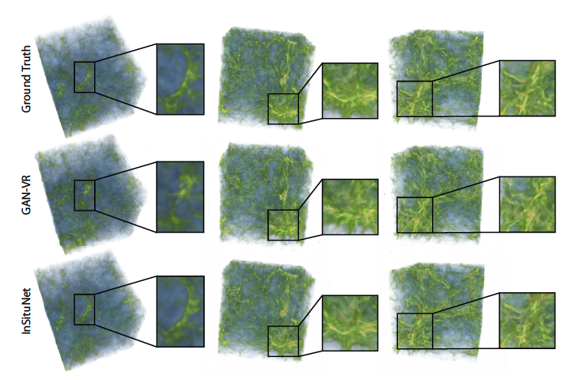
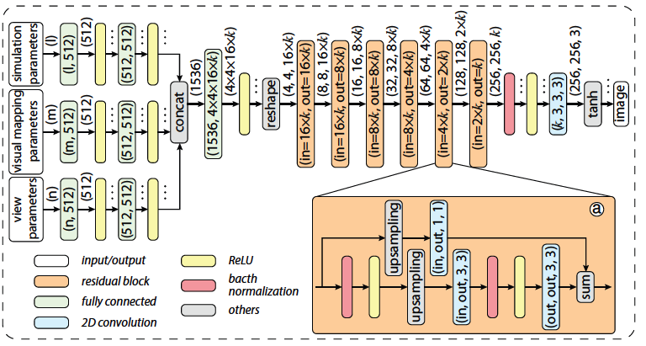
InSituNet: Deep Image Synthesis for Parameter Space Exploration of Ensemble Simulations (IEEE SciVis’19 Best Paper)
Scientific Achievement
Enable scientists to perform real time visual exploration of 3D ensemble simulation data without having to exhaustively run all possible parameter configurations.
Significance and Impact
We show that a DNN-based regressor can be used to learn from images collected at simulation time and reconstruct novel images for unseen simulations and visualization parameters
Research Details
Sample images are collected under various selected simulation and visualization parameters
A DNN regressor is trained offline to learn from the sample images
Perceptual loss and GAN loss are both taken into account in the DNN model to retain salient features from the data
In Post hoc analysis stage, only simulation and visualization parameters are needed to reconstructed the visualization of unseen simulation data
Comparisons of InSituNet with raw data and GANVR.
Architecture of the DNN regressor.
Notes:
In this work, we develop a deep neural network (DNN) based regressor that allows scientists to explore simulation results from unseen parameters. For ensemble simulations, the computation time and storage space required to run with all possible input parameter combination is prohibitively expensive. However, in order to understand the correctness of the simulation model and measure the uncertainty of the ensemble output, visualizing simulation results from arbitrary parameter configurations is often necessary. To solve the dilemma of not being able to devote enough computation time and storage space but in the mean time allow visualization and analysis of he simulation model, in this work we develop a DNN based model that can learn from a collection of training visualization images for the purpose of reconstructing visualization images generated from unseen arbitrary simulation parameters. Our DNN based regressor is trained based on the perceptual and GAN losses from images labeled by the simulation parameters. Our results show that it is possible to achieve very high accuracy with a modest amount of training time and data. Our system allows the scientists to freely explore the parameter space of their ensemble simulations with much reduced space and computation time consumption.

Slide 4
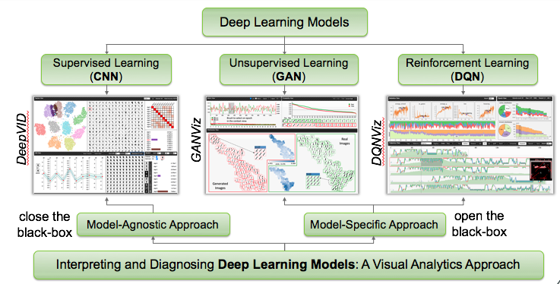
Vis4DNN: Interpreting and Diagnosing Deep Learning Models
Scientific Achievement
Allow the developers of deep learning models to open the black box to see how and why the DNN model functions, so as to further optimize its performance
Significance and Impact
We show that visual analytics approaches play an crucial role to explain modern AI models. Both model-agnostic and model-specific approaches will be needed to address a variety of challenges in explaining AI.
Research Details
GANViz: Interpret Generative Adversarial Nets. We identity the decision boundary of the discriminator and track the evolution of the boundary over time.
DQNViz: Interpret and Improve Deep Q-Networks. We develop a visual analytics system that provides effective visual summaries of the large event sequences generated from the DQN model.
DeepVID: Deep Visual Interpretation and Diagnosis for Image Classifiers. A model-agnostic approach to interpret and disanose images classifiers.
Organization of our Vis4DNN framework
Notes:
Although deep neural network (DNN) models have been applied to a wide range of applications and achieved breakthrough performance in multiple fronts, constructing and tuning a successful DNN model is still a major challenge. One difficulty for deploying a successful DNN is that many existing models are considered black box, that is, the reason for the DNN model to behave the way it is is unknown, and the knowledge learned by the DNN model and its extensibility and generalizability is questionable. We foresee that in order for DNN models to be accepted to a broad range of scientific community and produce trustable outcomes, one should be able to easily interpret the output of the models and diagnose the underlying problems when the models misbehave. Toward this need, This project takes a visual analytics approach to interpret and diagnose deep learning models. Currently focused on three major directions of DNN applications – Generative Adversarial Networks (GAN), Reinforce Learning based Deep Q Networks (DQN), and Knowledge distillation for image classification. We employ both model-agnostic and model-specific approaches to tackle our problems and show that visual analytics approaches play a crucial role in explaining modern DNN models.

