Slide 1
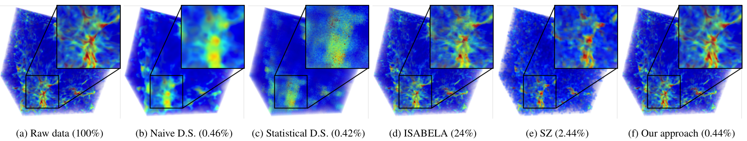
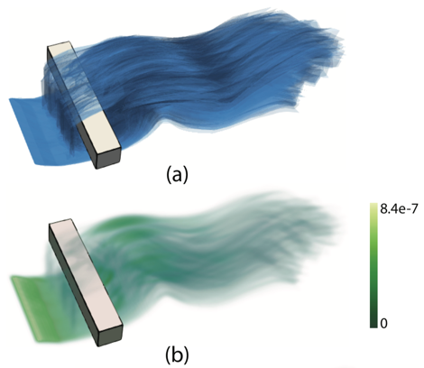
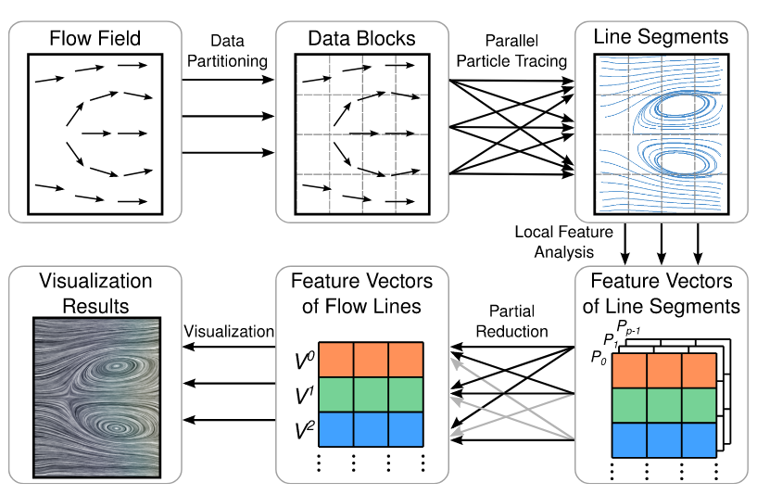
Visual Analytics for Large Scale Scientific Ensemble Datasets (PI: Woodring, LANL Lead)
Data & Viz
LANL Highlight: Statistical Super-Resolution, Accurately Modeling Large-Scale Cosmology Ensembles
Using GMMs + DNNs, we are able to accurately model and reduce the size of a large-scale 10 parameter cosmological study data set
(Nyx, Lukic, et al., LBL) - Size: from 85 TB to 388 GB (~0.5%) -
Accuracy: 0.01% RMSE or better, typically 0.001% RMSE
Not just for visualization! Data are statistical representations, used for uncertainty quantification, parameter, and statistical analysis
Interactive and explorable ensemble data sets - Enabling interactive science to decisions
Use statistical, CS, signal processing, et al. methods to compactly represent large scale, DOE ensemble data with efficiency - in situ, HPC, parallel, etc. algorithms
Analytics that are able to deal with volume, variety, and velocity of large-scale scientific parameter studies
User support through EDDA open-source - large-scale data modeling software using probabilities and distributions https://sites.google.com/site/gravityvisdb/edda
13 Papers, 3 Talks, 3 Awards:
Best paper - Wang, et al. GANViz: ... IEEE TVCG/PacificVis 2018.
Best paper, honorable mention - He, et al. Parallel Partial Reduction for Large-Scale Data Analysis & Visualization. IEEE LDAV 2018.
Best paper, honorable mention - Wang, et al. DQNVis: ... IEEE TVCG/VAST 2018.
OSU Highlight
Argonne Highlight
Collaborators: Ohio State (Shen), Argonne (Peterka and Guo) LANL Staffing: ~0.25 FTE (Woodring and 2 Summer GRAs) + OSU Subcontract
eFesta - Surface Density Estimates for Ensembles
Parallel Partial Reduction for Large-Scale Data Analysis
Notes:
Woodring lead PI w/ 2 summer students + OSU subcontract. LANL to OSU subcontract: Han-Wei Shen (partial) and students (2 full-time) supported. Argonne supported directly from ASCR.
First year (FY18) results - half way through second year
LANL Highlight:
GMM = Gaussian Mixture Models - a way to represent data as a statistical distribution, rather than the raw data samples
DNN = Deep Neural Networks - ML/AI/etc.
Developed by two summer students at LANL.
Achieves great data reductions as very minimal storage space and high accuracy. Compared to SZ and Isabella, outperforms both algorithms in both size and accuracy (have not compared to Lindstrom, et al.)
It is a combination in situ and offline algorithm:
1. Run a 1000 run, 200 time steps per run, 256^3 grid, ensemble parameter study using Nyx, i.e., 10 dimensional parameter study (parameters of interest)
2. With a sparse sampling of the parameter space (only 5 runs out of 1000), save the “raw data of a few simulations”, 7 quantities of interest - 25 GB total in this case
3. Use a combination of statistical modeling (Gaussian Mixture Models, GMMs) and deep neural networks (DNNs), build a data model of the sample space - GMMs model the values in a particular space using distributions, the DNN models the spatial position of the values - “Super Resolution” - this is the ML technique that is able to upsample low resolution to high resolution using prior knowledge of high-resolution images. Here, we use the prior knowledge of the distribution of values in a cosmological simulation to place values in their “correct spots”
4. For all other 995 runs, we use “statistical downsampling” to model the data using GMMs, and only save the GMM data (value distributions) - this is much smaller footprint, each simulation run now only takes 0.42% data
5. For analysis and reconstruction, we use the super-resolution data set to reconstruct the GMM data, later - GMMs are sampled using Monte Carlo methods from the distribution, and then the DNN Super resolution encodes where those values should be in space, upsampling them to the original resolution
6. The total size for a 1000 simulations runs goes from 85 TB to 388 GB, less than 0.5% of the original data set size, while maintaining a very high accuracy (0.01% RMSE or better). The reconstructed simulation data has been directly compared with Lukic's analyis tool, and we have a very high accuracy (near perfect) comparison in the statistical measures of importance, for instance the “power spectrum.”
7. Another thing to note, we really only need the 25GB of data to reconstruct any other data. So, high resolution data can be reconstructed “on the fly” from any downsampled data set from the simulation. With this perspective, the savings for the data are 25 GB to 85 TB in an ad hoc reconstruction for any data set in the 1000.
What's different from before, as there has been many GMM modeling techniques, is that for scientific visualization, the spatial position of values is very important. While GMMs can accurately encode the value distribution to be able to do statistics, creating reconstructions that accurately reflect the spatial representation has been difficult until now. How this differs from regular compression is that the data are represented as distributions, so all statistical and uncertainty quantification methods can be applied directly to the data sets, in addition to being able to create accurate visualizations. Furthermore, it is HPC friendly, as it minimizes the impact of storage, directly at the simulation - only a few simulations (5 out of 1000) have to be saved at full resolution, while all other simulations are saved in a “statistical down-sampled format. Later, full-resolution reconstructed (upsampled) data is created during analysis and visualization time. The statistical downsampling is implemented using parallel friendly algorithms (using VTK-m) meaning that they are accelerated using either GPU and/or multi-core CPU.
To be published in PacificVis 2019: “Statistical Super Resolution for Data Analysis and Visualization of Large Scale Cosmological Simulations”
Ko-Chih Wang (The Ohio State University)
Jiayi Xu (The Ohio State University)
Jonathan Woodring (Los Alamos National Laboratory)
Han-Wei Shen (The Ohio State University)
This summer plan to apply data modeling techniques towards large-scale, real world sensor data (i.e., the MINOS project) that has multi-terabytes of sensor data to infer the state of the HFIR and REDC facilities at Oak Ridge.
OSU Highlight:
We propose surface density estimate (SDE) to model the spatial distribution of
surface features—isosurfaces, ridge surfaces, and streamsurfaces—in 3D ensemble
simulation data. The inputs of SDE computation are surface features represented
as polygon meshes, and no field datasets are required (e.g., scalar fields or
vector fields). The SDE is defined as the kernel density estimate of the
infinite set of points on the input surfaces and is approximated by
accumulating the surface densities of triangular patches. We also propose an
algorithm to guide the selection of a proper kernel bandwidth for SDE
computation. An ensemble Feature Exploration method based on Surface densiTy
EstimAtes (eFESTA) is then proposed to extract and visualize the major trends
of ensemble surface features. For an ensemble of surface features, each surface
is first transformed into a density field based on its contribution to the SDE,
and the resulting density fields are organized into a hierarchical
representation based on the pairwise distances between them. The hierarchical
representation is then used to guide visual exploration of the density fields
as well as the underlying surface features. We demonstrate the application of
our method using isosurface in ensemble scalar fields, Lagrangian coherent
structures in uncertain unsteady flows, and streamsurfaces in ensemble fluid
flows.
As shown in the figure, the input surfaces and the output density
field are visualized in (a) and (b), respectively. Given an ensemble of
surfaces, a straightforward density estimation approach is to define a regular
grid over the surfaces, and then count the number of surfaces intersecting each
grid cell. However, after discretizing the surfaces with respect to a given
grid, the information of the surface patches (e.g., location, orientation, and
shape) within each grid cell is lost, which introduces discretization error
into the density estimation results. Although increasing the grid resolution
can reduce the discretization error, the computation cost increases. In this
work, we propose SDE, which generalizes the kernel density estimate (KDE) from
discrete sample points to the infinite set of points on input surfaces. We
approximate SDE of the input surfaces by accumulating the surface densities of
triangular patches, which can be calculated based on bivariate normal integrals
with efficient GPU computation.
Argonne Highlight:
We present a novel partial reduction algorithm to aggregate sparsely
distributed intermediate results that are generated by data-parallel analysis
and visualization algorithms. Applications of partial reduction include flow
trajectory analysis, big data online analytical processing, and volume
rendering. Unlike traditional full parallel reduction that exchanges dense data
across all processes, the purpose of partial reduction is to exchange only
intermediate results that correspond to the same query, such as line segments
of the same flow trajectory.
To this end, we design a three-stage algorithm that minimizes the communication
cost: (1) partitioning the result space into groups; (2) constructing and
optimizing the reduction partners for each group; and (3) initiating collective
reduction operations for all groups concurrently. Both theoretical and
empirical analyses show that our algorithm outperforms the traditional methods
when the intermediate results are sparsely distributed. We also demonstrate
the effectiveness of our algorithm for flow visualization, big log data
analysis, and volume rendering.
The figure shows an application of Lagrangian-based flow
visualization applications that can benefit from our partial reduction methods.
For example, the total length of flow lines can be calculated by summing the
lengths of flow line segments; the operator for the reduction is “add.”
Importantly for ensemble statistical-based analyses, streamline statistics
(histograms, mean, and variance) are also based on the add operator. The line
integral convolutions (LIC) result of a given streamline seed can be computed
by summing the convolution values across processes. The reduction of flow line
queries, such as predicates and pattern matching, is based on the
logical “or” operator.
Future work:
We have been extending scientific visualization and analysis
using machine learning and deep learning for in situ data representation and
reconstruction; this has been seen in our recent publications. Specifically, a
research extention would be how to represent ensemble simulation data with
latent variables, how to interpret the latent variables (definition of latent
variables in the next paragraphs), identify scientific features and patterns
from the data through learning, and reconstruct and generate data from the
encoded latent variable. We plan to dive into machine learning and deep
learning in the next few years for its applicability towards in situ data
representation, scientific understanding, and visualization.
Latent variables represent the most salient information about the data. They
are typically the intermediate output of an *Autoencoder*, and can be used to
reconstruct the data. Our research direction is to convert the large amount
of data into the latent representation such that they serve as the data proxy
for post hoc analysis and visualization. See for example LANL's highlight for
this. Applications include produce ensemble simulation data with novel
parameter configuration; reconstruct the raw data from images saved at in situ
time; etc.
Another area of research is is to further the interpretability and
explanability of machine learning and deep learning. For example, we have
multiple TVCG papers (4) on Vis for ML, and submitted multiple papers to SciVis
on the topic of ML for Vis. A unique accomplishment in our group is that we have
come a long way in visualization of deep learning models. This is under the
direction of having explainable AI. We have a several best paper awards and
nominations in IEEE Vis and PacificVis related to this, and also some papers in
the topic of ML being selected as top papers to TVCG. This research area, so
far, is not directly supported in this topic area and it is our wish and
goal to demonstrate the utility and feasibility of the technology for SciVis.
While many people are using ML, fully utilizing ML for *In Situ Visualization*,
i.e., HPC and DOE large-scale applications, is still very under explored. We
stand out because that we have already have done preliminary (award-winning)
work published in the top venues.
Finally, we propose to connect our EDDA (open-source software for data modeling
using distributions) effort to ML. Many ML/DNN algorithms are already based on
probability and distributions. Since EDDA's goal is to use distributions as the
fundamental data modeler, we will further this direction by applying DNN
algorithms for the distributions (again, see LANL's highlight). For example,
instead of directly computing the latent representations, we analyze the data
and extract features from the distributions. Also, we reconstruct the data in
post hoc analysis from the EDDA outputs – this is essentially similar to the
idea of Variational Autoencoder (VAE) and GAN. Our existing work in EDDA, and
statistical modeling, has allowed us to move farther and faster than other
groups.
Citations:
Soumya Dutta, Han-Wei Shen, and Jen-Ping Chen. *In Situ Prediction
Driven Feature Analysis in Jet Engine Simulations.* Pacific Visualization
Symposium (PacificVis), 2018 IEEE, 66-75.
Hanqi Guo, Wenbin He, Sangmin Seo, Han-Wei Shen, Emil Mihai
Constantinescu, Chunhui Liu, and Tom Peterka, *Extreme-Scale Stochastic
Particle Tracing for Uncertain Unsteady Flow Visualization and Analysis.* IEEE
Transactions on Visualization and Computer Graphics, 2019.
Wenbin He, Hanqi Guo, Tom Peterka, Sheng Di, Franck
Cappello, and Han-Wei Shen. *Parallel Partial Reduction for Large-Scale Data
Analysis and Visualization.* In Proceedings of 2018 IEEE Symposium on Large
Data Analysis and Visualization, 2018.
Wenbin He, Hanqi Guo, Han-Wei Shen, and Tom Peterka,
*eFESTA: Ensemble Feature Exploration with Surface Density Estimates.* IEEE
Transactions on Visualization and Computer Graphics, 2019.
Ayan Biswas, Soumya Dutta, and Han-Wei Shen.
*Information Guided Exploration of Scalar Values and Isocontours in Ensemble
Datasets.* Entropy 2018, 20(7), 540.
Subhashis Hazarika, Soumya Dutta, Han-Wei Shen, Jen-Peng Chen. *CoDDA:
A Flexible Copula-based Distribution Driven Analysis Framework for Large-Scale
Multivariate Data.* IEEE Transactions on Visualization and Computer Graphics.
Subhashis Hazarika, Ayan Biswas, Han-Wei Shen.
*Uncertainty Visualization Using Copula-Based Analysis in Mixed Distribution
Models.* IEEE Transactions on Visualization and Computer Graphics, 24(1):
934-943 (2018).
Cheng Li, Joachim Moortgat, and Han-Wei Shen. *An Automatic Data
Deformation Approach for Occlusion Free Egocentric Data Exploration.* Pacific
Visualization Symposium (PacificVis), 2018 IEEE, 215-224.
Junpeng Wang, Liang Gou, Han-Wei Shen, Hao Yang. *DQNViz: A Visual
Analytics Approach to Understand Deep Q-Networks.* IEEE Transactions on
Visualization and Computer Graphics.
Junpeng Wang, Liang Gou, Hao Yang, and Han-Wei Shen. *GANViz: A Visual
Analytics Approach to Understand the Adversarial Game.* IEEE Transactions on
Visualization and Computer Graphics, 24 (6), 1905-1917 (2018).
Junpeng Wang, Subhashis Hazarika, Cheng Li, Han-Wei
Shen. *Visualization and Visual Analysis of Ensemble Data: A Survey.* IEEE
Transactions on Visualization and Computer Graphics, 2018.
Ko-Chih Wang, Naeem Shareef, and Han-Wei Shen. *Image and Distribution
Based Volume Rendering for Large Data Sets.* Pacific Visualization Symposium
(PacificVis), 2018 IEEE, 26-35.
Tzu-Hsuan Wei, Soumya Dutta, and Han-Wei Shen. *Information Guided
Data Sampling and Recovery using Bitmap Indexing.* Pacific Visualization
Symposium (PacificVis), 2018 IEEE, 56-65.

