Slide 1
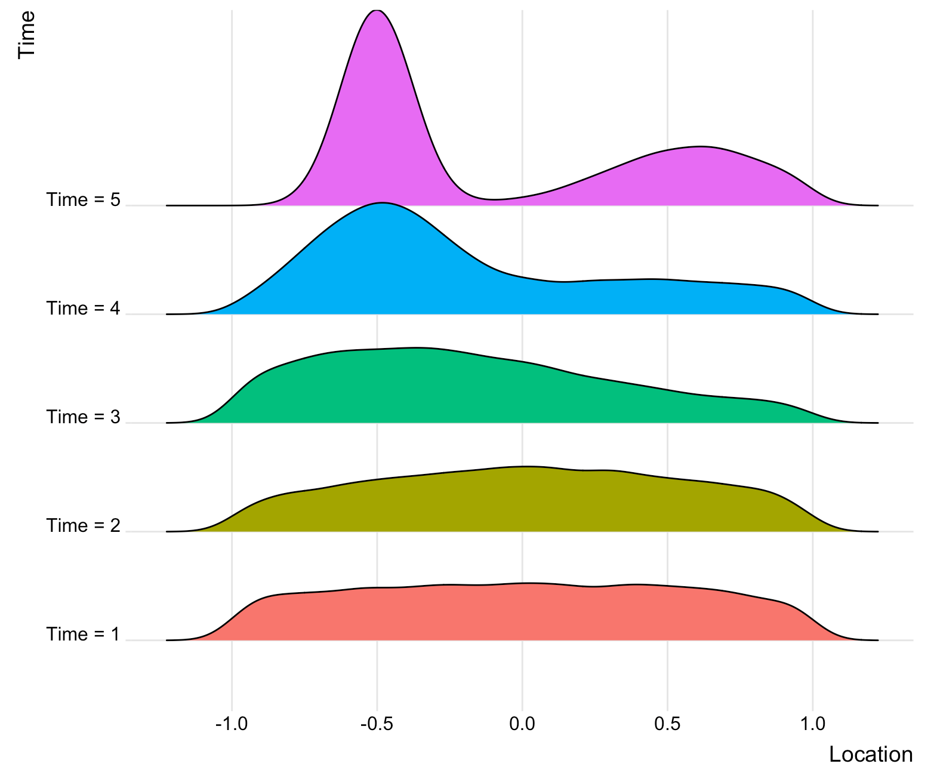


In Situ Spatial and Temporal Partitioning of Large-Scale Computer Simulations Abigael Nachtsheim Emily Casleton, Jon Woodring
Objectives
Impact
The continual growth in size and complexity of computer simulations poses challenges to data storage and post-processing.
One widely-used solution is to partition the simulation output, storing only a fraction of the data generated.
We develop a method for judiciously partitioning the simulated output, both within each time step, and over time, as the simulation is running.
In the partitioning framework, post-processing and analysis is performed using only the partitioned output.
Poorly-designed partitions can lead to incorrect conclusions.
Our method produces partitions that closely mirror the structure of the full data, resulting in improved understanding of the process under study.
Planned Accomplishments
Develop a method for strategically partitioning the output from large-scale computer simulations as the simulation runs.
Incorporate statistical theory to identify partitioning schemes that retain properties of the full data with decreased storage costs.
Illustrate the proposed method, using cosmological simulations carried out with Argonne's HACC code.
Compare the partitioned data to the pre-partitioned data over multiple time steps and across several partitioning designs, demonstrating the efficacy of the proposed method.
Partition and store distributional information only when the simulation output has changed statistically significantly.
Notes:
1

