Slide 1
Sharing Category Systems for Survey Items with Others in DDI-Lifecycle Format
Wolfgang Zenk-Möltgen GESIS – Leibniz Institute for the Social Sciences Wolfgang.Zenk-Moeltgen@gesis.org

Slide 2
Overview
What we have
What we want to do
Possibilities in DDI-Lifecycle
Evaluation Criteria and Results
Recommendations

Slide 3
What we have
Category Systems for Variables
CodebookExplorer Application
Trends and Scales
Multiple Languages
Hierarchical Structure
Variable Assignments

Slide 4
What we want to do
Export the Category Systems
Publish Independently from Database
Share with Others to be Re-Used
Maintain Versions
Get Cited

Slide 5
Category Systems for Variables
Example Database: “Childhood, Adolescence and becoming an Adult 1991-1997”
Topics: political-social experiences and orientations; youth and becoming adult as a phase in life in the framework of the course of life; courses of development and development risks; life styles, cultures and social reference groups of young people and the social-structural differentiating of the youth phase.
Source: Fischer, Arthur; Jugendwerk der Deutschen Shell, Hamburg; Silbereisen, Rainer K.; Vaskovics, Laszlo A.; Zinnecker, Jürgen (1999): Childhood, Adolencence, and Becoming an Adult 1991-1997 - Youth Longitudinal 1991-1995/96. GESIS Data Archive, Cologne. ZA3431 Data file Version 1.0.0, doi:10.4232/1.3431

Slide 6
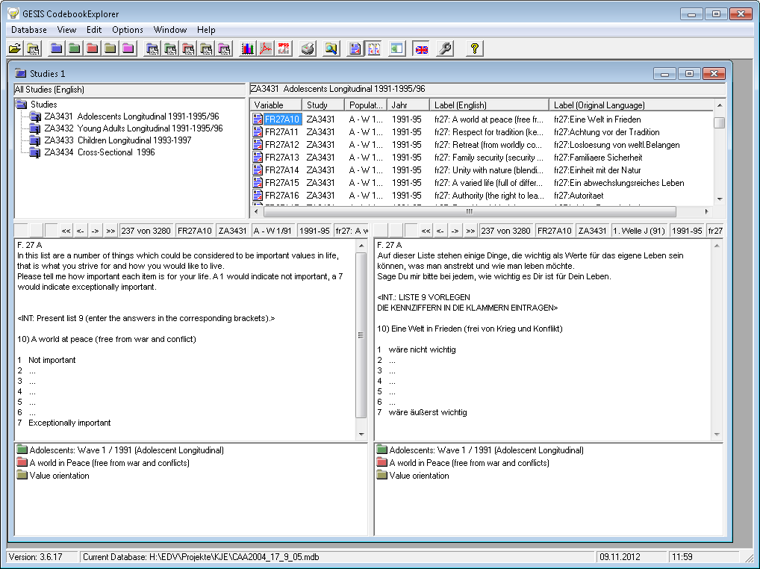
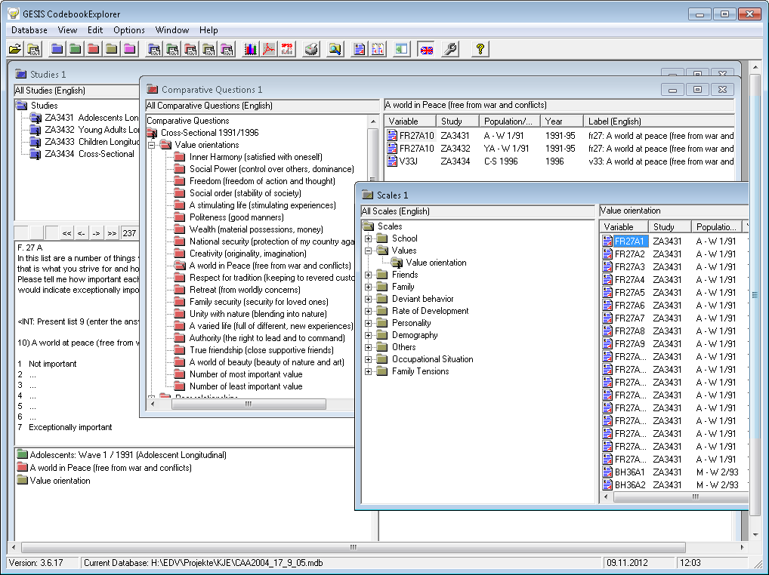
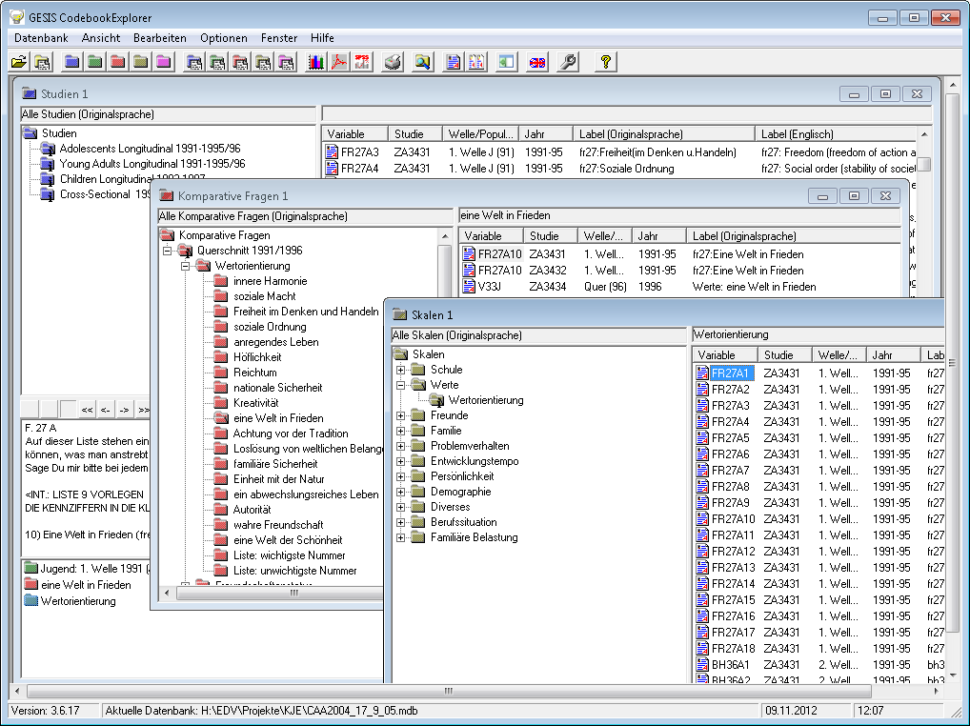
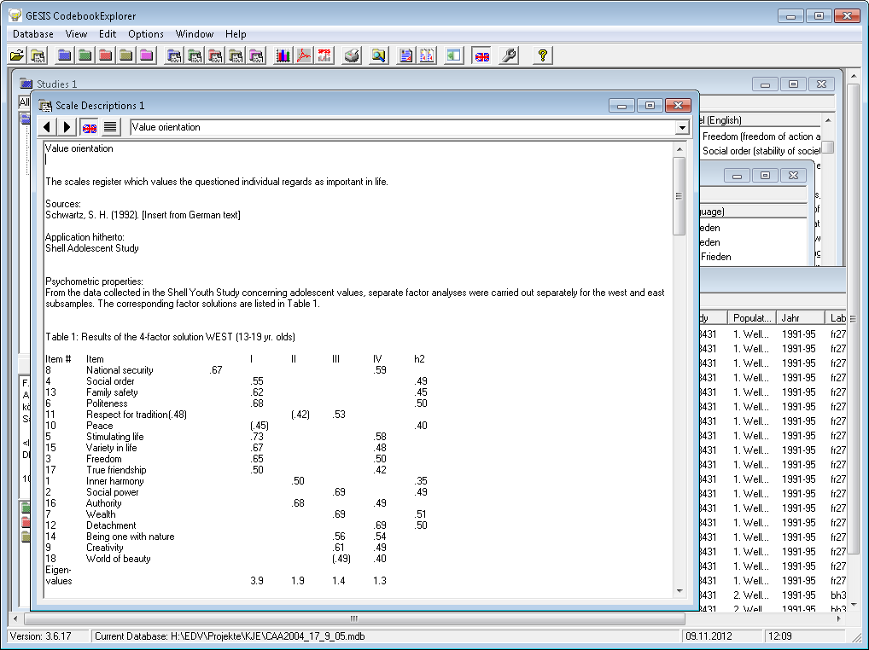
Screenshots
Studies and Variables
Comparative Questions and Scales
English and Original Language
Scale Descriptions

Slide 7
Possibilities in DDI-Lifecycle
Concepts
Subjects
Notes
Controlled Vocabularies (Genericode)

Slide 8
Concepts
ConceptScheme in RessourcePackage
Concept for each Node
Label
Description
UserID
ConceptGroup for Root Node
Nested ConceptReferences for Structure
Variables use ConceptReference
Notes:
from "DDI_3.1_Part_II_UserGuide.pdf", line 890:
Note that the purpose of Topical Coverage is different than that of concept and universe.
Concepts are what questions and variables are designed to measure and universe describes the
object to which the concept refers. These tend to be very specific and well defined. Subject
and keywords are more loosely applied and may reflect more about how someone would search for
specific information as opposed to the specified intent of the researcher.

Slide 9
Subjects
TopicalCoverage in Coverage in RessourcePackage
Subject for each Node
Optional with CodeListID for Controlled Vocabulary
No structure
No Variable Assignments

Slide 10
Notes
Notes in RessourcePackage
Header for Label
Content for Description
Relationship for Assignments to Variables
Type Attribute does not fit well
No Structure

Slide 11
Controlled Vocabularies
Uses Genericode Code Lists
DDI Alliance uses Column Set
Code
Term
Definition
Maintained by Code List Sets
No Hierarchy

Slide 12
Evaluation Criteria
Are the Semantics OK?
Support for Multiple Language?
Support for Structure?
Usable in Ressource Package?
Support for Variable Assignments?
Is It Possible to Maintain it?

Slide 13
Evaluation Results
 | Concept | Subject | Note | Controlled Vocabulary
Semantics | +/- | +/- | - | +
Language | + | + | + | +
Structure | + | - | - | -
Ressource Package | + | + | + | -
Variable Assignments | + | - | + | -
Maintainable | + | - | - | +

Slide 14
Recommendations
Use the DDI Concept Element
Include it in a Ressource Package
Use Hierarchical Structure
Include Languages and Ids
Reference Concepts from Variables

Slide 15
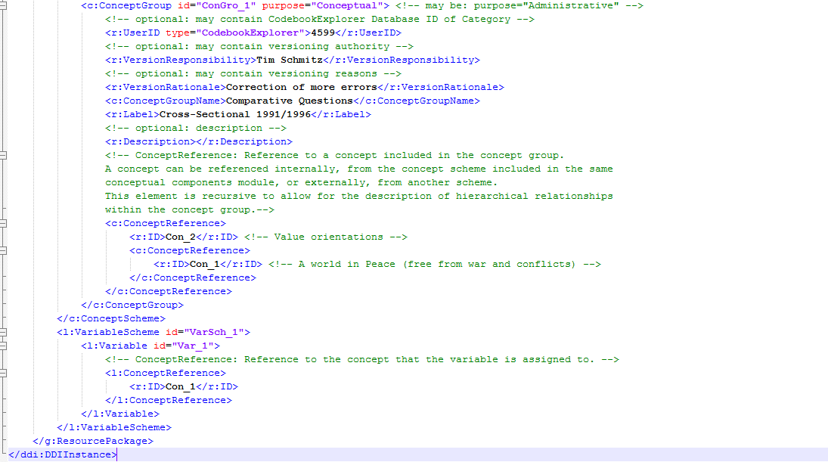
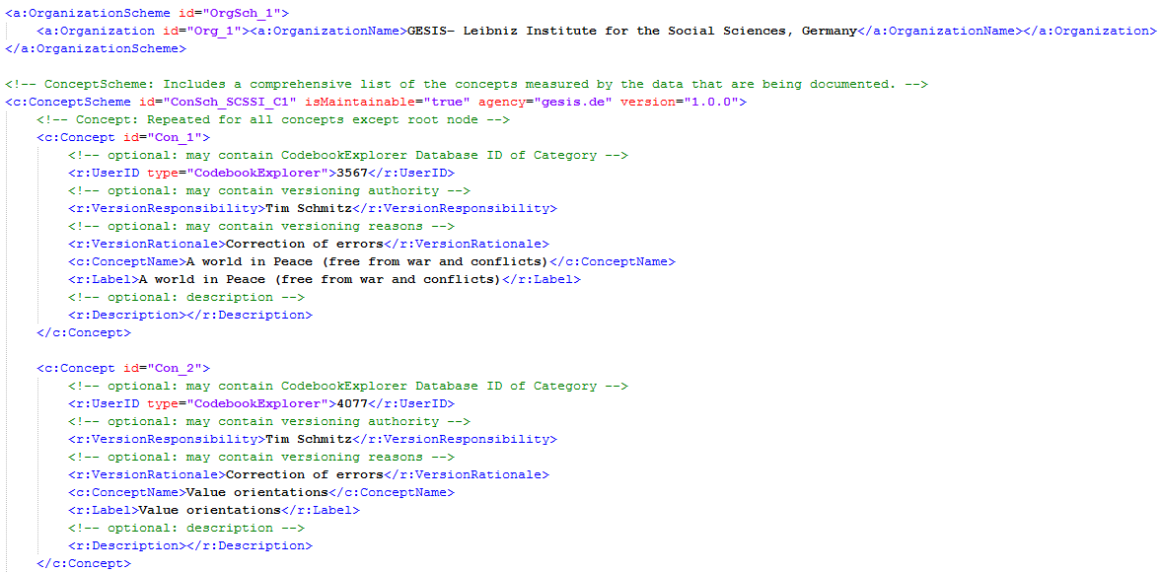
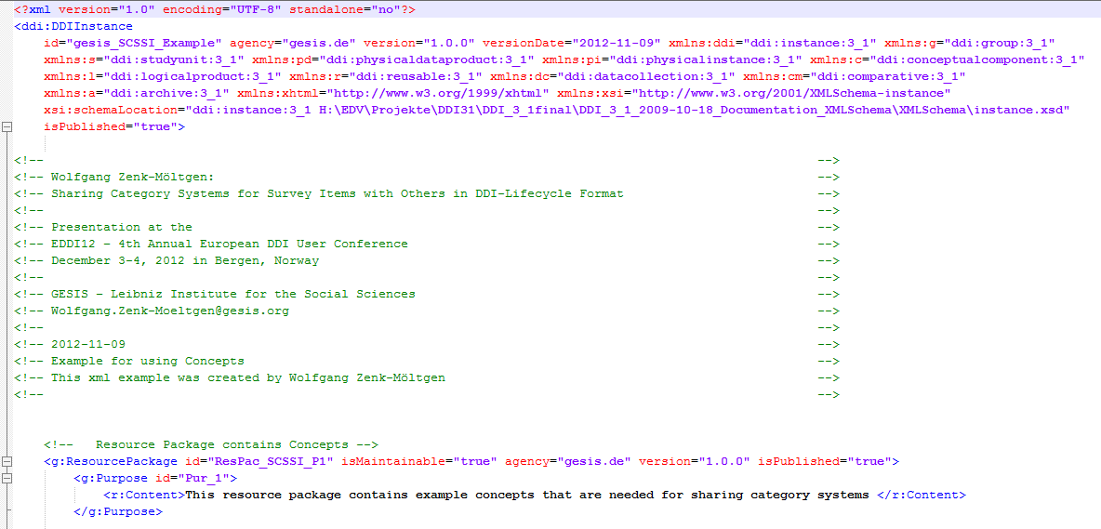
Example DDI Code

Slide 16
Future Work
Implement the Export into the next version of CodebookExplorer
Explore Linked Open Data Standards like SKOS

Slide 17
Thank you!
Remarks/Questions?
Wolfgang.Zenk-Moeltgen@gesis.org

