Slide 1
Using DDI to Automate Blaise Instrument Generation
Simon Wall Australian Bureau of Statistics
Notes:
Some background
Our aspirations
What we have done
What else we need to do

Slide 2
some background
ABS is modernising
new infrastructure and systems
process reengineering
Business is already changing
translating paper to web forms
modernisation
DDI
web forms
Notes:
ABS is part of push to modernise, HLG Stats Network, GSIM, DDI.
it has a vision of reengineering the production of statistics

Slide 3
about Blaise
ABS uses Blaise widely
CAPI, CATI, editing, web forms
Modernisation relies on automation
Automate everything we can
Manual coding of Blaise is a bottleneck
many cycles of change and testing
Notes:
Realisation of vision of modernisation relies on automation
Focus today is on web forms

Slide 4
manual coding is a problem
Poor specifications = poor metadata
IT staff are part of the business process
Very slow
Requires repeated and extensive testing
Takes focus away from business purpose
Many lost opportunities
visualisation
analysis
reuse
Notes:
lots of issues
also very flexible
what is the right (best) way?
dialects vary widely
(Separate implantation from spec -xforms is another possibility, ACES too)

Slide 5
what we are aiming for
Give subject matter experts a tool
reusing existing metadata wherever possible
Create collection instruments automatically
make Blaise a commodity not an asset
Use DDI as the enabling standard
registry
DDI
DDI
tool
Notes:
DDI as the enabling standard
our aspiration is actionability
Tools for subject matter experts to specify collection instruments, reusing existing metadata wherever possible.
Then generate instruments automatically.
SMA – QDT -→ DDI -→ DDI-Blaise --→ webform
Could be webform, CATI, CAPI, etc
Business users DON’T see DDI
Nothing really new in some ways
Goal is commodity code
Put the focus on business purpose
Don’t much care whether output is webform or something else, Blaise or something else -> this is about capturing specifications and then using them

Slide 6
what’s different?
Treat Blaise as a means, not an end
It shouldn’t be a metadata graveyard
Making it easier to get Blaise code is not enough
The specification is the real asset
Put power in hands of survey designers
Get technical people out of business processes
Empower the designers
Notes:
The aim is not Blaise - community have different focus
variety of people making tools to create/capture logical specs for questionnaires in ddi (not quite right)
MDQS tool does baize to ddi somewhat
Stats Canada, Stats Denmark using templates
CBS looking at DDI to blaise in order to get stuff into Blaise
Colectica
Specific instance/usecase of general problem – limited aspiration
we have one under development too!
, as opposed to techos having to understand spec, and bus area having to test - long, slow, tedious, fallible, expensive

Slide 7
fast-tracking development
Chose an existing business survey
LaMPS = Land Management Practices Survey
Handcoded DDI to represent the survey
Resolving representation issues
Put one team on the specification tool
Create output to match the sample
Put another team on the Blaise tool
Use the sample to create the form
Notes:
Lots of fine tuning, but much faster, more tangible.
Also, agile dev methodology, demonstarting to client often

Slide 8
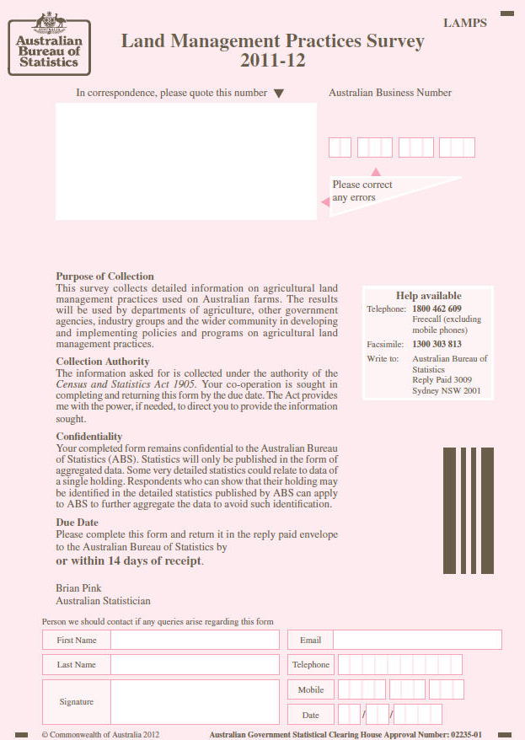
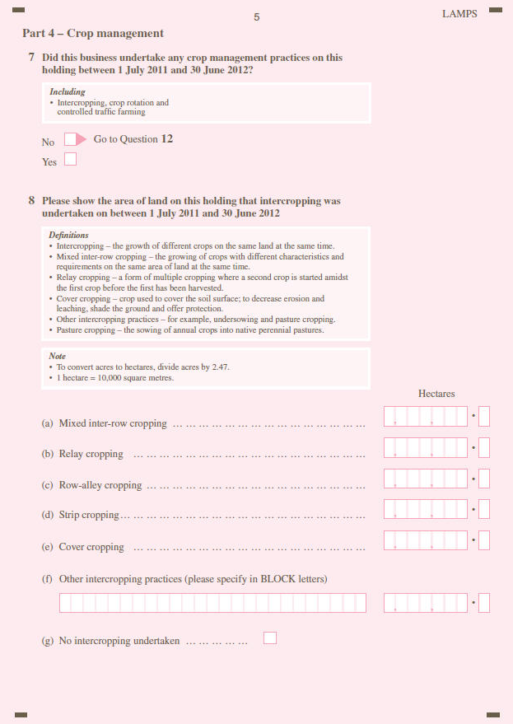
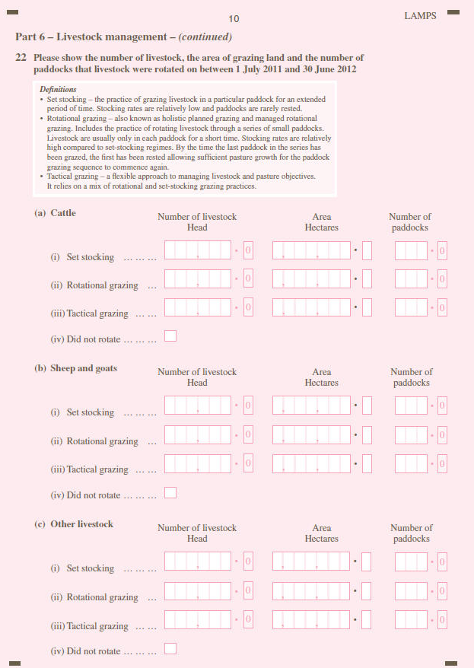
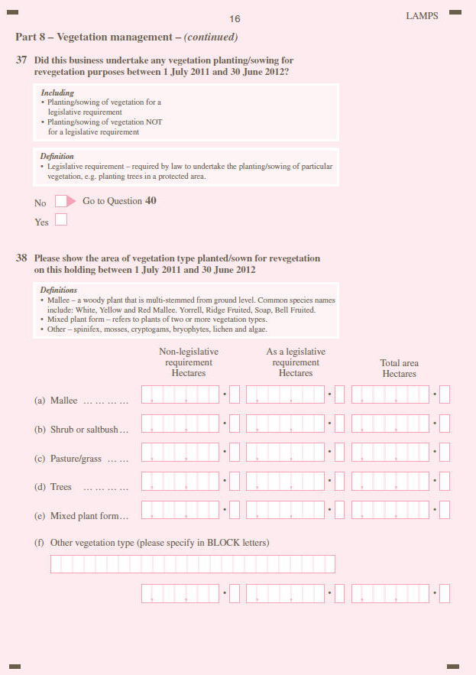

Slide 9
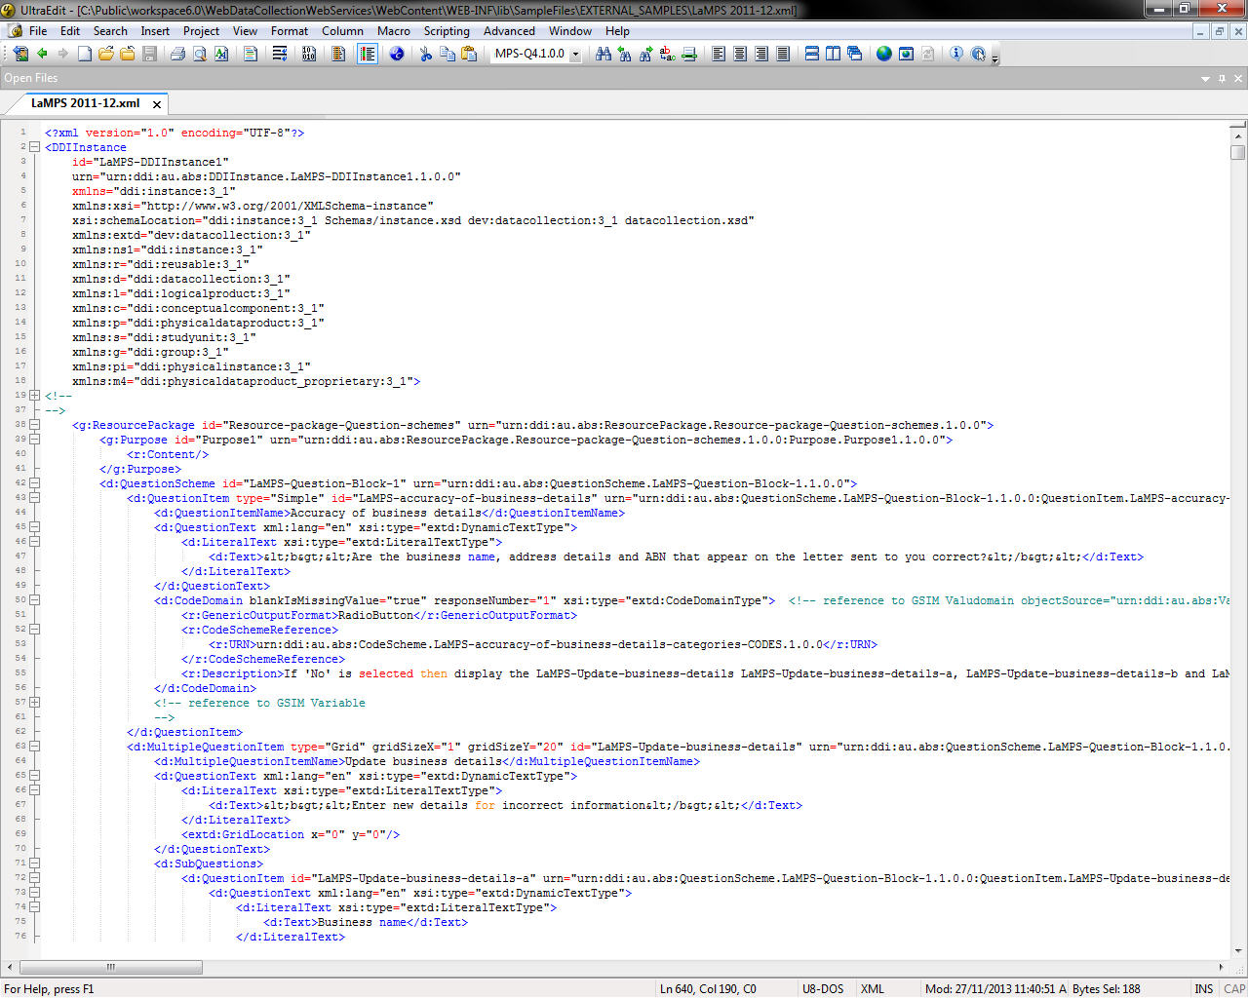
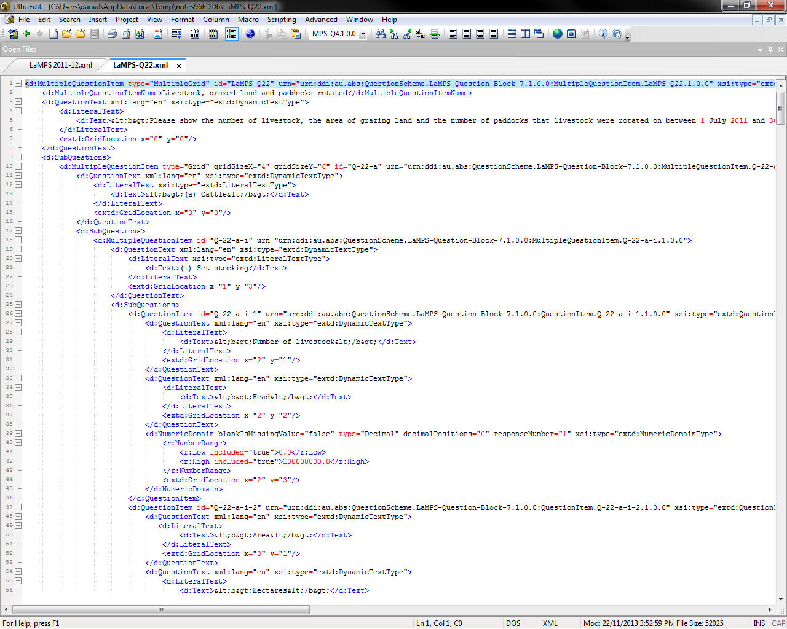
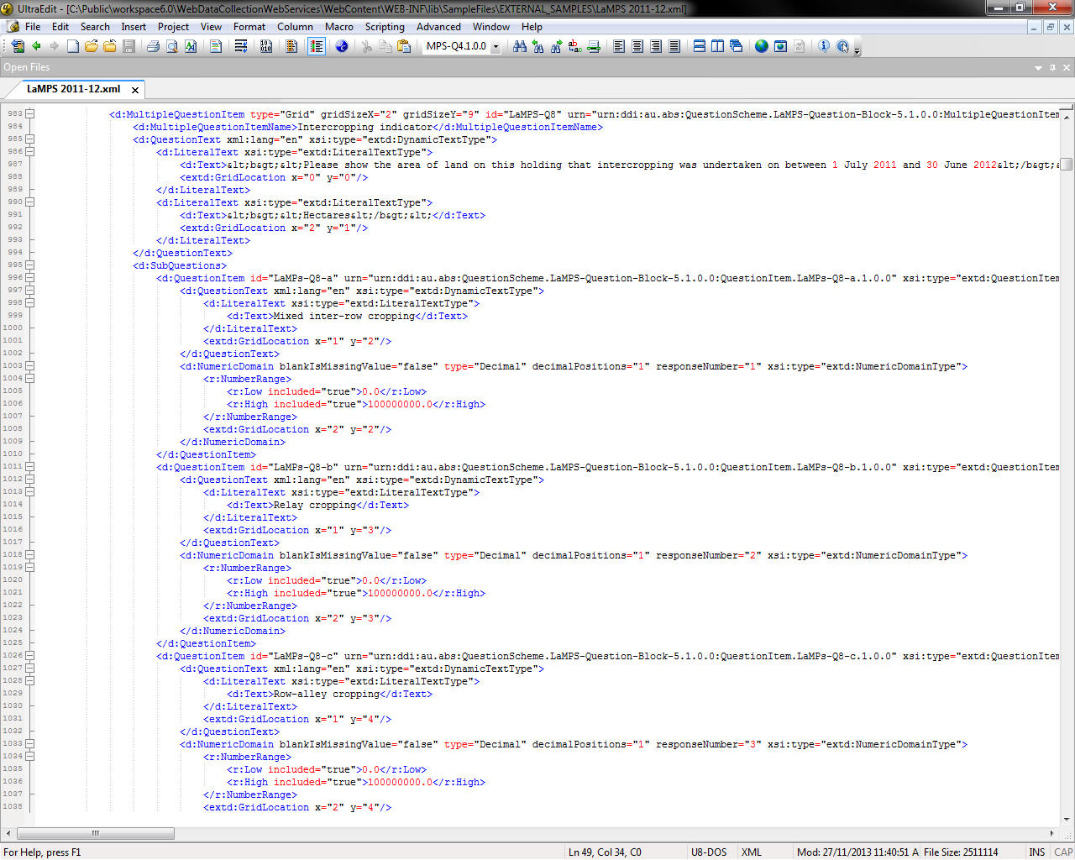

Slide 10
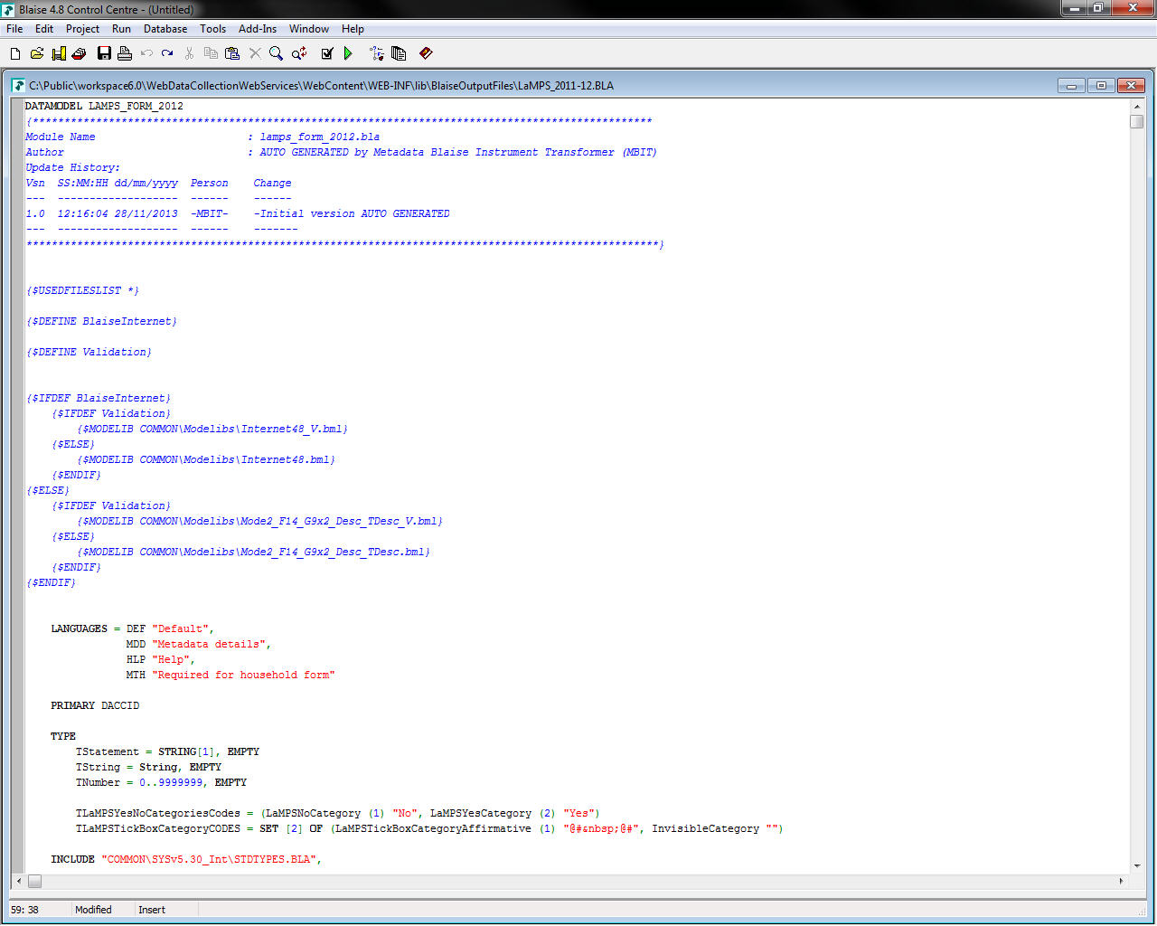
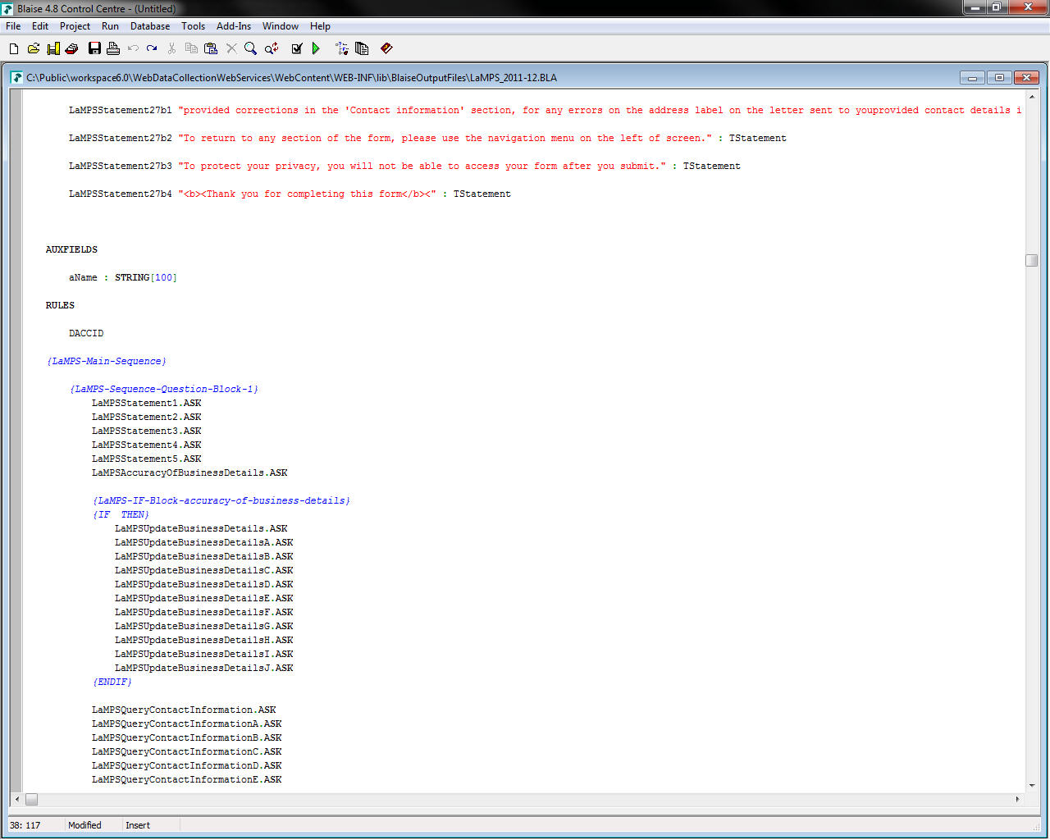
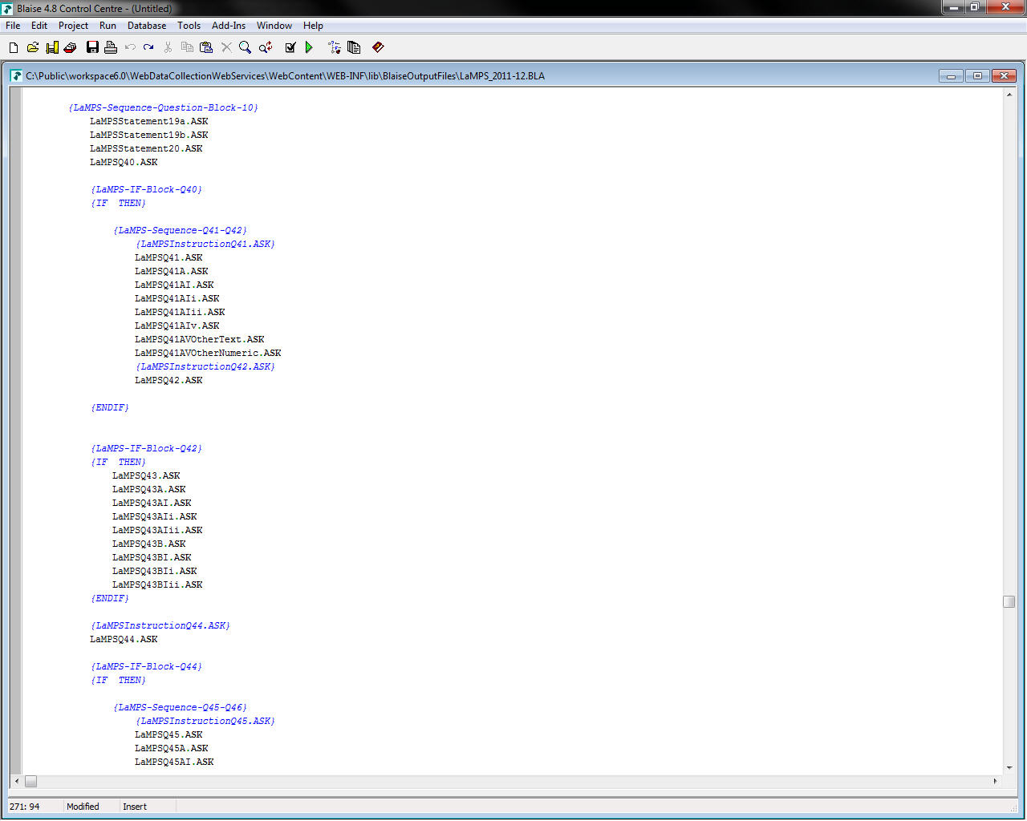
Notes:
blaise output
Field and sequencing
more sequencing

Slide 11
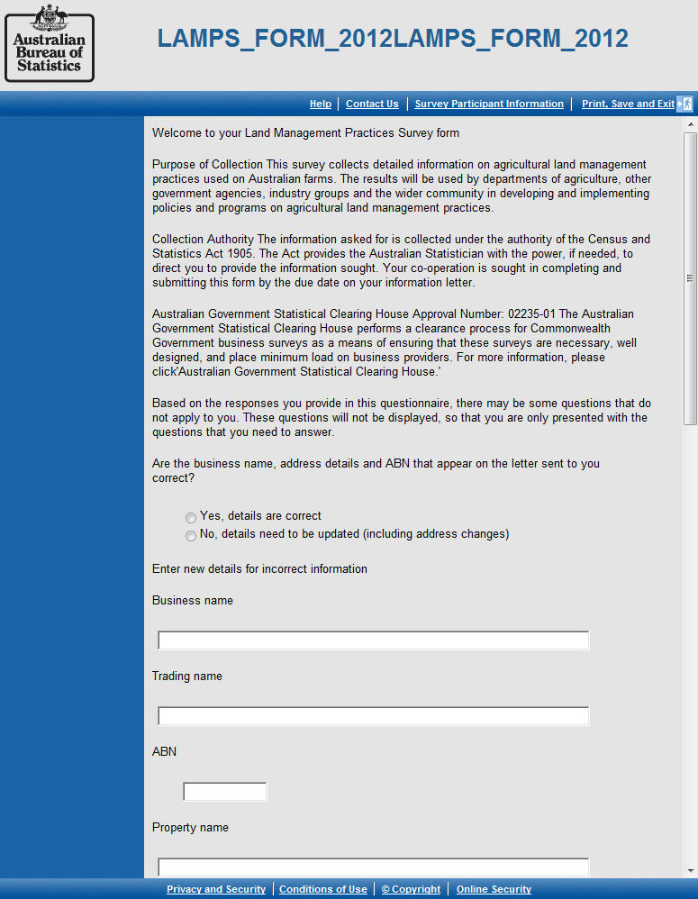
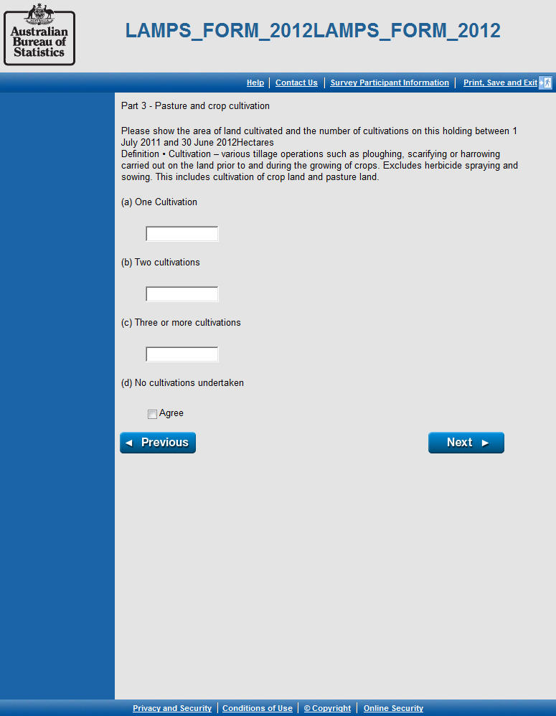
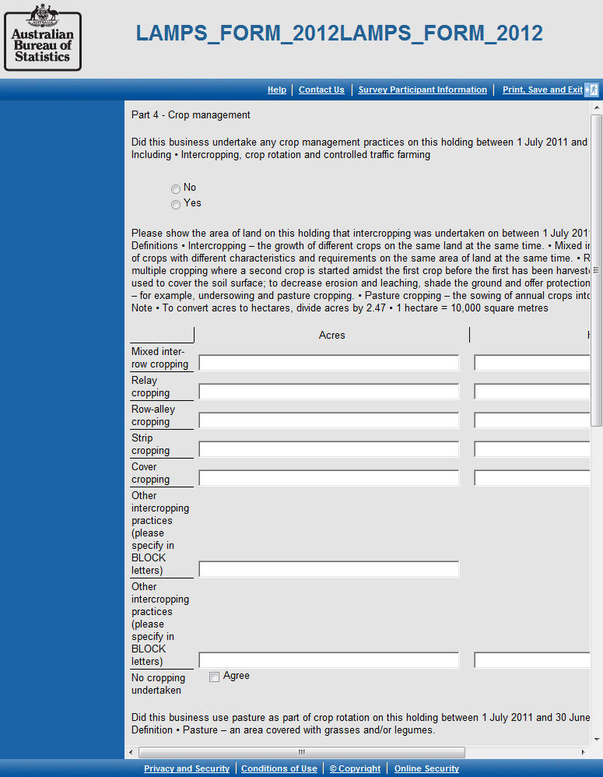
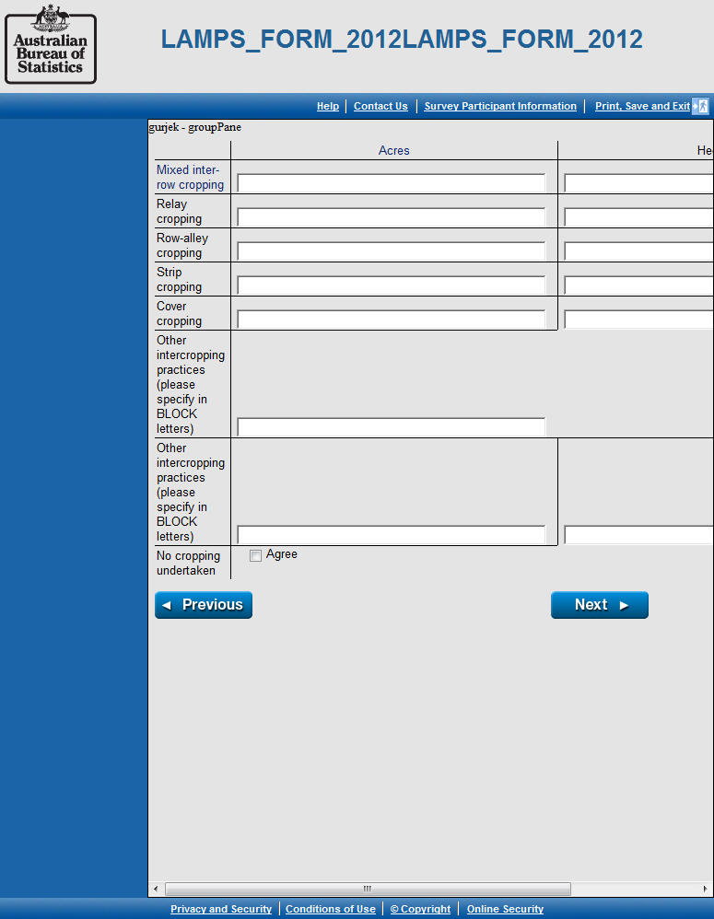
Notes:
end result
matrix question 2
matrix question
typical question

Slide 12
technical challenges
DDI too expressive
Common profiles?
Mapping specifications to Blaise
e.g. we can use Blaise tables for grid questions, but Blaise only allows 1 per page…
Pushing boundaries of DDI
Layout? Deployment?
Doing it all
“you can only do 80%”
Notes:
Low level
Deal with levels of DDI ability
‘DDI is horrible’
understand is easier
generate needs intense level of expertise

Slide 13
business challenges
Imposition of standardisation
Compared to past flexibility
Exploring new territory
E.g. best way to handle multi-modal specifications
Carrying baggage
Past practice is not always useful
Lack of expert guides
No one has the answers yet
Notes:
Higher level
Need new thinking
Another challenge with implementing metadata driven e-forms has been dealing with the existing processes within the ABS, such as the current form design process (e.g. that it is based on translating paper forms, rather than considering how best to design forms in an electronic environment). This has been challenging both from the perspective of the available metadata but is also a challenge for modernising the statistical processes for instrument design
May be incrementally useful, or develop enough to generate business forms, then look at household forms In parallel?
Multimodal stuff – the right way! Cant assume we know what best practice for specifying instruments is yet
Different sequence = different instrument? (modal bias) – talk to Emma
Important that someone has shown it can be done.

Slide 14
about the 80%...
Our tool will make Blaise code for LaMPS
The Blaise programmers will modify our output for use in the field
We’ll analyse what they changed, to reduce the need for them to do it again.
New metadata?
Better specifications and outputs?
Repeat until there is no manual coding

Slide 15
what’s next for the project
Make a better specification tool
More question types
Social surveys
Make a better output tool
Layout
Deployment
Share our work with others
Notes:
Keep working!
International partners?
(Can they get hold of it? Or us?)

Slide 16
what should come later
Better metadata opens up opportunities for making it easier to create better surveys, e.g.
Reuse of variables or concepts
Automated path analysis
Improved visualisation techniques
Simulated load testing

