Slide 1

Introduction to DDI and Colectica at Statistics Denmark
3th December 2013
Mogens Grosen, Statistics Denmark
Jeremy Iverson, Algenta

Slide 2
Agenda
Background and vision
EU – grant project
Implementation using Colectica
Plans for 2014

Slide 3

”The role of the NSI’s and metadata need to change … ”
200 years ago: “statistics as state secrets”
Vision: “handling complexity”
A lighthouse in the turbulent sea of information
Focus on metadata to support users knowledge processes
Metadata must give user exact knowledge on products
Use of international standards
  Share knowledge about statistics across organisation- and state- borders
  Cost-effective production of statistics

Slide 4
“Challenges on metadata … ”
Stove-pipe production with no links to GSBPM processes
Metadata are not reused and often only linked to final data
Parallel systems with tight links to DBMS-systems
Presentation of metadata on Internet is fragmented and incomplete
Concepts database incomplete with no hierarchy (Super-, sub- and synonym-concepts)
Classifications and code-lists in many places

Slide 5
EU-grant project
"Horizontal and vertical integration: Implementation of technical and statistical standards in the European Statistical System"

Slide 6

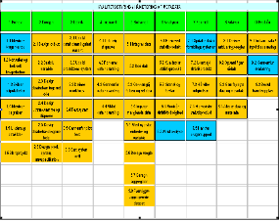


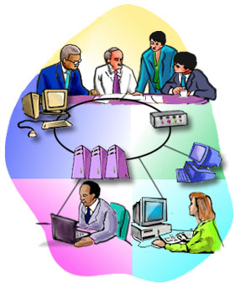
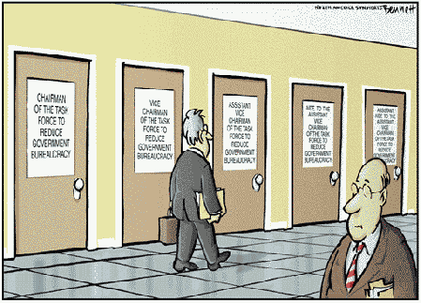
THE
SOLUTION
EXISTING
SYSTEMS
Enter Quality
Publish at Dst.dk
METADATA IN
COLECTICA
Publish at the Intranet
Transmit to EU

Slide 7
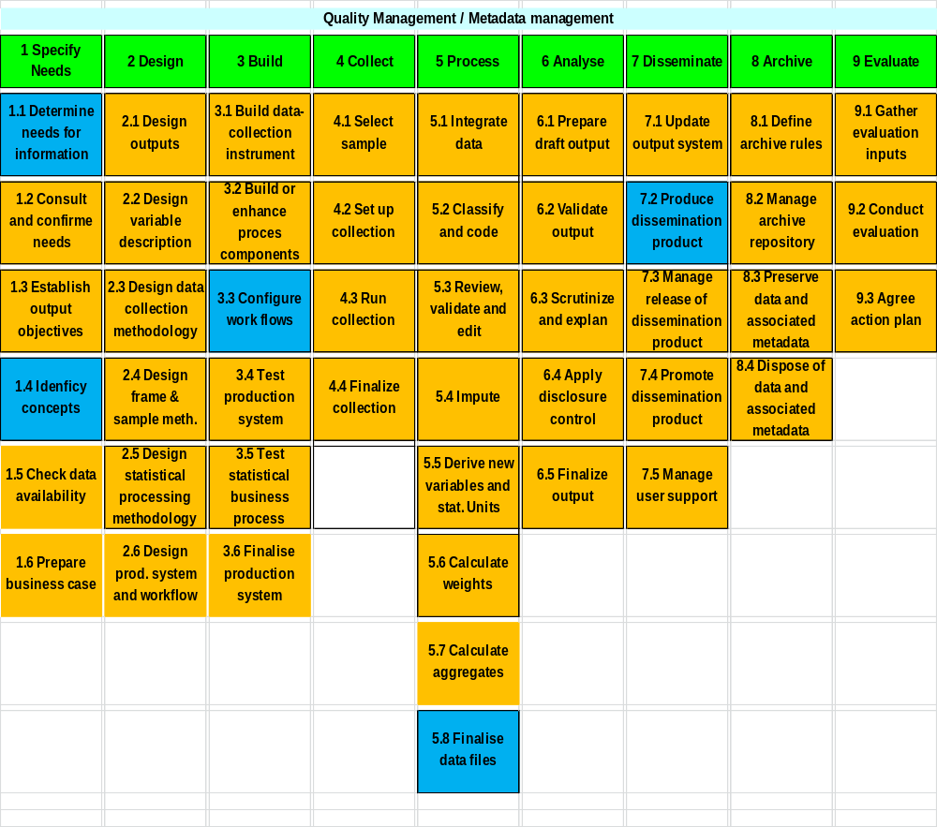
Selected processes in focus

Slide 8
Workprocesses and quality declarations
1. Needs :
Fill in contact, relevance, etc.
6. Analyse :
Fill in sampling error, etc.

Slide 9
Integrerede og reuseable metadata (DDI og SDMX)
Statbank
Methods
´Papers on methods
Quality Declarations
Concept
Variable/dataset
Conceptdatabase
Variabeldatabase
Hvad betyder
Classifications
Klassifikationsdatabase
Classificationsdatabase

Slide 10
EU-grant: deliverables
Quality declarations migrated to new metadata system for all statistics
Meetings and reports from external users
Dissemination of dst.dk developed in collaboration with users
Software (Colectica) installed - internal interface and external interface (dissemination at dst.dk)
Manuals and courses
  The transition from current to new quality declarations
  Continuous updates - follow Dst's process model
Communication:
  Newsletters, reference group and thematic meeting each quarter
  Intranet Page

Slide 11
TIME SCHEDULE
2013
2014
J | F | M | A | M | J | J | A | S | O | N | D
J | F | M | A | M | J | J | A | S | O | N | D
Pilotphase
part 1
Adjust-
ment
Pilotphase
part 2
Implementation on all surves
Evalua-
tion &
plan 2014
Evalua-
tion

Slide 12
Status November 2013
Communication rolled out (September and December)
Migration in place on 6 test surveys
Basic software (Colectica) installed
Most enhancement implemented, including GSBPM support (workflow and permission to be implemented)
Guidelines and software has been tested on 6 surveys
“Proof of Concept” about detailed reporting must be finalized
Meeting with external user and web-app. postponed

Slide 13
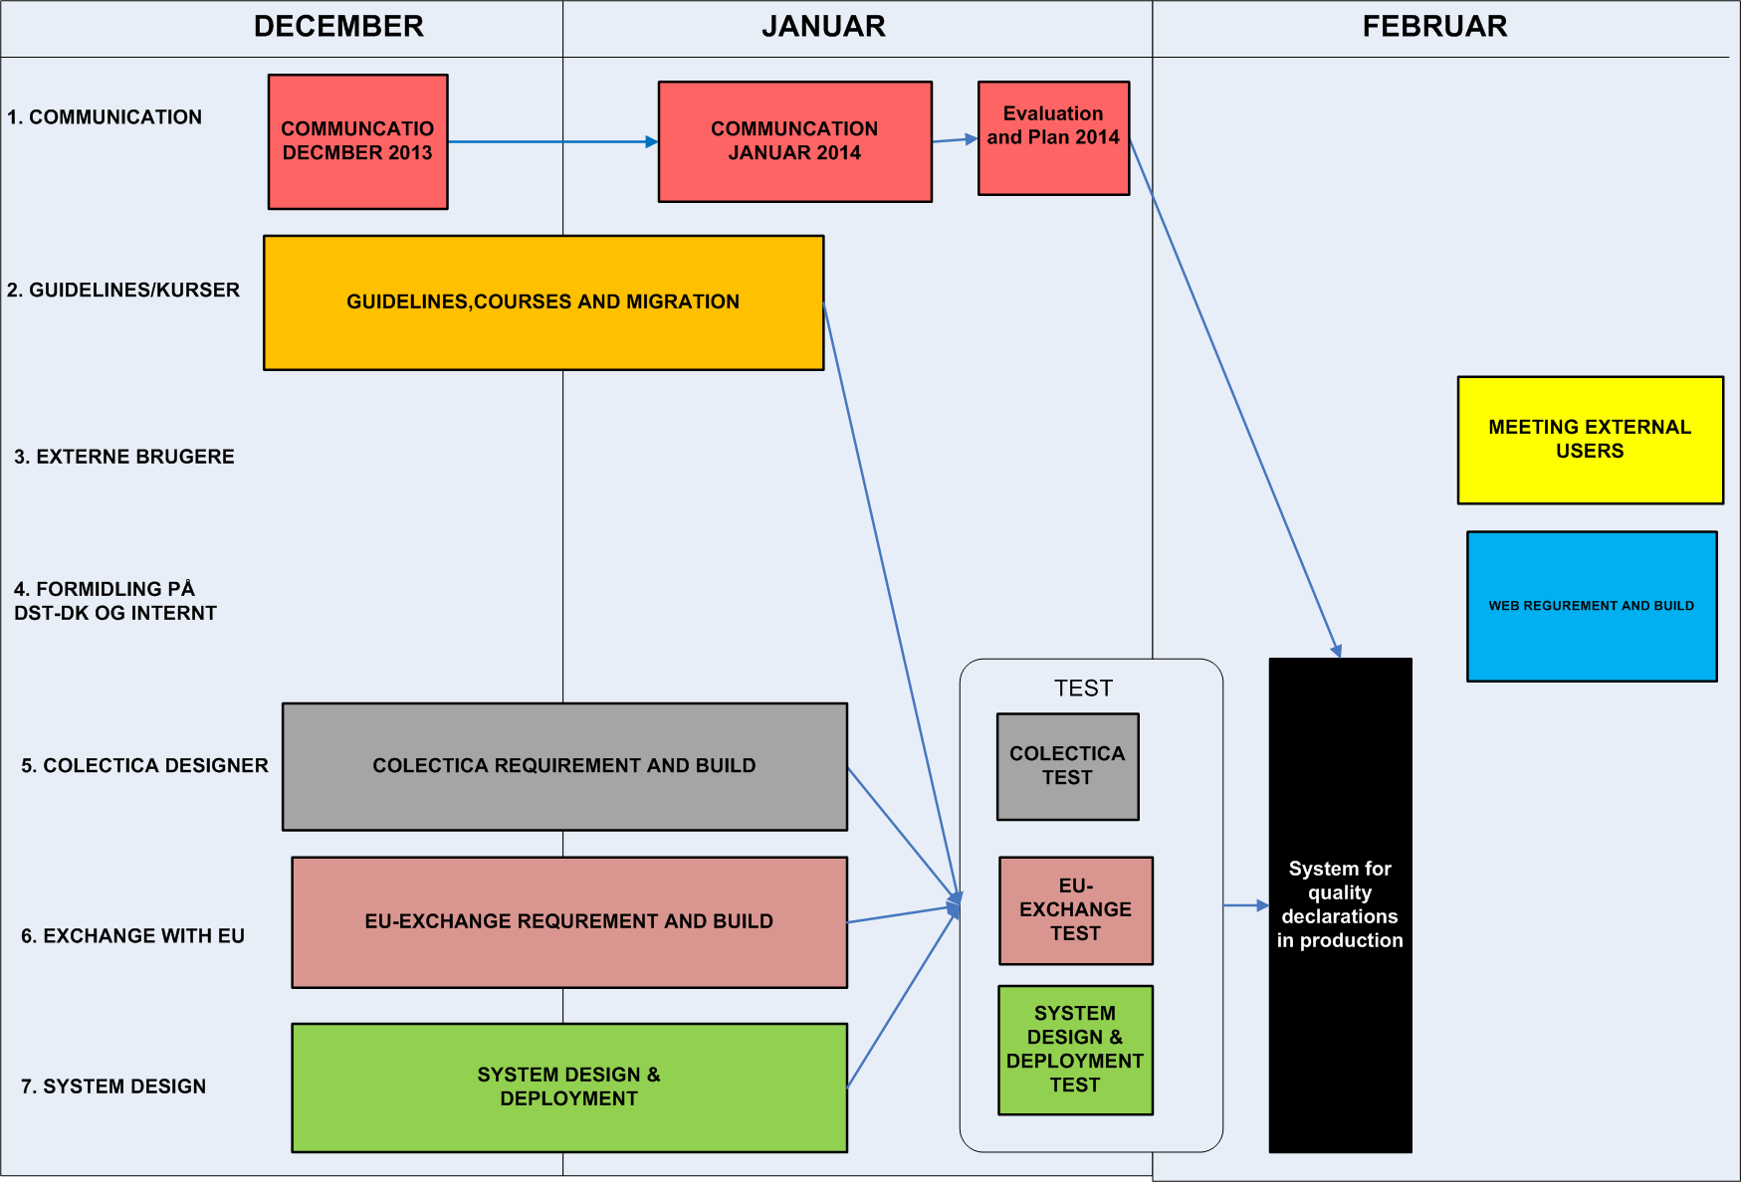
Plan: ult. November 2013 til primo februar 2014 – development and final test

Slide 14
IMPLEMENTATION USING COLECTICA

Slide 15
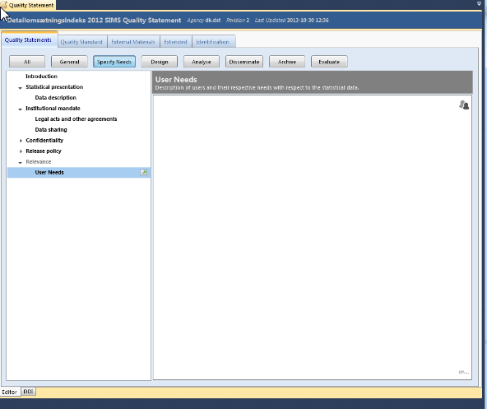
GSBPM put structure on and support the work-processes

Slide 16
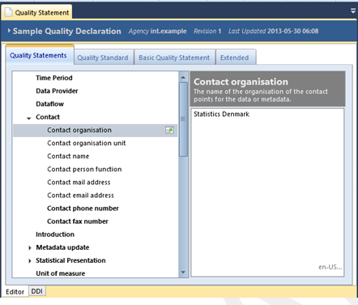
Reuse of metadata
Reuse as much as possible from existing metadata
  Concepts
  Coverage time
  Statistical population
  Contact information
  Release policy
  Etc

Slide 17
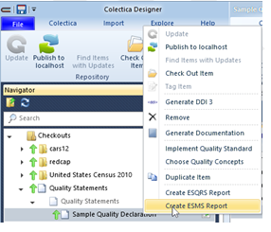
Generate reports with standard compliance
ESMS
ESQRS
SIMS
ESMS and ESQRS are reporting formats. SIMS is inventory of all quality-concepts

Slide 18
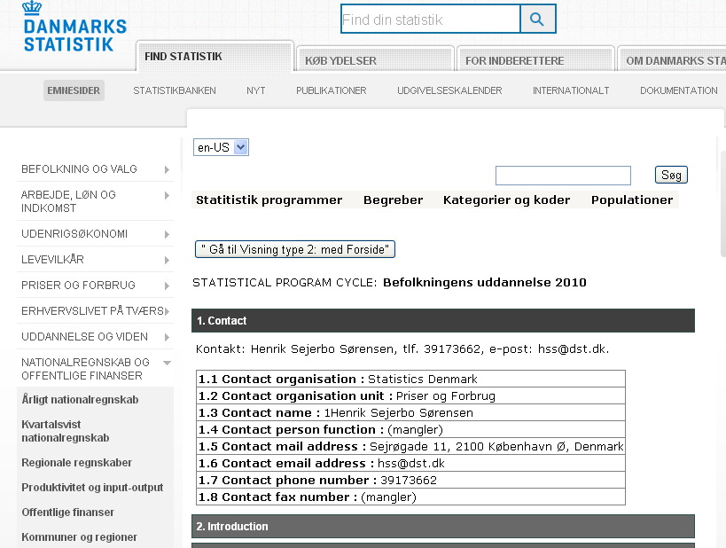
Customized presentation at dst.dk
Must support users business processes
Many views into quality declarations

Slide 19
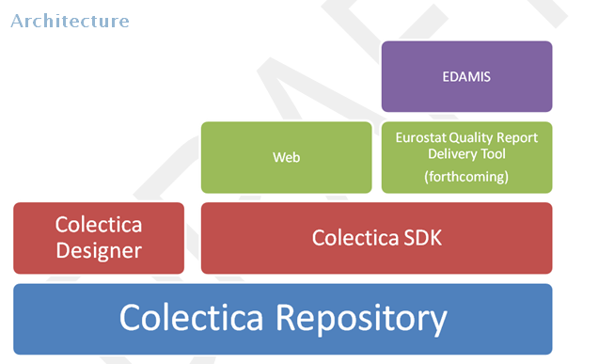
Software elements

Slide 20
Quality in DDI and SDMX
Define Eurostat SDMX quality concepts in DDI
Define QualityStandards for ESMS, ESQRS, SIMS
  QualityStandard = Concepts + Citation
DDI 3.2 QualityStatements

Slide 21
Quality in DDI and SDMX
Colectica Addins to pre-fill quality information
  Hardcoded information
  From local data sources
Generate SDMX reports based on QualityStatements

Slide 22
Plan for 2014
Overall strategy for GSBPM processes, quality and metadata
Work on migration of variables, classifications and concepts (including harmonization)
Pilot project on building a metadata-portal for DK

Slide 23





The End!

