Slide 1

RODA

Slide 2
RODA's Open-Source Web Platform for DDI
Adrian Dușa
Cosmin Rentea

Slide 3
Data & Metadata
RODA = Romanian Social Data Archive, Bucharest
Currently: less than 100 Codebooks (Nesstar) and associated datasets (SPSS)
Project Goals:
collect new data and metadata from Romanian public institutions and private organisations (doubling the archive contents after 2 years)
migrate existing data to DDI-Lifecycle

Slide 4
Software Solution
Open-source solution
Reusable extendable modules
Data Model implementing DDI-Codebook and a subset of DDI-Lifecycle
We are developing a multi-tier web application
Server: Java-based; Clients: JavaScript;
Complemented by other dedicated applications (CRM, DMS, Search)

Slide 5
Software Solution
Security-aware Application:
users, roles
multiple authentication methods
authorization (ACL)
possibility to use LDAP
Multiple persistence back-ends:
RDBMS
XML
File Storage
Indexing/Searching metadata
CESSDA requirements for future integration: Shibboleth authentication, harvester access

Slide 6
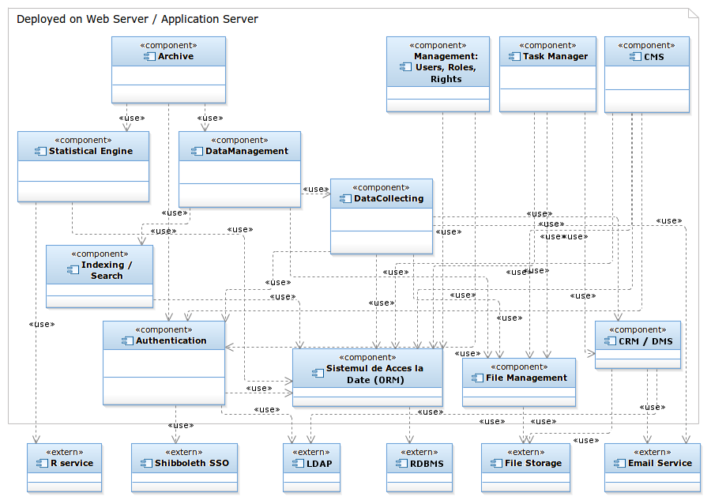
UML Component Diagram

Slide 7
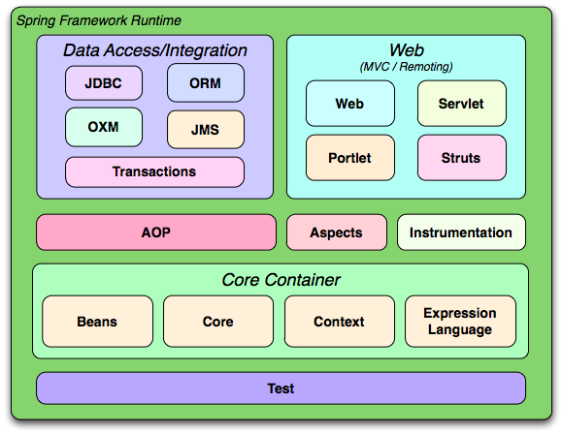
Spring Framework

Slide 8
Database
Database Schemas for
RODA Schema:
Studies and related concepts (methodology …)
Catalogs, Datasets, Variables, Questionnaires
Persons & Organizations
Geographical Info
Thesaurus (ELSST), Keywords, etc.
DDI original data
CMS
ACL
Versioning information
RDBMS choice: PostgreSQL

Slide 9
Components
Web U.I. – based on ExtJS
Task-Scheduling – using Spring
Data Versioning – using Hibernate Envers
Content repository – using JackRabbit for
Codebook-related files
CMS
Statistical module – using R

Slide 10
Components
Importer & Exporter – DDI data, other files (CSV, SQL, SPSS)
IMPORTER / EXPORTER
Object-to-XML Mapping
(OXM: JAXB)
Object-Relational Mapping
(ORM: Hibernate)
XML / DDI
RDBMS

Slide 11
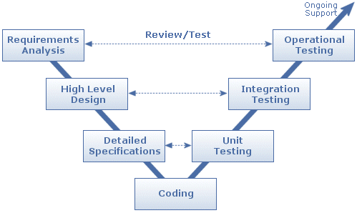
Quality Assurance
Tests
Unit Tests (JUnit)
Integration Tests
Spring Testing Framework
Selenium
Build manager
Maven
Continuous Build System
Jenkins
Version-Control
SVN private repository
(for the Archive’s data)
Github for code : https://github.com/cosminrentea/roda

Slide 12
Hardware used by the software platform
Storage Server
Database Server(s)
Web Server
Email Server
Backup Server
LDAP server
Workstations, Laptops, Tablets

Slide 13







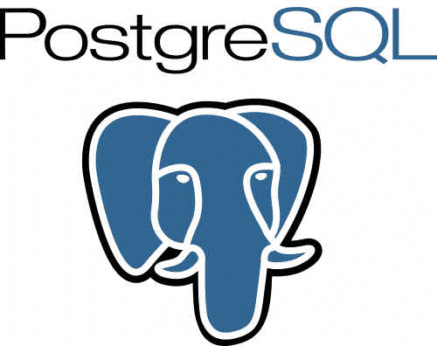

Technologies

Slide 14
Closing Remarks
RODA is dedicated to open-source software
Willingness to share, test, reuse, contribute
Modular application design
Data Model (Java) for DDI standards can be a shared asset
Many Components reusable for Social Sciences online platforms:
CMS, DMS, Task-Scheduling, DB Versioning, Importer/Exporter
We can later share the encountered issues & best practices in both software development and data migration process

Slide 15


