Slide 1
Encoding Provenance of Social Science Data: Integrating PROV with DDI
Carl Lagoze,¹ Jeremy Williams, ² Lars Vilhuber, ³ and William C. Block,²
¹ School of Information, University of Michigan
² Cornell Institute Social and Economic Research, Cornell University
³ Labor Dynamics Institute, Cornell University
Presentation at the 5th Annual European DDI User Conference (EDDI13)
Paris, France
4 December 2013

Slide 2
Outline
The Problem: replication vs. security
Background/Previous Work
Integrating PROV with DDI
Questions and Discussion

Slide 3
Our motivation: replication of research results critical to scientific advancement
Scientific Method 101: theory, hypothesis testing, replication
Data inputs, methods, and computation: all essential elements of the scientific approach
Encouraging: Increased interest in archiving scientific data inputs (e.g., academic journals, U.S. funding agencies, Data Management Plans, etc.)

Slide 4
Problem: Replication relies on good data curation (difficult in a secure environment)
By definition: Access is Restricted
Lack of data curation blocks future discovery and access
Replication of results becomes increasing difficult
Critically important! The Scientific Method depends on the ability to replicate the results of research

Slide 5
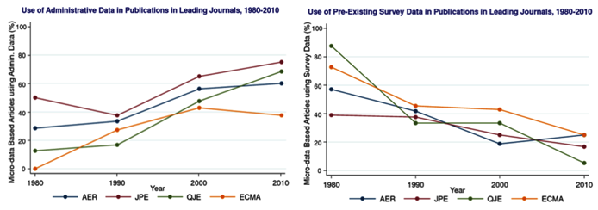
Increasing number of scholars pursuing research programs that mandate inherently identifiable data

Slide 6
Problem is not limited to economics and social science
“Many of the emerging ‘big data’ applications come from private sources that are inaccessible to other researchers. The data source may be hidden, compounding problems of verification, as well as concerns about the generality of the results.”
Huberman, Nature 482, 308 (16th February 2012)

Slide 7
Familiar problem to EDDI: examples from North America and Europe
North America:
U.S.: Census Bureau (including RDC), Internal Revenue Service, Bureau of Labor Statistics (confidential, public-use data)
Canada: Centre for Data Development and Economic Research (CDER: RDC-like for business data); Statistics Canada, Canadian RDC network
Europe:
France: R´eseau Quetelet, Centre d’acc´es s´ecuris ´e
distant aux donn´ees (CASD)
Germany: IAB

Slide 8
Solution: Comprehensive Extensible Data Documentation and Access Repository (CED²AR)
We develop the core of a method for solving the data archive
and curation problem that confronts the custodians of
restricted-access research data and the scientific users of such
data. Our solution recognizes the dual protections afforded by
physical security and access limitation protocols, and allows for
much improved provenance tracking.

Slide 9
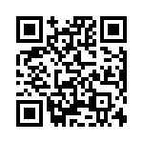
NSF-Census Research Network (NCRN) – Cornell Node (“Integrated Research Support, Training and Documentation”)
CED²AR is one part of this project
Funded by NSF Grant #1131848.
For more information, see www.ncrn.cornell.edu.

Slide 10
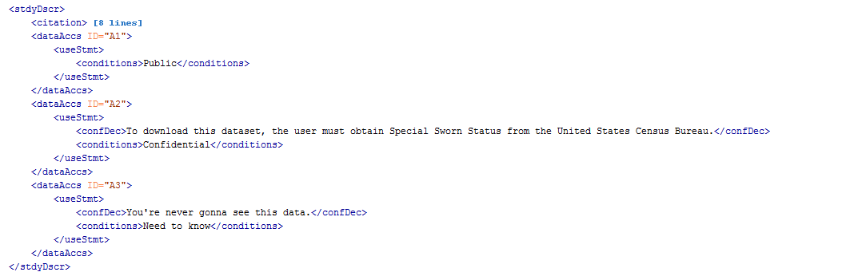
Proposed a <dataAccs> Solution at EDDI12 in Bergen
NCRN DDI Solution at the Variable Level: <dataAccs>
10
15

Slide 11
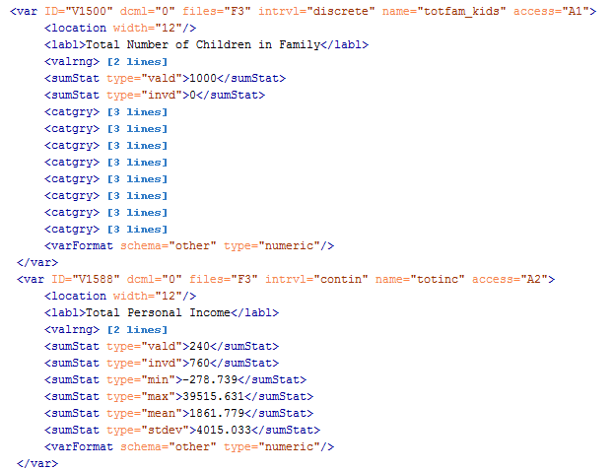
Variable Level Solution (continued)
11
Notes:
In this scenario, totfam_kids is public and totinc is confidential

Slide 12
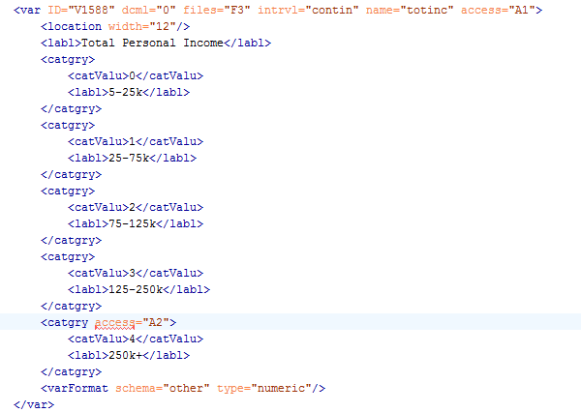
No DDI Solution at the level of a Value Label
Small tweak to the DDI Codebook Schema would fix this.
12
Notes:
Wouldn’t it be cool if we could make totinc public, but make certain value codes confidential (currently not possible to assign access id to catgry element in DDI 2.5)

Slide 13
<dataAccs> developments since EDDI12
In Lagoze, Block et.al. (2013) we more completely described
the solution for embedding field-specific and value-specific
cloaking in DDI Metadata*
Proposed formal change to DDI 2.5 (April 2013)
Brought modified “DDI 2.5.NCRN” schema online for testing
(Fall 2013)
Look forward to DDI Technical Implementation Committee
taking up our proposal; we have learned a lot since EDDI12
*Lagoze, C., Block, W., Williams, J., Abowd, J. M., & Vilhuber, L. (2013). Data Management of Confidential
Data. In International Data Curation Conference. Amsterdam.
13
Notes:
Wouldn’t it be cool if we could make totinc public, but make certain value codes confidential (currently not possible to assign access id to catgry element in DDI 2.5)

Slide 14
Provenance
“data provenance, one kind of metadata, pertains to the derivation history of a data product starting from its original sources” [...] “from it, one can ascertain the quality of the data base and its ancestral data and derivations, track back sources of errors, allow automated reenactment of derivations to update the data, and provide attribution of data sources”*
*Simmhan, Plale, and Gannon, “A survey of data provenance in e-science,” ACM Sigmod Record, 2005
14

Slide 15
Provenance and Metadata
Not (currently) a “native” component of DDI, closest thing is:
<xs:complexType name="othrStdyMatType">
<xs:complexContent>
<xs:extension base="baseElementType">
<xs:sequence>
<xs:element ref="relMat" minOccurs="0" maxOccurs="unbounded"/>
<xs:element ref="relStdy" minOccurs="0" maxOccurs="unbounded"/>
<xs:element ref="relPubl" minOccurs="0" maxOccurs="unbounded"/>
<xs:element ref="othRefs" minOccurs="0" maxOccurs="unbounded"/>
</xs:sequence>
</xs:extension>
</xs:complexContent>
</xs:complexType>
Downside: No structure. Mostly verbose entries.

Slide 16
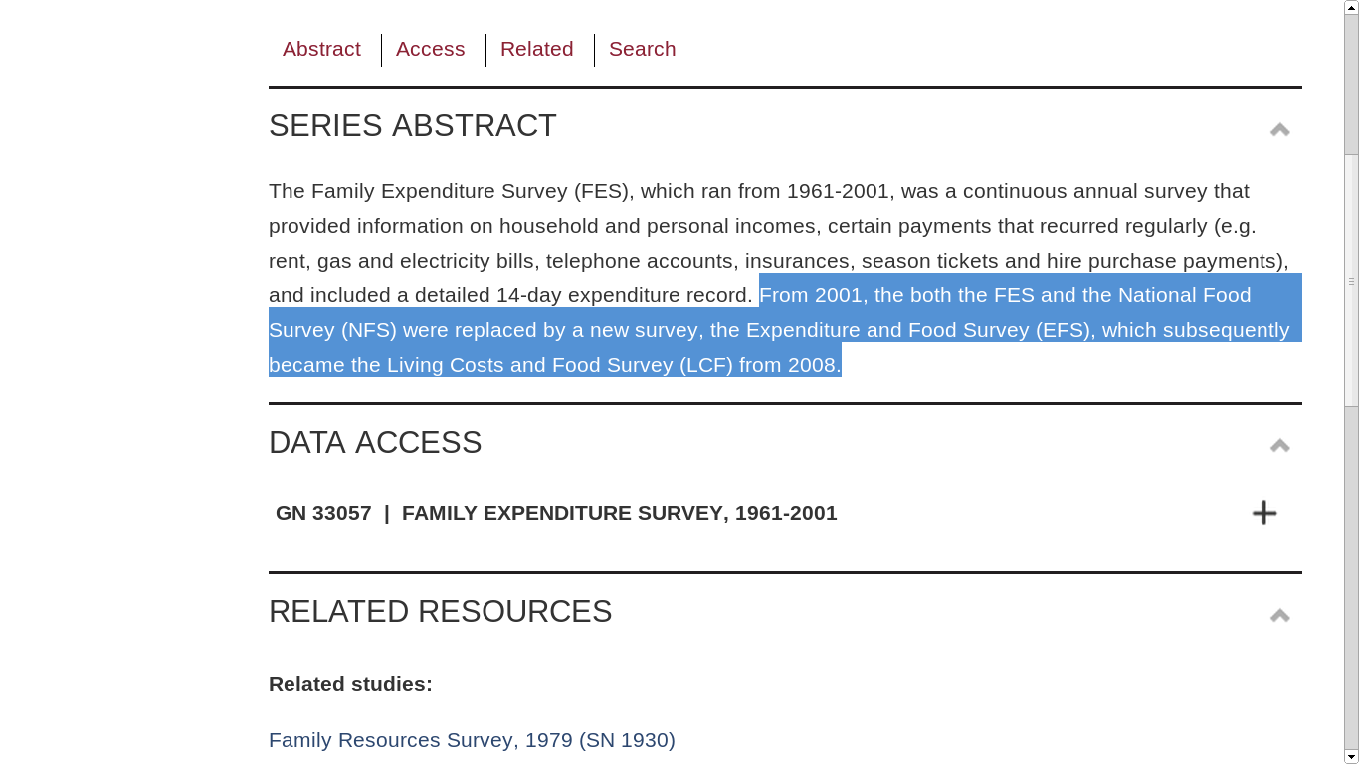
Provenance example from the UK Data Archive

Slide 17
Earlier 2013 work (Lagoze, Williams, et. al) explored encoding PROV in RDF/XML*
Required use of CDATA tag to avoid interfering with schema compliance; deemed less promising
Interested in the RDF encoding for DDI effort (e.g., Bosch, Cyganiak, Gregory, and Wackerow 2013)**
*Lagoze, C., Williams, J., & Vilhuber, L. (2013). Encoding Provenance Metadata for Social Science Datasets. In 7th Metadata and Semantics Research Conference. Thessaloniki.
**Bosch, T., Cyganiak, R., Gregory, A., & Wackerow, J. (2013). DDI-RDF Discovery Vocabulary: A Metadata Vocabulary for Documenting Research and Survey Data. In Linked Data on the Web Workshop. Rio de Janeiro

Slide 18
More recently: exploring W3C PROV Model as basis
for encoding provenance metadata in DDI
W3C PROV Model is based upon:
entities that are physical, digital, and conceptual things in
the world;
activities that are dynamic aspects of the world that change and create entities; and
agents that are responsible for activities.
A set of relationships that can exist between them that express attribution, delegation, derivation, etc.

Slide 19
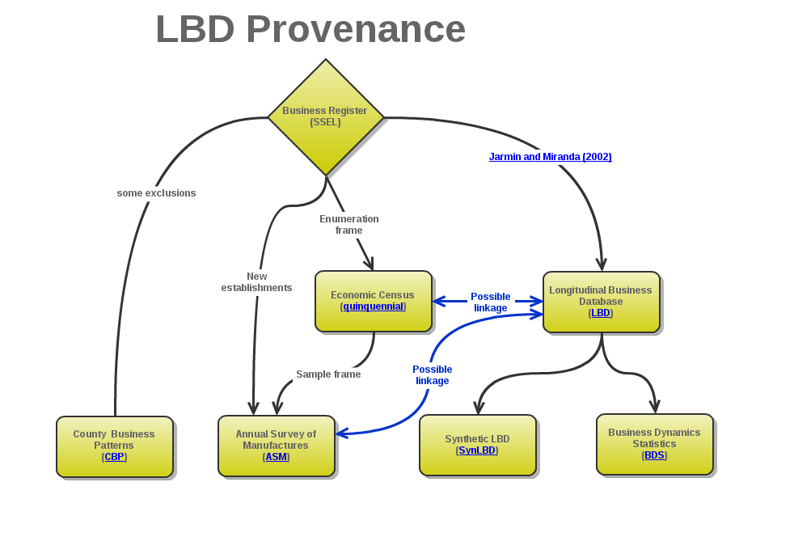
Provenance of Longitudinal Business Database (LBD)

Slide 20
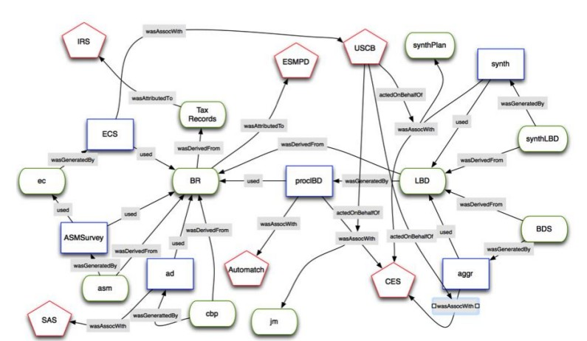
LBD Provenance expressed in PROV
Oval Nodes: Entities
Rectangular Nodes: Activities
Pentangular Nodes: Agents

Slide 21
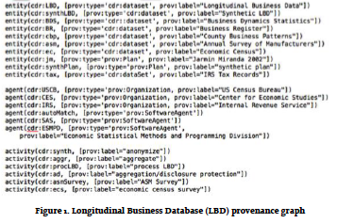
LBD Provenance expressed in PROV
Oval Nodes: Entities
Rectangular Nodes: Activities
Pentangular Nodes: Agents

Slide 22
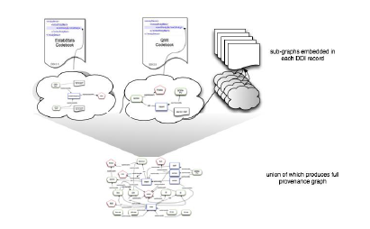
Modular Approach; Stitching Provenance Bundles together
Provenance subgraph “bundles” link, by resource, to other subgraphs
Allows dynamic generation of entire provenance graph

Slide 23
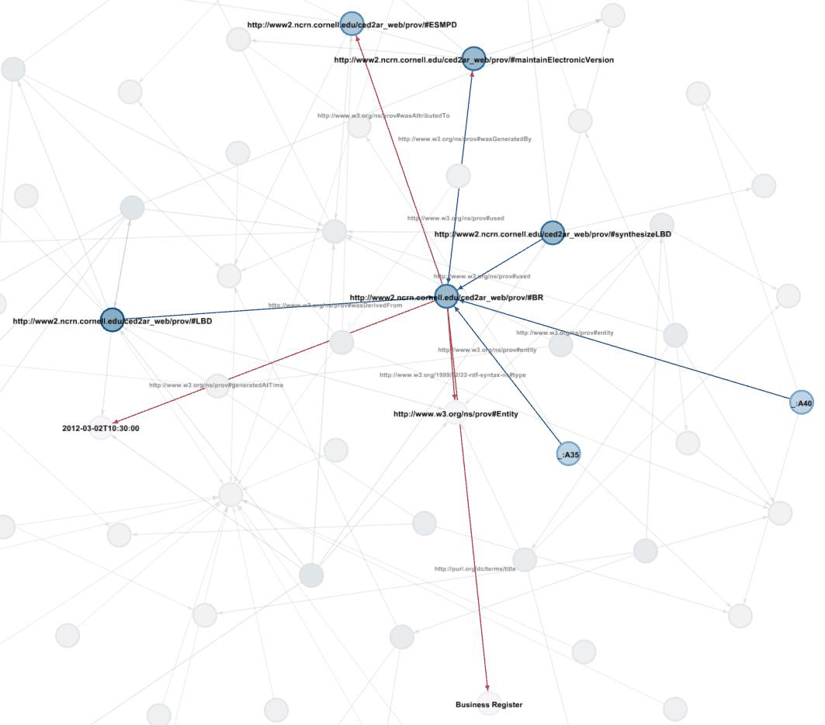
Future Work: User Visualization and Exploration
of Provenance Graphs
Draft release early 2014
Look forward to continued interaction with DDI community as we continue to refine CED²AR

Slide 24
Merci!
Questions?
block@cornell.edu
ncrn.cornell.edu

