Slide 1
DwB Discovery Portal A New CESSDA Portal for European Research Data Discovery
John Shepherdson - UKDA
Pascal Heus - Metadata Technology
Ørnulf Risnes - NSD

Slide 2
Overview
Supports DwB goal “equal and easy access to official microdata for the European Research Area”
provides “more coherent system for resource discovery of official statistics”
demonstrates ability to ingest metadata from multiple sources, via multiple protocols

Slide 3
Scope of the portal
Content-wise
Metadata from NSIs + Archives
Technical
Build prototype/beta
Sound, future proof methods, architecture, components
Standards-based
Extensible
Easy to handover to ‘sustainability’ body

Slide 4
Aspects of the portal
Research data discovery (obviously)
Provider portal, QA
Platform for additional services

Slide 5
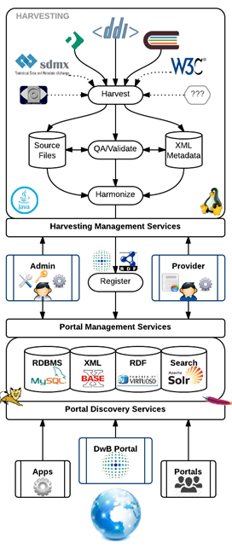
Metadata ingest
Metadata gets...
harvested
made ready for QA
transformed into canonical model
indexed
exposed

Slide 6
Canonical metadata model
Harmonisation
DDI-C, DDI-L, MISSY, CIMES, etc
Builds on DISCO
(DDI discovery RDF)

Slide 7
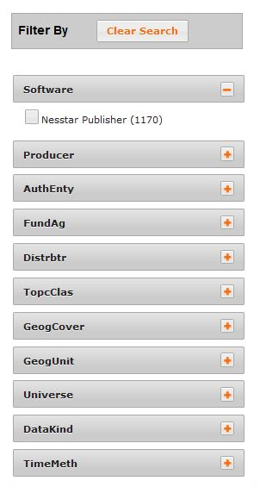
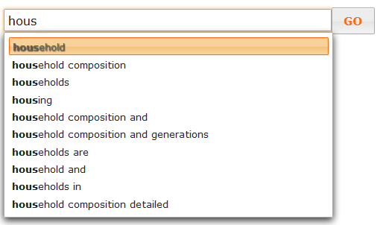
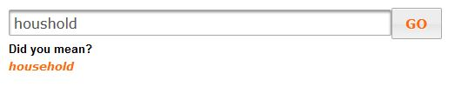
Research data discovery
Powered by Solr
Facets
producer, geography, date, data type ...
Suggestions / autocomplete
‘Did you mean?’ functionality

Slide 8
Provider portal, QA
Quality reports on own metadata
Tools to improve quality
Tools to improve quality
Version control of metadata (optional)
Profile and visibility management

Slide 9
Platform for services
DwB search portal is just a front-end application
Machine-actionable interfaces for most functions

Slide 10
What Next?
Integrate ELSST multi-lingual thesaurus
expansion of queries
14 languages, synonyms/ broader/ narrower terms
Pre-harvest preparation tools
based on e.g. DataForge:SledgeHammer

Slide 11
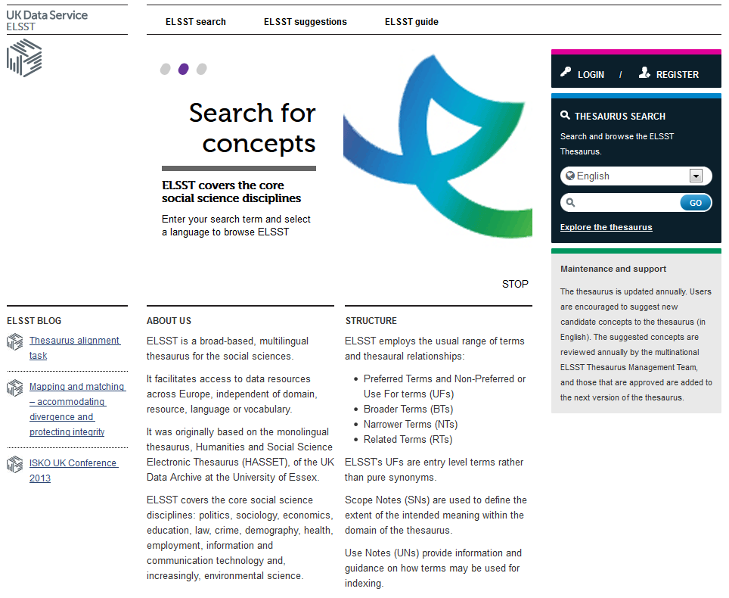
ELSST

Slide 12
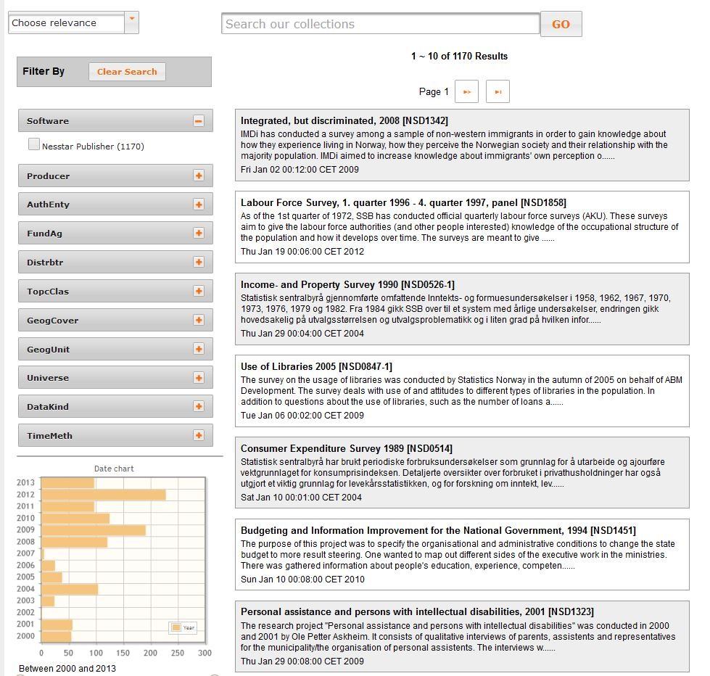
Questions?

