Slide 1
To 3.2 or Not to 3.2? That is the Question
Wendy Thomas
(Minnesota Population Center)
Jon Johnson
(Centre for Longitudinal Studies, London)
EDDI 2013

Slide 2
“Whether ‘tis nobler in the mind to suffer the slings and arrows…”*
There’s a new model driven DDI version already in the works. Shouldn’t I just wait for this?
The work on version 4 just started and while there will be packages coming out during the 18 month development period the full functionality of this won’t be available until the work is complete.
There’s so many changes and I’ve got software for 3.1. Do I want to go through the pain of change?
Probably not. If what you have works, stick with it. But pay attention to some changes in 3.2 that will facilitate work with later models.
What took so long? I really need 3.2 to do my work!
If you need the new functionality SWITCH!
*Shakespeare’s Hamlet (Act 3 Scene 1)

Slide 3
There’s so many changes and I’ve got software for 3.1. Do I want to go through the pain of change?

Slide 4
“And makes us rather bear those ills we have, Than fly to others that we know not of.”*
Bundling language equivalents in a single element
Representations and missing values
Managing identification content
Name clashes
New Code Value Types
*Shakespeare’s Hamlet (Act 3 Scene 1)

Slide 5
“And makes us rather bear those ills we have, Than fly to others that we know not of.”*
Bundling language equivalents in a single element
Make sure multiple language content is complete
Note where cardinality has been constrained in 3.2
Loss of Identified Structured String – when multiple languages are involved
Representations and missing values
Managing identification content
Name clashes
New Code Value Types
*Shakespeare’s Hamlet (Act 3 Scene 1)

Slide 6
“And makes us rather bear those ills we have, Than fly to others that we know not of.”*
Bundling language equivalents in a single element
Representations and missing values
Valid and Invalid (Missing) Values are handled separately in 3.2 – and probably into the future
Create CodeSchemes that combine a CodeScheme of valid values and a CodeScheme of invalid (missing) values
Managed Representations (Numeric, Text, DateTime,…)
Managing identification content
Name clashes
New Code Value Types
*Shakespeare’s Hamlet (Act 3 Scene 1)

Slide 7
“And makes us rather bear those ills we have, Than fly to others that we know not of.”*
Bundling language equivalents in a single element
Representations and missing values
Managing identification content
Use URN’s! This is the only place where all the content of the full object identification can be expressed for Identifiable and Versionable types
Name clashes
New Code Value Types
*Shakespeare’s Hamlet (Act 3 Scene 1)

Slide 8
“And makes us rather bear those ills we have, Than fly to others that we know not of.”*
Bundling language equivalents in a single element
Representations and missing values
Managing identification content
Name clashes
Note where object names are changing (these may be namespace specific)
New Code Value Types
*Shakespeare’s Hamlet (Act 3 Scene 1)

Slide 9
“And makes us rather bear those ills we have, Than fly to others that we know not of.”*
Bundling language equivalents in a single element
Representations and missing values
Managing identification content
Name clashes
New Code Value Types
Many attributes were changed to elements to support external controlled vocabularies (CodeValueType)
Constrain current content of these fields to values you plan to provide in an external controlled vocabulary
*Shakespeare’s Hamlet (Act 3 Scene 1)

Slide 10
What took so long? I really need 3.2 to do my work!

Slide 11
“'Tis a consummation Devoutly to be wished.”*
Complex Questionnaires
Question Grids and Question Blocks
Data Processing
New representations and response domains
Concept Management
Conceptual modeling
Managed representations and missing (invalid) values
Content Management
Quality and authority statements
Reorganizing Organizations and Individuals
Archiving submitted content
Consistency
Multilanguage content
Geographic content consistency
Scheme structure consistency
*Shakespeare’s Hamlet (Act 3 Scene 1)

Slide 12
Complex Questionnaires
The primary reason for using 3.2
Complex questionnaires are defined as those using:
Complex Question Grids
Question Blocks - where a set of questions are related to a specific stimulus item (common in educational testing)
Need for a broader set of response domains
Scales, capturing a mark on an object, geographic codes, ranking, distribution, etc.
Complex routing and reuse of data for calculations
Incorporating pre-loaded content
Extensive use of response information to inform the content of dynamic text
Data validation done during the collection process

Slide 13
3.1 Multiple Question Item
Did you visit any one of the following performances or facilities over the past 12 months?
(Circle the correct response for each)
Yes No a theatre performance
Yes No a cabaret performance
Yes No a concert of classical music
Yes No an opera or operetta
Yes No a concert of popular music, pop, jazz, musical or pop
opera
Yes No a 'dance' event, houseparty
Yes No a ballet performance
Yes No the cinema
Yes No an art gallery
Yes No a museum

Slide 14
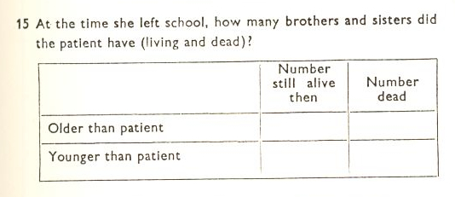
Simple Grid
Question Block example (PISA)
Source: British Perinatal Mortality Study (1958)

Slide 15
Example of a simple grid
<d:QuestionGrid versionDate="2013-11-20T12:09:32+00:00">
<r:ID>qg1</r:ID>
<d:QuestionGridName>
<r:String xml:lang="en-GB">butler15</r:String>
</d:QuestionGridName>
<d:QuestionText>
</d:QuestionText>
<d:QuestionIntent xml:lang="en-GB">number of siblings</d:QuestionIntent>
<d:GridDimension rank="1" displayCode="false" displayLabel="false">
<d:CodeDomain>
<r:CodeListReference>
<r:ID>cl1</r:ID>
</r:CodeListReference>
</d:CodeDomain>
</d:GridDimension>
<d:GridDimension rank="2" displayCode="false" displayLabel="false">
<d:CodeDomain>
<r:CodeListReference>
<r:ID>cl2</r:ID>
</r:CodeListReference>
</d:CodeDomain>
</d:GridDimension>
<d:NumericDomainReference>
<r:ID>n1</r:ID>
<r:TypeOfObject>ManagedNumericRepresentation</r:TypeOfObject>
</d:NumericDomainReference>
</d:QuestionGrid>
Source: British Perinatal Mortality Study (1958)

Slide 16
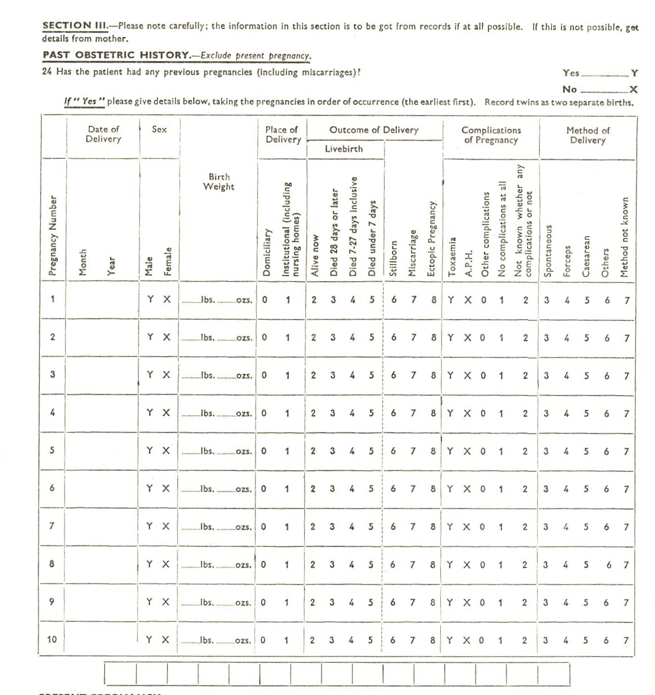
Complex Grid
Scales, etc.
Source: British Perinatal Mortality Study (1958)

Slide 17
Question Grids with Roster
14. Please write down the names of the places you stayed overnight and the duration of the stays in chronological order separately.
Places you stayed overnight in chronological order |  |  | Type of accommodation for overnight stays (Please specify the number of nights)
 | Name of the place (City, town, etc.) | Total number of nights | Hotel | Motel | Holiday village | Pension | Camp/ Caravan | Youth And Holiday Camp | Own House | Rented House | House of a relative or friend | In the vehicle (Cruise, Yacht, Train, TIR) | Other (Please specify) (…………………..........)
 |  |  | 01 | 02 | 03 | 04 | 05 | 06 | 07 | 08 | 09 | 10 | 11
...... | ............... | ................ | ......... | ......... | ......... | ......... | ...... | ........... | ......... | ......... | ......... | ........... | .....................................
...... | ............... | ................ | ......... | ......... | ......... | ......... | ...... | ........... | ......... | ......... | ......... | ........... | ....................................
...... | ............... | ................ | ......... | ......... | ......... | ......... | ...... | ........... | ......... | ......... | ......... | ........... | .....................................
...... | ............... | ................ | ......... | ......... | ......... | ......... | ...... | ........... | ......... | ......... | ......... | ........... | .....................................
(Go to Question 15) (Go to Question 17)
Source: TURKSTAT Tourism Survey

Slide 18
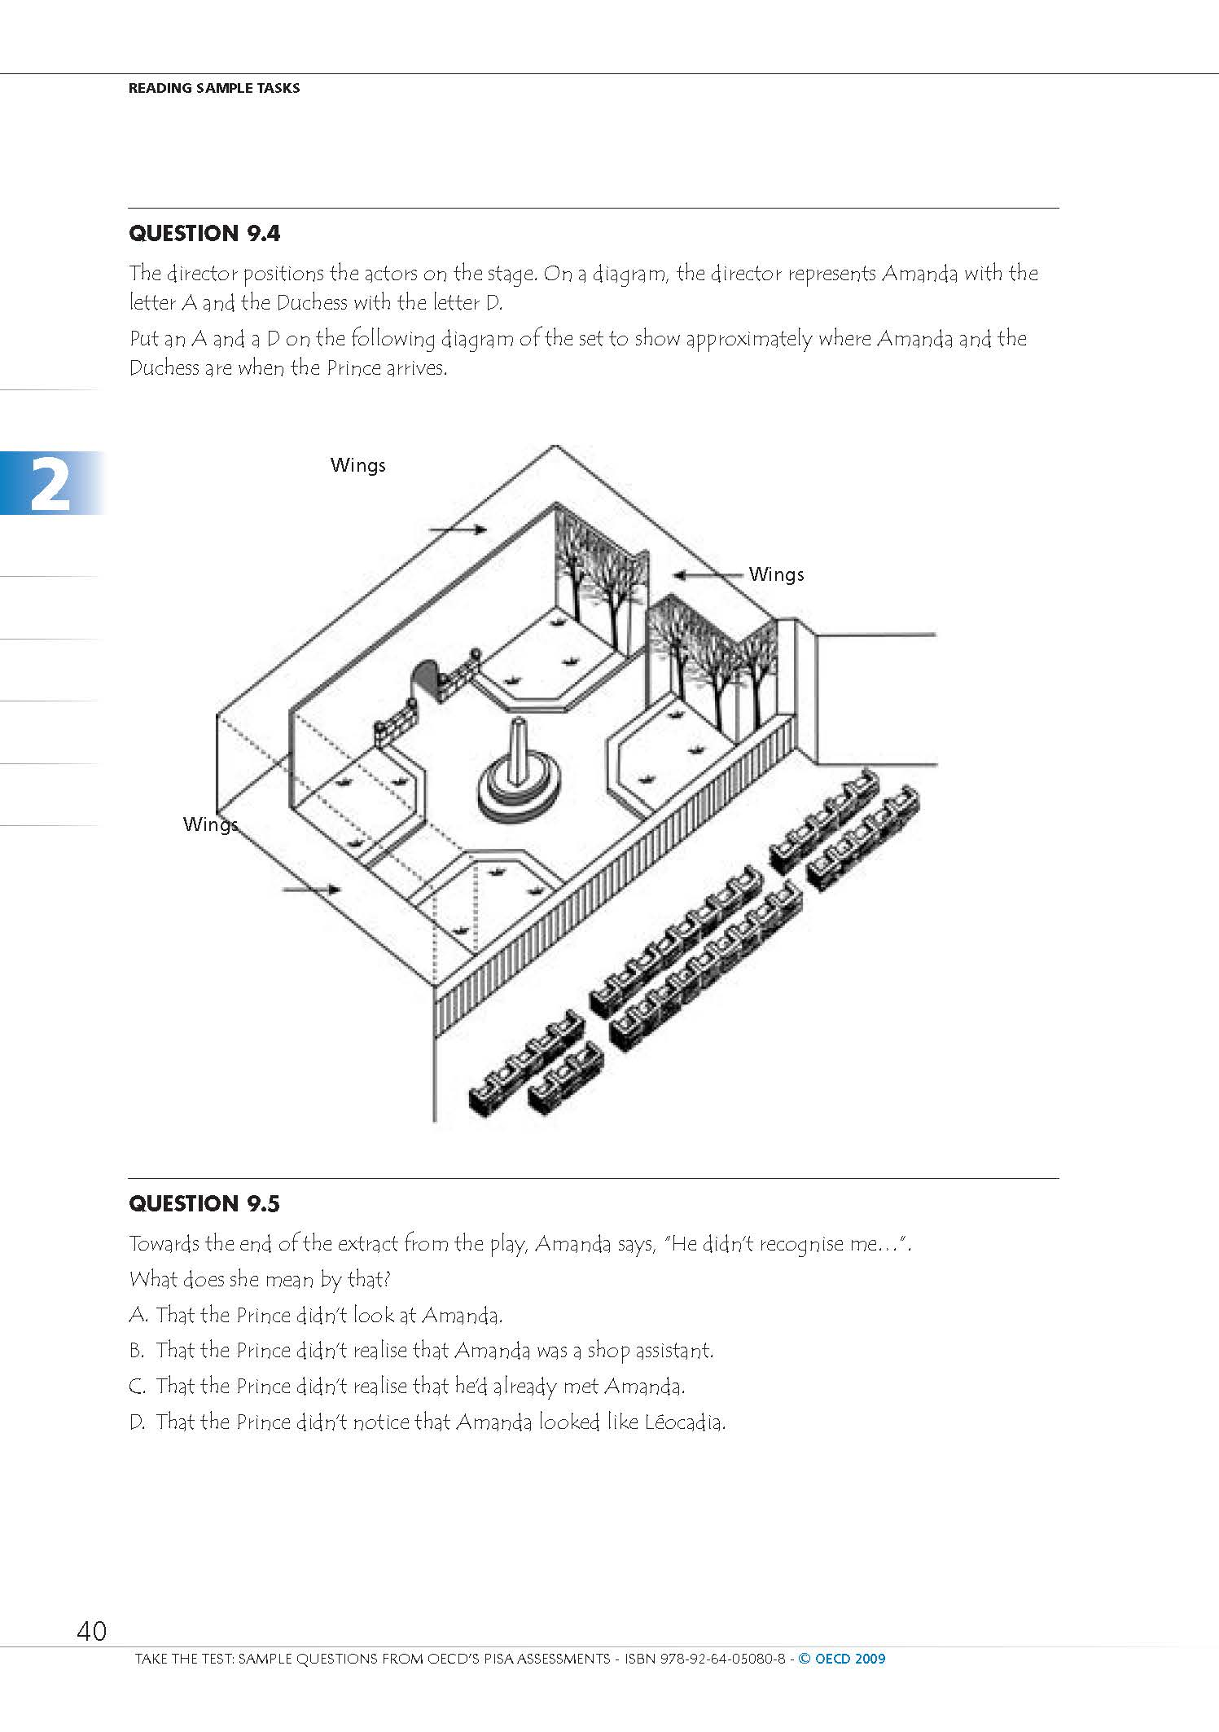
Question
Block

Slide 19
More Response Domains
Location of marks on an image or recording
Nominal level (for grids – checked or unchecked)
Ranking (place categories in a specific order)
Distribution (distribute a total value among a number of categories)
Direct use of Geographic Structure and Location Codes
Scales (anchored, unanchored, with/without a continuous line, etc.)

Slide 20
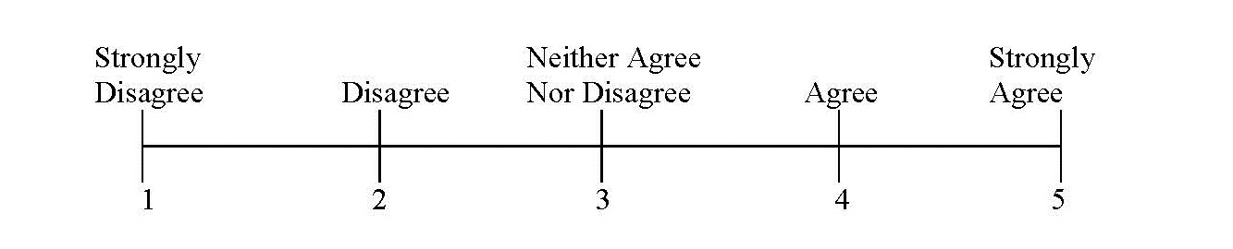
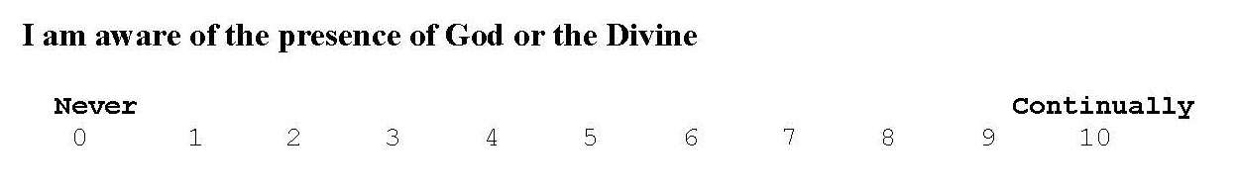
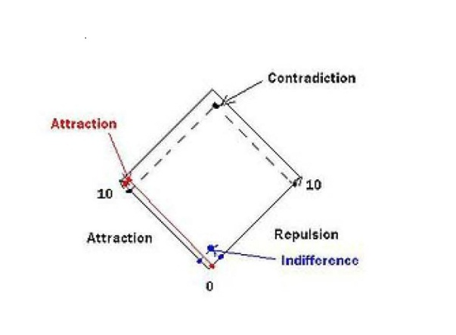
Scales

Slide 21
Concept Management
DDI is not fully there but 3.2 dramatically improves support for concept management and expression
Alignment with GSIM content regarding Concepts, Conceptual Variables, and Represented Variables
Managed representations allow numeric, textual, datatime and other representations to be captured once and reused
BONUS: managed representations can be mapped for comparison, i.e. a numeric representation of age to a coded set of age cohorts

Slide 22
Conceptual Variable
Universe
Concept
Represented Variable
Value Representation
Category Scheme
Code Representation
Described representation

Slide 23
Content Management: Quality
Capture information on Quality Frameworks, Quality Standards, and other means of assuring the quality of the data, metadata, and process.
Quality statements can be referenced from many levels within DDI
Additional content to reflect authorization, legal status, budget, and evaluation procedures have been added

Slide 24
Content Management: Actors
Organization Scheme content has been cleaned up and stripped down
Organization and Individual information can be better managed over time (specific contact information is time stamped, etc.)
Relationships between any two Organizations and/or Individuals is tracked separately under “Relation”. Roles are assigned as part of the Relation
Locations in DDI where names are associated with specific roles within the context of the Study can now reference an Individual or Organization

Slide 25
Content Management: Archiving
Supports inclusion of all major packaging types as submitted (deposited) content (StudyUnit, Group, ResourcePackage)
Supports Local Added Content of all packaging types
Links Local Added Content to Submitted (Deposited) content by mapping
Local Object Reference
Depository Object Reference
Relationship Action (CodeValueType) i.e. Overides, Deletes, Extends, Restricts, etc.
Description

Slide 26
Language Consistency
Bundling equivalent content expressed in multiple languages
<r:Label xml:lang=“en”>What is it?</r:Label>
<r:Label xml:lang=“de”>Was ist das?</r:Label>
<r:Label>
<r:String xml:lang=“en”>What is it?</r:String>
<r:String xml:lang=“de”>Was ist das?</r:String>
</r:Label>

Slide 27
Geographic content consistency
Added composite geographies (Metropolitan Areas – composite of counties)
Improved management of geographic change over time
Added ability to use geographic structures (names and codes) and geographic locations (names and codes) directly as representations or response domains
Added ability to reference specific locations for the purpose of defining Spatial Coverage

Slide 28
Scheme structure consistency
All schemes have the following structural features
XxxxSchemeName, Label, Description
Inclusion of a scheme by reference
Object type included in-line or by reference
Object Group included in-line or by reference
All schemes have an XxxxGroup to support grouping for administrative or conceptual purposes
XxxxGroupName, Label, Description, and TypeOfXxxxGroup
Universe and Concept references
Subject and Keyword
Group and object included by reference

Slide 29
What if I’m just starting out?
A number of new tools are already available for 3.2
Colectica
Rogatus Platform
If DDI-C or DDI-L 3.1 does it for you and there are tools to support your work, USE THEM
But….pay attention to the consistency changes made in 3.2 to make your work easy to migrate forward. These changes were made in anticipation of future version needs.

Slide 30
Questions?
Technical Committee – ddi-srg@icpsr.umich.edu

