Slide 1
Harmonizing Between Different Agencies Using DDI Profiles
EDDI 2013
04.12.2013, Paris
David Schiller, IAB
Ingo Barkow, DIPF
Marcel Hebing, DIW

Slide 2
Outline
When developing software for data documentation one has to think about how to incorporate the DDI standard
DDI-L 3.1 is a powerful standard that can support sophisticated data models and data production modes
At the same time software needs to be manageable and adjusted to the given institution

Slide 3
DDI-L - considerations
DDI Lifecycle 3.1 / 3.2
XML Schema
DDI 3.1 – about 900 main elements
DDI 3.2 – about 1150 main elements
Each element might contain a number of sub-elements
Some elements are quite domain specific
High degree of complexity
Number of mandatory element quite low due to the demands of different organizations or domains

Slide 4
Challenge when building tools
Normally there is only a need for 50-60 main elements for a given survey or organisation
But not always for the same 50-60 main elements
Huge challenge when building software tools
Especially when it is about DDI import and export functionalities
The results are likely not interoperable solutions

Slide 5
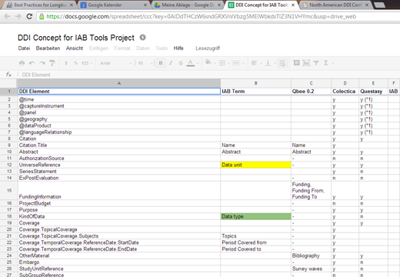
Example from the IAB Metadata project

Slide 6
Solution DDI Profiles by “topic”
Creating of DDI Profiles is described in an article from 2010
The idea is to not have individual profiles but standardized profiles by “topics”
Examples of topics may include: “survey design”, “data collection” or more specific “administrative data”; what else?
Institutions can than choose the needed profiles for their institution and be interoperable with others

Slide 7
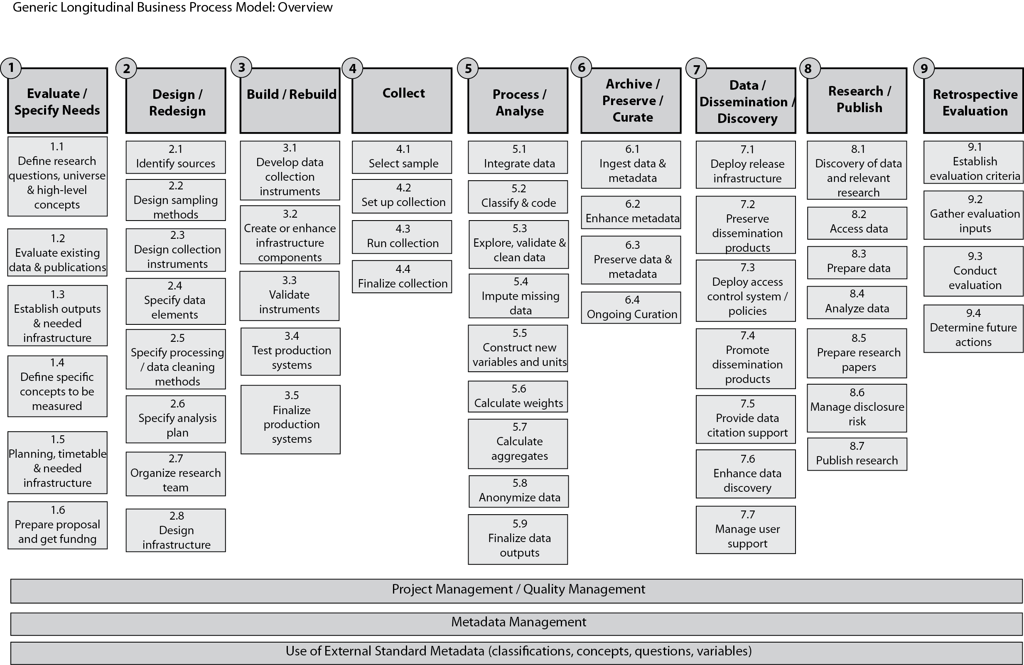
Creating profiles – GLBPM

Slide 8
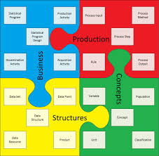
Creating profiles – GSIM
Create profiles related to the business objects in GSIM (ABS)

Slide 9
Creating profiles – product view
Requirement for "product-specific" exchange formats
Dataset description standard (like DDI-C, but with DDI-L elements)
Questionnaire description standard
Concept vocabulary standard
→ Potential to create those product-specific standards as DDI Profiles

Slide 10
Standard DDI profiles: Main goals
Standard DDI profiles should cover the most used DDI elements by topics
Agencies can choose from those profiles
This will lead to an harmonized use of DDI
And to easier exchange between tools and agencies

Slide 11
Summary
Different approaches to create standard profiles
Institutional view (e.g. IAB needs), conceptual view (GLBPM, GSIM), product view (questionnaire, etc.)
Goal is:
to make DDI-L manageable and
to ensure exchange possibilities between different software (harmonization between agencies)
to prepare shift to DDI-L 4.0
Useful standard DDI-L profiles need to be discussed and agreed on

Slide 12
Thank you for your attention
david.schiller@iab.de
barkow@dipf.de
marcel@ddionrails.org
http://fdz.iab.de
http://www.dipf.de
http://www.diw.de

