Slide 1
Proposing a Metadata Solution over Multiple RDCs in the German Context
EDDI 2013
03.12.2013, Paris
David Schiller, IAB
Ingo Barkow, DIPF

Slide 2
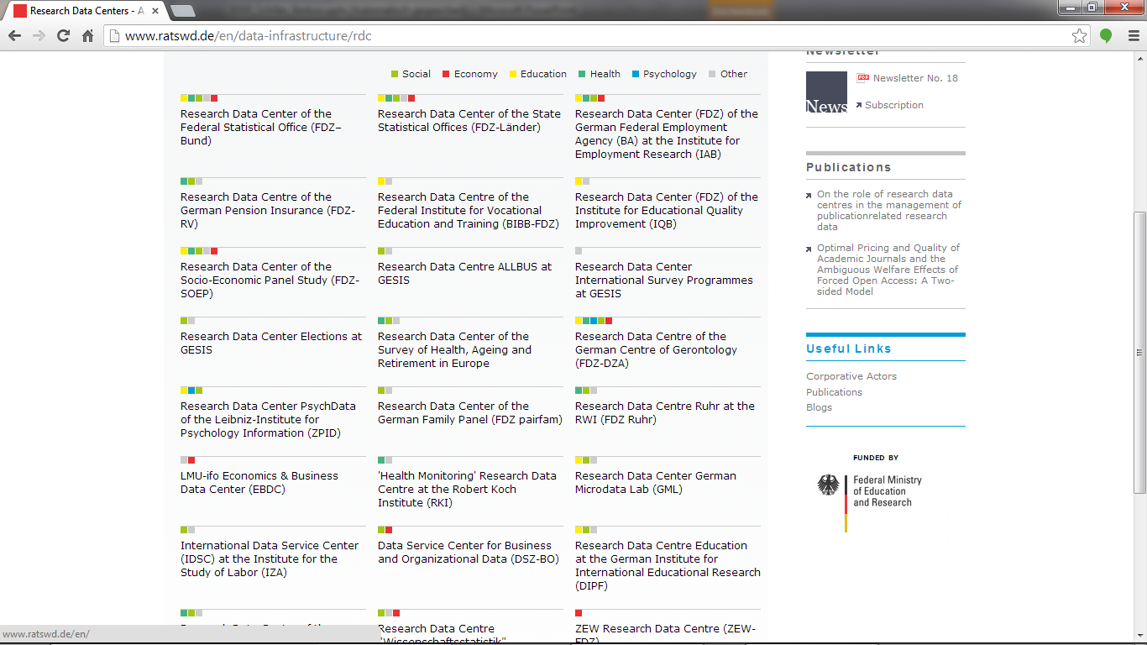
A wide range of data – the German context

Slide 3
Research Data Centre in Germany
Due to legislation, data has to be made available for scientific research
The German Data Forum (for social sciences) accredits Research Data Centre
Currently there are 26 Research Data Centre
They offer a wide range of data
Social, Education, Economy, Health, Psychology, etc.
Survey data and administrative data

Slide 4
The good and the evil
Data is there:
26 organizations offer data for scientific research
They create or extract it and prepare it for research
According to that they are the experts for their data
But what data is exactly where and how can it be reached?
26 website offer information to the researcher
They have different structures and explain different things
They are not connected in a structured way

Slide 5
Researcher needs
Researchers have to be supported in the way they work.
First an idea for a research topic originates
Then they look for appropriate data
E.g. content, “power” of data; how to work with it
If they cannot find the information easily, they will likely skip the planned project
A waste of the 26 data sources

Slide 6
Needs of data owners and funding bodies
Data owners are normally experts in creating or extracting their data
They are not all experts in data documentation
Therefore they at least need tools to guide them through the documentation process
Funding bodies are not interested in sponsoring 26 more or less equivalent infrastructures
They are interested in cheap and efficient approaches

Slide 7
Single point for information
The best thing would be one single point for all the needed information about research data
Within this point the researcher can search in a structured way for:
Available data by topics
Detailed information about content and quality on variable level
Possibilities to combine data sources
Circumstances for accreditation and accessing data

Slide 8
Standard documentation
Such a single point can only be established by using a standardized way of data documentation
First for the researchers to easily understand it
Second for the data owner to easily create it
Third for different tools to easily “work” with the documentation
Thereby researchers and data owner shouldn’t have to learn the documentation structure in the background, the tools should help them in an enjoyable way.

Slide 9
Obstacles
No commonly used standard (DDI 20%); needs are
Standard, i.e. not moving to upgrades to often
Manageable coverage (profiles)
Practical exchange and storage format
No central platform or access point in place
No mechanism to pool (harvesting etc.) the documentations
No organizational structure to node the data owners to a central platform

Slide 10
Ways to go
DDI must proof that it is a practical standard
reliable standard, manageable, exchange and storage, connectable to other standards, supported by harmonized tools;
Connectable tools have to be in place and easy to use
For people that are not developers the tool creates the standard by offering a comfortable working interface; the standards work invisible for the user in the background.
Strong will to work within an organizational structure
Give services to others, by agreements and concentrate on the own area of expert knowledge (data creation)

Slide 11
Summary
The German context
Data is there
A easy to use infrastructure to discover data is missing
DDI has to position itself as the standard of choice by being practical
Tools have to be harmonized
I guess the discussed issue is not only a German one

Slide 12
Thank you for your attention
david.schiller@iab.de
barkow@dipf.de
http://fdz.iab.de
http://www.dipf.de

