Slide 1
New Tools for Complex Surveys:
the DASISH Questionnaire Design and Development Tool
and the Question Variable Data Base
Hilde Orten, Håvard V. Bakkmoen
NSD - Norwegian Social Science Data Services
Yvette Prestage, Sally Widdop
City University London

Slide 2
Outline
Introduction
the Data Service Infrastructure for the Social Sciences and Humanities (DASISH) task 3.2 tools and interoperability
the Questionnaire Design and Development Tool (QDDT)
the Question Variable Data Base (QVDB)
DDI usage
Why DDI?
What DDI will be used?
How we work with DDI in practice
A common metadata understanding for the three tools
Work towards a common metadata understanding for the task 3.2 tools
Requirements for a common metadata model

Slide 3

DASISH task 3.2 tools
Questionnaire Design
and Development Tool
QDDT
Question Variable Database
QVDB
Translation Management Tool
TMT
Survey Quality Predictor
SQP
Interoperability between the three tools QDDT, TMT and QVDB is the key
Possibilities for interoperability with SQP should be explored

Slide 4
The Questionnaire Design and Development Tool (QDDT)
Purpose:
- Facilitate and document questionnaire development
- of the European Social Survey (ESS) researchers involved in questionnaire design
- of other survey projects
- Reveal rationale behind the design of questions and entire modules
- Document results of pretesting
- Questionnaire output (CAPI, PAPI, Web survey)
- Browsing possibilities for researchers and students
- Interoperability with other systems and tools
- Reusable model and code
Possible users:
- ESS is the usecase
- Other DASISH survey projects
- Projects outside DASISH
- Researchers and students

Slide 5
The Question Variable Data Base (QVDB)
Purpose:
- Searchable database with broad public profile
- User access to survey questions in original languages, concepts,
variables etc.
- Primary aim: To serve business processes of the ESS and other surveys
- Browsing possibilities for researchers and students
- Interoperability with other systems and tools
- Reusable model and code
Possible users (same as for the QDDT):
- ESS is the usecase
- Other DASISH survey projects
- Projects outside DASISH
- Researchers and students

Slide 6
QVDB and QDDT, a selection of the requirements
DDI - Lifecycle based storage structure for metadata elements of high level of granularity
multilinguality
study-independent components
DDI - Lifecycle and DDI-Codebook export and import possibilities
to/from tools/web-services
Communication between the three tools should be possible; minimal human interaction
Support boolean field level search
Reusable database model
Core module based on DDI components; DDI profile; Resource Packages
Open source system
User access rights

Slide 7
DDI usage: Why?
The model
DDI-Lifecycle (3.2) excellent metadata model for complex surveys
Communication
DDI makes communication between the DASISH task 3.2 tools and other tools possible

Slide 8
DDI usage: What?
Which version of DDI?
DDI-Lifecycle
- 3.2 (public review version) new functionality
- Look to DDI4 developments
- Loose DDI coupling to allow for compatibility
with different versions
Compatibility with DDI-Codebook is an aim

Slide 9
DDI usage: What? (2)
Useful new things in DDI 3.2 (review version of October 2013):
Data element/represented variable
- study independent components of variable
Data element concept/conceptual variable
- links universe to concept
Separate system for missing values
Question grid
- allows for structuring complext questions/grids

Slide 10
DDI usage: What? (3)
Useful new things in DDI 3.2 ctd.:
Categories can have concepts
- useful for categories with complex meaning
Scale domain
- interesting alternatives for display formats
Codelist scheme
Fragment
- transport of maintainable/versionable objects in any order, e.g. questions
New identification system

Slide 11
DDI usage: How?
QDDT:
- Focus on ESS questionnaire development workflow, actors and outputs.
- Find metadata elements :
- Analyses of documents used in current questionnaire module development
- ESS questionnaire
- Questionnaire Design Template currently used
QVDB:
- Focus on business processes of the ESS to detect possible usages of the
QVDB at different stages in the survey lifecycle
- Find metadata elements:
- Analyses of output from the different stages of the archive processes
- documents, protocols, reports
- variable specifications

Slide 12
DDI usage: How? (2)
Mapping of identified metadata elements to DDI – Lifecycle
(DDI 3.2 public review version)
Explore other tools (Questacy, MISSY, Colectica etc.)
Look to DDI models for DDI based tools (MISSY)

Slide 13
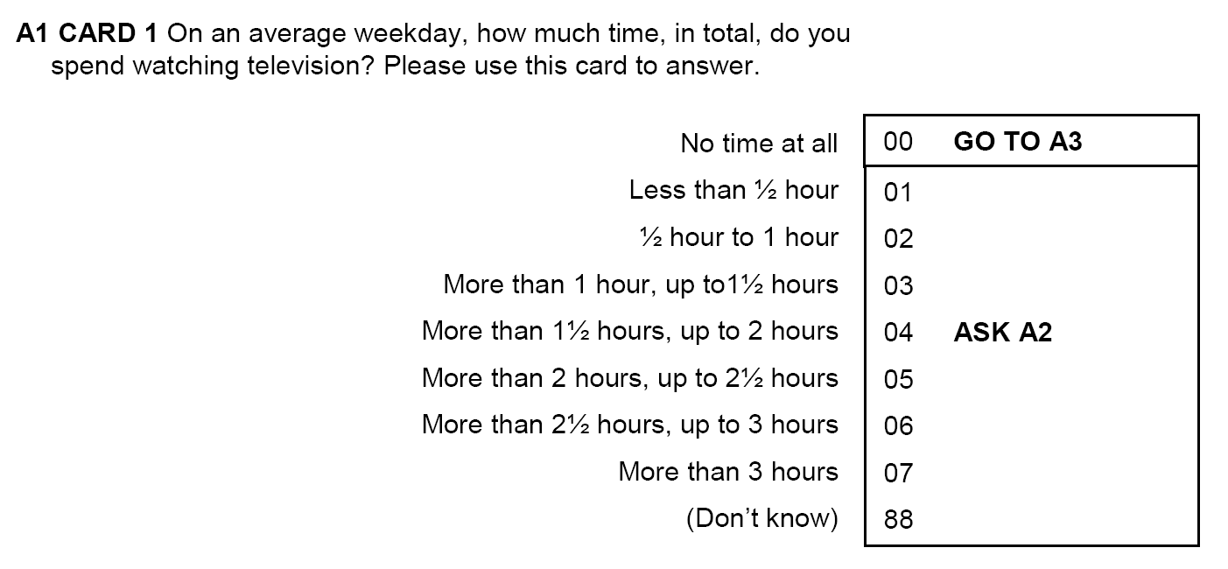
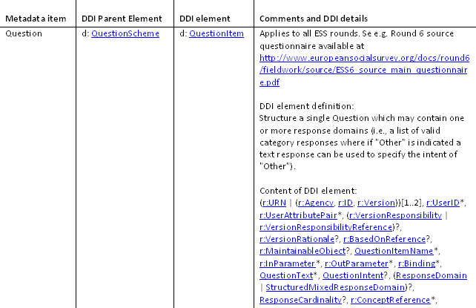
Mapping of metadata elements to DDI

Slide 14
Work towards a common metadata understanding for the three tools
Requirements for a common, DDI-L based metadata model:
Issues to be resolved:
Which metadata elements will be used in the transfer between the three tools?
Mapping between the metadata elements and the DDI
The direction for the flow of metadata elements between the three tools, as well as the steps in the work processes at which metadata components are exchanged
Administrative ownership of metadata
A common identification and versioning system, including a versioning policy
How the exchange of DDI metadata takes place, which type of DDI instances or fragments that will be transported, and which type of web-service will be used

Slide 15
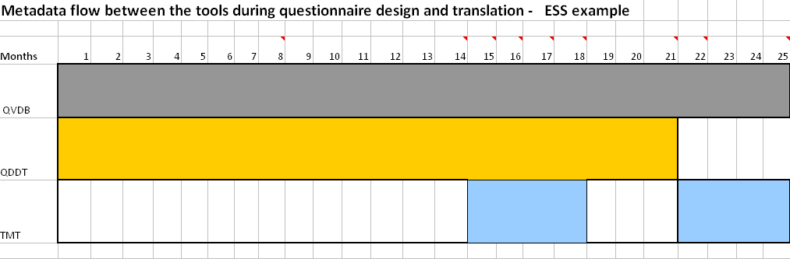
Example: Metadata flow between the three tools
n-th draft template
elements
n+1-th draft template
elements
Pilot questionnaire
n+2-th draft template
elements
Final module/
Source questionnaire
Final translations

Slide 16
Example: Identification system
Best practice for common identifiers/PID?
- DDI3.2 URN canonical vs. deprecated
- Role of agency in identifier (DDI4 Sprint#1 discussions)
- Usage of user id
- Other identification issues

Slide 17
Work towards a common metadata understanding for the three tools (2)
Work continues
Fill requirements for common DDI-L based
metadata model with content
Ideas for best practices?

Slide 18
Acknowledgements
Special thanks to
metadata expert Joachim Wackerow
for consultancy
Thank you for your attention!
hilde.orten@nsd.uib.no havard.bakkmoen@nsd.uib.no Yvette.Prestage.1@city.ac.uk Sally.Widdop.1@city.ac.uk

