Slide 1
Developing a transportable, standardised system of monitoring: employing harmonised metadata files which can aid central field supervision, control and monitoring
Yvette Prestage, Sally Widdop (ESS, CITY)
Johanna Bristle (MPG)
5th Annual EDDI user groups meeting – Paris, 3-4 December 2013
Notes:
Abstract mentions that we will be adapting SHARE’s SMS for other surveys – should highlight that this will be about adapting for the ESS in the first instance.

Slide 2
Outline
About the European Social Survey (ESS)
SHAREs Sample Management System (SMS)
Designing the Fieldwork Management System (FMS):
  Essential features
  Optional features
Scope for compatibility with DDI-L

Slide 3
European Social Survey (ESS)
An academically driven social survey, conducted every two years since 2001
Cross national - 25 - 30 participating countries each round
Face to face – mixture of CAPI and PAPI
‘Model’ contact forms used to record all contact attempts
NCs provide updates on progress during fieldwork, but frequency, content and detail of these varies greatly
We need a computerised system that:
Enables interviewers to manage cases assigned to them
Enables countries to consistently provide timely updates
Is in a transportable, mobile format
Notes:
Each National coordination team is provided with ‘model’ contact forms (CF) appropriate for household, address or individual sample frames.
The CFs are used by ESS interviewers to record what happens when they attempt to contact respondents throughout fieldwork.
The availability of information from the contact form varies by country according to a number of factors e.g.
CAPI/PAPI administration and length of time taken for information to be returned from the field to the fieldwork organisation;
length of time taken to key data from the CF into the data file;
whether the national coordination requests the information from the fieldwork organisation
and whether the information is then made available during fieldwork.
During fieldwork, all NC teams are required to submit written reports on fieldwork progress to their assigned fieldwork contact, but its rare that all reports include the required information
The main limitation of the ESS model is that the frequency and content of information provided as well as the amount of detail varies greatly across the participating countries.
We need a system that enables all countries to consistently provide fieldwork information quicker than is currently possible, whilst retaining the level of detail required. The ESS would also benefit from such a system being available in a transportable, mobile format to make it easier for interviewers to record the information in the field. The current system – where interviews either use paper forms or record the information in laptops - is not optimal as forms are sometimes lost or the use of a laptop is impractical whilst on the move/on the doorstep.

Slide 4
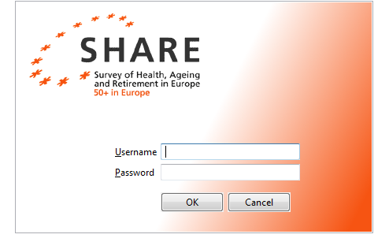
SHARE’s Sample Management System (SMS)
Enables interviewers to:
  Manage sample and fieldwork
  Document contact attempts
User:
  Interviewer facing
Benefits:
  Data on fieldwork is available during fieldwork
  Fieldwork procedure is comparable across all SHARE-countries
Notes:
ESS procedures are very different to SHARE since there is no centralised CAPI system, and in some ESS countries PAPI is used).
Despite this, we think it will be possible to develop a tool to help survey agencies and interviewers manage the fieldwork and sample/cases allocated.
These are the features of SHARE’S SMS that we want to replicate – taking into account input from survey coordination and the fieldwork directors perspective (gained via a consultation survey)

Slide 5
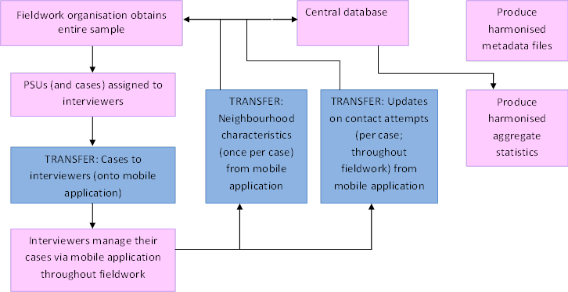
Transfer of information
Notes:
Transfer of information from/to fieldwork organisation, mobile application and central database
Q: What information is planned to be sent where, how and in which format?
A: Info = lots! From:
fw agency to app (sample, cases),
app to central database (updates on progress)
central database to fw agency
fw monitors (aggregate reports per int or per country).
The app will feed directly into the central database.
Q: Will the central database not be based on DDI?
A: ?? probably if that makes sense?! (might make more sense to do that than make the app DDI compliant? Another query for the audience?)
Final decisions haven’t been made yet.
If we use the SHARE model this is most likely to be what we will end up doing. JB’s additional text for Del 3.6 includes something on this I think e.g. there is a diagram that might help. (See also her comments re: para/meta data which are also of relevance to the FMS presentation – I think.)

Slide 6
Essential features of the FMS
From a cross national coordination and fieldwork monitoring perspective, it must:
  Facilitate respondent selection
  Contain the address (and name) of a target respondent
  Capture contact attempts and visit information
  Collect information about neighbourhood characteristics
  Ensure that all information is transferred, stored and used securely
Notes:
We combined the results of our consultation with fieldwork directors with the features needed from a coordination point of view, and have produced a list of ‘essential’ and ‘optional’ features of the FMS.
In addition to the generic requirements, such as:
It must be suitable for both CAPI and PAPI interviewers
It must be simple and easy to use and must not be an additional burden for either the Fieldwork directors or interviewers
The most important detail is that the FMS needs to capture all the information currently recorded in the contact forms. This includes details of respondent selection; logging visits and contact attempts; recording the outcome of contact attempts; recording reasons for refusal; estimation of likely cooperation in future; recording status of invalid outcome address and recording neighbourhood characteristic
So all of these features are essential, so it must
Allow respondent selection via either the KISH grid selection or the birthday method, as both are used on the ESS
The name and address details will also need to be held by the tool
It will need to collect, store and transmit all information about the contact attempts.
It should also capture information about the neighbourhood characteristics (currently captured via the contact forms).
Ensure that information transferred to and from the fieldwork organisation, and to and from the central database is done so securely.

Slide 7
Optional features of the FMS
Additional features which could be included are:
A note making facility for interviewers
Message facility for interviewer / fieldwork agency communication
A map function
Colour coded status updates
Simultaneous transfer to fieldwork organisation and central database
Filters for interviewers to manage their caseload
To ensure compatibility with existing systems
Notes:
There were a number of other features identified which, while aren't essential, could make the FMS more user friendly and fieldwork more efficient.
These include:
A note making facility – for interviewers to record notes to themselves
The ability to send messages to the fieldwork organisation.
A map function to plot addresses so that interviewers can plan their workload easily based on geogaphy.
Colour coding the status of a case (based on outcome codes) – so that interviewers can see the cases status at a glance
Simultaneous transfer to fieldwork organisation and central database
Filters to manage cases e.g. by location of respondent (with map function?), their status (see above)
Ensuring compatibility with fieldwork organisation’s existing systems

Slide 8
Scope for compatibility with DDI-L
A number of options to incorporate DDI-L, including:
Implement DDI at the archiving stage
Implement DDI for the contact form data
Do not implement DDI-L at all
Something else???
Notes:
We think there are a number of options open to use about how we could incorporate DDI. These are :
Implement DDI at the archiving stage only (contact form data is processed by our archive at NSD, Norway and the datasets are usually made available to coincide with the main data releases)
Begin to implement DDI now, at the design stage – but only with respect to the data collected in what would replace the contact forms
3. Do nothing! The easy option, and do not incorporate DDI at all.
4. Is there a further step where other parts of the FMS (other than the contact form data) could be incorporated into DDI?
Our needs
We would get raw data files from the app during fieldwork.
We would want to harmonise these files across all interviewers and all countries so that they contain the same info (rather than e.g. including a wild code for a specific interviewer / country).
This harmonisation would involve processing the files – which could be done after fieldwork – or automated with DDI?
Aggregate stats (at interviewer or country level) would also be an advantage.
DDI
so that the components can be reused by others, they can be translated, amended in later rounds etc.
Perhaps we have to apply DDI separately – to the FMS app and to the database? Unless we set-up the database to be DDI compatible(?)
Could the lifecycle event be used? I.e. to document those actions taken to enhance fieldwork
Metadata = aggregated data about the data (e.g. response rates)
Paradata = “case level” files on the process of collecting the data i.e. call records and timestamps.
For SHARE the data is extracted as paradata, and then we create metadata out of it

Slide 9

Contact:
Yvette Prestage or Sally Widdop
Yvette.Prestage.1@city.ac.uk or Sally.Widdop.1@city.ac.uk
ESS, City University London
Notes:
We welcome help and suggestions from the experts in the room as to what would be the most beneficial for the tool

