Slide 1
Data Model and Data Standard - a Happy Marriage?
Dr. Brigitte Mathiak
Oliver Hopt
GESIS - Leibniz Institute for the Social Sciences

Slide 2
This talk is about
Problem statement
DDI decisions
Technical exploration
Open issue

Slide 3
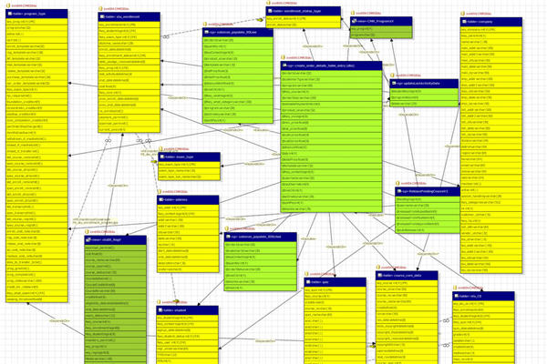


What is a Data Model for?
Data

Slide 4
What is a Data Standard for?
Some kind of structured text
Data

Slide 5
Data Model vs. Data Standard
Individual
Object oriented
Platform dependent
Modularity for abstraction
(Proprietary)...
General
Not object oriented
Platform independent
Modularity for content grouping
(Open)…

Slide 6
DDI development from the technical point of view
DDI 2 appears as plain data standard.
DDI 3 seems to be a data model expressed in data standard language.
DDI future is planned as a data model with mapping towards a data standard.
→ Can this work?

Slide 7
Modularization
Exotic
Quest.
full standard
Adv.
Quest.
abstract standard
classes
Simple
Quest.
corner case
extentions
Core
Simple
DataSet
DataSet
Exotic
DataSet

Slide 8
The happy part of the marriage
Technology stack: POJOs, JAXB, JPA
Generating POJOs from UML
Direct mapping into relational database (JPA)
Identification handling (db versus ddi)
Out of the box (un-)marshalling works!!!

Slide 9
Trouble with modularity
Basic
Advanced
BasicQuestionnaire
AdvancedQuestionnaire
Title
Questions
Title
Questions
Flow
Source
…
…
My system can only deal with BasicQuestionnaires.
I get delivered a document with AdvancedQuestionnaires.
→ No library to determine the mapping on standard level.
→ Handmade mapping for each and every interaction.

Slide 10
Increasing the trouble
Advanced V2
Basic
Advanced
AdvancedQuestionnaire
Title
Questions
Flow
Source
SomeNewProperty
BasicQuestionnaire
AdvancedQuestionnaire
…
Title
Questions
Title
Questions
Flow
Source
…
…
MyOwn
MyOwnQuestionnaire
Title
Questions
Flow
MyOwnProperty
…

Slide 11
Solution I: Exchange layer
Provide XSL-snippets for up-casting and version change.
Compile a style sheet from XSL-snippets based on the used namespaces in source an destination.
Upstream transformation of each import
Lot of work and issues

Slide 12
Solution II: Application layer
Extend POJOs with methods for up-casting and version change.
Provide an API with all modules in each version.
Cast to fitting objects before storing.
Lot of work and issues

Slide 13
Solution III: Cheating
Basic
Advanced
Questionnaire
Questionnaire
Title
Questions
Title
Questions
Flow
Source
…
…
Parser are usually implemented to ignore anything they do not understand
So, an implementation of the Questionnaire from Basic will typically be able to parse an Advanced Questionnaire input, no casting/transformation needed

Slide 14
Issues with solution III
Somewhat weird to have two objects with different properties, but the same name in the same standard
Requiring anything not in Basic is impossible
xs:any needs to be added to everything
Different modeling philosophy is needed

Slide 15
Time for Discussion
Contact:
brigitte.mathiak@gesis.org
oliver.hopt@gesis.org

