Slide 1

EDDI2013, Paris December 4 2013
Maurice Martens M.G.J.Martens@uvt.nl
Edwin de Vet
E.C.J.M.deVet@uvt.nl
12/4/2013

Slide 2
TMT
LMU developed since 2004 for SHARE
Now integrated in Dasish
Goal is to make TMT available as service
TRAPD compatible
DDI

Slide 3
TMT
Web service for translating large questionnaires
1 time programming, ex ante harmonized
Fast development cycle
Customizable workflow

Slide 4
TMT
Cuts questionnaire up in translatable elements
Question texts, interviewer instructions, answers, fills, error messages
Buttons, sms texts, labels, help files, coding
Imports Blaise, exports translated Blaise

Slide 5
TMT
Let’s have a look

Slide 6
TMT – Database Structure
Questionnaire
Modules
Questions
Categories
Question Texts
Category Texts

Slide 7
Export as single wave study
Each wave/questionnaire exported as a single wave study
Each module a separate QuestionScheme
ns1:DDIInstance
s:StudyUnit
d:DataCollection
d:QuestionScheme (multiple)
d:ControlConstructScheme (multiple)
l:LogicalProduct
l:CategoryScheme (multiple)
l:CodeScheme (multiple)

Slide 8
Export as longitudinal study
All question items in a single question scheme
ns1:DDIInstance
g:Group
g:StudyUnit (multiple)
s:StudyUnit
d:DataCollection
d:ControlConstructScheme
l:LogicalProduct
l:VariableScheme
g:ResourcePackage
d:QuestionScheme
l:CategoryScheme (multiple)
l:CodeScheme (multiple)

Slide 9
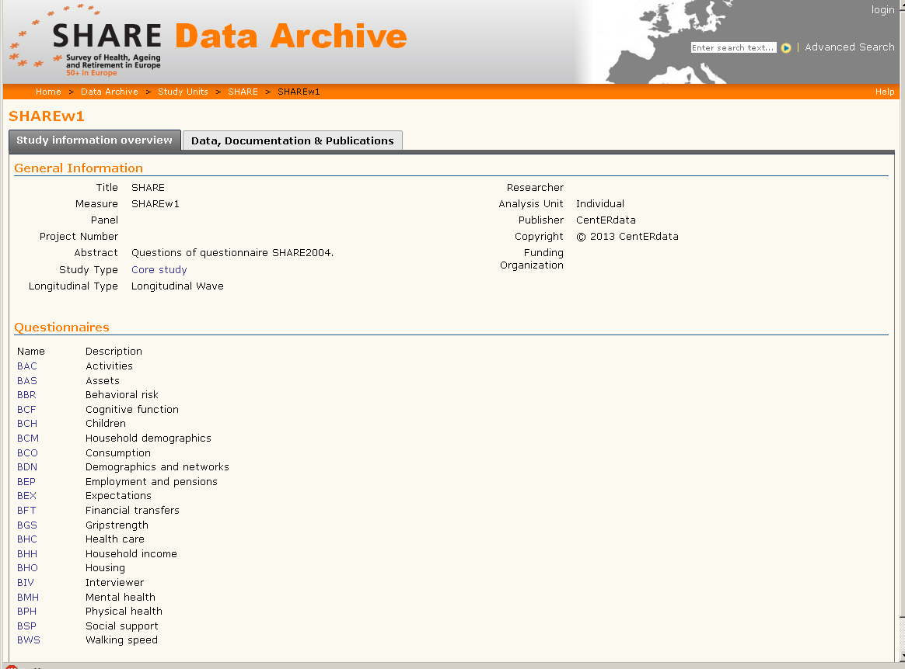
Import into questasy - modules

Slide 10
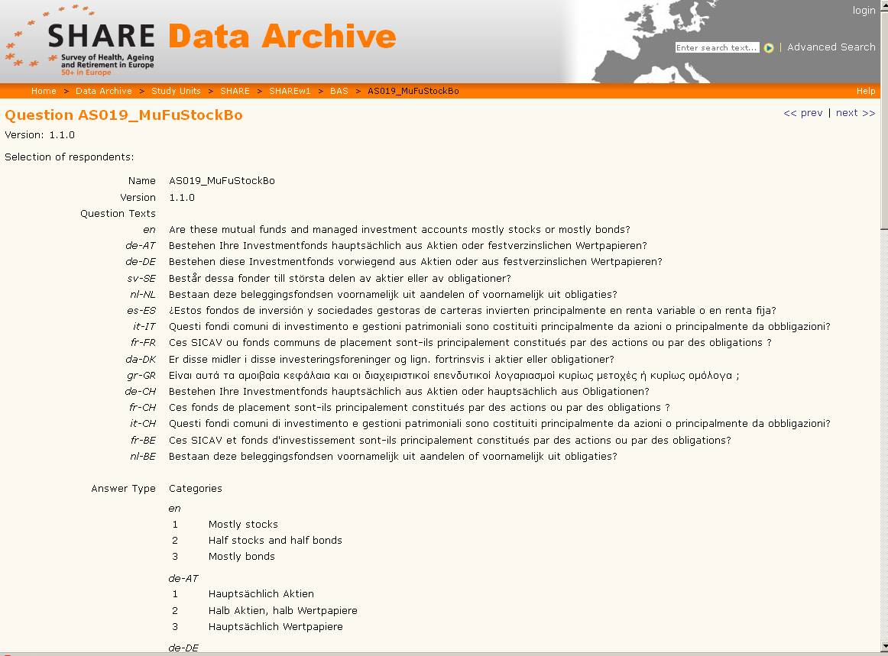
Individual question

Slide 11
Use of DDI to transfer data
Example of the use of DDI to transfer information from one system to another
Conclusion: it works!

