Slide 1
Create Your Own Information Systems on the Basis of DDI-Lifecycle
4th Annual European DDI User Conference
(EDDI 2012)
03.12.2012
Thomas Bosch
M.Sc. (TUM)
Ph.D. student
boschthomas.blogspot.com
GESIS - Leibniz Institute for the Social Sciences
Matthäus Zloch
M.Sc.
Ph.D. student
GESIS - Leibniz Institute for the Social Sciences
Notes:
Time:
Welcome and Outline
10-15 minutes

Slide 2
Introduction of Attendees
What is your name?
What’s your organization?
Why are you here?
What are you mostly interested in?
What do you expect from this tutorial?
…
Appr. 30 seconds

Slide 3
Goals of This Presentation
Introduction to DDI-Lifecycle
Give a DDI Lifecycle overview
Show you (basic) elements of the DDI-Lifecycle and the main structure
How does Identification, Versioning, Maintenance work?
DDI Discovery Vocabulary “disco”
How to use the DDI Documentation
Individual software project
Introduce you to basics of software architecture design
Show you how the software architecture of your project may look like
Show you how a software project leverages DDI and the disco model
Introduce you to a project template for using the disco model in the back-end

Slide 4
Outline
Matthäus
Thomas
Missy – General Information
Requirements to Developers
Use-Cases in Missy
Software Architecture
Multitier
MVC
Missy Data Model
Extendable Data Model
DDI-L Overview
Identification, Versioning, Maintenance
DDI-L Main Structures
DDI Instance
Study Unit
Conceptual Component
Logical Products
Data Collection
disco-model

Slide 5
Outline
Persistence Layer
Programming Interface
Types of physical data storages
Examples
Physical Data Product
Physical Instance
Archive
DDIProfile
DDI Serialization Examples
DDI-XML
DDI-RDF / disco-spec
Relational-DB
Outlook

Slide 6
Outline
Matthäus
Thomas
Missy – General Information
Requirements to Developers
Use-Cases in Missy
Software Architecture
Multitier
MVC
Missy Data Model
Extendable Data Model
DDI-L Overview
Identification, Versioning, Maintenance
DDI-L Main Structures
DDI Instance
Study Unit
Conceptual Component
Logical Products
Data Collection
disco-model
Presentation
Business Layer

Slide 7
Outline
Persistence Layer
Programming Interface
Types of physical data storages
Examples
Physical Data Product
Physical Instance
Archive
DDIProfile
DDI Serialization Examples
DDI-XML
DDI-RDF / disco-spec
Relational-DB
Data Storage Access
Outlook
Data Storage

Slide 8

Feel free to ask questions at any time!

Slide 9
What comes next?
Before we start with the use-case Missy…
Thomas, can you give us a top-level overview of DDI?
You might also include how DDI treats identification, versioning and maintenance…

Slide 10
What comes next?
Missy – General Information
Requirements to Developers
Use-Cases in Missy
Software Architecture
Multitier
MVC
Missy Data Model
Extendable Data Model
DDI-L Overview
Identification, Versioning, Maintenance
DDI-L Main Structures
DDI Instance
Study Unit
Conceptual Component
Logical Products
Data Collection
disco-model
Presentation
Business Layer
Notes:
Time: 20-25 minutes

Slide 11
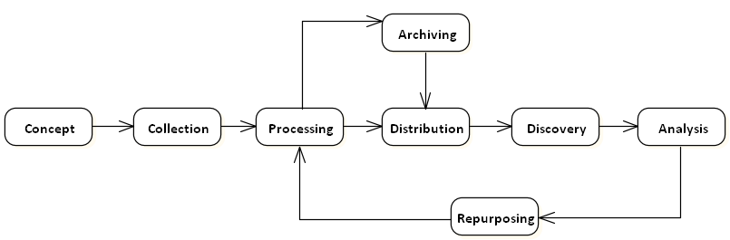

DDI-L Stages

Slide 12
using
Study
Survey
Instruments
measures
made up of
about
Concepts
Questions
Universes

Slide 13
Categories/
Codes,
Numbers
with values of
Questions
Variables
collect
made up of
Responses
Data Files
resulting in

Slide 14
What comes next?
Missy – General Information
Requirements to Developers
Use-Cases in Missy
Software Architecture
Multitier
MVC
Missy Data Model
Extendable Data Model
DDI-L Overview
Identification, Versioning, Maintenance
DDI-L Main Structures
DDI Instance
Study Unit
Conceptual Component
Logical Products
Data Collection
disco-model
Presentation
Business Layer

Slide 15
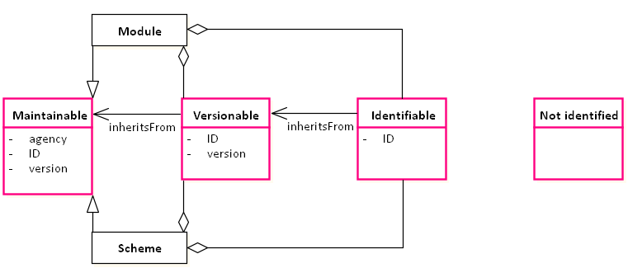
Element Types
IDs must be unique within maintainables
Not identified elements are contained by other element types

Slide 16
Identification
Agency, ID, Version
or
URN (= Agency + ID + Version)

Slide 17
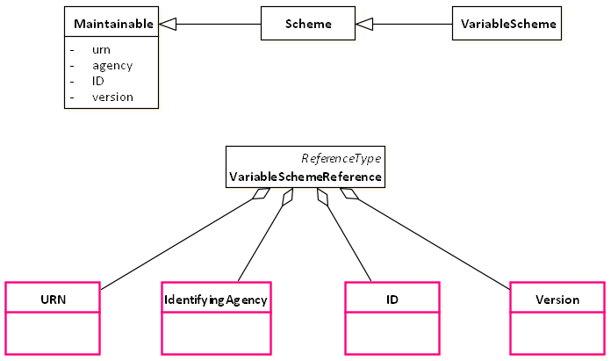
Referencing Maintainables

Slide 18
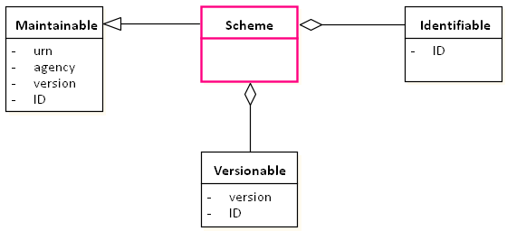
Schemes
Very often, identifiable and versionable elements are maintained in parent schemes

Slide 19
Maintenance Rules
Maintenance Agency
identified by a reserved code (based on its domain name; similar to it’s website and e-mail)
Registration of maintenance agency (e.g. GESIS)
Ownership
Maintenance agencies own the objects they maintain
Only they are allowed to change or version the objects
Reference
Other organizations may reference external items in their own schemes, but may not change those items
You can make a copy which you change and maintain, but once you do that, you own it!

Slide 20
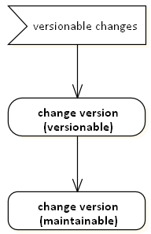
Versioning Rules

Slide 21
Identifiable (DDI 3.1 XML)
<DataItem id=“AB347”>
…
</DataItem>

Slide 22
Versionable (DDI 3.1 XML)
<Variable id=“V1” version=“1.1.0” versionDate=“20012-11-12”>
<VersionResponsibility>
Thomas Bosch
</VersionResponsibility>
<VersionRationale>
Spelling Correction
</VersionRationale>
…
</Variable >

Slide 23
Maintainable (DDI 3.1 XML)
<VariableScheme
id=“VarSch01”
agency =“us.mpc”
version=“1.4.0”
versionDate=“2009-02-12”>
…
</VariableScheme>

Slide 24
URN (DDI 3.1)
urn:ddi:us.mpc:VariableScheme. VarSch01.1.4.0:Variable.V1.1.1.0

Slide 25
URN (DDI 3.1)
urn:ddi:us.mpc:VariableScheme. VarSch01.1.4.0:Variable.V1.1.1.0

Slide 26
URN (DDI 3.1)
urn:ddi:us.mpc:VariableScheme. VarSch01.1.4.0:Variable.V1.1.1.0
Maintaining agency

Slide 27
URN (DDI 3.1)
urn:ddi:us.mpc:VariableScheme. VarSch01.1.4.0:Variable.V1.1.1.0
Maintainable (element type, ID, version)

Slide 28
URN (DDI 3.1)
urn:ddi:us.mpc:VariableScheme. VarSch01.1.4.0:Variable.V1.1.1.0
Identifiable (element type, ID, version number)
ID must be unique within maintainable

Slide 29
URN Resolution
DNS-based resolution for DDI services
URN can be resolved by DNS means
http://registry.ddialliance.org/
details and library
list of available DNS services for this DDI agency
URNs are mapped to local URLs
XML Catalog can be used as simple resolution mechanism

Slide 30
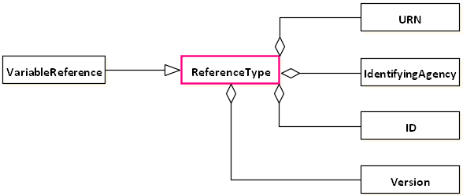
Referencing (DDI 3.1)
(Agency, ID, Version) vs. URN
Often, these are inherited from a maintainable object

Slide 31
Referencing (DDI 3.1 + 3.2)
Internal
In same DDI Instance
(agency, ID, version)
Maintainable (agency, ID, version)
Identifiable (ID), versionable (ID, version)
External
To other DDI Instances
URN > (agency, ID, version)

Slide 32
Internal Reference (DDI 3.1)
<VariableReference isReference=“true” isExternal=“false” lateBound=“false”>
<Scheme isReference=“true” isExternal=“false” lateBound=“false”>
<ID>VarSch01</ID>
<IdenftifyingAgency>us.mpc</IdentifyingAgency>
<Version>1.4.0</Version>
</Scheme>
<ID>V1</ID>
<IdenftifyingAgency>us.mpc</IdentifyingAgency>
<Version>1.1.0</Version>
</VariableReference>

Slide 33
External Reference (DDI 3.1)
<VariableReference isReference=“true” isExternal=“true” lateBound=“false”>
<urn>
urn:ddi:us.mpc:VariableScheme.VarSch01.1.4.0:Variable. V1.1.1.0
</urn>
</VariableReference>

Slide 34
Identifiers (DDI 3.2)
Why new IDs?
better support of persistent identification (less semantics, context information)
URN or (agency, ID, version)
Version changes?
Administrative metadata → No
Payload metadata → yes
No inheritance
Why? (implementation problems, …)
Deprecated vs. Canonical IDs
Deprecated (no version of maintainables)
Mechanism for roundtrip available between DDI 3.2 canonical ID, DDI 3.2 deprecated ID, DDI 3.1 ID

Slide 35
Canonical URN (DDI 3.2)
urn:ddi:us.mpc:VariableScheme. VarSch01.1.4.0:Variable.V1.1.1.0
No maintainables

Slide 36
Canonical URN (DDI 3.2)
urn:ddi:us.mpc:Variable.V1.1.1.0
No maintainables

Slide 37
Canonical URN (DDI 3.2)
urn:ddi:us.mpc:Variable.V1.1.1.0
Agency, ID, version (Identifiable, Versionable)

Slide 38
Canonical URN (DDI 3.2)
urn:ddi:us.mpc:Variable.V1.1.1.0
ID unique in agency (not maintainable)

Slide 39
Canonical URN (DDI 3.2)
urn:ddi:us.mpc:Variable.V1.1.1.0
No element types

Slide 40
Canonical URN (DDI 3.2)
urn:ddi:us.mpc:V1.1.1.0
No element types

Slide 41
Canonical URN (DDI 3.2)
urn:ddi:us.mpc:Variable.V1.1.1.0
Colon is separator

Slide 42
Canonical URN (DDI 3.2)
urn:ddi:us.mpc:Variable.V1:1.1.0
Colon is separator

Slide 43
Canonical URN (DDI 3.2)
urn:ddi:us.mpc:V1:1.1.0
No maintainables
Agency, ID, version (Identifiable, Versionable)
ID unique in agency (not maintainable)
No element types
Colon is separator

Slide 44
What comes next?
This was the DDI Overview with identification, versioning, and maintenance
But, what is the use-case actually?
What do you want to use DDI for?

Slide 45
What comes next?
Missy – General Information
Requirements to Developers
Use-Cases in Missy
Software Architecture
Multitier
MVC
Missy Data Model
Extendable Data Model
DDI-L Overview
Identification, Versioning, Maintenance
DDI-L Main Structures
DDI Instance
Study Unit
Conceptual Component
Logical Products
Data Collection
disco-model
Presentation
Business Layer
Notes:
Time: 10 minutes

Slide 46
General Information About Missy
Missy – Microdata Information System
Largest household survey in Europe
Provides detailed information about individual datasets
Currently consists of “microcensus" survey, which is comprised of statistics about, e.g.
general population in Germany
situation about employment market
occupation, professional education, income, legal insurance, etc.

Slide 47
General Information About Missy
May be split in two parts
Missy Web (end-user front-end part)
Missy Editor for documentation (back-end part)
Consists of approx. 500 Variables & Questions
Captures 25 years, since 1973

Slide 48
Missy 3
That’s what it’s all about! The “next generation Missy”
Integration of further surveys, e.g. EU-SILC, EU-LFS, …
Implementation of Missy Editor as a Web-Application
Notes:
EU-SILC – European Union Statistics of Income and Living Conditions
EU-LFS – European Union Labour Force Survey

Slide 49
Use-Cases in Missy
General Information about survey “microcensus”
Variables by thematic classification and year
List of variables by year
List of generated variables by year
Show details of a variable with statistics
Variable-Time Matrix
List of variables by thematic classification and year (selectable)
Questionnaire Catalogue

Slide 50
Use-Cases in Missy
General Information about survey “microcensus”
Variables by thematic classification and year
List of variables by year
List of generated variables by year
Show details of a variable with statistics
Variable-Time Matrix
List of variables by thematic classification and year (selectable)
Questionnaire Catalogue
In future: browse by survey and country!

Slide 51
Use-Cases in Missy
General Information about survey “microcensus”
Variables by thematic classification and year
List of variables by year
List of generated variables by year
Show details of a variable with statistics
Variable-Time Matrix
List of variables by thematic classification and year (selectable)
Questionnaire Catalogue

Slide 52
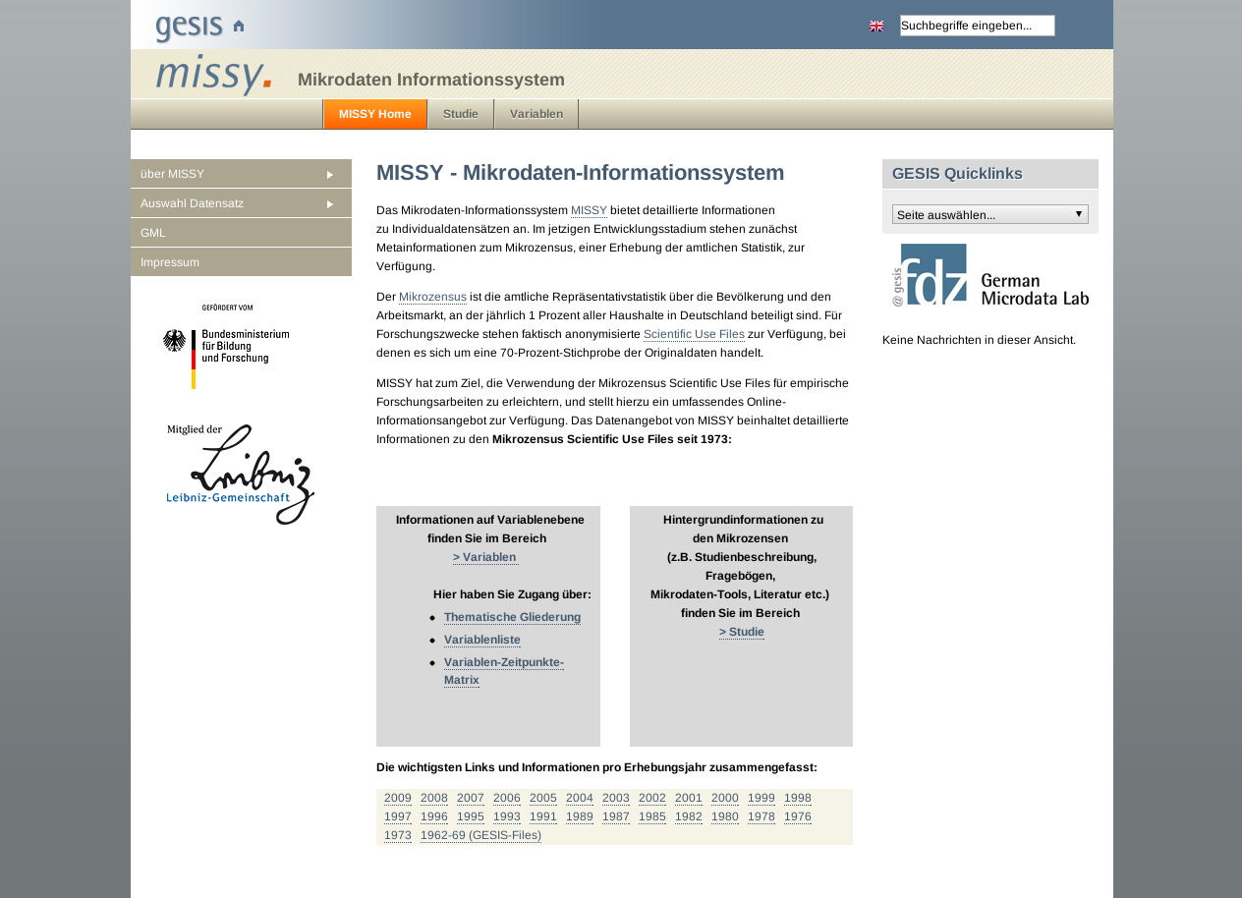

Slide 53
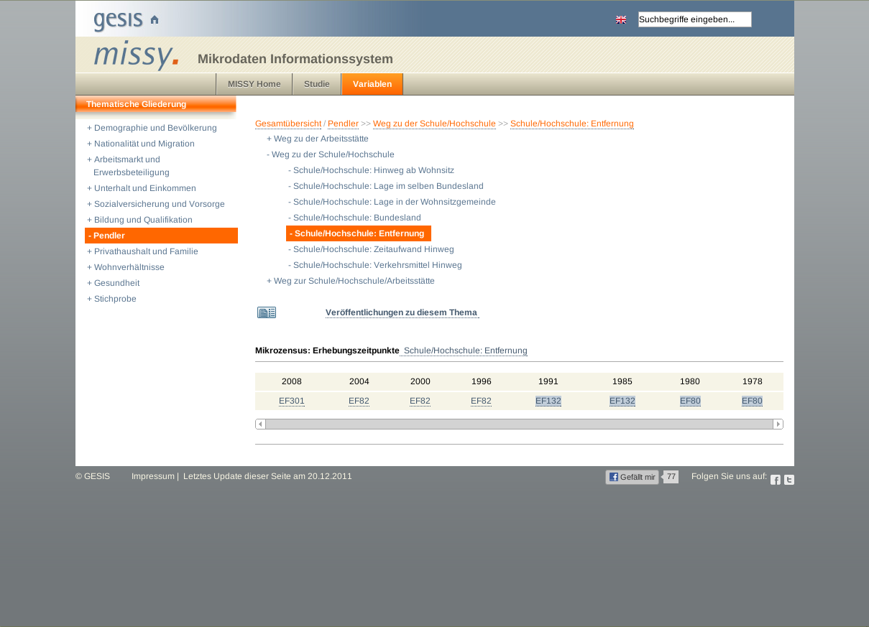

Slide 54
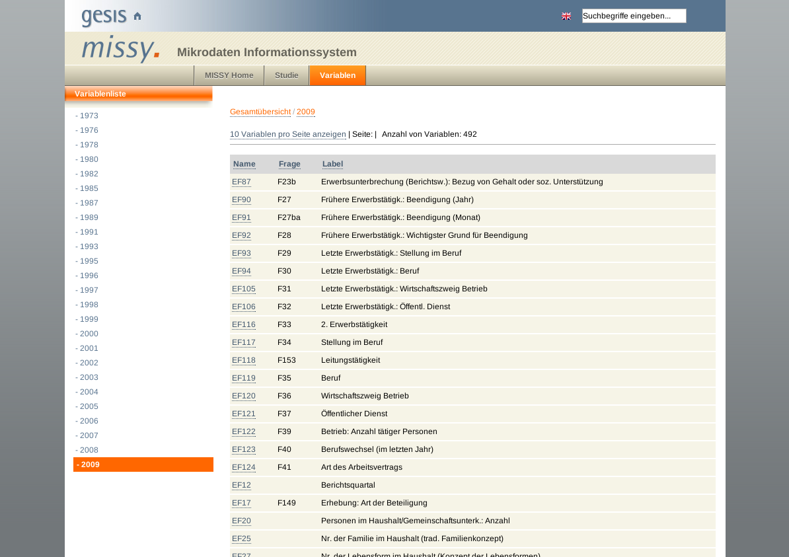

Slide 55
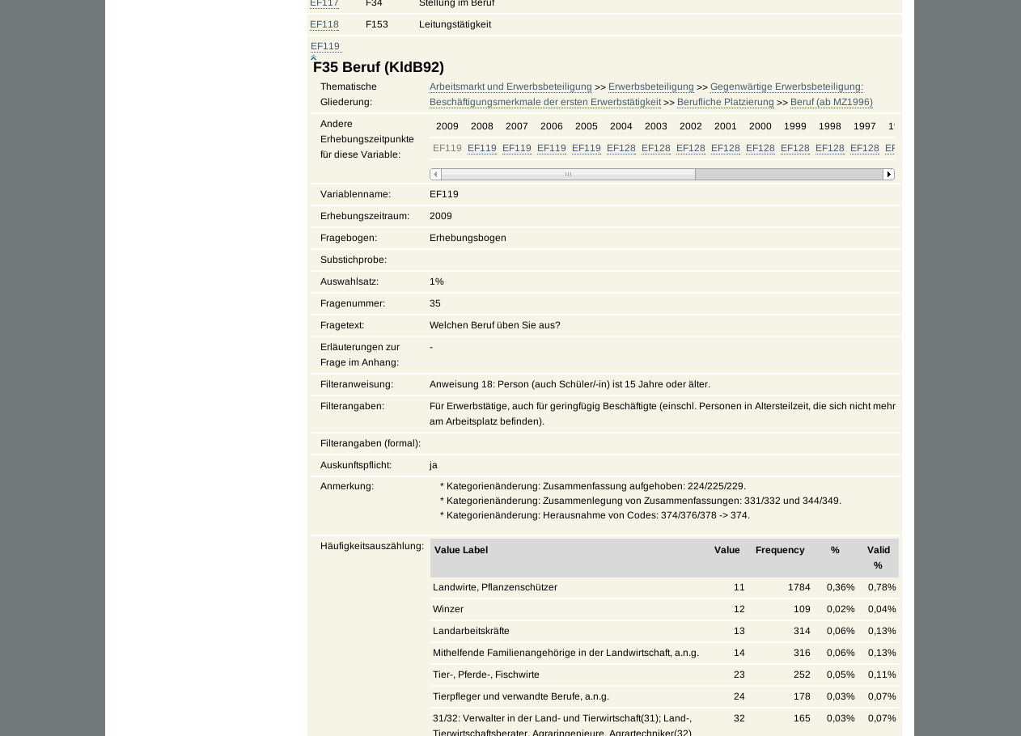

Slide 56
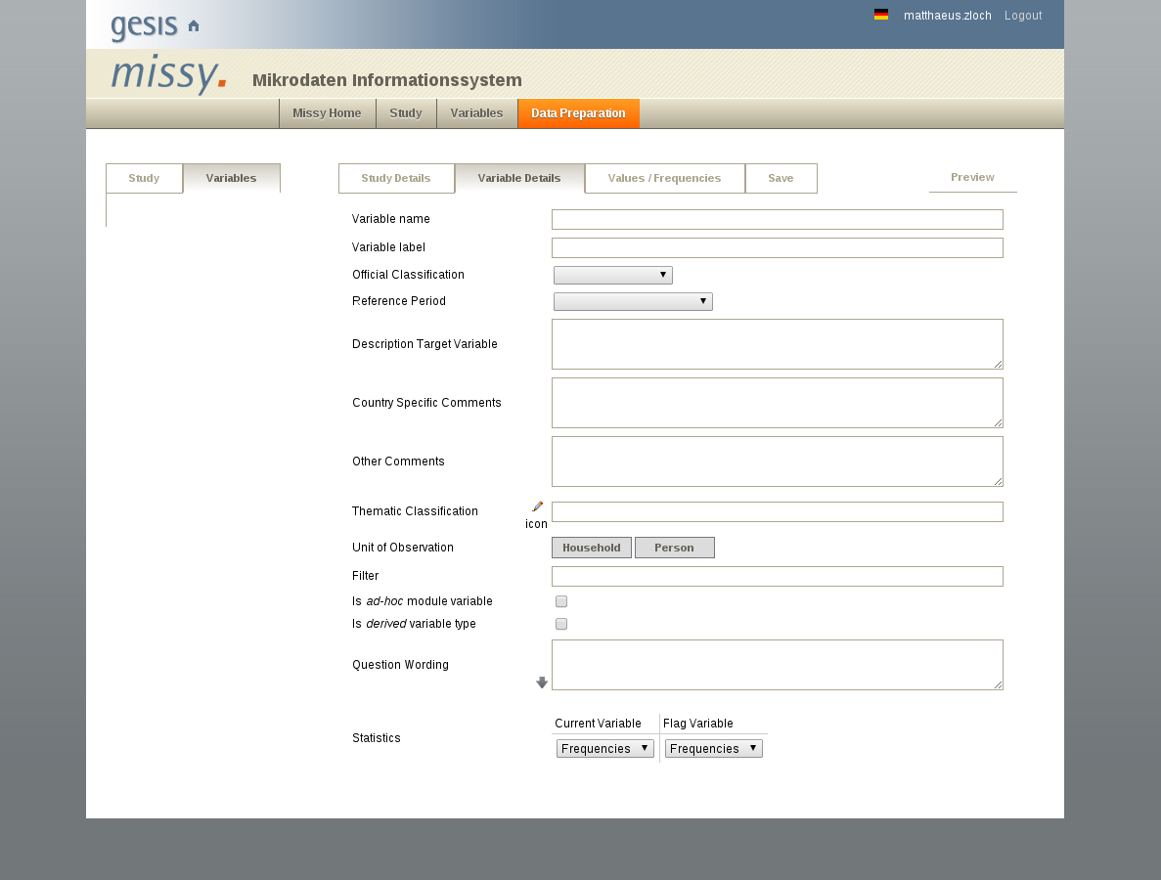

Slide 57
Requirements to Software Developers
Complex data model to represent use-cases
Focus lies on reusability
Flexible Web Application Framework and modern architecture
Service-oriented
Semantic Web technologies
Creation of an abstract framework and architecture
should be well designed to be able to be extended and reusable
Notes:
Flexible-Framework:
Integration of Missy2 modules
Extensions written by individual projects

Slide 58
What comes next?
We have seen Missy as an use-case with several fields which holds values
I would like to use DDI
What are the main structures of DDI-L, Thomas?

Slide 59
What comes next?
Missy – General Information
Requirements to Developers
Use-Cases in Missy
Software Architecture
Multitier
MVC
Missy Data Model
Extendable Data Model
DDI-L Overview
Identification, Versioning, Maintenance
DDI-L Main Structures
DDI Instance
Study Unit
Conceptual Component
Logical Products
Data Collection
disco-model
Presentation
Business Layer
Notes:
Time: 20 minutes

Slide 60
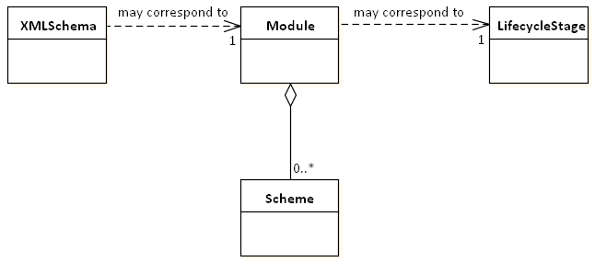

Slide 61
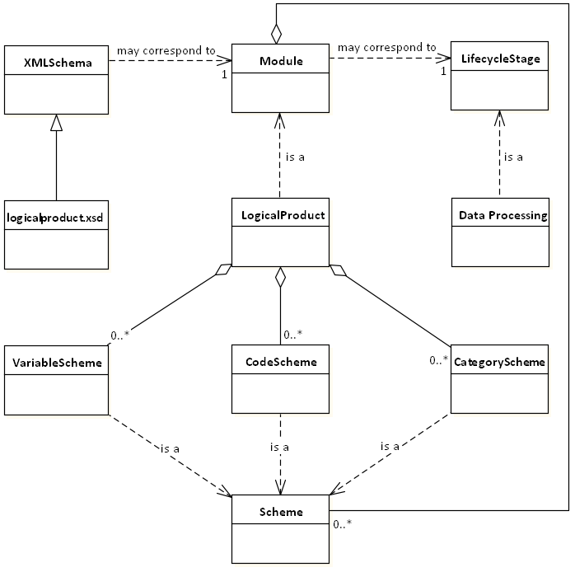

Slide 62
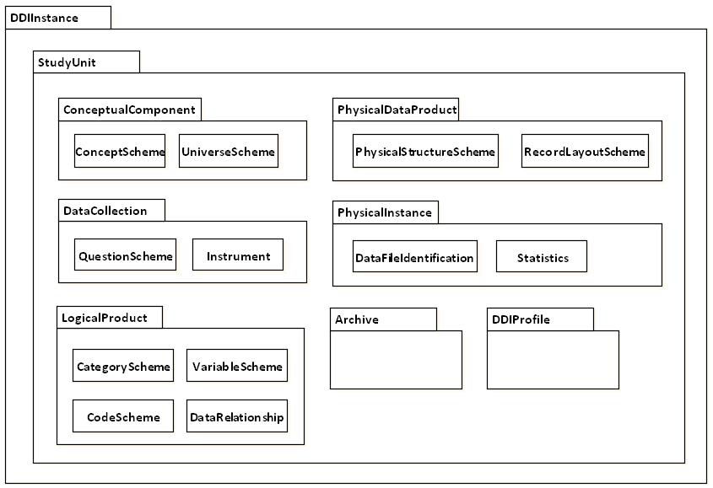
Modules

Slide 63
What comes next?
Missy – General Information
Requirements to Developers
Use-Cases in Missy
Software Architecture
Multitier
MVC
Missy Data Model
Extendable Data Model
DDI-L Overview
Identification, Versioning, Maintenance
DDI-L Main Structures
DDI Instance
Study Unit
Conceptual Component
Logical Products
Data Collection
disco-model
Presentation
Business Layer

Slide 64
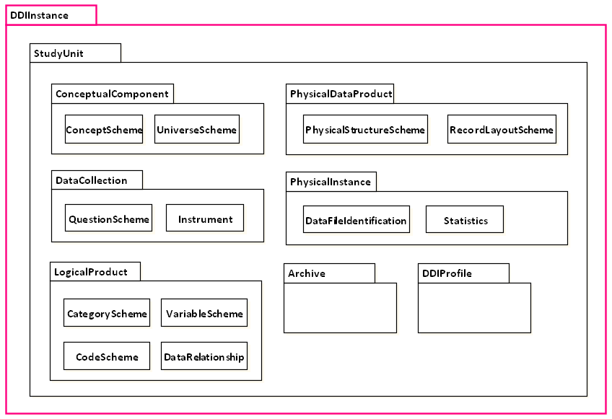
DDIInstance

Slide 65
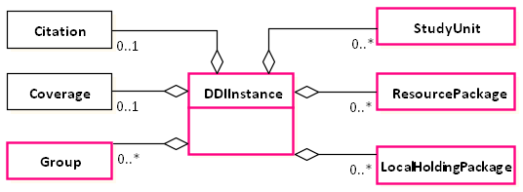
DDIInstance

Slide 66
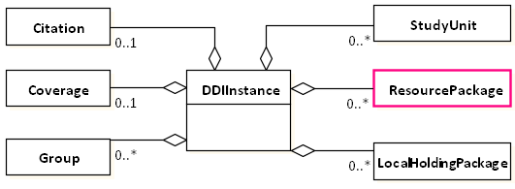
ResourcePackage

Slide 67
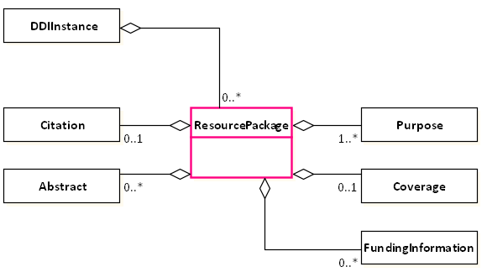
ResourcePackage
Allows packaging of any maintainable item as a resource item
Structure to publish non-study-specific materials for reuse

Slide 68
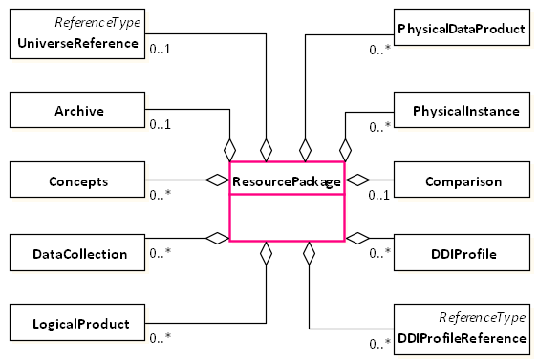
ResourcePackage
Any module (except: StudyUnit, Group, LocalHoldingPackage)

Slide 69
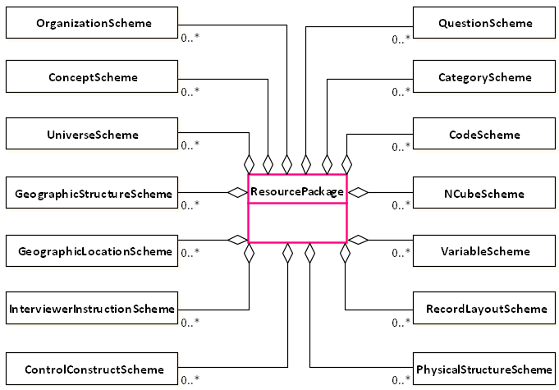
ResourcePackage
Any Scheme
Internal or external references to schemes and elements within schemes

Slide 70
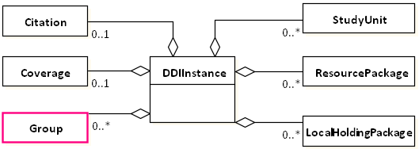
Group

Slide 71
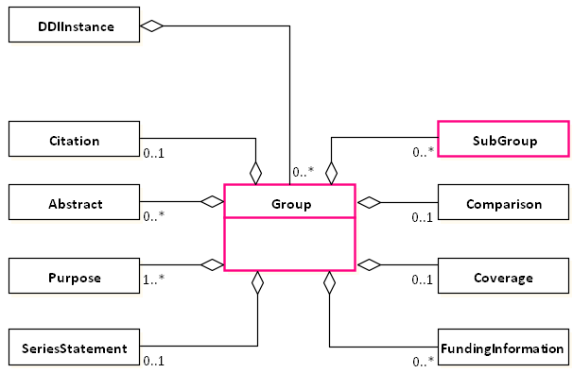
Group
Groups allow inheritance

Slide 72
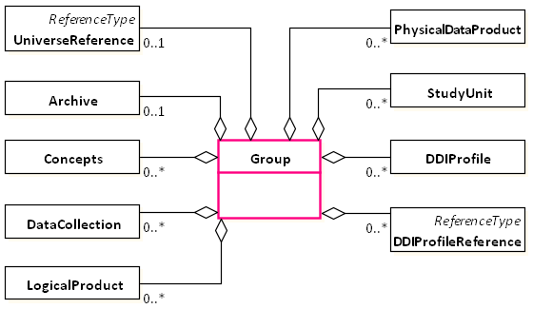
Group

Slide 73
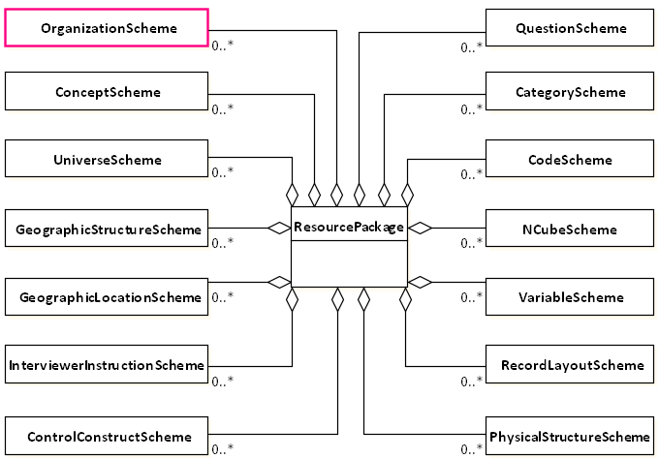
Organization

Slide 74
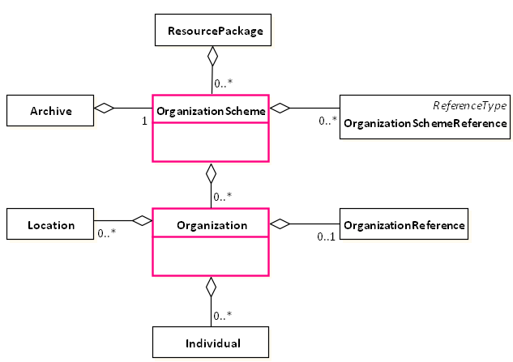
Organization

Slide 75
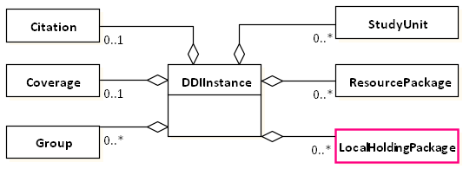
LocalHoldingPackage

Slide 76
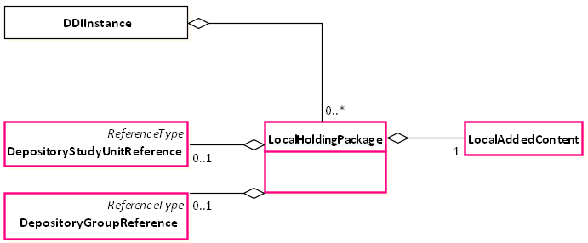
LocalHoldingPackage
Add local content to a deposited study unit or group
without changing the version of the study unit, group

Slide 77
What comes next?
Missy – General Information
Requirements to Developers
Use-Cases in Missy
Software Architecture
Multitier
MVC
Missy Data Model
Extendable Data Model
DDI-L Overview
Identification, Versioning, Maintenance
DDI-L Main Structures
DDI Instance
Study Unit
Conceptual Component
Logical Products
Data Collection
disco-model
Presentation
Business Layer

Slide 78
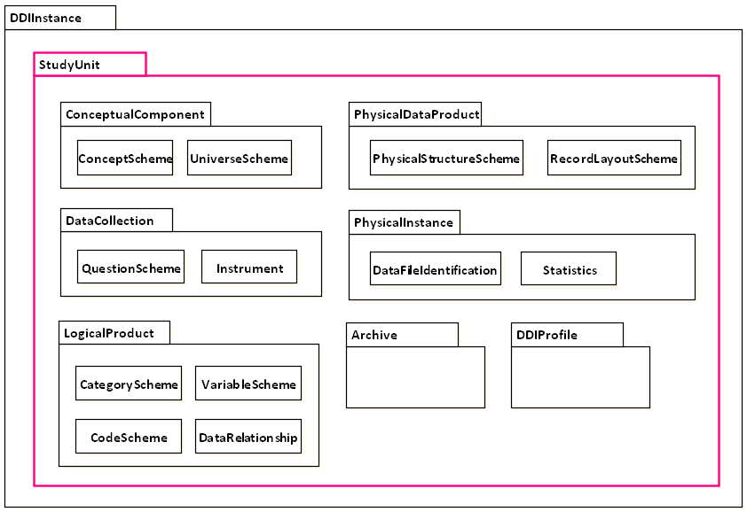
StudyUnit

Slide 79
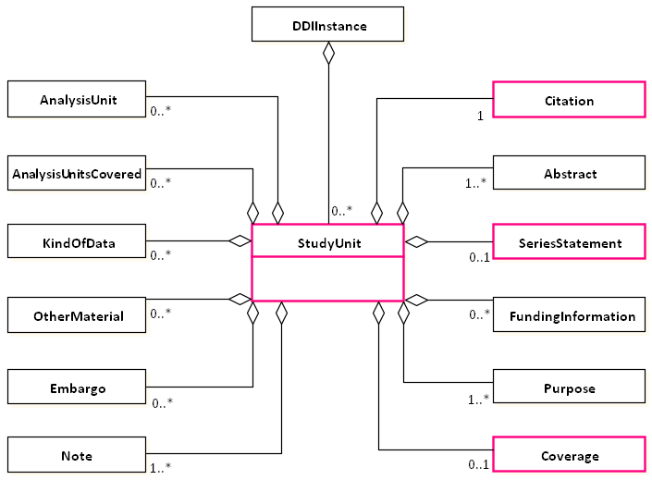
StudyUnit

Slide 80
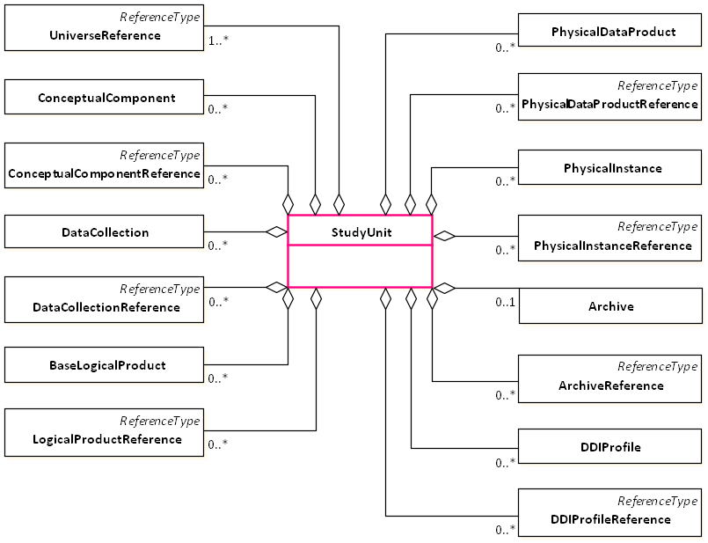
StudyUnit

Slide 81
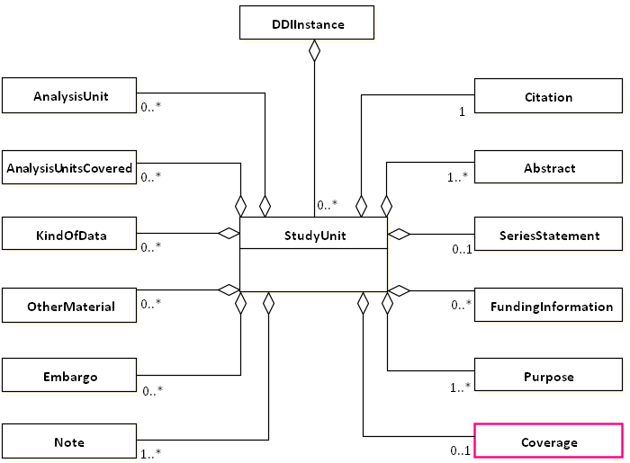
Coverage

Slide 82
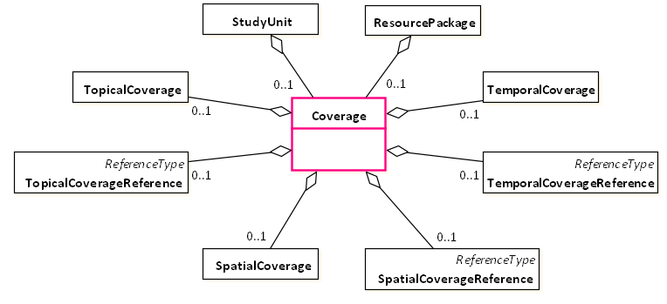
Coverage

Slide 83
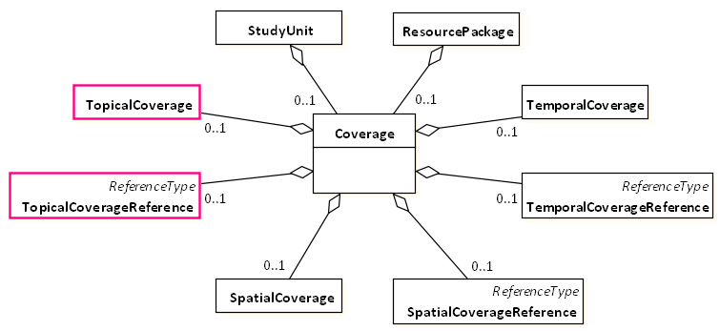
TemporalCoverage

Slide 84
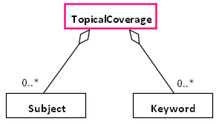
TopicalCoverage

Slide 85
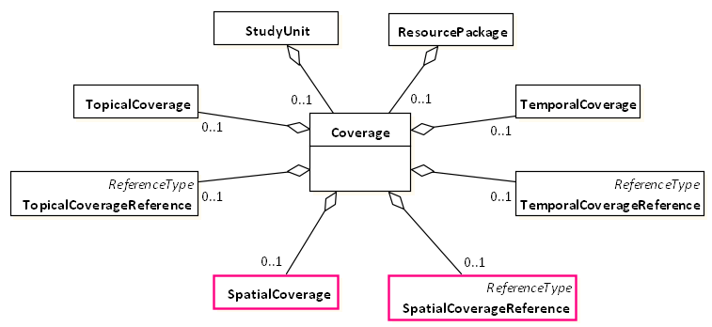
SpatialCoverage

Slide 86
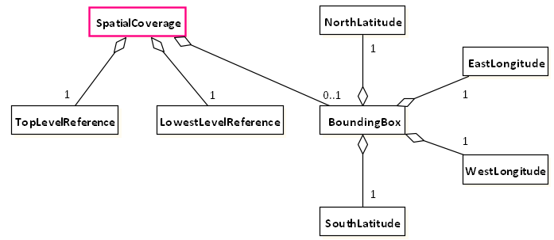
SpatialCoverage

Slide 87
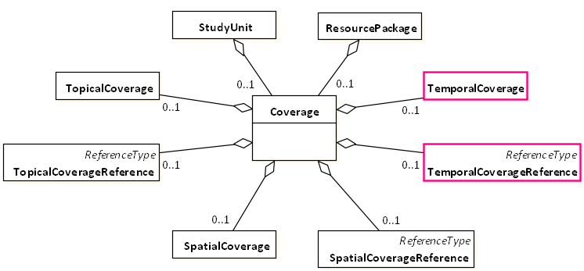
TopicalCoverage

Slide 88
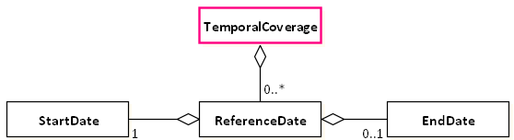
TemporalCoverage

Slide 89
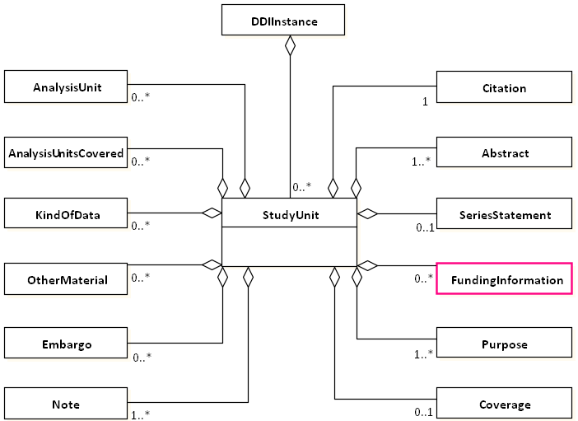
FundingInformation

Slide 90
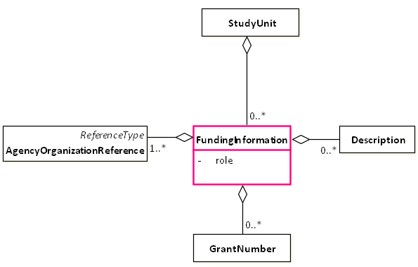
FundingInformation

Slide 91
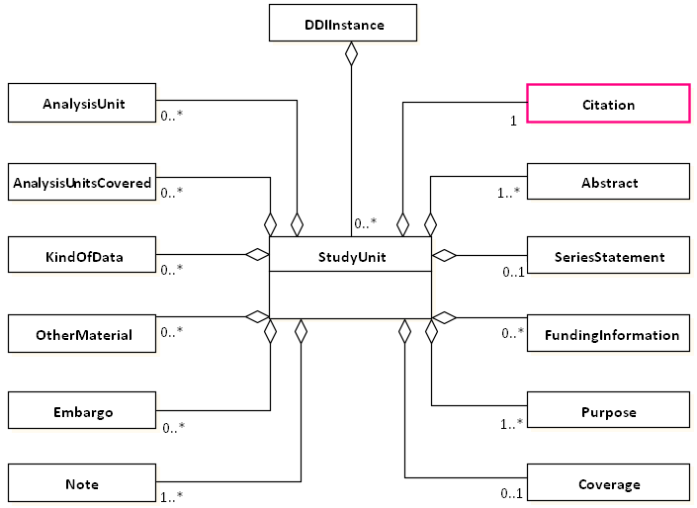
Citation

Slide 92
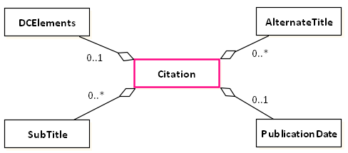
Citation

Slide 93
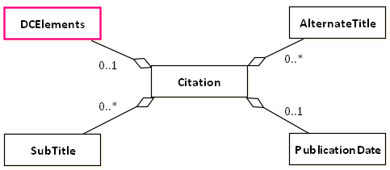
Citation

Slide 94
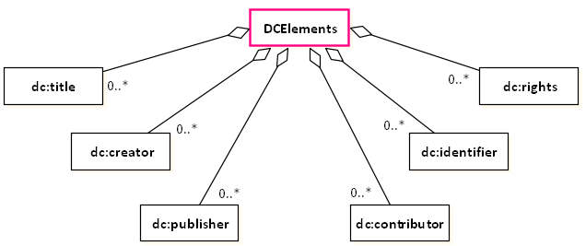
Citation

Slide 95
How the presentation is continued
Ok, I have shown you
the main structures as well as
the main modules of DDI-Lifecycle
If you want to use DDI you have to have a model or idea of your software architecture
How would your software architecture look like?

Slide 96
What comes next?
Missy – General Information
Requirements to Developers
Use-Cases in Missy
Software Architecture
Multitier
MVC
Missy Data Model
Extendable Data Model
DDI-L Overview
Identification, Versioning, Maintenance
DDI-L Main Structures
DDI Instance
Study Unit
Conceptual Component
Logical Products
Data Collection
disco-model
Presentation
Business Layer
Notes:
Time: 15 minutes

Slide 97
What makes Missy interesting
Cross-linking between different multilingual studies
enabled by the common data model
provides different use-cases
Missy leverages DDI as its back-end data model and exchange format
Modern web project architecture, e.g. Multitier, MVC, etc.
Is designed to be published as open-source project with an API to persist DDI data

Slide 98
Software Architecture
Standard technologies to develop software
a multitier architecture
Model-View-Controller (MVC-Pattern)
Project management software, e.g. Maven
Multitier architecture separates the project into logical parts
presentation
business logic or application processing
data management
persistence
…

Slide 99
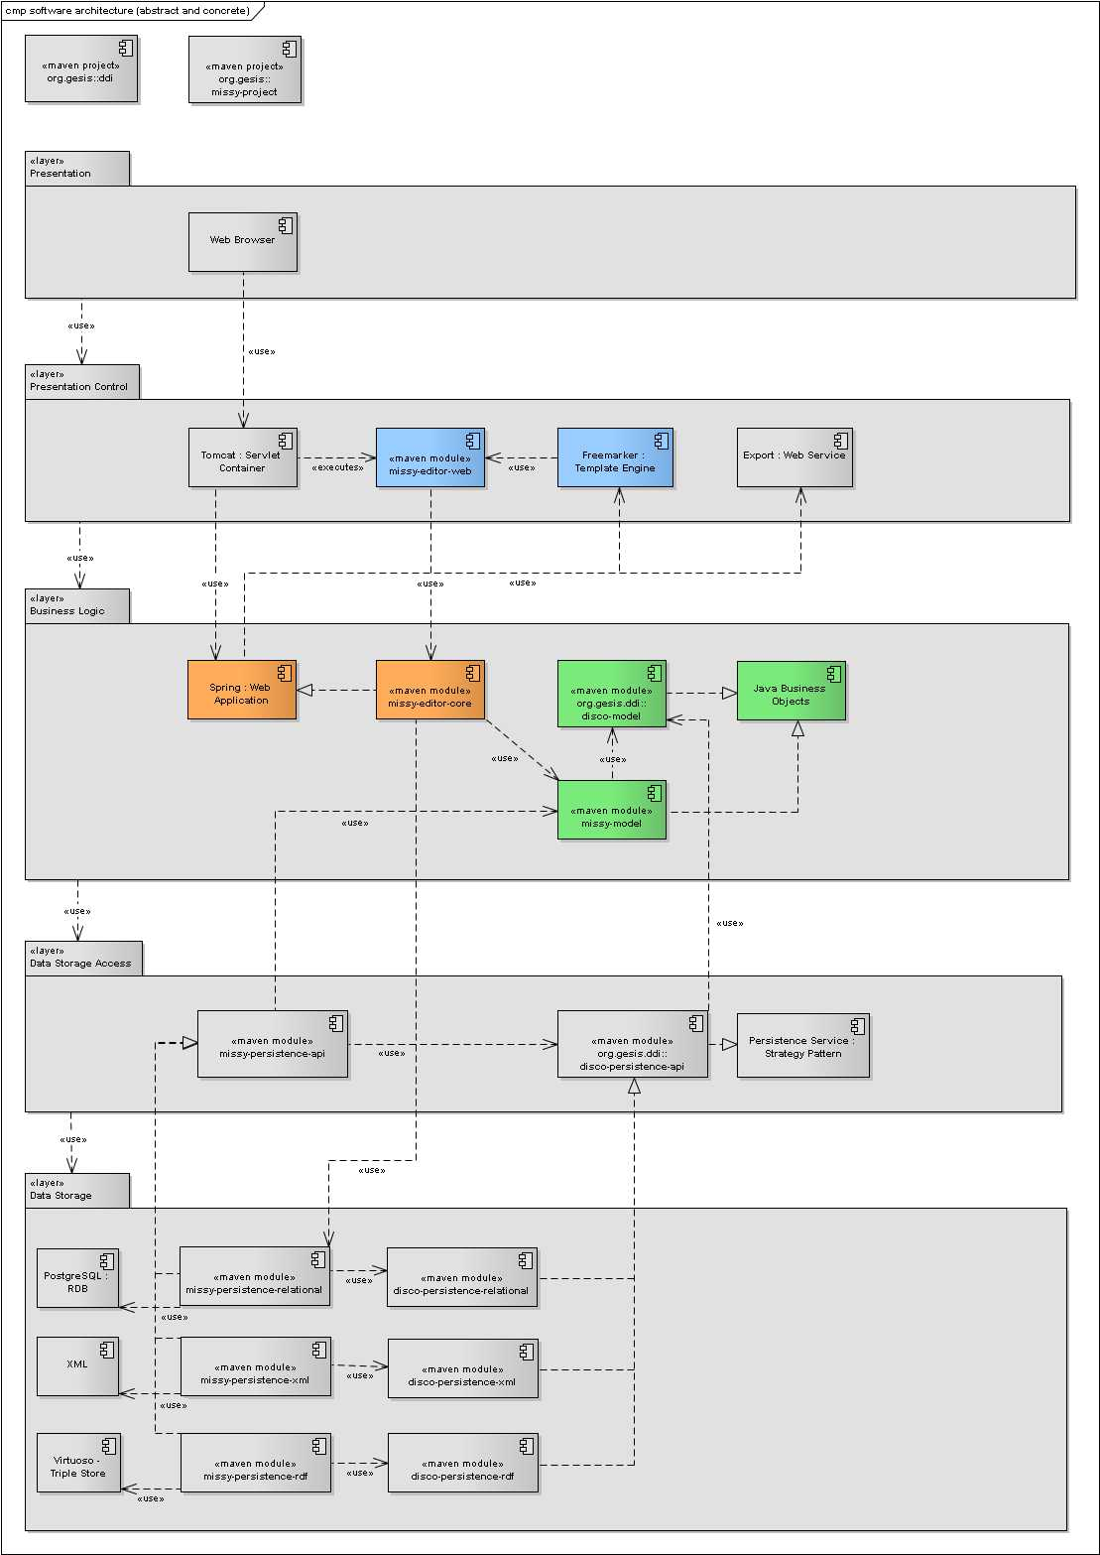

Slide 100
Model-View-Controller
separation of
representation of information
interactions with the data
components
the key is to have logically separated parts, where people might work collaboratively

Slide 101
MVC – Interactions
View
controls
Controller
accesses
manipulates
Model

Slide 102
Model
Represents the business objects, i.e. real life concepts, and their relations to each other
Sometimes also includes some business logic
Independent of the presentation and the controls

Slide 103
View
Responsible for the presentation of information to the user
Provides actions, so that the user can interact with the application
"Knows" the model and can access it
Usually does not display the whole model, but rather special "views" or use-cases of it

Slide 104
Controller
Controls the presentations, i.e. views
Receives actions from users
interprets/evaluates them
acts accordingly
Manipulates the data / model
Usually each view has its own controller
Be warned of code reuse of controllers
controllers are most often the throwaway components

Slide 105
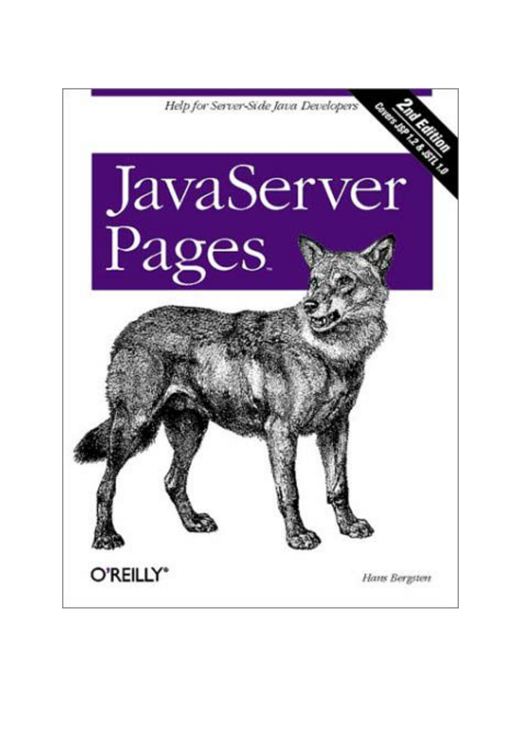


View Technologies
View
controls
…
Controller
accesses
manipulates
Model

Slide 106
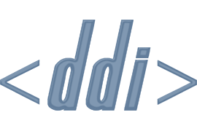
Data Model
View
controls
…
Controller
accesses
manipulates
Model

Slide 107

Missy Technologies
View
controls
Controller
accesses
manipulates
Model

Slide 108
What we have discussed so far
Brief introduction to Missy and the use-cases
With which technologies a web application framework might be build up today
How a modern software architecture looks like

Slide 109
How the presentation is continued
What the DDI-L core modules are and how they are organized
Introduction the disco model and
How to extend it

Slide 110
What comes next?
Missy – General Information
Requirements to Developers
Use-Cases in Missy
Software Architecture
Multitier
MVC
Missy Data Model
Extendable Data Model
DDI-L Overview
Identification, Versioning, Maintenance
DDI-L Main Structures
DDI Instance
Study Unit
Conceptual Component
Logical Products
Data Collection
disco-model
Presentation
Business Layer
Notes:
Time: 30-35 minutes

Slide 111
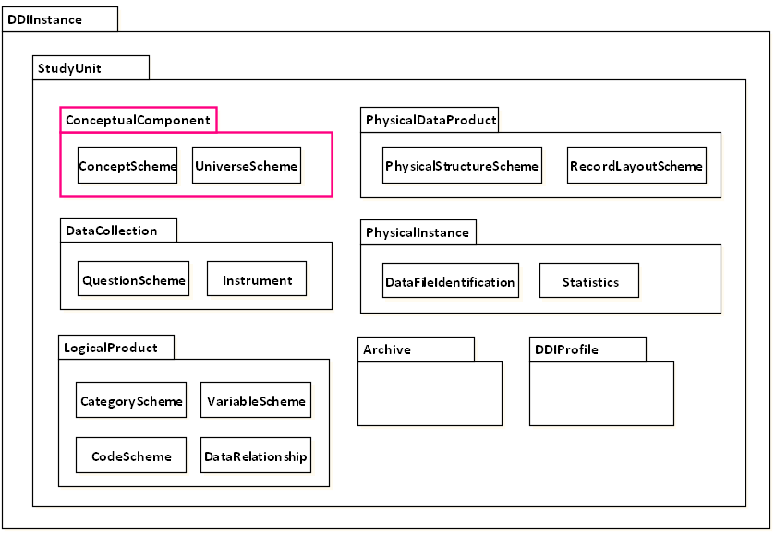
ConceptualComponent
ConceptualComponent

Slide 112
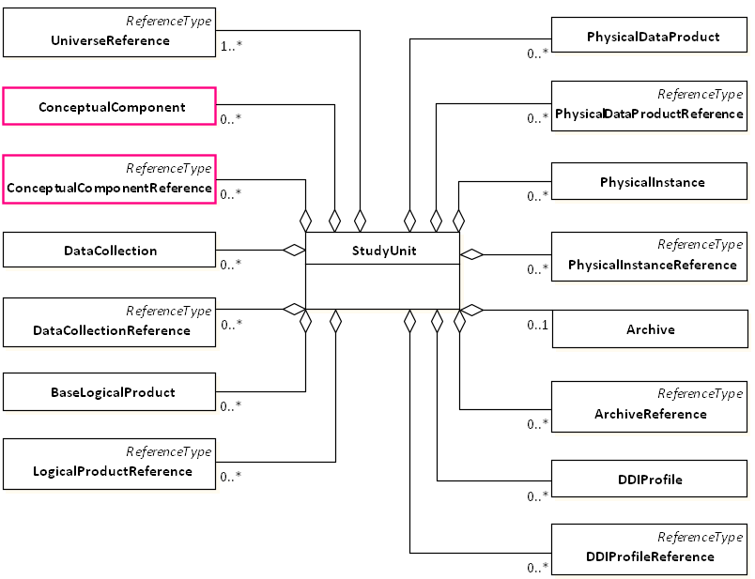
ConceptualComponent

Slide 113
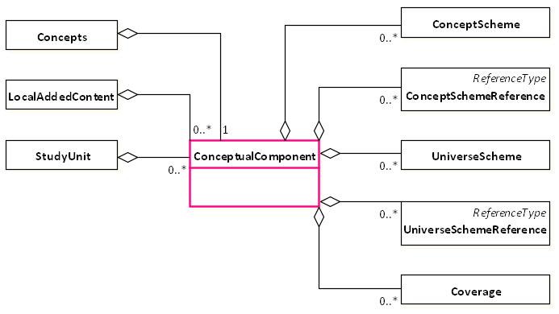
ConceptualComponent

Slide 114

ConceptScheme

Slide 115

ConceptScheme

Slide 116

Concept

Slide 117

Concept

Slide 118

Universe

Slide 119

Universe

Slide 120
What comes next?
Missy – General Information
Requirements to Developers
Use-Cases in Missy
Software Architecture
Multitier
MVC
Missy Data Model
Extendable Data Model
DDI-L Overview
Identification, Versioning, Maintenance
DDI-L Main Structures
DDI Instance
Study Unit
Conceptual Component
Logical Products
Data Collection
disco-model
Presentation
Business Layer

Slide 121

LogicalProduct

Slide 122

LogicalProduct

Slide 123

LogicalProduct

Slide 124

CodeScheme

Slide 125

CodeScheme

Slide 126

Code

Slide 127

Code

Slide 128

CategoryScheme

Slide 129

CategoryScheme

Slide 130

Category

Slide 131

Category

Slide 132

VariableScheme

Slide 133

VariableScheme

Slide 134

Variable

Slide 135

Variable

Slide 136

Representation

Slide 137

Representation

Slide 138

CodeRepresentation

Slide 139

CodeRepresentation

Slide 140

NumericRepresentation

Slide 141

NumericRepresentation

Slide 142

TextRepresentation

Slide 143

TextRepresentation

Slide 144

VariableGroup

Slide 145

VariableGroup

Slide 146
What comes next?
Missy – General Information
Requirements to Developers
Use-Cases in Missy
Software Architecture
Multitier
MVC
Missy Data Model
Extendable Data Model
DDI-L Overview
Identification, Versioning, Maintenance
DDI-L Main Structures
DDI Instance
Study Unit
Conceptual Component
Logical Products
Data Collection
disco-model
Presentation
Business Layer

Slide 147

DataCollection

Slide 148

DataCollection

Slide 149

DataCollection

Slide 150

Methodology

Slide 151

Methodology

Slide 152

CollectionEvent

Slide 153

CollectionEvent

Slide 154

QuestionScheme

Slide 155

QuestionScheme

Slide 156

QuestionItem

Slide 157

QuestionItem

Slide 158

Response Domain

Slide 159

Response Domain

Slide 160

Instrument

Slide 161

Instrument

Slide 162

ControlConstruct

Slide 163

ControlConstructScheme

Slide 164

ControlConstruct

Slide 165

Sequence

Slide 166

Sequence (bahavioral)

Slide 167
Sequence (XML)
<Sequence>
<ControlConstructReference> [Q1] </ControlConstructReference>
<ControlConstructReference> [Q2] </ControlConstructReference>
<ControlConstructReference> [Q3] </ControlConstructReference>
</Sequence>

Slide 168

Sequence (structural)

Slide 169

StatementItem

Slide 170

StatementItem (behavioral)

Slide 171
StatementItem (XML)
<StatementItem>
<DisplayText>
statement
</DisplayText>
</StatementItem>

Slide 172

StatementItem (structural)

Slide 173

QuestionConstruct

Slide 174

QuestionConstruct (behavioral)

Slide 175
QuestionConstruct (XML)
<QuestionConstruct>
<QuestionReference> [Q1] </QuestionReference>
</QuestionConstruct>

Slide 176

QuestionConstruct (structural)

Slide 177

IfThenElse

Slide 178

IfThenElse (behavioral)

Slide 179
IfThenElse (XML)
<IfThenElse>
<IfCondition>
<Code programmingLanguage="…"> yes </Code>
<SourceQuestionReference> [Q1] </SourceQuestionReference>
</IfCondition>
<ThenConstructReference> [Q2] </ThenConstructReference>
<ElseIf>
<IfCondition>
<Code programmingLanguage="…"> no </Code>
<SourceQuestionReference> [Q1] </SourceQuestionReference>
</IfCondition>
<ThenConstructReference> [Q3] </d:ThenConstructReference>
</ElseIf>
</IfThenElse>

Slide 180

IfThenElse (structural)

Slide 181

Loop

Slide 182

Loop (behavioral)

Slide 183
Loop (XML)
<Loop>
<InitialValue>
<Code programmingLanguage=“Java"> i = 0 </Code>
</InitialValue>
<LoopWhile>
<Code programmingLanguage=“Java"> i < 10 </Code>
</LoopWhile>
<StepValue>
<Code programmingLanguage=“Java"> i = i + 1 </Code>
</StepValue>
<ControlConstructReference> [Q1] </ControlConstructReference>
</Loop>

Slide 184

Loop (structural)

Slide 185

RepeatWhile

Slide 186

RepeatWhile (behavioral)

Slide 187
RepeatWhile (XML)
<RepeatWhile>
<WhileCondition>
<Code programmingLanguage=“Neutral"> no </Code>
<SourceQuestionReference> [Q1] </ SourceQuestionReference >
</WhileCondition>
<WhileConstructReference> [Q1] </WhileConstructReference>
</RepeatWhile>

Slide 188

RepeatWhile (structural)

Slide 189

RepeatUntil

Slide 190

RepeatUntil (behavioral)

Slide 191
RepeatUntil (XML)
<RepeatUntil>
<UntilCondition>
<Code programmingLanguage="Neutral"> yes </Code>
<SourceQuestionReference> [Q1] </SourceQuestionReference>
</UntilCondition>
<UntilConstructReference> [Q1] </UntilConstructReference>
</d:RepeatUntil>

Slide 192

RepeatUntil (structural)

Slide 193
What comes next?
Missy – General Information
Requirements to Developers
Use-Cases in Missy
Software Architecture
Multitier
MVC
Missy Data Model
Extendable Data Model
DDI-L Overview
Identification, Versioning, Maintenance
DDI-L Main Structures
DDI Instance
Study Unit
Conceptual Component
Logical Products
Data Collection
disco-model
Presentation
Business Layer

Slide 194


Slide 195

How to extend the disco model?

Slide 196
What we have seen so far
An introduction to the core DDI modules
A short introduction to the disco-model, which covers the most important parts of DDI-Lifecycle and DDI-Codebook

Slide 197
How the presentation is continued
Now that we know the data model…
How can it be used for the Missy use-case, Matthäus?
Can we create a mapping of the fields in the disco-model and the fields in Missy?

Slide 198
What comes next?
Missy – General Information
Requirements to Developers
Use-Cases in Missy
Software Architecture
Multitier
MVC
Missy Data Model
Extendable Data Model
DDI-L Overview
Identification, Versioning, Maintenance
DDI-L Main Structures
DDI Instance
Study Unit
Conceptual Component
Logical Products
Data Collection
disco-model
Presentation
Business Layer
Notes:
Time: 20-25 minutes

Slide 199

Use-case “variable details”

Slide 200


Slide 201



Slide 202


Slide 203



Slide 204


Slide 205


Sub-Sample:
is-a Sub-Universe with the UniverseType „subSample“
Filter Statement
is-a Sub-Universe with the UniverseType „filterStatement“

Slide 206


Slide 207


Slide 208


Slide 209


Slide 210


Slide 211


Slide 212


Slide 213


Slide 214
What we have seen so far
disco-model
designed for the discovery use-case
provides object types, properties and data type properties designed for discovery use-case
One Missy use-case and all the data type and object properties that are covered
The idea of how theoretically the disco can be extended

Slide 215
How the presentation is continued
But, what if a project has specific requirements to the model, that are not covered by the disco model?
How are we going to implement that?

Slide 216
What comes next?
Missy – General Information
Requirements to Developers
Use-Cases in Missy
Software Architecture
Multitier
MVC
Missy Data Model
Extendable Data Model
DDI-L Overview
Identification, Versioning, Maintenance
DDI-L Main Structures
DDI Instance
Study Unit
Conceptual Component
Logical Products
Data Collection
disco-model
Presentation
Business Layer

Slide 217

Business Logic

Slide 218


Slide 220
disco-model API
The disco-model implementation is designed to be extended
For one project’s individual requirements
Speaking in MVC-pattern language: the model is separated and independent from the views and the controllers

Slide 221
disco-model API
abstract classes
define the basic elements, i.e. data type and object properties, that are provided and covered by the disco-model
may be extended, but cannot be instantiated
e.g. AbstractVariable
model classes
represent the actual entity types of disco-model
may be instantiated and reused
e.g. Variable

Slide 222
disco-model API
abstract classes
define the basic elements, i.e. data type and object properties, that are provided and covered by the disco-model
may be extended, but cannot be instantiated
e.g. AbstractVariable
model classes
represent the actual entity types of disco-model
may be instantiated and reused
e.g. Variable
Implementation of the Template Pattern

Slide 223


Slide 224
Provided Types

Slide 225
Project specific extensions

Slide 226
Project Specific Extensions
Projects may just simply use
and extend the defined classes
Introduce new fields and methods, such as getter/setter
Change the type of existing fields when they overwrite the return type (in Java this is only possible in case of covariant returns)

Slide 227
How is the presentation continued
Now that I have the data model… and I can extend it
I just need to store my data somewhere…
Are there any persistence mechanisms that are offered by the DDI-Lifecycle model?

Slide 228
Outline
Persistence Layer
Programming Interface
Types of physical data storages
Examples
Physical Data Product
Physical Instance
Archive
DDIProfile
DDI Serialization Examples
DDI-XML
DDI-RDF / disco-spec
Relational-DB
Data Storage Access
Outlook
Data Storage
Notes:
Time: 10 minutes

Slide 229

PhysicalDataProduct

Slide 230

PhysicalDataProduct

Slide 231

PhysicalDataProduct

Slide 232
Outline
Persistence Layer
Programming Interface
Types of physical data storages
Examples
Physical Data Product
Physical Instance
Archive
DDIProfile
DDI Serialization Examples
DDI-XML
DDI-RDF / disco-spec
Relational-DB
Data Storage Access
Outlook
Data Storage

Slide 233

PhysicalInstance

Slide 234

PhysicalInstance

Slide 235

PhysicalInstance

Slide 236
Outline
Persistence Layer
Programming Interface
Types of physical data storages
Examples
Physical Data Product
Physical Instance
Archive
DDIProfile
DDI Serialization Examples
DDI-XML
DDI-RDF / disco-spec
Relational-DB
Data Storage Access
Outlook
Data Storage

Slide 237

Archive

Slide 238

Archive

Slide 239

Archive
Contains persistent lifecycle events
Contains archive-specific information (archive reference, access, funding)

Slide 240
Outline
Persistence Layer
Programming Interface
Types of physical data storages
Examples
Physical Data Product
Physical Instance
Archive
DDIProfile
DDI Serialization Examples
DDI-XML
DDI-RDF / disco-spec
Relational-DB
Data Storage Access
Outlook
Data Storage

Slide 241

DDIProfile

Slide 242

DDIProfile

Slide 243

DDIProfile
Describes which DDI-L elements you use in your institution’s DDI flavor

Slide 244
How the presentation is continued
How can the disco-model be persisted?
and
How can it be done in a project with individual data model elements?
How do we do this in the Missy application?

Slide 245
Outline
Persistence Layer
Programming Interface
Types of physical data storages
Examples
Physical Data Product
Physical Instance
Archive
DDIProfile
DDI Serialization Examples
DDI-XML
DDI-RDF / disco-spec
Relational-DB
Data Storage Access
Outlook
Data Storage
Notes:
Time: 10-15 minutes

Slide 246
Data Storage Access

Slide 247


Slide 249
Persistence Layer – Motivation
In a well-defined software architecture the application itself does not need to know how the data is stored
It just needs to know the API
Methods that are provided to access and store objects
May be abstracted away from the actual implementation
An actual implementation or strategy can just be a matter of configuration

Slide 250
Persistence Layer – Strategy Pattern
Implementation of the Strategy Pattern
simple interface
actual implementations are the different strategies
A strategy is an implementation of the actual type of persistence or physical storage, respectively
e.g. DDI-L-XML, DDI-RDF, XML-DB, Relational-DB, etc.

Slide 252
Modules
disco-persistence-api
Defines persistence functionality for model components regardless of the actual type of physical persistence
disco-persistence-relational
Implements the persistence functionality defined in disco-persistence-api with respect to the usage of relational DBs
disco-persistence-xml
Implements the persistence functionality defined in disco-persistence-api with respect to the usage of DDI-XML
disco-persistence-rdf
Implements the persistence functionality defined in disco-persistence-api with respect to the usage of the disco-specification

Slide 253
Data Access Object
A DAO is an object that is responsible for providing methods for reading and storing of objects in our model
A DAO is again implemented against an interface
For each business object in the data model there exists a DAO
Persistence strategy interface defines methods for obtaining specific DAOs (data access objects)

Slide 254

DAO Pattern

Slide 255
disco-persistence-api
Provides an API and implementations for the disco-model
PersistenceService
Available in the disco-persistence-api
Encapsulates the actual strategy
Strategy can be instantiated and injected into the PersistenceService

Slide 256
Extendable disco-persistence-api
But, projects have own requirements to the data model
=> new business objects are included
=> DAOs need to be written for reading and storing these objects
=> these DAOs also have to implement the appropriate type of persistence used by that project
=> this API has to be extendable

Slide 257
Extendable disco-persistence-api
But, projects have own requirements to the data model
=> new business objects are included
=> DAOs need to be written for reading and storing these objects
=> these DAOs also have to implement the appropriate type of persistence used by that project
=> this API has to be extendable
Luckily it is, because of the interface structure!
Projects only need to implement the defined methods

Slide 260
Missy Specific Modules
missy-persistence-api
Defines additional persistence functionality for model components regardless of the actual type of physical persistence
missy-persistence-relational
Implements additional persistence functionality for model components with respect to the usage of relational DBs
missy-persistence-xml
Implements additional persistence functionality for model components with respect to the usage of DDI-XML
missy-persistence-rdf
Implements additional persistence functionality for model components with respect to the usage of the disco-specification

Slide 261
What we have seen so far
Implementation of a persistence API for the disco model
How the persistence API can be extended in individual projects

Slide 262
How the presentation is continued
How does, on the persistence level, the serialization of data stored in DDI really look like?

Slide 263
Outline
Persistence Layer
Programming Interface
Types of physical data storages
Examples
Physical Data Product
Physical Instance
Archive
DDIProfile
DDI Serialization Examples
DDI-XML
DDI-RDF / disco-spec
Relational-DB
Data Storage Access
Outlook
Data Storage
Notes:
Time: 5-10 minutes

Slide 264

Questionnaire - Question

Slide 265

Questionnaire – Question (DDI 3.1 XML)

Slide 266
DataCollection
Instrument
IntrumentName
ControlConstructReference
ControlCostructScheme
QuestionConstruct
QuestionReference
QuestionScheme
QuestionItem
QuestionItemName
QuestionText

Slide 267

Questionnaire – Question (DDI-RDF)

Slide 268

Variable - SummaryStatistics

Slide 269
Variable – SummaryStatistics (DDI 3.1 XML)
PhysicalInstance
Statistics
VariableStatistics
VariableReference
SummaryStatistic
SummaryStatisticType
'Minimum'
Value
10
Variable
VariableName
'v1'
Label
'Age'

Slide 270

Variable – SummaryStatistics (DDI-RDF)

Slide 271
Outline
Persistence Layer
Programming Interface
Types of physical data storages
Examples
Physical Data Product
Physical Instance
Archive
DDIProfile
DDI Serialization Examples
DDI-XML
DDI-RDF / disco-spec
Relational-DB
Data Storage Access
Outlook
Data Storage
Notes:
Time: 5 minutes

Slide 272
Relational-DB Example

Slide 273
Relational-DB Example

Slide 274

Relational-DB Example

Slide 275
Inheritance of Properties
From Identifiable

Slide 276
Inheritance of Properties
From abstract class

Slide 277
Declaration of own Properties
Own properties

Slide 278
What comes next?
What are you going to do with the MISSY project?
Is there ongoing work?

Slide 279
Outline
Persistence Layer
Programming Interface
Types of physical data storages
Examples
Physical Data Product
Physical Instance
Archive
DDIProfile
DDI Serialization Examples
DDI-XML
DDI-RDF / disco-spec
Relational-DB
Data Storage Access
Outlook
Data Storage
Notes:
Time: 5 minutes

Slide 280
Outlook
YES! There is ongoing work!
Use the API in other projects, e.g. GESIS internal projects like StarDat
Publish the persistence API as open-source on github
Two presentations at IASSIST 2013
One poster at IASSIST 2013

Slide 281
Poster
Shows detailed information regarding Missy
Multitier Architecture, MVC
Employed Technologies
Specific Maven Modules
Project Home
Excerpts from disco-model and the mapping of the fields

Slide 282


Slide 283
Thank you for your attention…
Feel free to download the sources from GitHub:
https://github.com/missy-project
Give us feedback!
Feel free to criticize!
Thomas Bosch
GESIS - Leibniz Institute for the Social Sciences
thomas.bosch@gesis.org
boschthomas.blogspot.com
Matthäus Zloch
GESIS - Leibniz Institute for the Social Sciences
matthaeus.zloch@gesis.org

