Slide 1
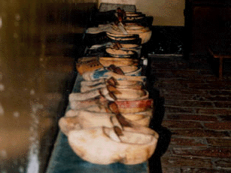
Cultural Changes in the Netherlands, Moving from DDI Codebook to DDI Lifecycle Marion Wittenberg (DANS) Edwin de Vet (CentERdata)
Data Archiving and Networked Services

Slide 2
Outline of the presentation
Background of the study Cultural Changes
The old question bank
Moving form DDI codebook to DDI lifecycle
DDI issues (Edwin)

Slide 3



Cooperation of
SCP (the Netherlands Institute of Social Research)
CentERdata
DANS
Conversion of Question Databank Cultural Changes in an instance of Questasy (databank of Centerdata)
Project has started in November 2012

Slide 4
The Survey Cultural Changes
The Netherlands Institute for Social Research (SCP)
Cross section survey since 1975
It measures changes in general opinions and attitudes of the Dutch population
Annual till 1999, biannual since then
Face to face and drop-off questionnaire
Until 2002 International Social Survey Programme (ISSP) part of questionnaire

Slide 5
Question databank Cultural changes (1)
Documentation of every round
Variables keep their variable name over time
Variables can be part of blocks / sets
Emphasis on question wordings
Small changes in wordings can occur
Answer categories
Sample / routing information
Interview instructions
Concepts, keywords and notes

Slide 6
Disadvantages of this system
Back office system, not web based
Only available for researchers of the SCP
Study information in other system
Data in other system
Tool developed in 2001
An advantage: DANS has used the content for their NESTAR DDI descriptions

Slide 7
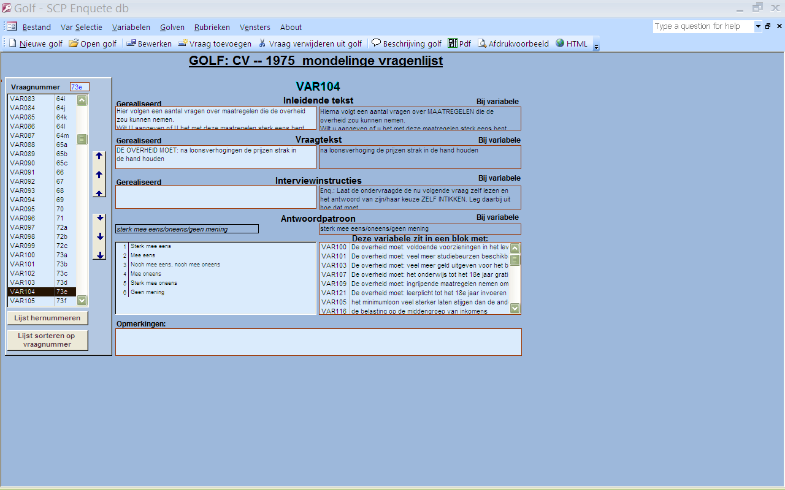
Question belonging to variable var104 in old questionbank

Slide 8
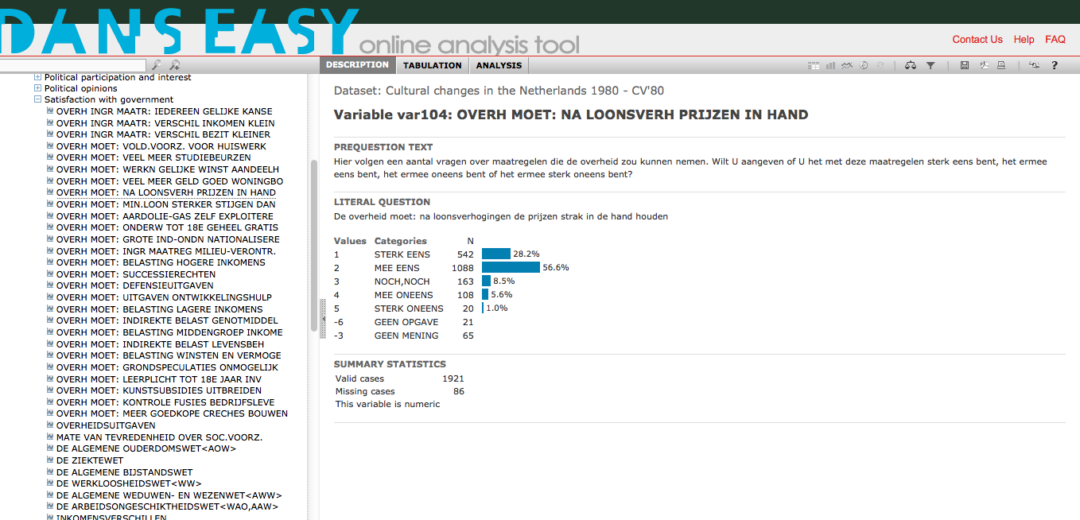
variable var104 in NESSTAR

Slide 9
Conversion of metadata into Questasy
answer categories DDI-codebook
Question database
Cultural Changes
NESSTAR DDI
Cultural Changes
Instance of Questasy

Slide 10
Issues
Variables in Cultural Changes keep their name over time > need for versioning in Questasy
But sometimes there are little changes in question wordings > how to deal with that
Blocks of questions differ over time
Questasy is build for panels, Cultural Changes is a cross section survey > consequences for shopping basket

Slide 11
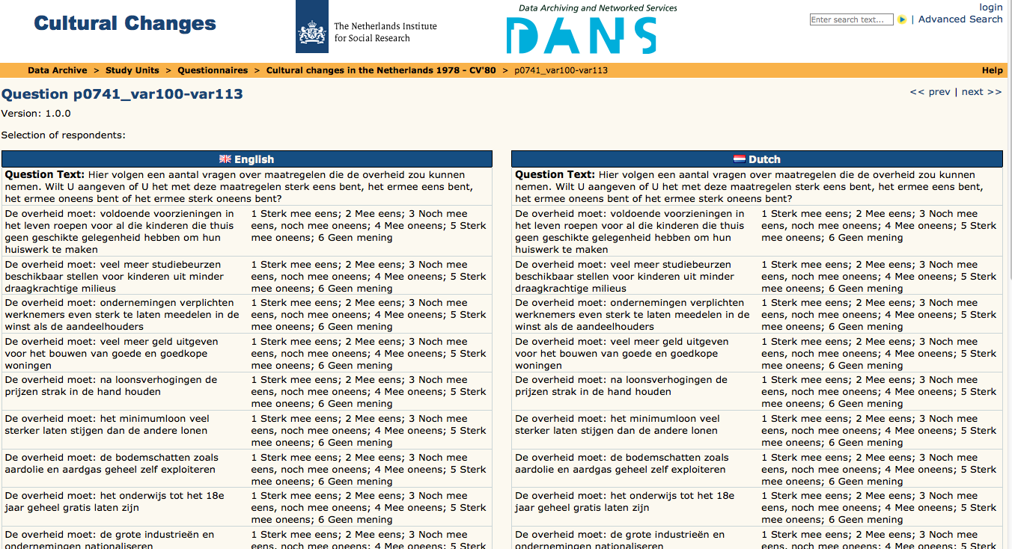
Question belonging to variable var104 in Questasy

Slide 12

Thank you for your attention
For more information please contact
marion.wittenberg@dans.knaw.nl

