Slide 1
Questasy: Documenting and Disseminating Longitudinal Data Online with DDI 3
Edwin de Vet
Notes:
Because some people in the audience are more familiar with Questasy than others, I'll start
off by overviewing the issues Questasy solves, then talk more specifically about how the
product works and show a demo.

Slide 2
CentERdata
Research institute
University of Tilburg, Netherlands
Data collection
Manage several panels
Quantitative Analysis
Software solutions
Notes:
Non-profit organization founded in 1997
Manage panels including the LISS Panel of the MESS Project, the CentERpanel, the DHS Panel, and more
Software solutions
Several tools for data collection and dissemination for major research projects including
LISS panel in Netherlands
Understanding Society in UK
European Values Study & SHARE project across Europe
DDI tools include Questasy and DatapluS project (in IASSIST session D1 on Thursday morning )

Slide 3
LISS Panel
~6000 households in Netherlands
Studies conducted on various schedules
Includes longitudinal studies
Datasets prepared on various schedules
Notes:
6000 households with almost 10,000 panel members
Questasy started out of a need for a dissemination system for the LISS Panel
Longitudinal Panel
Track Studies & Questions as they are used across waves
Present this to researchers

Slide 4
“DDI is Complex”
Study Unit
Conceptual Component
Concept Scheme
Data Collection
Logical Product
Physical Instance
Collection Event
Question Scheme
Construct Scheme
Question Item
Question Construct
Concept
Category Scheme
Category
Code Scheme
Code
Variable Scheme
Variable
Phys. Data Product
Notes:
This a extremely simplified view of a DDI Study Unit
There are many items to manage, and the terminology is confusing to administrators/researchers

Slide 5
Questasy Hides DDI Complexity
Study Unit
Conceptual Component
Concept
Data Collection
Logical Product
Data File
Collection Event
Question-naire
Question Scheme
Question Construct
Concept Scheme
Category Scheme
Category
Code Scheme
Code
Variable Scheme
Variable
Dataset
Question Item
Notes:
Questasy simplifies the management & terminology
Uses terms that make sense to researchers
Automatically manages the elements marked in grey boxes, so administrators don’t have to worry about it. They can focus on the content that matters (Questions, Variables, Concepts) without worrying about all the DDI relationships.
Even better, it manages them for multiple studies, including longitudinal studies.

Slide 6
Questasy
Web application based on DDI 3
Manages data & metadata
Administrator Interface
Data entry without DDI knowledge
Researcher Interface
Browse/search metadata
Download data, variable export
Public Interface
Browse/search metadata
Notes:
Questasy is a web application
Manages the metadata and data files, primarily for longitudinal panels
The admin interface went live in January 2009, and that’s when metadata entry started.
The researcher interface went live 2 months later for researchers to access the data/metadata

Slide 7
Questasy Architecture
Notes:
MVC Architecture, model based on DDI 3
code is easy to maintain & add features
?
Written in PHP using MySQL database
Runs on Windows, Linux, etc.

Slide 8
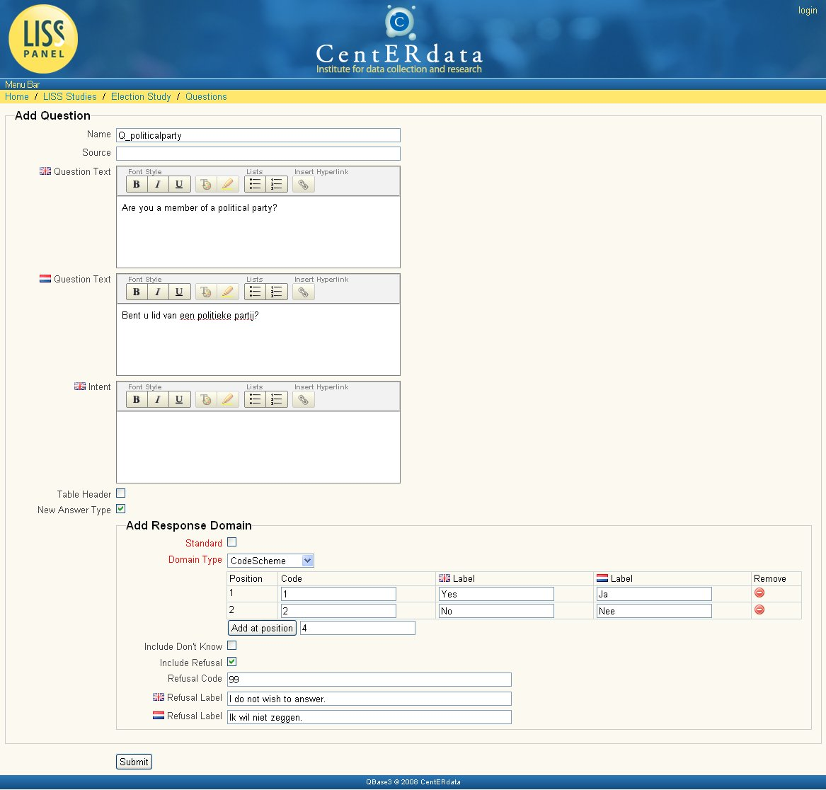
Add Question Item
Question Item
Response Domain
Code Scheme
Code (multiple)
Category Scheme
Category (multiple)
Notes:
Administrators fill out one simple form, Questasy manages all the DDI elements and relationships automatically.
Questasy also supports multiple languages. For the LISS panel, we document surveys in both English and Dutch.

Slide 9
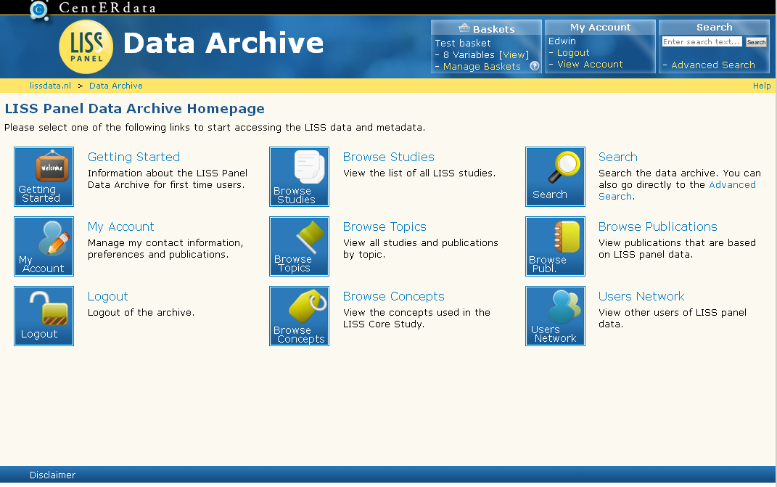
Researcher Interface

Slide 10
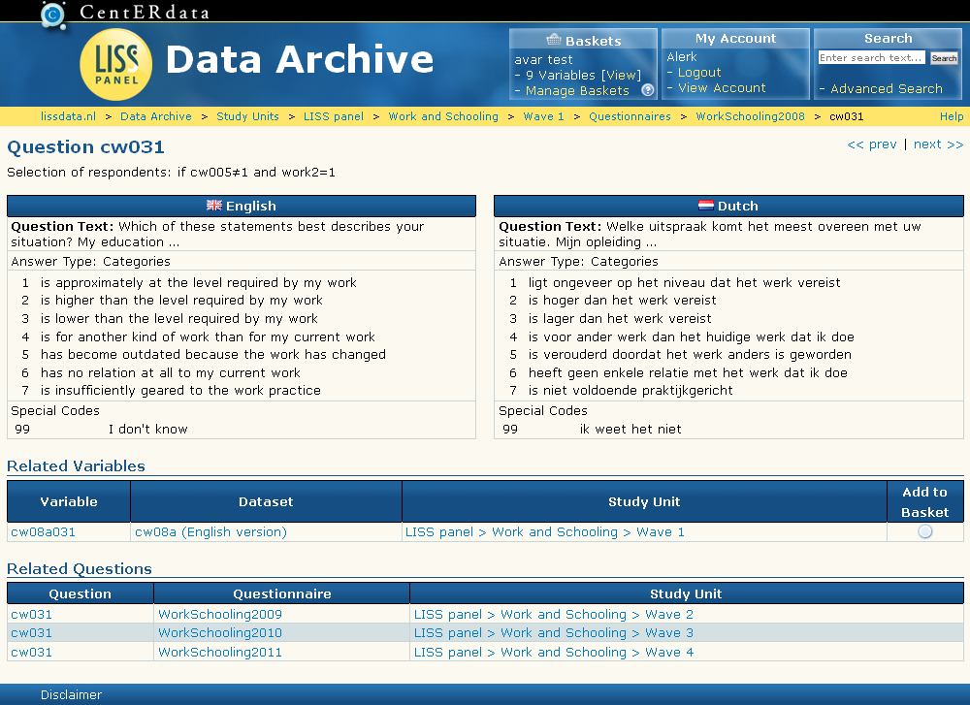
Question View

Slide 11
Questasy Relationships

Slide 12
Other Recent Features
Version 3.4
Support for multiple panels
Themes
Search Engine Optimization (SEO)
Performance Improvements
Version 4.0
Variable Baskets
Custom datasets
Custom codebooks

Slide 13
Questasy version 4.1
New view for study units
Images inside questions
Search function improved + restyled
Versioning of questions
Variable basket: long format data support

Slide 14
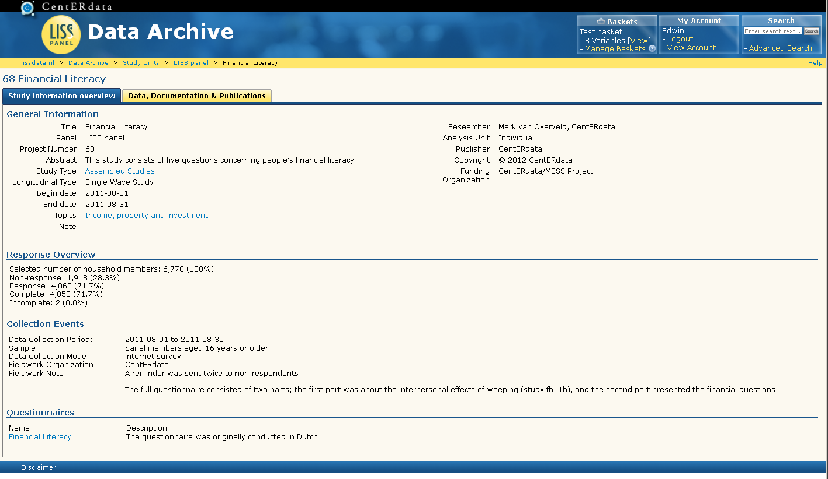
Study Unit View - Tab 1

Slide 15
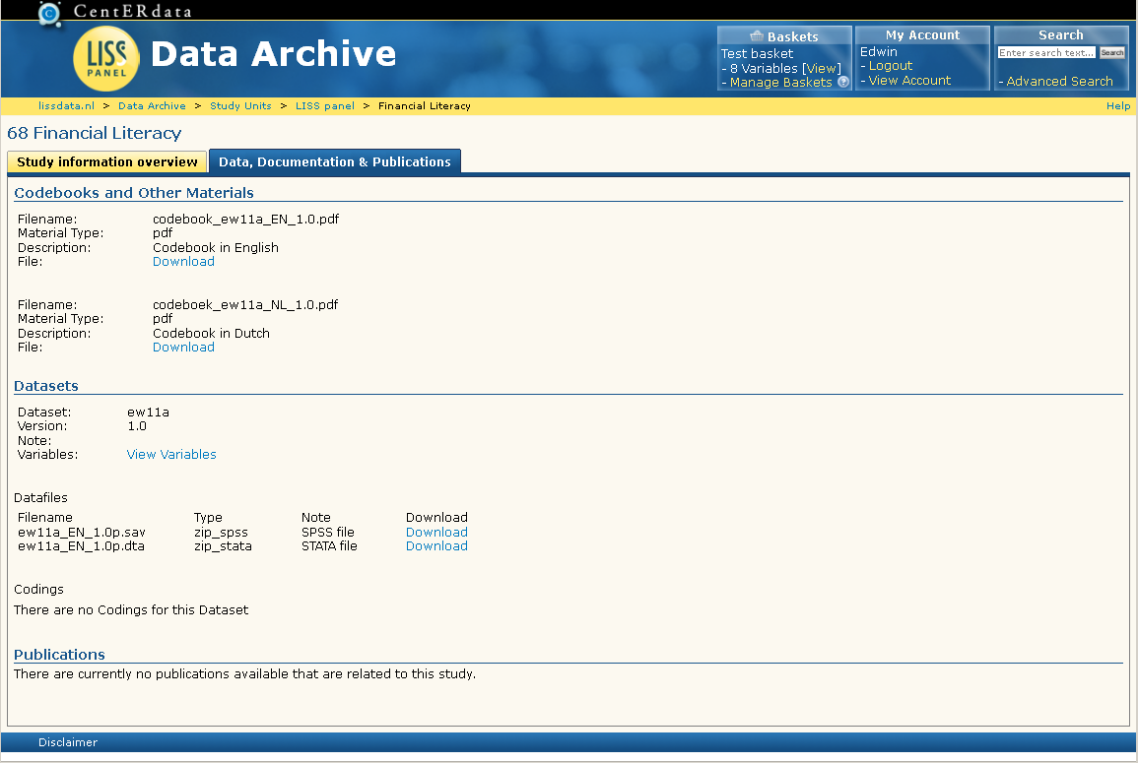
Study Unit View – Tab 2

Slide 16
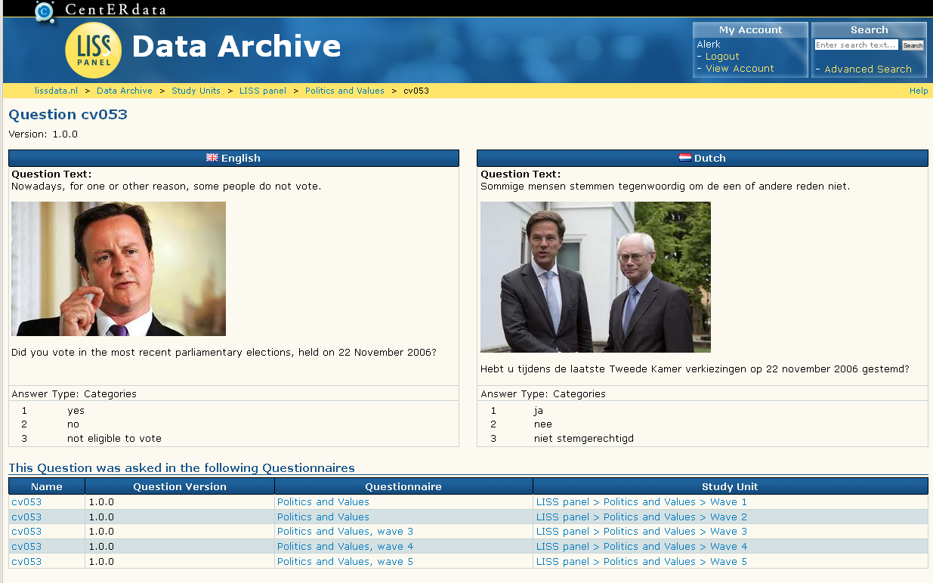
Images in Questions

Slide 17
Indexed Search Engine
Sphinx search engine
Indexed fields defined in configuration file
Added: search for files and datasets
Pagination of search results
Filtering of search results

Slide 18
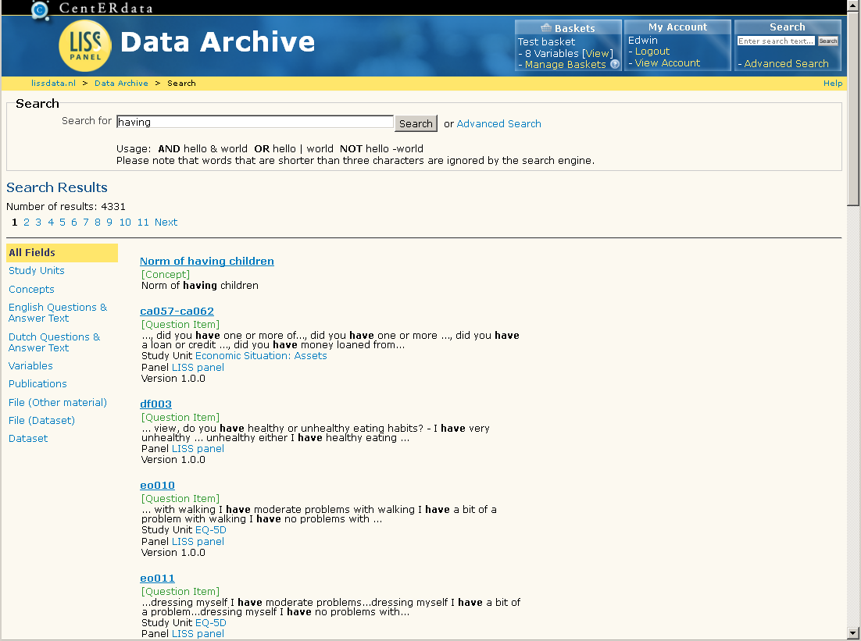
Search Results

Slide 19
Versioning of Questions
Simple implementation without major restructuring of the database
Added a ‘version’ column to question items table
Mainly relevant for longitudinal studies

Slide 20
Versioning of Questions
Question items are each other versions if:
Have the same name
Are located in the same question scheme
Have a different version number

Slide 21
Versioning – Longitudinal Study
QI
1.0.0
QC Wave 1
QC Wave 2
QC Wave 3
QC Wave 4
QC Wave 5
QI
1.0.0
QI
1.0.2
QC Wave 1
QC Wave 2
QC Wave 3
QC Wave 4
QC Wave 5

Slide 22
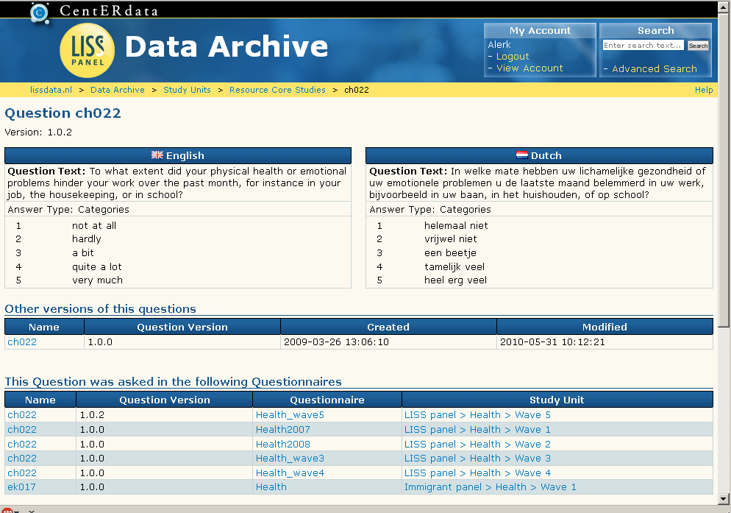
View of Versioned Question

Slide 23
Versioning of Questions - Tables
Table headers with subquestions
Versioned as one block
If the header or one of the subquestions changes, a new version of the complete block is created
The header and subquestions have all the same version number

Slide 24
Variable Baskets
Researchers can choose variables to create custom datasets
Questasy baskets
Variable baskets per panel
Each researcher can create/manage multiple baskets
Basket management integrated into web interface
Download custom datasets along with custom codebooks

Slide 25
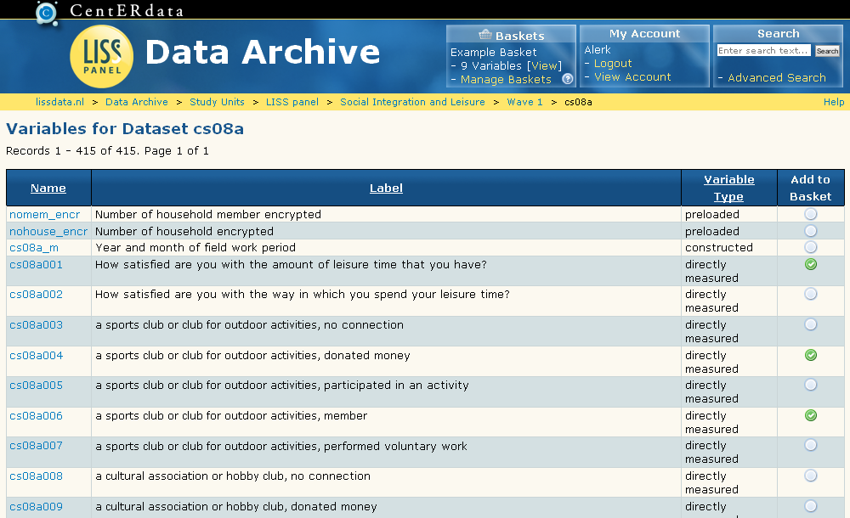
Add Variables to Basket

Slide 26
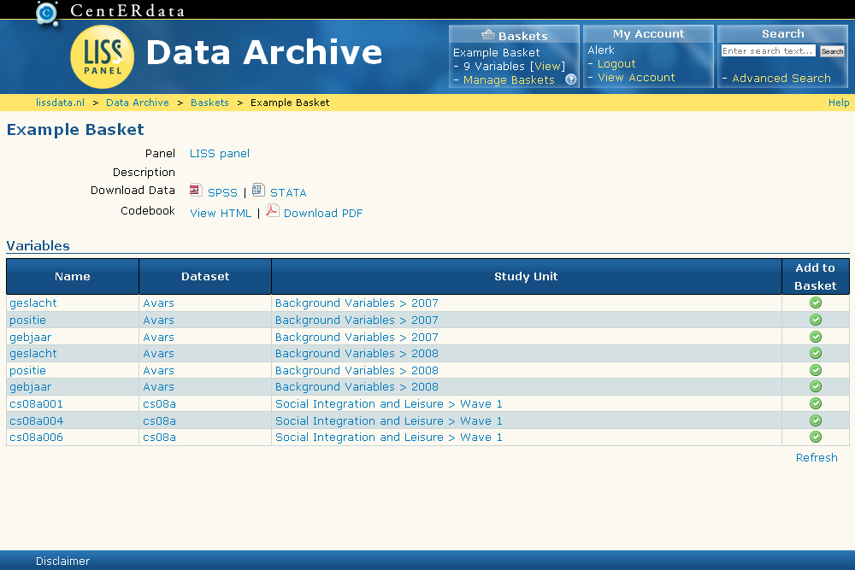
Basket Download

Slide 27
Wide versus Long Format
Wide Data: one row for each individual
Long Format Data: multiple rows for each individual
Examples of Long Format Data:
Background variables
Weigh data

Slide 28
Basket – Wide versus Long
Only wide format
Join variable -> Id of individual
Wide format + Long format
Join variable -> Id of individual
Wave -> Year + Month

Slide 29
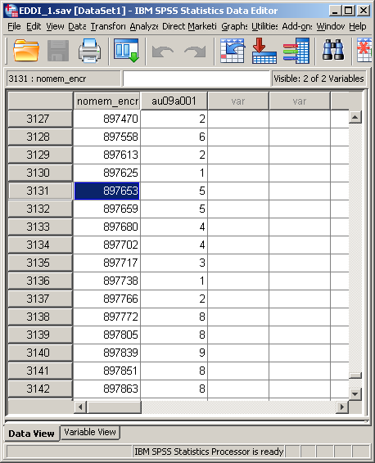
Basket – One Wide Variable

Slide 30
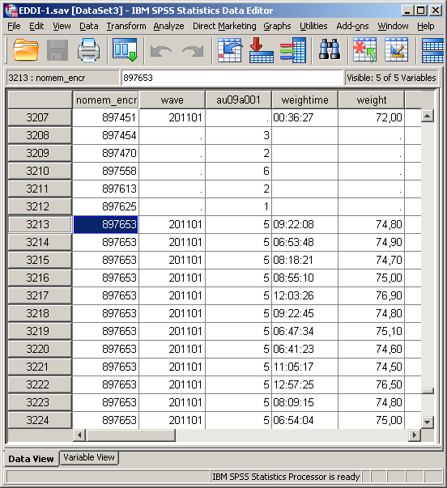
Basket – Adding Long Format

Slide 31
Licensing
Free
Including source code
License agreement available
Available for non-profit scientific & government institutes

