Slide 1
Data and Metadata Management: A Business Perspective
Wendy Thomas – Minnesota Population Center
Marcel Hebing – German Socio-Economic Panel Study (SOEP), DIW Berlin
EDDI 2012
EDDI-2012_Business by Wendy Thomas and Marcel Hebing is licensed under a Creative Commons Attribution-NonCommercial\\\\-ShareAlike 3.0 Unported License.

Slide 2
Credits
UPDATE IN THE END!
Slides 1-7, 13-14, 64-65 Wendy Thomas
Slide 53 Herve L’Hours (UKDA)
Remainder of Slides:
The slides were developed for several DDI workshops at IASSIST conferences and at GESIS training in Dagstuhl/Germany
Major contributors
Wendy Thomas, Minnesota Population Center
Arofan Gregory, Open Data Foundation
Further contributors
Joachim Wackerow, GESIS – Leibniz Institute for the Social Sciences
Pascal Heus, Open Data Foundation
Attribute: http://creativecommons.org/licenses/by-sa/3.0/legalcode

Slide 3
PART I
Introduction to DDI

Slide 4
Welcome and outline
Introduction to DDI

Slide 5
Outline
Introduction to DDI
Welcome
DDI in 60 Seconds
Processes
DDI-Standard
Tools
Codebook and Lifecycle
Advanced Topics
DDI-L in Detail
Questionnaire example
Schemes and Reuse
Comparison
Question & Answer
Conclusion

Slide 6
Introductions
Who are you?
What does your organization do?
Data collection
Data production
User access
Preservation
What is the scale of your operations?

Slide 7
Changes in the environment:
Expanded access to data
Data available through multiple portals
Cross portal access
Linking and layering of data from different sources and different disciplines
Cost of developing system specific software
Cost of non-interoperability over the life of the data

Slide 8
The Challenge
In a large organization, there are many different streams of data production
“Silos” tend to emerge, each with a different set of systems and processes
This makes the management of data, metadata, and the production process very difficult – the different systems/silos don’t interoperate easily
It is difficult to realize the vision of “industrialized” data production, with its attendant efficiencies

Slide 9
Why Such a Mess?
Everyone thinks their data are special
And they are right – they are special…
They’re just not as special as they think!
The point is that good IT solutions for data management can be built on the basis of the similarities across the silos
Computers can’t think!
They manipulate the structural aspects of data
The structural aspects of data are the same

Slide 10

Ddi 3 in 60 seconds
Introduction to DDI

Slide 11
using
Study
Survey
Instruments
measures
made up of
about
Concepts
Questions
Universes
Copyright © GESIS – Leibniz Institute for the Social Sciences, 2010
Published under Creative Commons Attribute-ShareAlike 3.0 Unported

Slide 12
Categories/
Codes,
Numbers
with values of
Questions
Variables
collect
made up of
Responses
Data Files
resulting in
Copyright © GESIS – Leibniz Institute for the Social Sciences, 2010
Published under Creative Commons Attribute-ShareAlike 3.0 Unported

Slide 13
processes
Introduction to DDI

Slide 14
Looking at your organization
What activities take place and what materials do they involve?
What specific processes take place and in what order?
Which processes produce metadata of what type?
What are the critical activities or processes?
What do you control?

Slide 15
Traditional Process Model
Environment
Process
INPUT
OUTPUT

Slide 16
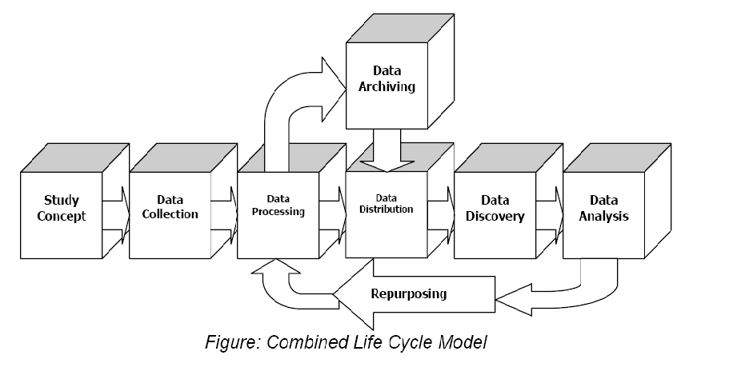
DDI Lifecycle Model
Metadata Reuse
Notes:
16

Slide 17
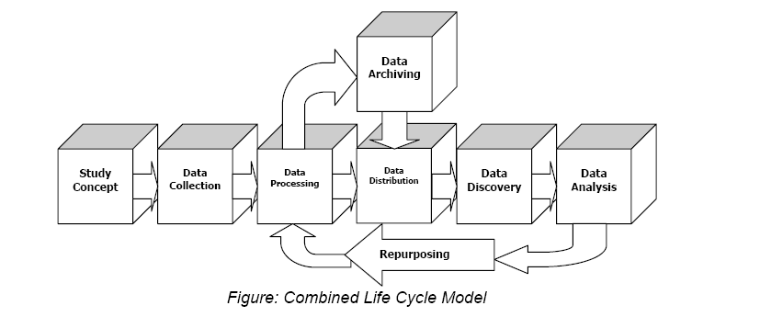
Data/Metadata Life Cycle Orientation
pre-production production post-production
secondary use
new research
effort
Notes:
Using Data Documentation Initiative (DDI) Guidelines
3MC Conference, 2008, Berlin
17
17

Slide 18
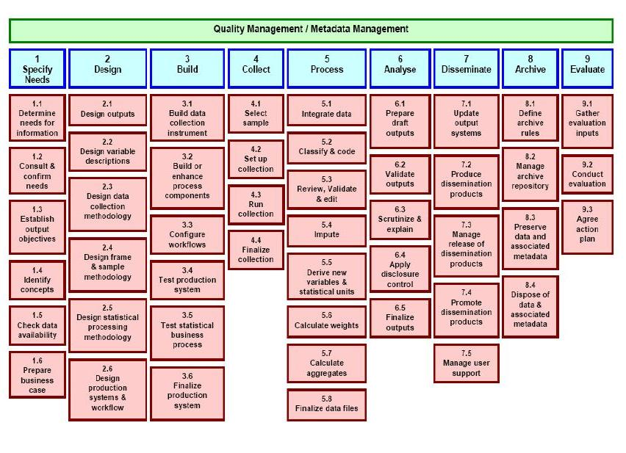

Slide 19
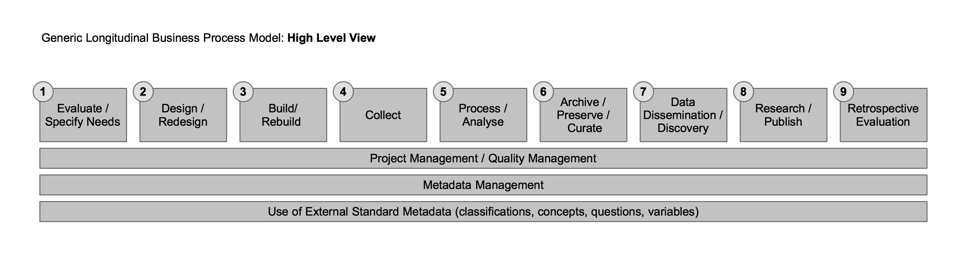
Note the similarity to the DDI Combined Lifecycle Model
and the top level of the GSBPM

Slide 20
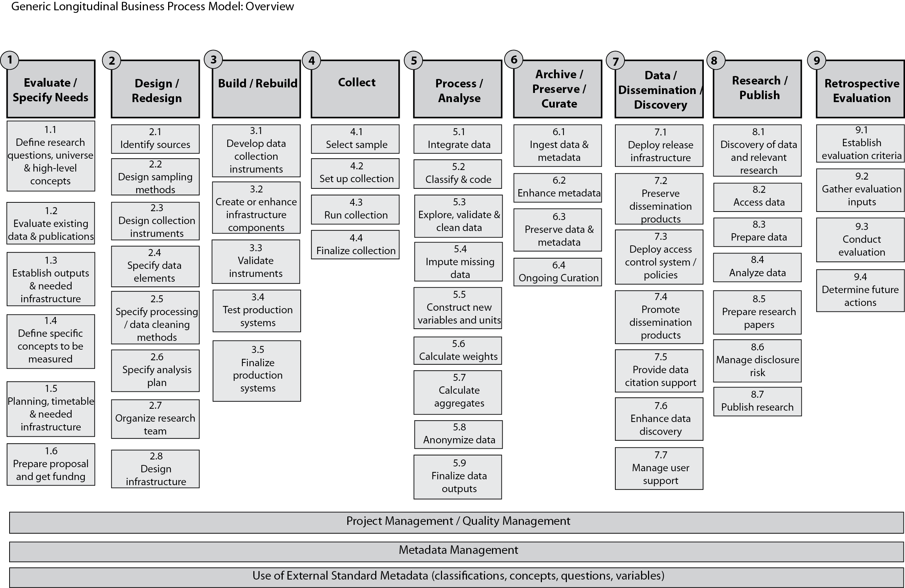

Slide 21
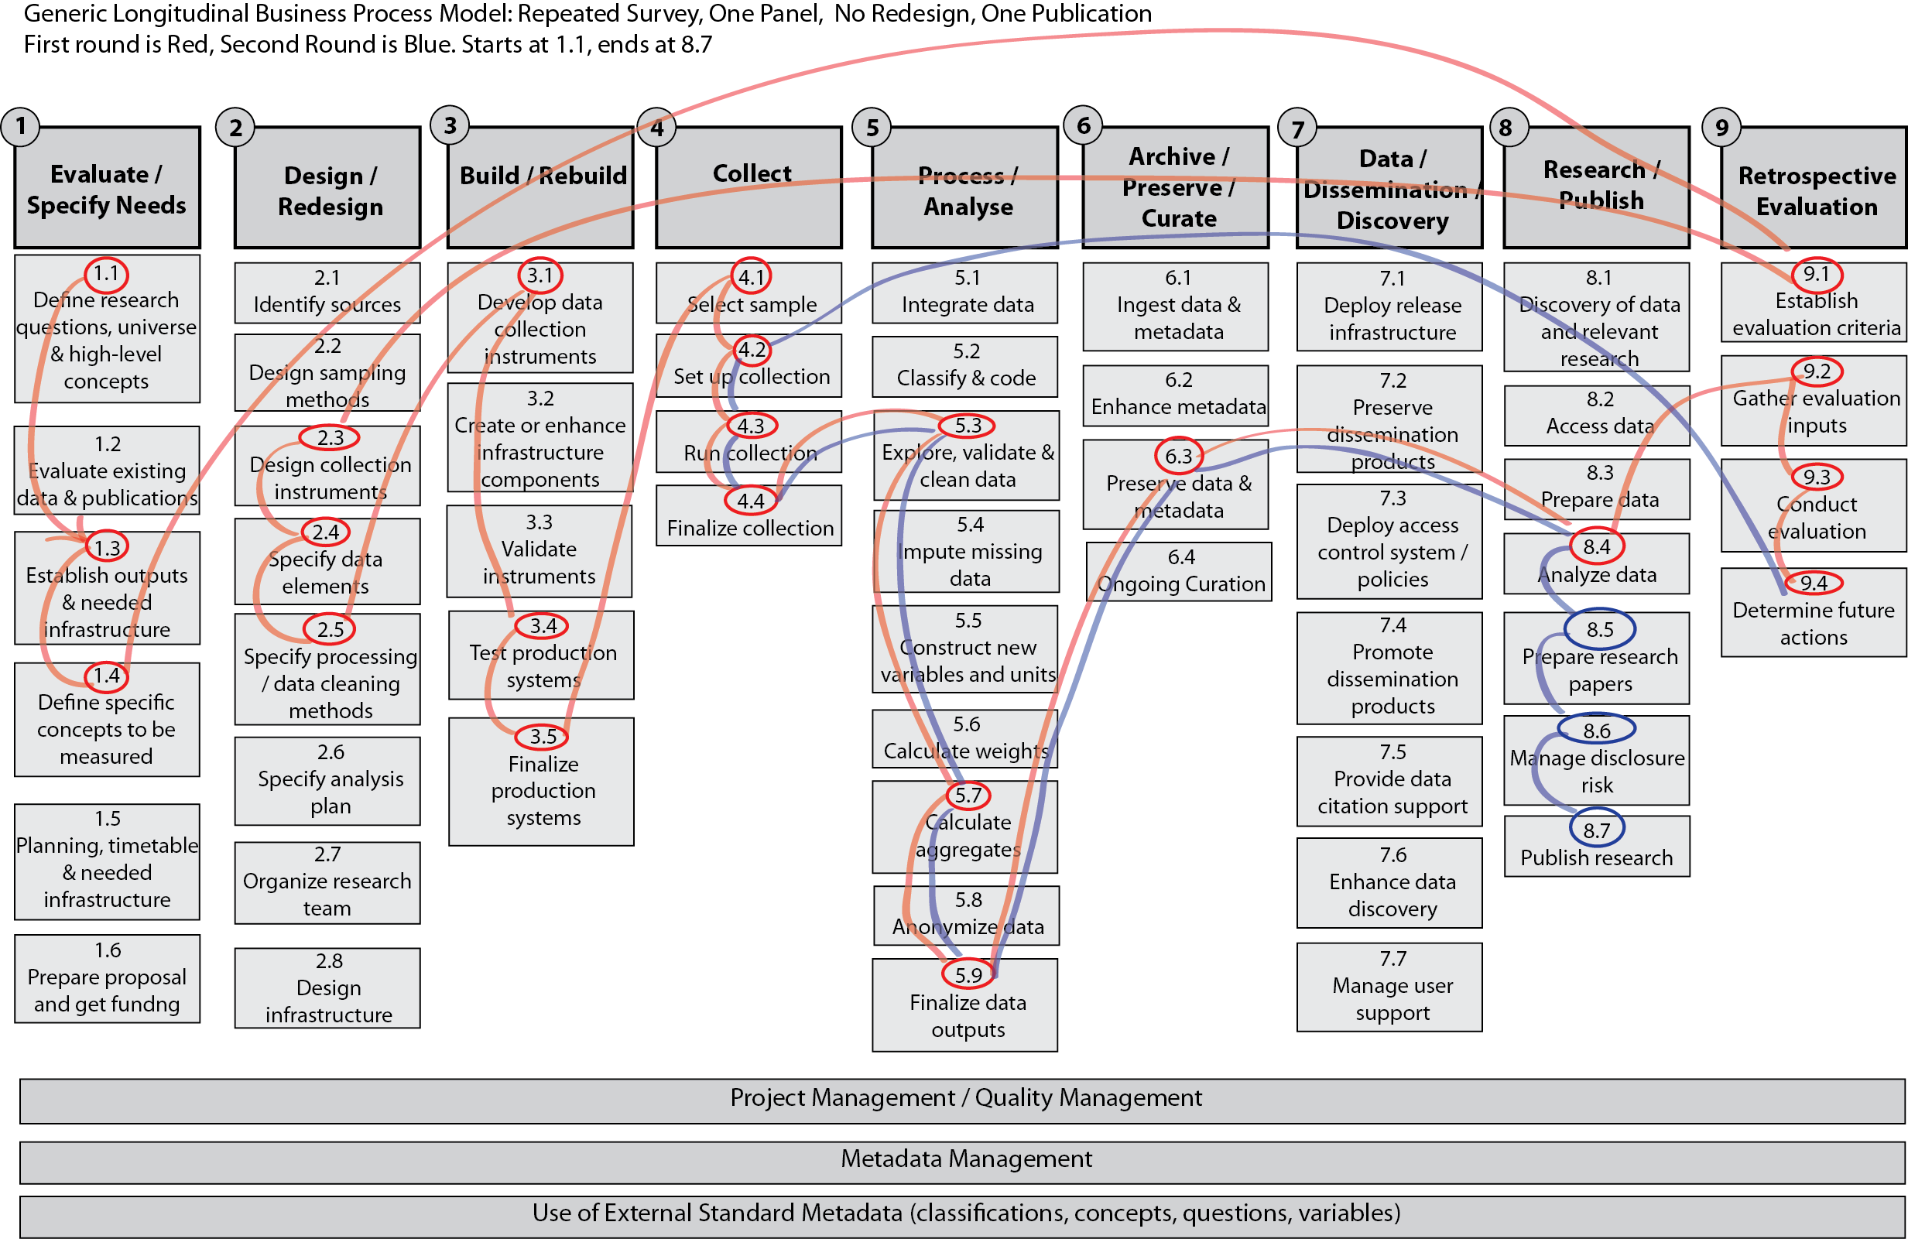

Slide 22
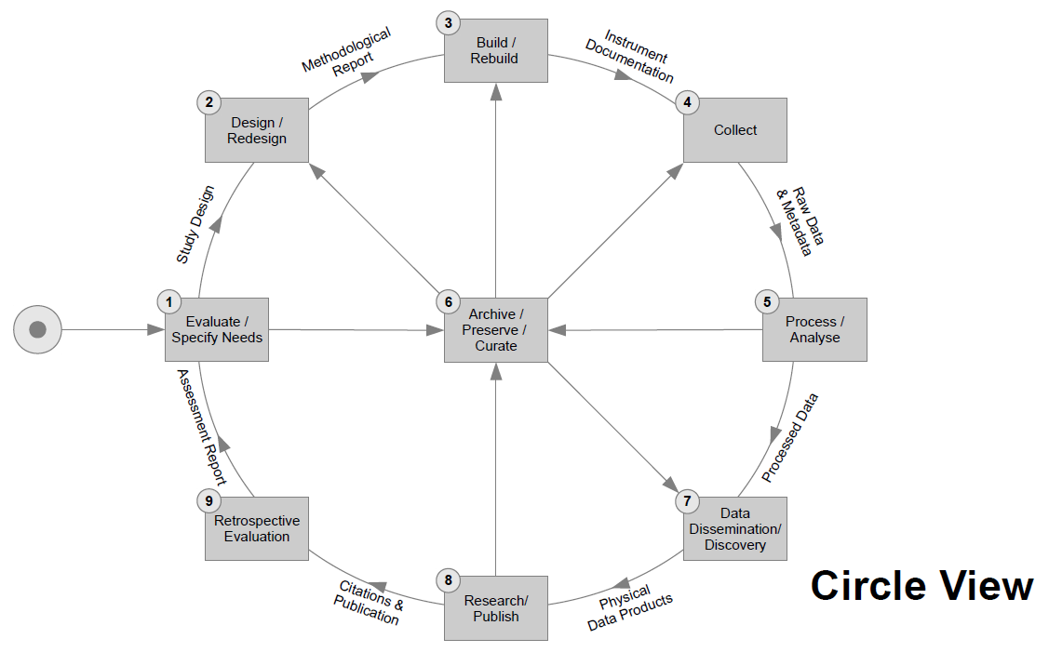

Slide 23
The ddi-standard
Introduction to DDI

Slide 24
What Is DDI I?
An international specification for structured metadata describing social, behavioral, and economic data
A standardized framework to maintain and exchange documentation/metadata
DDI metadata accompanies and enables data conceptualization, collection, processing, distribution, discovery, analysis, repurposing, and archiving.
A basis on which to build software tools
Currently expressed in XML – eXtensible Markup Language

Slide 25
History
1995 -- First international committee established
2000 -- First DDI version published (aligned with codebooks, XML DTD-based)
2003 – DDI 2 published (support for aggregate/tabular data and geography added)
2003 -- Formation of the DDI Alliance, a self-sustaining membership organization
2008 – DDI 3 published (aligned with data lifecycle, XML Schema-based)
2010 – DDI rebranding – DDI Codebook (DDI 2 branch) and DDI Lifecycle (DDI 3 branch) development lines

Slide 26
XML Elements
<Book>
<Title>
The Hitchhiker's Guide to the Galaxy
</Title>
<Author>
Douglas Adams
</Author>
<Year>
1979
</Year>
</Book>

Slide 27
XML Attributes
<Book language=“English”>
<Title>
The Hitchhiker's Guide to the Galaxy
</Title>
<Author>
Douglas Adams
</Author>
<Year>
1979
</Year>
</Book>

Slide 28
Conflicting Tag Names
<MyData>
<Table>
<Legs>4</Legs>
<Length units="feet">5</Length>
<Width units="feet">3</Width>
</Table>
<Table>
<Rows>4</Rows>
<Columns>3</Columns>
</Table>
</MyData>

Slide 29
<MyData
xmlns:kitchen=“http://www.example.org/kitchen”
xmlns:data=“http://www.example.org/data”>
<kitchen:Table>
<Legs>4</Legs>
<Length units="feet">5</Length>
<Width units="feet">3</Width>
</kitchen:Table>
<data:Table>
<Rows>4</Rows>
<Columns>3</Columns>
</data:Table>
</MyData>
<MyData
xmlns:kitchen=“http://www.example.org/kitchen”
xmlns:data=“http://www.example.org/data”>

Slide 30
DDI and XML
<DDIInstance>
<StudyUnit> ... </StudyUnit>
<ResourcePackage>
<QuestionScheme>...</QuestionScheme>
<VariableScheme>...</VariableScheme>
<ConceptScheme>...</ConceptScheme>
<PhysicalInstance>...</PhysicalInstance>
</ResourcePackage>
</DDIInstance>

Slide 31
tools
Introduction to DDI

Slide 32
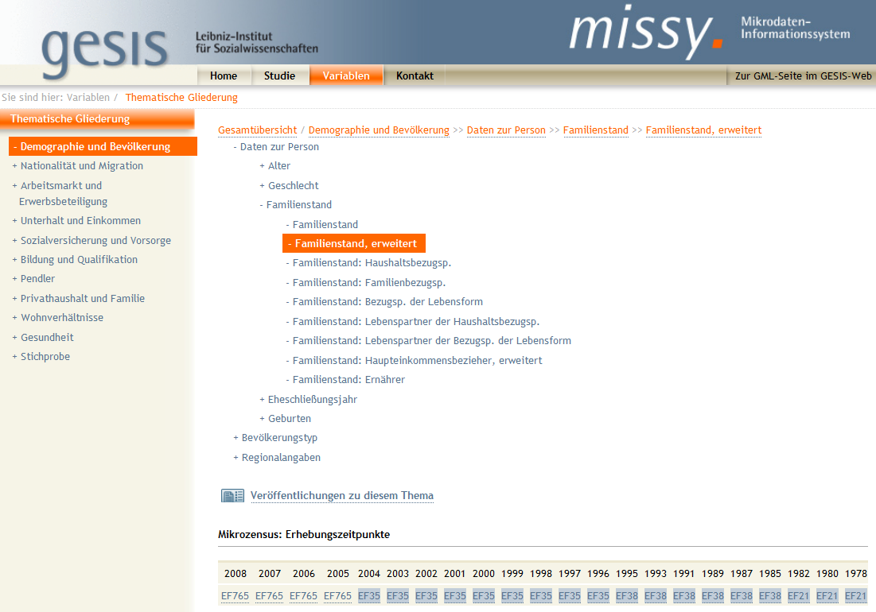
MISSY

Slide 33
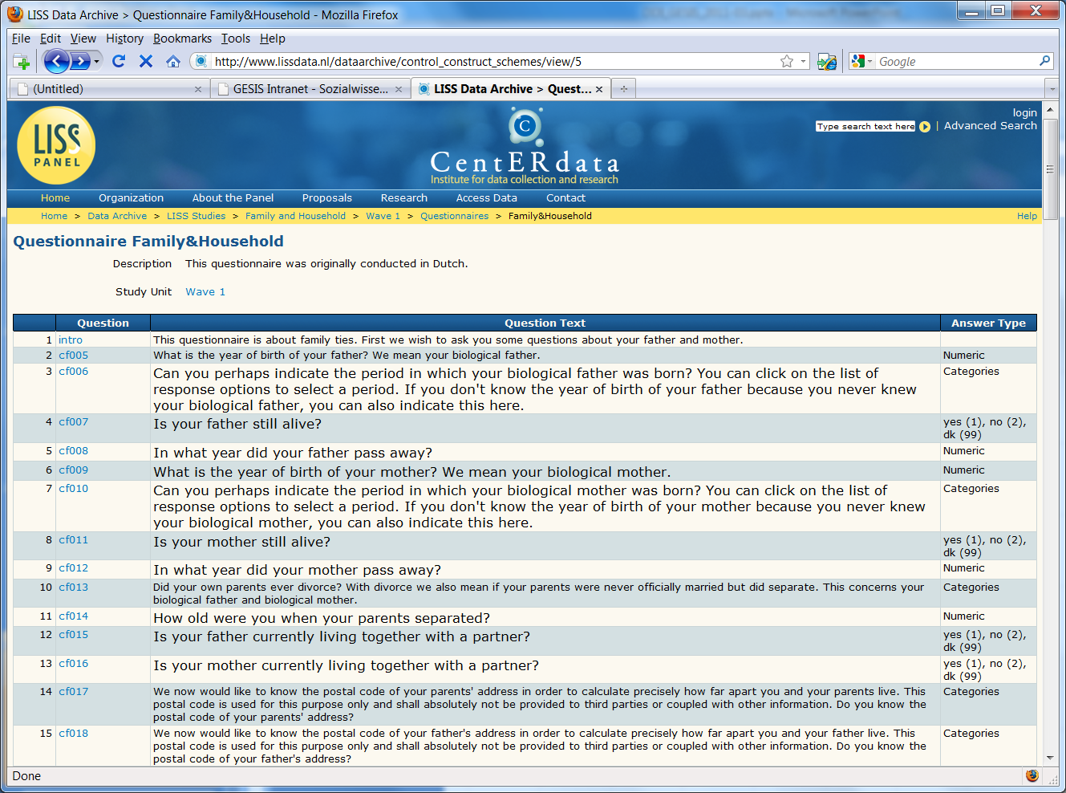
CentERdata – LISS Panel / Questasy

Slide 34
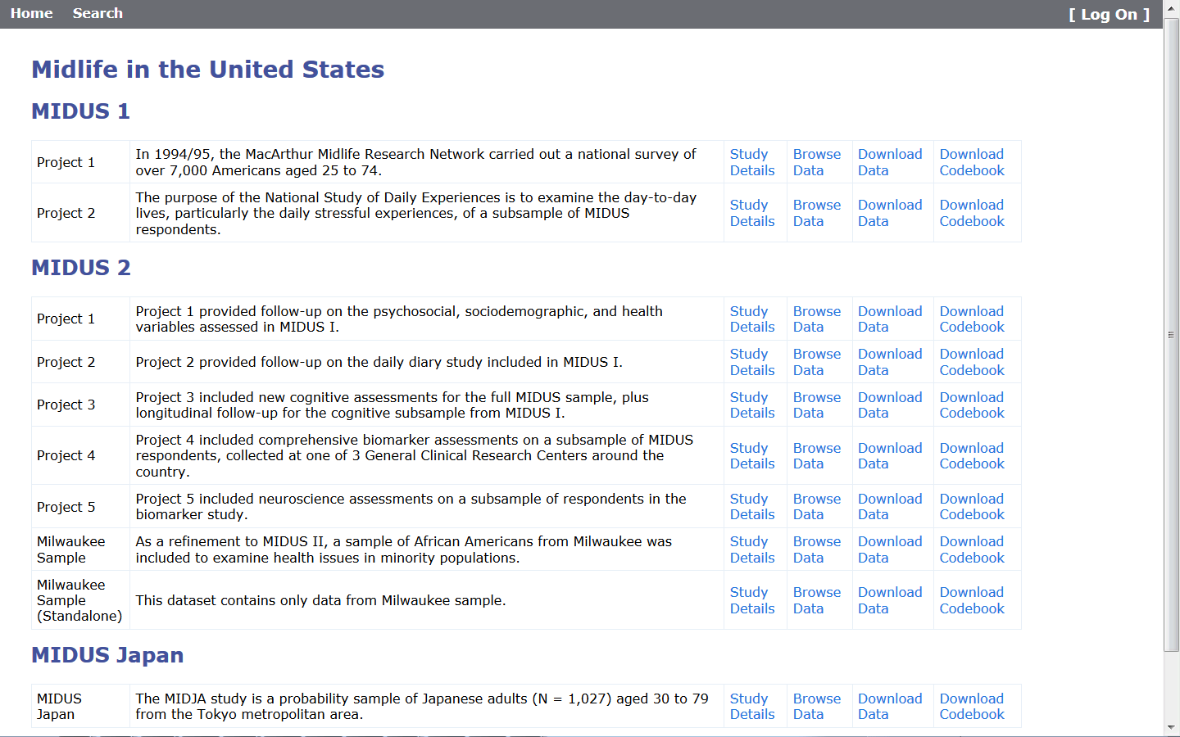

Slide 35
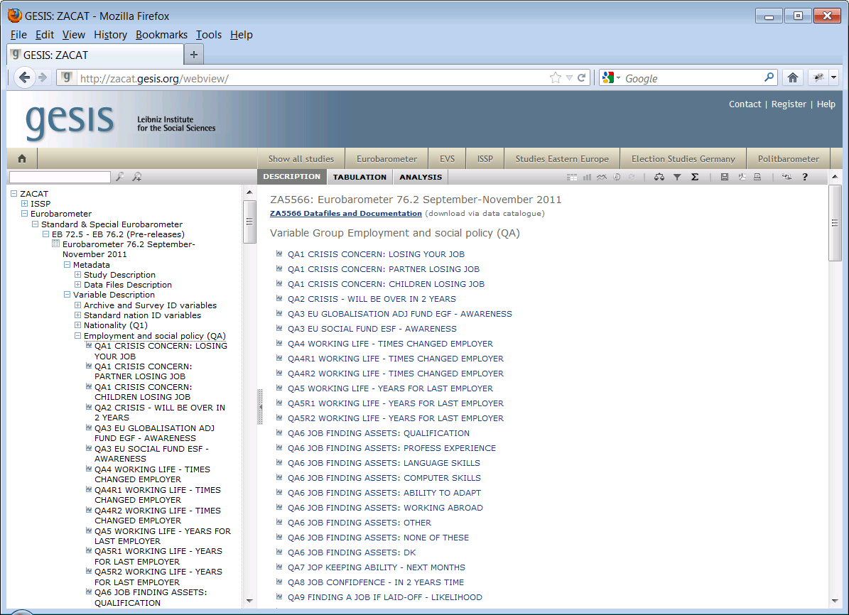

Slide 36
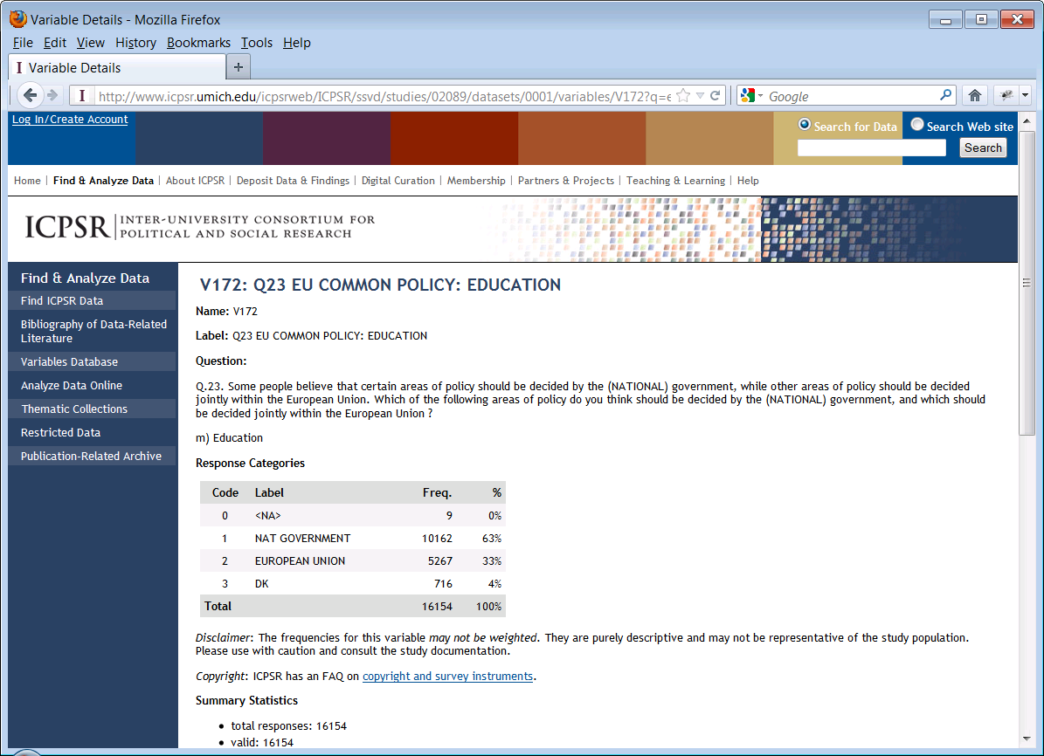

Slide 37
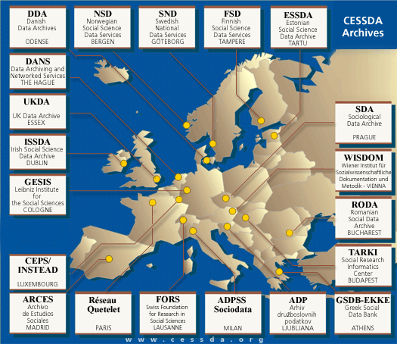
CESSDA - Council of European Social Science Data Archives

Slide 38
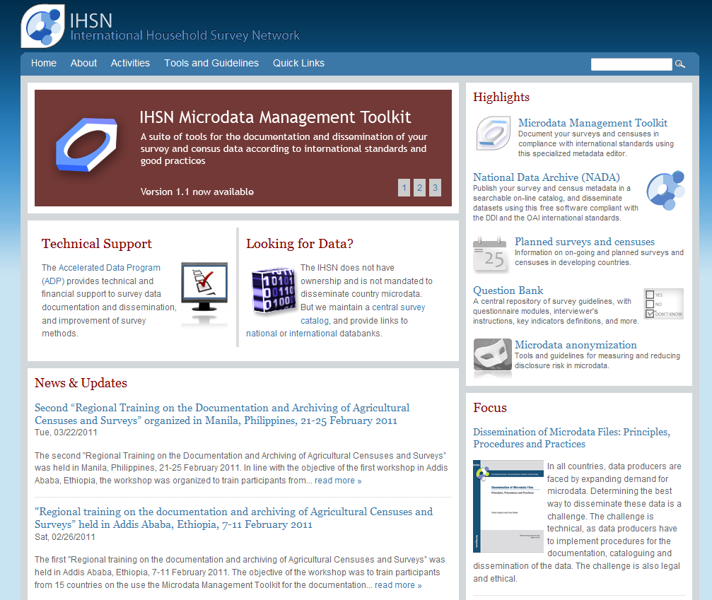

Slide 39
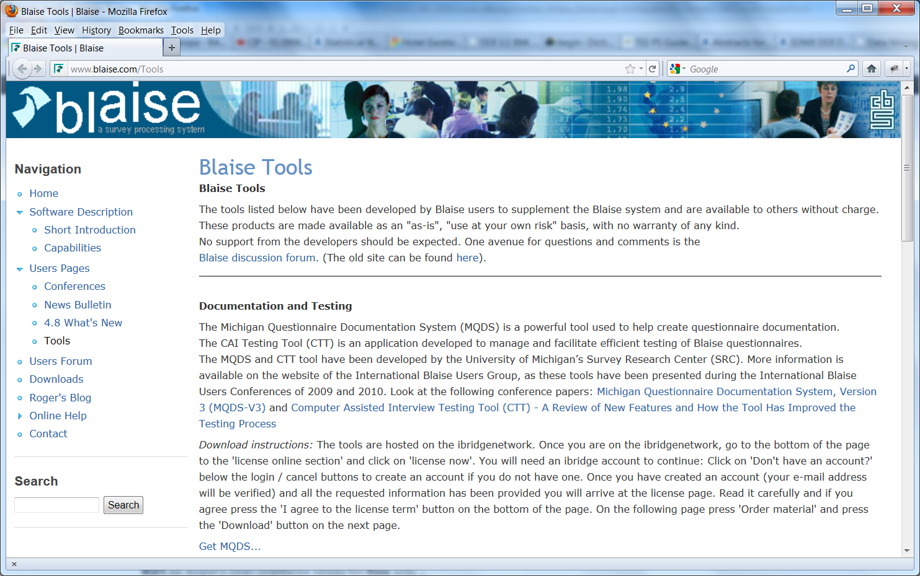
Michigan Questionnaire Documentation System (MQDS) as Blaise Tool

Slide 40
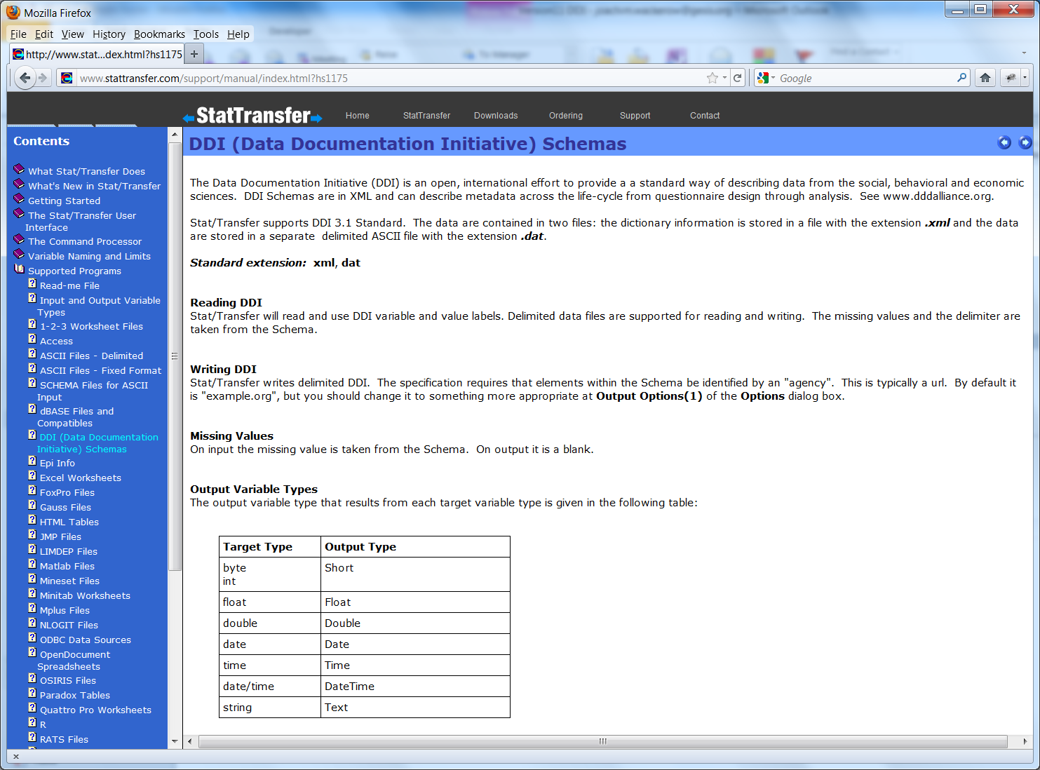
Stat/Transfer Version 11 supports DDI Lifecycle

Slide 41
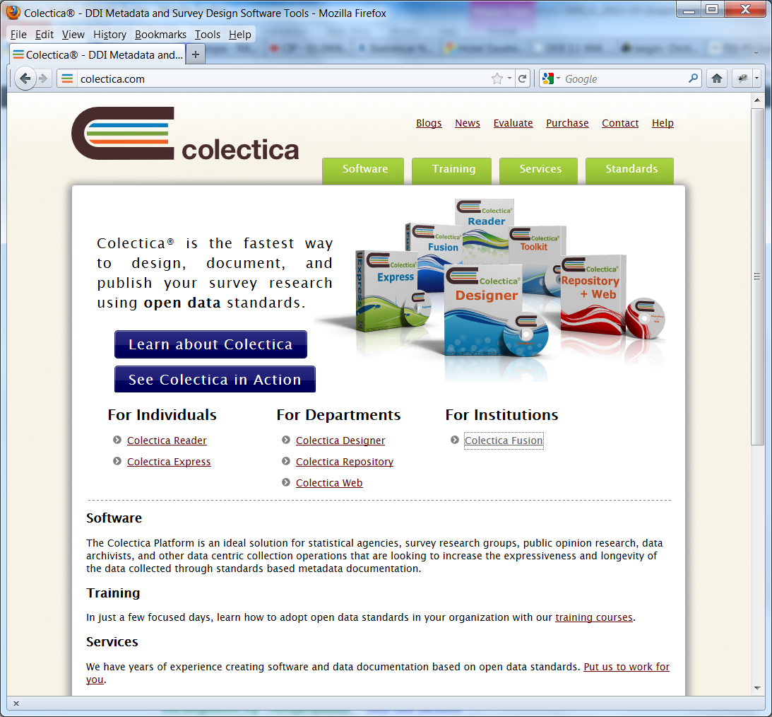
Colectica

Slide 42
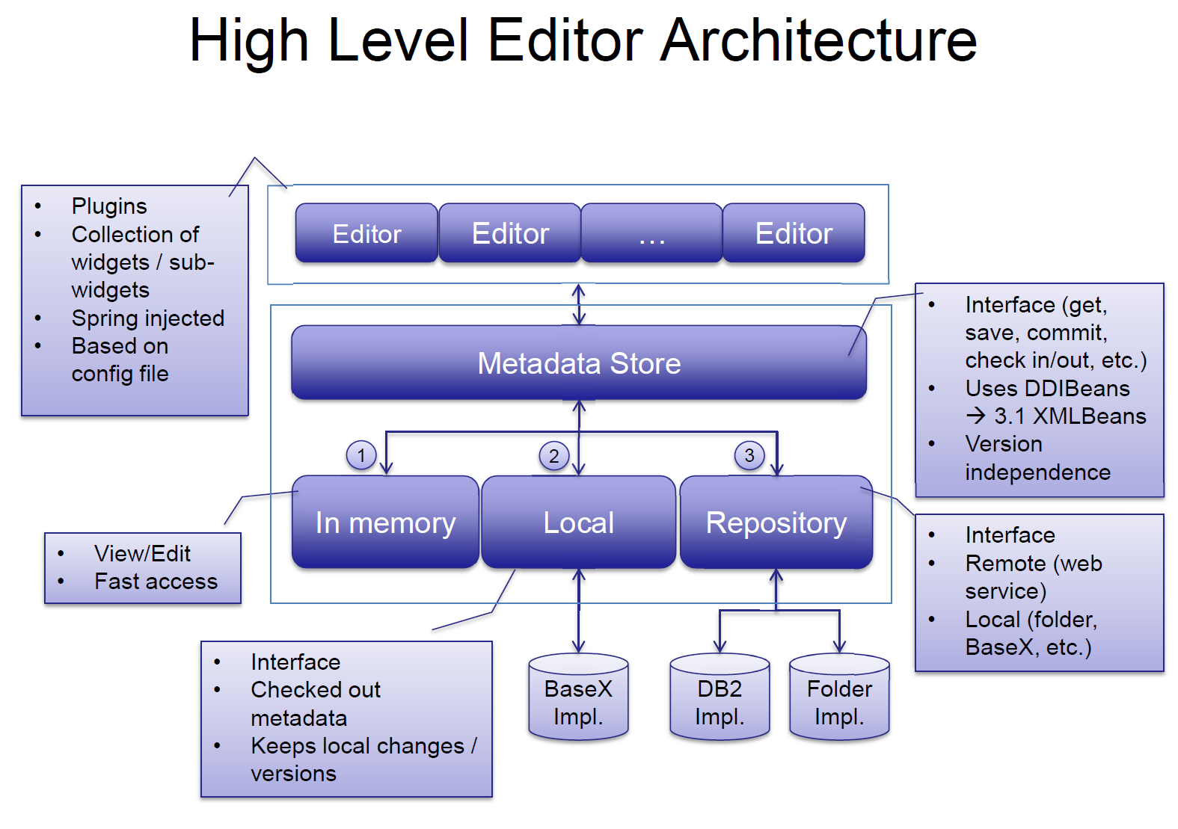
Canadian Research Data Centre Network (CRDCN) DDI 3 Data/Metadata Management Platform

Slide 43
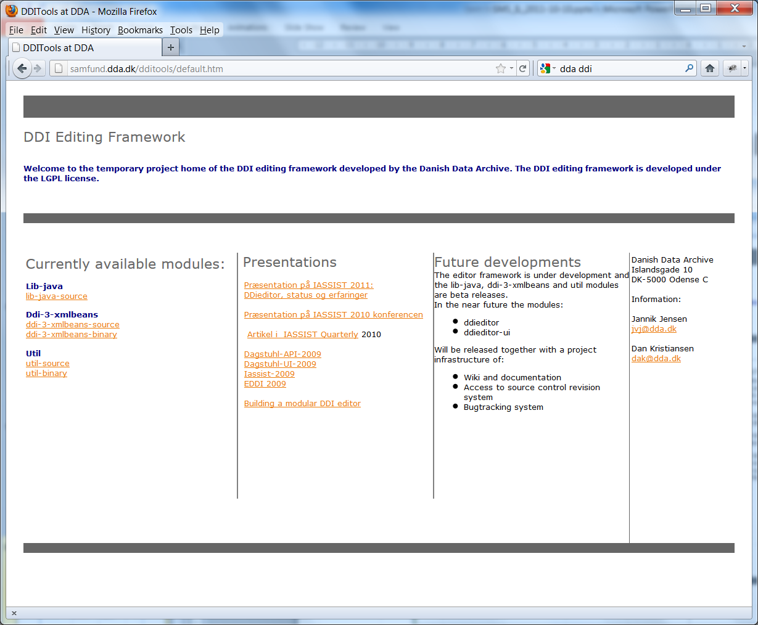
Danish Data Archive DDI Editing Framework

Slide 44
Tools and Standards
Tool A
Tool B
Tool C
Tool D

Slide 45
Tools and Standards
Tool A
Tool B
Standard
Tool C
Tool D

Slide 46
Codebook and lifecycle
Introduction to DDI

Slide 47
Formerly known as…
DDI 2 → DDI Codebook → DDI-C
DDI 3 → DDI Lifecycle → DDI-L

Slide 48
DDI Codebook
Document Description
Study Description
File Description
Variable Description

Slide 49
DDI Lifecycle Model
Metadata Reuse
Notes:
49

Slide 50
DDI Lifecycle Features
Machine-actionable
Modular and extensible
Multi-lingual
Aligned with other metadata standards
Can carry data in-line
Focused on metadata reuse

Slide 51
DDI Lifecycle Features
Support for CAI instruments
Support for longitudinal surveys
Focus on comparison, both by design and after-the-fact (harmonization)
Robust record and file linkages for complex data files
Support for geographic content (shape and boundary files)
Capability for registries and question banks

Slide 52
PART II
Advanced Topics

Slide 53
DDI lifecycle in detail
Advanced Topics

Slide 54
DDI structures
Study Unit
Data Collection
Methodology
Questions
Question flow [optional]
Variables
Physical structures
Group [optional]
Local Holding Package

Slide 55
Study Unit
Study Unit
Identification
Coverage
Topical
Temporal
Spatial
Conceptual Components
Universe
Concept
Representation (optional replication)
Purpose, Abstract, Proposal, Funding
Identification is mapped to Dublin Core and basic Dublin Core is included as an option
Geographic coverage mapped to FGDC / ISO 19115
bounding box
spatial object
polygon description of levels and identifiers
Universe Scheme, Concept Scheme
link of concept, universe, representation through Variable
also allows storage as a ISO/IEC 11179 compliant registry
Notes:
55

Slide 56
Data Collection
Methodology
Question Scheme
Question
Response domain
Instrument
using Control Construct Scheme
Coding Instructions
question to raw data
raw data to public file
Interviewer Instructions
Question and Response Domain designed to support question banks
Question Scheme is a maintainable object
Organization and flow of questions into Instrument
Used to drive systems like CASES and Blaise
Coding Instructions
Reuse by Questions, Variables, and comparison
Notes:
56

Slide 57
Logical Product
Category Schemes
Coding Schemes
Variables
NCubes
Variable and NCube Groups
Data Relationships
Categories are used as both question response domains and by code schemes
Codes are used as both question response domains and variable representations
Link representations to concepts and universes through references
Built from variables (dimensions and attributes)
Map directly to SDMX structures
More generalized to accommodate legacy data
Notes:
57

Slide 58
Physical storage
Physical Data Structure
Links to Data Relationships
Links to Variable or NCube Coordinate
Description of physical storage structure
in-line, fixed, delimited or proprietary
Physical Instance
One-to-one relationship with a data file
Coverage constraints
Variable and category statistics
Notes:
58

Slide 59
Archive Module
The Archive module is used to track lifecycle events and provide information about who was responsible for each event
The use of this module is optional
It provides support throughout the lifecycle, or for just some specific portion of the lifecycle within a single organization
Lifecycle events are any process step which is significant to the creator of the metadata
Can reflect OAIS archiving model, etc.
Completely configurable
Notes:
59

Slide 60
Archiving and Organizations/Individuals
Archive contains:
Archive-specific information about the holdings in the archive (access, funding information, embargoes, etc.)
A list of organizations and individuals, with contact details, etc. (the Organization Scheme)
A list of lifecycle events, which reference the acting organization, the date, the type of event, a description of it, and a link to the affected metadata
Contains Other Materials and Notes
Notes:
60

Slide 61
Lifecycle Events
Basic information: type of event, date, responsible organization/individual, and description of the event
Use to list major development activities in the study
Use to record archival activities such as acquisition, validation, value added, archive management activities, etc.
May link to specific metadata affected by the event

Slide 62
Mining the Archive
With metadata about relationships and structural similarities
You can automatically identify potentially comparable data sets
You can navigate the archive’s contents at a high level
You have much better detail at a low level across divergent data sets

Slide 63
Long term data collection process
Goal may be from cradle to grave or as much as has value to the process
Data Element management, concepts (and variations on a scheme), questions, question flows, data processing steps and instructions,
Quality control aspects
A collection process undergoing change (paper to online collection) - providing a base and then moving it back into development process, providing tools and support for backward integration of processes. Finding the payoff for the bushiness process

Slide 64
Why can DDI 3 do more?
It is machine-actionable – not just documentary
It’s more complex with a tighter structure
It manages metadata objects through a structured identification and reference system that allows sharing between organizations
It has greater support for related standards
Reuse of metadata within the lifecycle of a study and between studies

Slide 65
General Variable Components
VariableName, Label and Description
Links to Concept, Universe, Question, and Embargo information
Provides Analysis and Response Unit
Provides basic information on its role:
isTemporal
isGeographic
isWeight
Describes Representation

Slide 66
Representation
Detailed description of the role of the variable
References related weights (standard and variable)
References all instructions regarding coding and imputation
Describes concatenated values
Additivity and aggregation method
Value representation
Specific Missing Value description (proposed DDI 3.2)
Can be used in combination with any representation type

Slide 67
Value Representation
Provides the following elements/attributes to all representation types:
classification level (“nominal”, “ordinal”, “interval”, “ratio”, “continuous”)
blankIsMissingValue (“true” “false”)
missingValue (expressed as an array of values)
These last 2 may be replaced in 3.2 by a missing values representation section
Is represented by one of four representation types (numeric, text, code, date time)
Additional types are under development (i.e., scales)

Slide 68
Schemes and re-use
Advanced Topics

Slide 69
DDI Schemes
Brief overview of what DDI schemes are and what they are designed to do including:
Purpose of DDI Schemes
How a DDI Study is built using information held in schemes

Slide 70
DDI Schemes: Purpose
A maintainable structure that contains a list of versionable things
Supports registries of information such as concept, question and variable banks that are reused by multiple studies or are used by search systems to location information across a collection of studies
Supports a structured means of versioning the list
May be published within Resource Packages or within DDI modules
Serve as component parts in capturing reusable metadata within the life-cycle of the data

Slide 71
XML Schemas, DDI Modules, and DDI Schemes
Correspond to a stage in the lifecycle
XML Schemas
DDI Modules
<file>.xsd
<file>.xsd
<file>.xsd
<file>.xsd
May Contain
May Correspond
DDI Schemes

Slide 72
Why Schemes?
You could ask “Why do we have all these annoying schemes in DDI?”
There is a simple answer: reuse!
DDI 3 supports the concept of metadata registries (eg, question banks, variable banks)
DDI 3 also needs to show specifically where something is reused
Including metadata by reference helps avoid error and confusion
Reuse is explicit

Slide 73
Designed to Support Registries
A “Registry” is a catalog of metadata resources
Resource package
Structure to publish non-study-specific materials for reuse
Extracting specified types of information in to schemes
Universe, Concept, Category, Code, Question, Instrument, Variable, etc.
Allowing for either internal or external references
Can include other schemes by reference and select only desired items
Providing Comparison Mapping
Target can be external harmonized structure
Notes:
73

Slide 74
Management of Information, Data, and Metadata
An organization can manage its organizational information, metadata, and data within repositories using DDI 3 to transfer information into and out of the system to support:
Controlled development and use of concepts, questions, variables, and other core metadata
Development of data collection and capture processes
Support quality control operations
Develop data access and analysis systems

Slide 75
Upstream Metadata Capture
Because there is support throughout the lifecycle, you can capture the metadata as it occurs
It is re-useable throughout the lifecycle
It is versionable as it is modified across the lifecycle
It supports production at each stage of the lifecycle
It moves into and out of the software tools used at each stage

Slide 76
Metadata Driven Data Capture
Questions can be organized into survey instruments documenting flow logic and dynamic wording
This metadata can be used to create control programs for Blaise, CASES, CSPro and other CAI systems
Generation Instructions can drive data capture from registry sources and/or inform data processing post capture

Slide 77
Reuse by Reference
When a piece of metadata is re-used, a reference can be made to the original
In order to reference the original, you must be able to identify it
You also must be able to publish it, so it is visible (and can be referenced)
It is published to the user community – those users who are allowed access

Slide 78
Change over Time
Metadata items change over time, as they move through the data lifecycle
This is especially true of longitudinal/repeat cross-sectional studies
This produces different versions of the metadata
The metadata versions have to be maintained as they change over time
If you reference an item, it should not change: you reference a specific version of the metadata item

Slide 79
DDI Support for Metadata Reuse
DDI allows for metadata items to be identifiable
They have unique IDs
They can be re-used by referencing those IDs
DDI allows for metadata items to be published
The items are published in resource packages
Metadata items are maintainable
They live in “schemes” (lists of items of a single type) or in “modules” (metadata for a specific purpose or stage of the lifecycle)
All maintainable metadata has a known owner or agency
Maintainable metadata can be versionable
This reflects changes over time
The versionable metadata has a version number

Slide 80
Reusable Study-independent Information in Resource Package
Study A
Study B
Study B
Ref=
“Variable X”
Ref=
“Variable X”
uses
uses
uses
re-uses by reference
Variable ID=“X”
Variable ID=“X”
Resource Package
published in

Slide 81
questionnaire example
Advanced Topics

Slide 82
Questionnaires
Questions
Question Text
Response Domains
Statements
Pre- Post-question text
Instructions
Routing information
Explanatory materials
Question Flow
Notes:
82

Slide 83
Simple Questionnaire
Please answer the following:
1. Sex
(1) Male
(2) Female
2. Are you 18 years or older?
(0) Yes
(1) No (Go to Question 4)
3. How old are you? ______
4. Who do you live with?
__________________
5. What type of school do you attend?
(1) Public school
(2) Private school
(3) Do not attend school
Notes:
83

Slide 84
Simple Questionnaire
Please answer the following:
1. Sex
(1) Male
(2) Female
2. Are you 18 years or older?
(0) Yes
(1) No (Go to Question 4)
3. How old are you? ______
4. Who do you live with?
__________________
5. What type of school do you attend?
(1) Public school
(2) Private school
(3) Do not attend school
Questions
Notes:
84

Slide 85
Simple Questionnaire
Please answer the following:
1. Sex
(1) Male
(2) Female
2. Are you 18 years or older?
(0) Yes
(1) No (Go to Question 4)
3. How old are you? ______
4. Who do you live with?
__________________
5. What type of school do you attend?
(1) Public school
(2) Private school
(3) Do not attend school
Questions
Response Domains
Code
Numeric
Text
Notes:
85

Slide 86
Representing Response Domains
There are many types of response domains
Many questions have categories/codes as answers
Textual responses are common
Numeric responses are common
Other response domains are also available in DDI 3 (time, mixed responses)

Slide 87
Simple Questionnaire
Please answer the following:
1. Sex
(1) Male
(2) Female
2. Are you 18 years or older?
(0) Yes
(1) No (Go to Question 4)
3. How old are you? ______
4. Who do you live with?
__________________
5. What type of school do you attend?
(1) Public school
(2) Private school
(3) Do not attend school
Questions
Response Domains
Code
Numeric
Text
Statements
Notes:
87

Slide 88
Simple Questionnaire
Please answer the following:
1. Sex
(1) Male
(2) Female
2. Are you 18 years or older?
(0) Yes
(1) No (Go to Question 4)
3. How old are you? ______
4. Who do you live with?
__________________
5. What type of school do you attend?
(1) Public school
(2) Private school
(3) Do not attend school
Questions
Response Domains
Code
Numeric
Text
Statements
Instructions
Notes:
88

Slide 89
Simple Questionnaire
Please answer the following:
1. Sex
(1) Male
(2) Female
2. Are you 18 years or older?
(0) Yes
(1) No (Go to Question 4)
3. How old are you? ______
4. Who do you live with?
__________________
5. What type of school do you attend?
(1) Public school
(2) Private school
(3) Do not attend school
Questions
Response Domains
Code
Numeric
Text
Statements
Instructions
Flow
Skip Q3
Notes:
89

Slide 90
Is Q2 = 0 (yes)
Statement 1
Question 1
Question 2
No
Yes
Question 3
Question 4
Question 5
Notes:
90

Slide 91
comparison
Advanced Topics

Slide 92
Comparison
There are two types of comparison in DDI 3:
Comparison by design
Ad-hoc (after-the-fact) comparison
Comparison by design can be expressed using the grouping and inheritance mechanism
Ad-hoc comparison can be described using the comparison module
The comparison module is also useful for describing harmonization when performing case selection activities
Notes:
92

Slide 93
Data Comparison
To compare data from different studies (or even waves of the same study) we use the metadata
The metadata explains which things are comparable in data sets
When we compare two variables, they are comparable if they have the same set of properties
They measure the same concept for the same high-level universe, and have the same representation (categories/codes, etc.)
For example, two variables measuring “Age” are comparable if they have the same concept (e.g., age at last birthday) for the same top-level universe (i.e., people, as opposed to houses), and express their value using the same representation (i.e., an integer from 0-99)
They may be comparable if the only difference is their representation (i.e., one uses 5-year age cohorts and the other uses integers) but this requires a mapping

Slide 94
DDI Support for Comparison
For data which is completely the same, DDI provides a way of showing comparability: Grouping
These things are comparable “by design”
This typically includes longitudinal/repeat cross-sectional studies
For data which may be comparable, DDI allows for a statement of what the comparable metadata items are: the Comparison module
The Comparison module provides the mappings between similar items (“ad-hoc” comparison)
Mappings are always context-dependent (e.g., they are sufficient for the purposes of particular research, and are only assertions about the equivalence of the metadata items)

Slide 95
Comparability
The comparability of a question or variable can be complex. You must look at all components. For example, with a question you need to look at:
Question text
Response domain structure
Type of response domain
Valid content, category, and coding schemes
The following table looks at levels of comparability for a question with a coded response domain
More than one comparability “map” may be needed to accurately describe comparability of a complex component

Slide 96
Detail of question comparability
Comparison Map | Textual Content of Main Body |  | Category |  | Code Scheme
 | Same | Similar | Same | Similar | Same | Different
Question | X |  | X |  | X
 | X |  | X |  |  | X
 | X |  |  | X | X
 | X |  |  | X |  | X
 |  | X | X |  | X
 |  | X | X |  |  | X
 |  | X |  | X | X
 |  | X |  | X |  | X

Slide 97
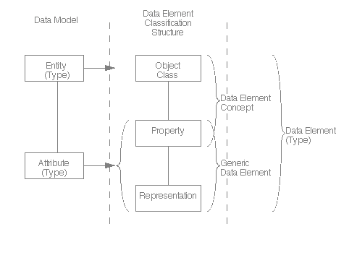
ISO/IEC 11179-1
Universe
Concept
Variable OR
Question Construct
Data Element
Concept
New in 3.2
Data Element
Variable Representation
Question Response Domain
International Standard ISO/IEC 11179-1: Information technology – Specification and standardization of data elements – Part 1: Framework for the specification and standardization of data elements Technologies de l’informatin – Spécifiction et normalization des elements de données – Partie 1: Cadre pout la specification et la normalization des elements de données. First edition 1999-12-01 (p26) http://metadata-standards.org/11179-1/ISO-IEC_11179-1_1999_IS_E.pdf

Slide 98
Data Comparison
To compare data from different studies (or even waves of the same study) we use the metadata
The metadata explains which things are comparable in data sets
When we compare two variables, they are comparable if they have the same set of properties
They measure the same concept for the same high-level universe, and have the same representation (categories/codes, etc.)
For example, two variables measuring “Age” are comparable if they have the same concept (e.g., age at last birthday) for the same top-level universe (i.e., people, as opposed to houses), and express their value using the same representation (i.e., an integer from 0-99)
They may be comparable if the only difference is their representation (i.e., one uses 5-year age cohorts and the other uses integers) but this requires a mapping

Slide 99
DDI Support for Comparison
For data which is completely the same, DDI provides a way of showing comparability: Grouping
These things are comparable “by design”
This typically includes longitudinal/repeated cross-sectional studies
For data which may be comparable, DDI allows for a statement of what the comparable metadata items are: the Comparison module
The Comparison module provides the mappings between similar items (“ad-hoc” comparison)
Mappings are always context-dependent (e.g., they are sufficient for the purposes of particular research, and are only assertions about the equivalence of the metadata items)

Slide 100
Study A
Study B
Group
uses
Variable A
uses
uses
Variable B
Variable A
Variable A
Variable C
Variable B
Variable B
Variable C
Variable C
Variable D
Variable X
contains
contains
Study A
Study B
Grouping
uses
uses
Variable D
Variable X

Slide 101
Comparison
Comparison Module
Is the Same As
Study A
Study B
uses
Is the Same As
uses
Variable A
Variable W
Variable B
Is the Same As
Variable X
Variable C
Variable Y
Variable D
Is the Same As
Variable Z

Slide 102
Your questions
Advanced Topics

Slide 103
conclusion
Advanced Topics

Slide 104
Points to remember
Few are starting from scratch
Ongoing processes cannot stop
You can only act in areas you control
DDI is not an all or nothing structure

Slide 105
Check list
Who do you need to interact with in your environment INPUTS and OUTPUTS?
Where is your focus (may be different for different parts of the organization)?
What do you control?
What is your process flow - how far upstream is it practical to insert DDI like structures?

Slide 106
Backup slides

Slide 107
DDI structures
Schemes
Data Element
Concepts
Geography
Questions
Variables
Group
Comparison
Control Construct
Processing Events
Processing Instructions

Slide 108
DDI Structures
Question
Variables
Interviewer Instructions
Versioning
Comparison
Other Materials
Organization scheme

Slide 109
Study Unit
Citation / Series Statement
Abstract / Purpose
Coverage / Universe / Analysis Unit / Kind of Data
Other Material / Notes
Funding Information / Embargo
Conceptual
Components
Data
Collection
Logical
Product
Physical
Data
Product
Physical
Instance
Archive
DDI
Profile

Slide 110
Process Items
General Coding Instruction
Missing Data (left as blanks)
Suppression of confidential information such as name or address
Generation Instructions
Recodes
Review of text answers where items listed as free text result in more than one nominal level variable
Create variable for each with 0=no 1=yes
Or a count of the number of different items provided by a respondent
Aggregation etc.
The creation of new variables whose values are programmatically populated (mostly from existing variables)
Notes:
110

Slide 111
IPUMS International
Archival for INPUT, INPUT is data capture for harmonization and creation of data product, PRODUCT is input to archive and data discovery, OUTPUT is delivered to client who treats it as INPUT to their own process
Focus of IPUMS and the underlying database is the PRODUCT
We can create a basic DDI instance for the full product and subsets delivered to the client
Instance does NOT capture the original INPUT structure or changes due to processing
[codebook content, question bank, comparison, code lists, variable banks, data items]
[capture metadata from INPUT in a structured way - what can be harvested from current practice, capture change process, focus on actionable metadata and input to system - retain links to source materials, move all used support information to the database to enforce structural consistency, capture change over time for series (censuses within a single country) capturing difs]

Slide 112
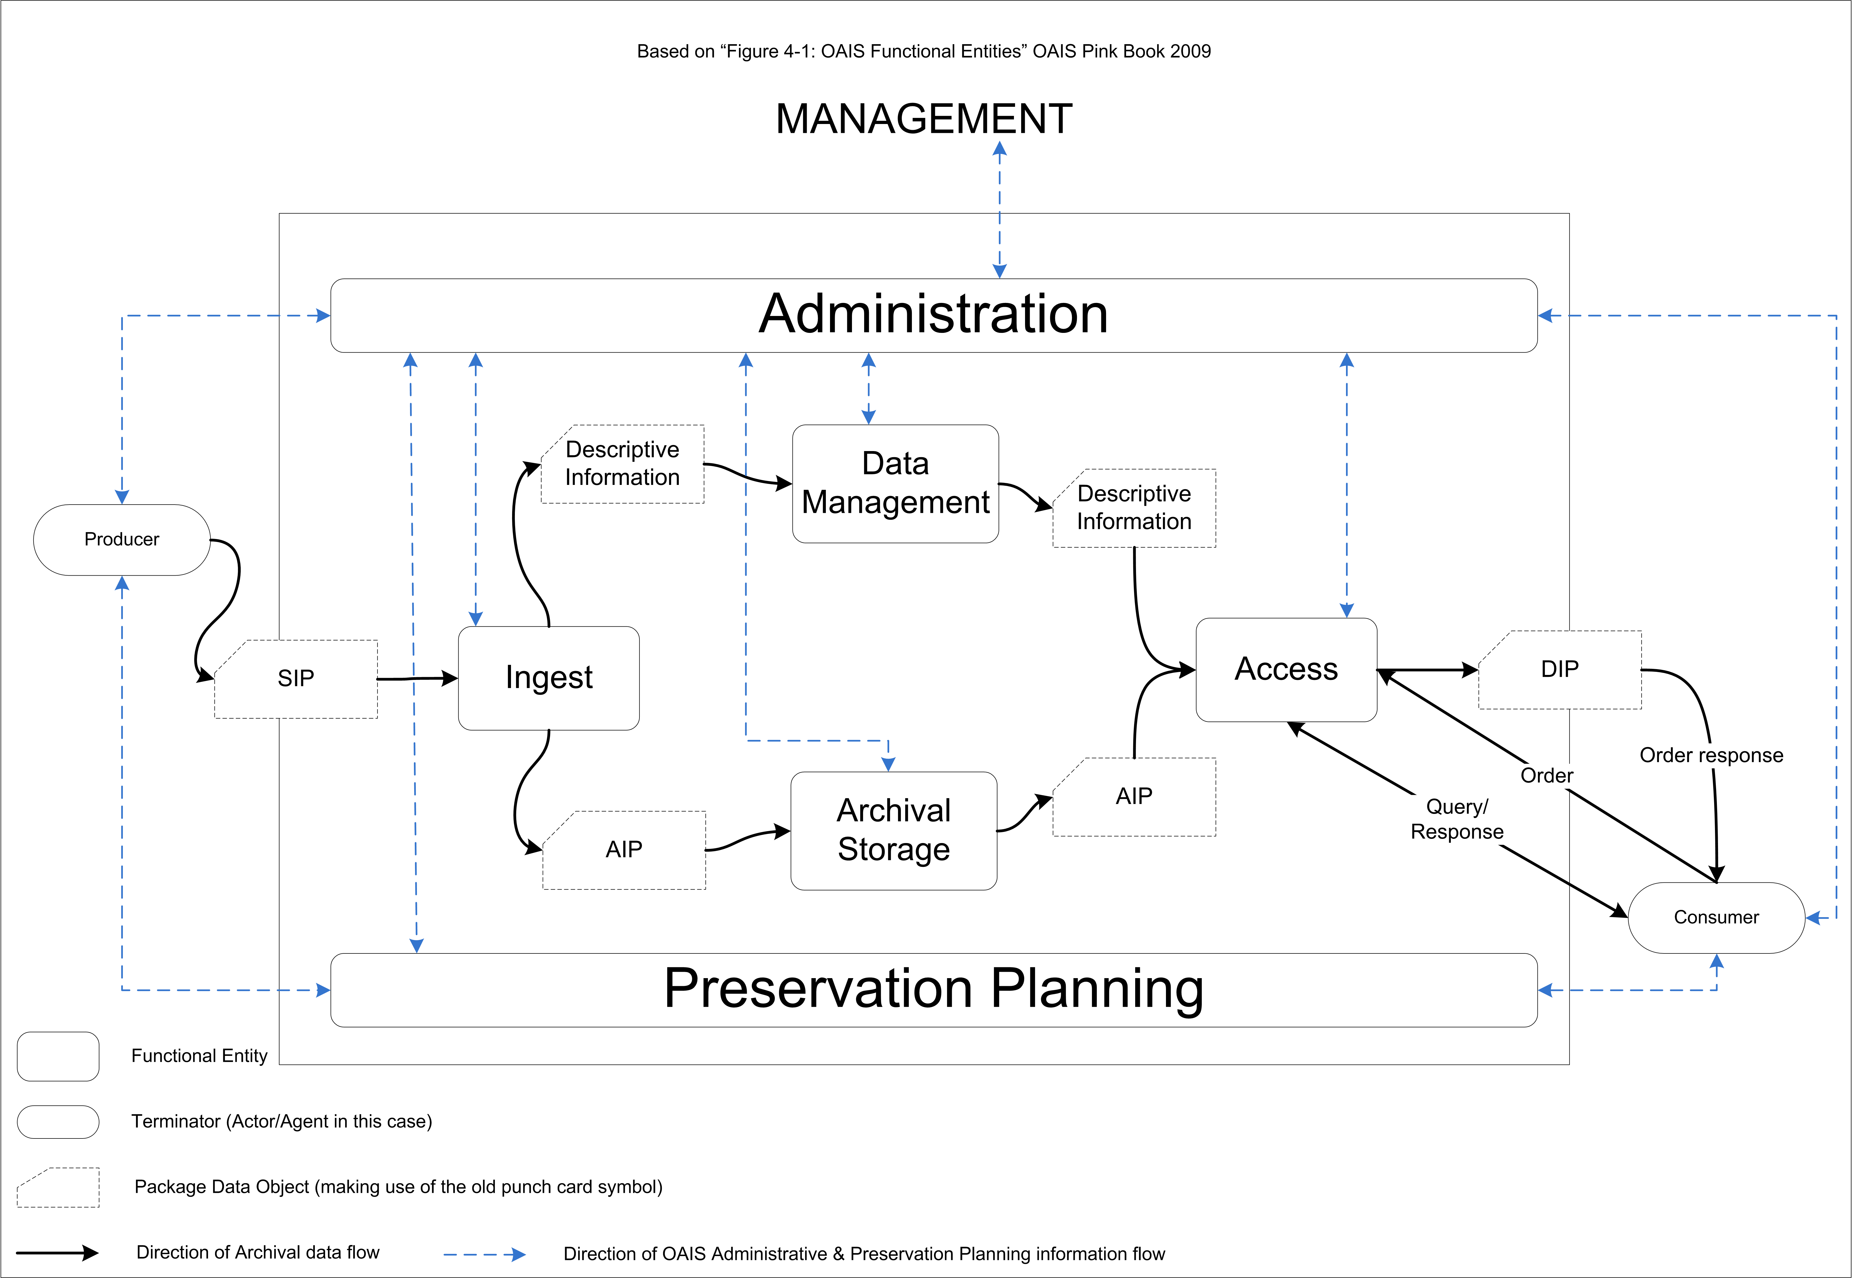

Slide 113
XML Schemas, DDI Modules, and DDI Schemes
Data Collection
Logical Product
Physical Data Structure
Archive
Conceptual Component
Reusable
Ncube
Inline ncube
Tabular ncube
Proprietary
Dataset
Instance
Study Unit
Physical Instance
DDI Profile
Comparative

Slide 114
, XML Schemas DDI Modules, and DDI Schemes
Data Collection
Logical Product
Physical Data Structure
Archive
Conceptual Component
Reusable
Ncube
Inline ncube
Tabular ncube
Proprietary
Dataset
Instance
Study Unit
Physical Instance
DDI Profile
Comparative

Slide 115
XML Schemas, DDI Modules, and DDI Schemes
Data Collection
Question Scheme
Control Construct Scheme
Interviewer Instruction Scheme
Logical Product
Category Scheme
Code Scheme
Variable Scheme
NCube Scheme
Physical Data Structure
Physical Structure Scheme
Record Layout Scheme
Archive
Organization Scheme
Conceptual Component
Concept Scheme
Universe Scheme
Geographic Structure Scheme
Geographic Location Scheme
Reusable
Ncube
Inline ncube
Tabular ncube
Proprietary
Dataset
Instance
Study Unit
Physical Instance
DDI Profile
Comparative

Slide 116
Reuse of Metadata
You can reuse many types of metadata, benefitting from the work of others
Concepts
Variables
Categories and codes
Geography
Questions
Promotes interoperability and standardization across organizations
Can capture (and re-use) common cross-walks

Slide 117
Reuse Across the Lifecycle
This basic metadata is reused across the lifecycle
Responses may use the same categories and codes which the variables use
Multiple waves of a study may re-use concepts, questions, responses, variables, categories, codes, survey instruments, etc. from earlier waves

