Slide 1
Experimenting with DDI-L at the French Center of Socio-Political Data
EDDI15 – 7th Annual European DDI User Conference
December,2 2015, Copenhagen
Alina Danciu, Simon Le Corgne, Alexandre Mairot

Slide 2
Institution
The Center of Socio-Political Data (CDSP)
The Réseau Quetelet partner, the French portal for data in humanities and social sciences
The CDSP started disseminating surveys in 2005
About 220 data files are documented and disseminated

Slide 3
Summary
Definition of a DDI-L profile
Our DDI-C template
Mapping a DDI-C template into a DDI-L template
XSLT to create a DDI-L profile
A first version of a metadata system
Tools
Logical data model
Programs, interfaces and procedures

Slide 4
Our first steps towards a new metadata system
The datasets are disseminated in DDI-C on a Nesstar server;
Today, we are building a DDI-L compliant metadata system:
DDI-L profile defined
First version of our metadata system built
First programs and procedures written

Slide 5
DDI-L Profile: our DDI-C template
codebook
+ | docDscr
 | + | citation
 |  | + | titlStmt
+ | stdyDscr
 | + | citation
 |  | + | titlStmt
 |  | + | rspStmt
 |  | + | prodStmt
 |  | + | distStmt
 |  | + | serStmt
 |  | + | verStmt
 |  | + | biblCit
 | + | stdyInfo
 |  | + | subject
 |  | + | abstract
 |  | + | sumDscr
 | + | method
 |  | + | dataColl
 |  | + | notes
 | + | dataAccs
 |  | + | setAvail
 |  | + | useStmt
 | + | othrStdyMat
 |  | + | relMat
 |  | + | relStdy
 |  | + | relPubl
 |  | + | othRefs
+ | fileDscr
 | + | fileTxt
 |  | + | fileName
 |  | + | fileCont
 |  | + | dimensns
 |  | + | fileType
 |  | + | filePlace
 |  | + | dataChck
 |  | + | ProcStat
 |  | + | dataMsng
 |  | + | verStmt
+ | dataDscr
 | + | varGrp
 |  | + | labl
 |  | + | txt
 |  | + | defntn
 |  | + | universe
 |  | + | notes
 | + | var
 |  | + | location
 |  | + | labl
 |  | + | qustn
 |  | + | valrng
 |  | + | invalrng
 |  | + | universe
 |  | + | TotlResp
 |  | + | sumStat
 |  | + | txt
 |  | + | catgry
 |  | + | concept
 |  | + | varFormat
 |  | + | notes

Slide 6
Mapping DDI-C into DDI-L: DDI-L template
Mapping of DDI-C elements into DDI-L using the documentation on the DDI Alliance website
http://www.ddi-alliance.org/Specification/DDI-Lifecycle/3.0/#3.0convert
Definition of a DDI-L template

Slide 7
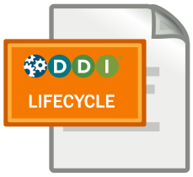
XSLT to create a DDI-L profile
http://www.ddialliance.org/tool/ddiprofilexslt
ddi:DDIInstance
+ | r:URN
+ | r:Citation
 | + | r:Title
 | + | r:SubTitle
 | + | r:AlternateTitle
+ | s:StudyUnit
 | + | r:URN
 | + | r:VersionRationale
 | + | r:Note
 | + | r:Abstract
 | + | r:UniverseReference
 | + | r:SeriesStatement
 |  | + | r:SeriesRepositoryLocation
 |  | + | r:SeriesName
 |  | + | r:SeriesDescription
 | + | r:FundingInformation
 |  | + | r:AgencyOrganizationReference
 |  | + | r:GrantNumber
 |  | + | r:Description
 | + | r:Coverage
 |  | + | r:TopicalCoverage
 |  | + | r:SpatialCoverage
 |  | + | r:TemporalCoverage
 | + | r:AnalysisUnit
 | + | r:KindOfData
 | + | r:OtherMaterial
 |  | + | r:URN
 |  | + | r:TypeOfMaterial
 |  | + | r:Citation
 |  | + | r:ExternalURLReference
 | + | c:ConceptualComponent
 |  | + | r:URN
 |  | + | c:UniverseScheme
 |  | + | c:Concept
 | + | d:DataCollection
 |  | + | r:URN
 |  | + | d:Methodology
 |  | + | d:CollectionEvent
 |  | + | d:InstrumentScheme
 |  | + | d:ProcessingEventScheme
 |  | + | d:QuestionScheme
 |  | + | d:ControlConstructScheme
 |  | + | d:InterviewerInstructionScheme
 | + | l:LogicalProduct
 |  | + | r:URN
 |  | + | l:DataRelationship
 |  | + | l:CategoryScheme
 |  | + | l:CodeListScheme
 |  | + | r:ManagedRepresentationScheme
 |  | + | l:VariableScheme
 | + | p:PhysicalDataProduct
 |  | + | r:URN
 |  | + | p:PhysicalStructureScheme
 |  | + | p:RecordLayoutScheme
 | + | pi:PhysicalInstance
 |  | + | r:URN
 |  | + | r:VersionRationale
 |  | + | r:Note
 |  | + | r:Citation
 |  | + | pi:DefaultMissingValuesReference
 |  | + | pi:GrossFileStructure
 |  | + | pi:StatisticalSummary
 | + | a:Archive
 |  | + | r:URN
 |  | + | a:ArchiveModuleName
 |  | + | a:ArchiveSpecific
 |  | + | a:OrganizationScheme

Slide 8
Summary
Definition of a DDI-L profile
Our DDI-C template
Mapping a DDI-C template into a DDI-L template
XSLT to create a DDI-L profile
A first version of a metadata system
Tools
Logical data model
Programs, interfaces and procedures

Slide 9
The first version of the metadata system
Data as starting point: a nine-wave political study
Each wave has specific variables and several common variables with the other waves
Background variables collected during an annual study
Some variables based on the French national population census of 2011
Weighting variables
Using the DDI-L profile to define the structure of the metadata system

Slide 10
Tools
At the beginning, only 2 software:
MS Excel used as a documentation tool
Notepad++ as XML editor/validator
➔ only DDI-C XML files generated
Today, new tools have been added:
MS Access: database structure + user interfaces
R: data management + computing + XML generator
➔ DDI-C and DDI-L XML files generated

Slide 11
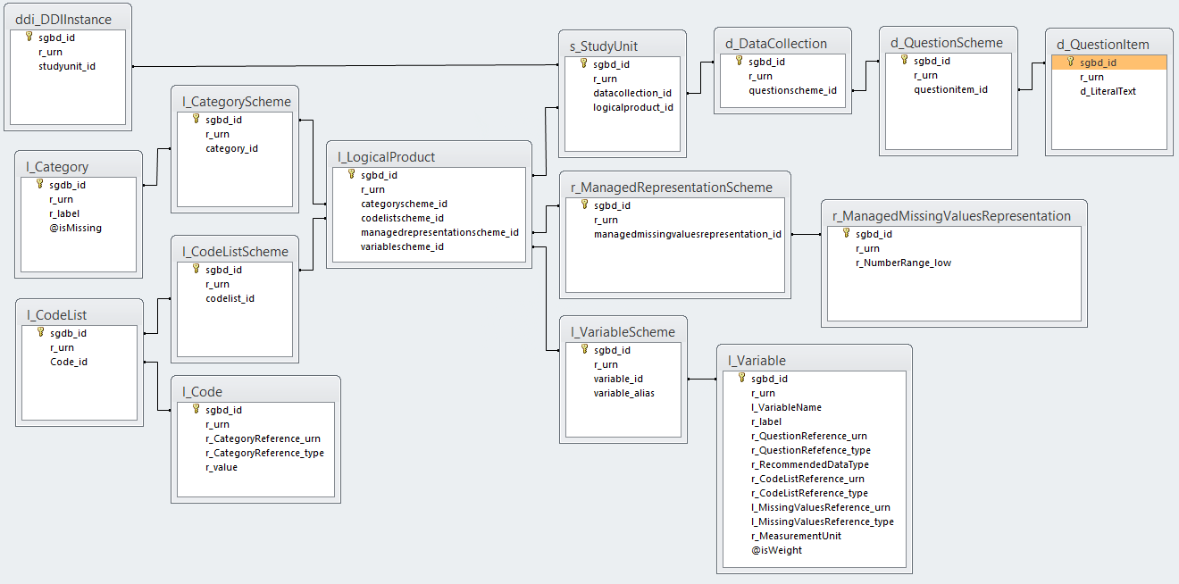
Logical Data Model (a view)

Slide 12
Programs, interfaces and procedures
Scripts/Programs:
Import Excel files into the metadata system (OK)
Import DDI-C files into the metadata system (in progress)
…
Interfaces
User interfaces for variables’ documentation (in progress)
…
Procedures
Handling metadata duplication (in progress)
…

Slide 13


An example: How interested in politics
Variable name: INTPOL
Variable label: How interested in politics
Literal question: How interested would you say you are in politics ? are you?
Variable categories
1- Very interested
2- Quite interested
3- Hardly interested
4- Not at all interested
7- Refusal (missing value)
8- Don’t know (missing value)

Slide 14
Road map
In the near future: Finalize the creation of the programs, the interfaces and the procedures
In the middle future: Migrate the database and the interfaces on a web solution

Slide 15
http://cdsp.sciences-po.fr
http://quanti.dime-shs.sciences-po.fr/
alina.danciu@sciencespo.fr
simon.lecorgne@sciencespo.fr
alexandre.mairot@sciencespo.fr

