Slide 1
How can DDI make the most of RDF?
EDDI15 Conference – Franck Cotton / Guillaume Duffes - Insee

Slide 2
Contents
Brief overview of RDF
DDI and RDF: the premises
RDF vs XML: any value added for DDI?
DDI4 and RDF
RDF in the statistical community
RDF and DDI at Insee
Conclusion

Slide 3
Brief overview of RDF
RDF is defined in the W3C specification as follows: “Resource Description Framework (RDF) is a foundation for processing metadata; it provides interoperability between applications that exchange machine-understandable information on the Web.[…] The broad goal of RDF is to define a mechanism for describing resources that makes no assumptions about a particular application domain, nor defines (a priori) the semantics of any application domain.”

Slide 4
Brief overview of RDF
The basic model consists of three types of elements represented below:
object
subject
Insee
http://rdf.insee.fr/classification/naf
predicate
dcterms:publisher

Slide 5
DDI and RDF: the premises
In its early versions, DDI already dealt with vocabularies, e.g the Dublin Core elements which have RDF as main implementation today.
Imported a priori as an external XML Schema (own namespace). Limits…
What if another framework allowed to reference a posteriori as many vocabularies as needed → RDF

Slide 6
RDF vs XML: any value added for DDI?
XML serialised as XML Schemas → strongly typed and binding...
But also a closed model: if one property is missing, it cannot be added from another XSD schema.
The only solution would be: extend the schema → backward compatibility impossible.

Slide 7
RDF vs XML: any value added for DDI?
RDF on the contrary allows to combine different vocabularies.
If a property is missing, then certainly a more specific vocabulary exists and defines it, use it!
Well known and defined RDF vocabularies are now legions: Dublin Core, FOAF, SKOS, PAV, PROV, etc.

Slide 8
DDI4 and RDF
DDI4 is documented according to functional views.
DDI4 should make the most of existing vocabularies in functional views (e.g a concept in DDI should be a SKOS concept)
RDF comes along now with RDF databases called Triple Stores. Mature commercial or open-source solutions exist.

Slide 9
RDF in the statistical community
Various initiatives in the statistical community are under progress:
HLG-MOS (UNECE): Work on Linked Open Metadata
One Work Package in the DIGICOM project (European level)
Continuing development of the RDF Data Cube
SemStats.

Slide 10
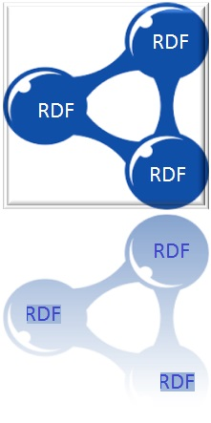
RDF and DDI at Insee
DDI-RDF
DDI-XML
RDF-Turtle
Triple-store based Repository
Datalift Framework + additional modules
Colectica Repository and Designer
Variable
CodeList
Question
Colectica API
Datasets
Concept
Classification
Datalift API
Web Services
SPARQL Queries

Slide 11
RDF and DDI at Insee
How to implement in RDF the following ddi:ConceptualVariable takesMeaningFrom skos:Concept?
@prefix rdfs: <http://www.w3.org/2000/01/rdf-schema#> .
@prefix skos: <http://www.w3.org/2004/02/skos/core#> .
@prefix gsim: <http://rdf.unece.org/gsim/v2#> .
@prefix ddi: <http://rdf.ddialliance.org/ddi#> .
SELECT ?cncptvarlab ?cnpt WHERE
{
?cncptvar gsim:takesMeaningFrom ?cnpt .
?cnpt a skos:Concept .
?cnptvar rdfs:label ?cncptvarlab .
?cncptvar a ddi:ConceptualVariable .
}
Demo

Slide 12
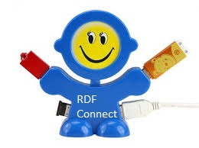
Conclusion
RDF enables interoperability between applications:
that deal with machine-actionable information on the Web
or that manage linked information internally
RDF is then tailor-made for DDI.
How would both DDI serialisations evolve in parallel when one is much more “pluggable” than the other?

