Slide 1
Encapsulating DDI Metadata within a Spatio-Temporal Data Feed for British Historical Statistics
Humphrey Southall & Michael Stoner
(Great Britain Historical GIS/ University of Portsmouth)
(gbhgis@port.ac.uk)

Slide 2
Statistical data feeds:
ONS experimental OpenAPI
Launched November 2014
https://www.ons.gov.uk/ons/apiservice/web/apiservice
Access data values within each census table
ONS also have easy to use tools for selecting and visualisation
ONS no longer reports aggregated data totals from the previous census with current census reporting areas.
InFuse:
New MIMAS/UK Data Service interface, which sits on top of a currently private API
Combine, and link data, across a complete census.
Programmatic discloser rules
Notes:
[ TODO ADD these? NHGIS and Social Explorer]
Maybe also [TODO Expand/example]

Slide 3
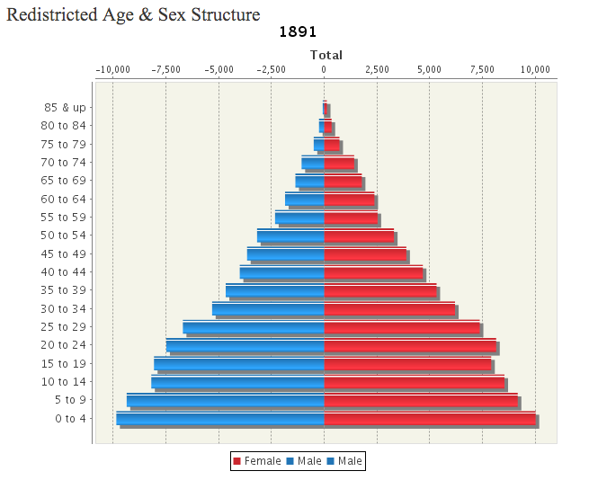
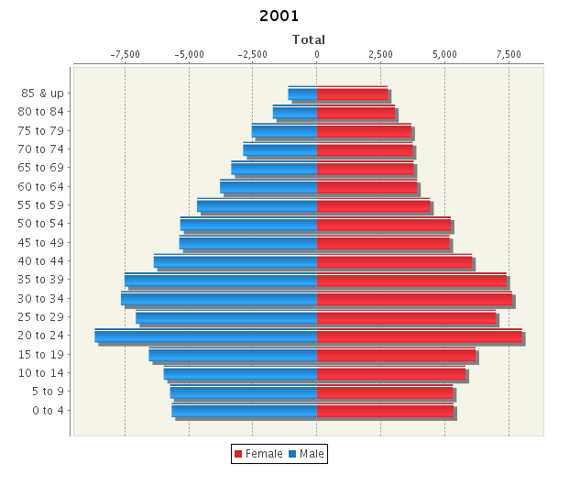
GBH GIS Data
Integrated data structure for 14 million data values
Allows redistricted data to be presented as a time series, e.g. Portsmouth Pop. Pyramid: http://visionofbritain.org.uk/unit/10168181/cube/AGESEX_85UP

Slide 4
GBH GIS Statistical Content 14 million data values:
Data from every Census of Population 1801-2001
Parish-level population counts
Age by sex by district
Occupations, industries, housing conditions, etc …
Working now on adding 2011 data
Vital statistics
Decennial data: cause of death by age by sex by district
Votes for each candidate in each constituency in each election 1832-2005
Farm census: crop acreages and numbers of animals, by county, at least decennial since 1869
Unemployment and poor law data, by town/district
… a diverse but very ordinary set of social statistics

Slide 5
GBH GIS Data Architecture Overview
Gazetteer/ Admin Unit Ontology
Source?
Where?
Data Documentation System
Source Documentation System
What?
Data
DDS
When?
Date Object
Thanks
Ack.
Notes:
Data in single table.

Slide 6
GBH GIS Data Architecture Overview
Gazetteer/ Admin Unit Ontology
Source?
Where?
Data Documentation System
Source Documentation System
What?
Time
Data
DDS
Meaning
Space
When?
Date Object
Thanks
Ack.

Slide 7
Detailed structure of g_data table:
Topic | Column Name | Data type
Row ID | g_seq | integer
Data value | g_data | numeric
Behaviour | g_data_precision | character varying(3)
 | g_data_status | character varying(1)
 | dominant | character varying(1)
Where? | g_unit | integer
 | g_unit_type | character varying(16)
 | g_rel_to | integer
 | g_type_period | character varying(1)
What? | cellref | character varying(48)
When? | start_year | integer
 | start_date | date
 | end_year | integer
 | end_date | date
 | end_date_decimal | numeric
Source? | g_authority | character varying(20)
 | g_auth_note | character varying(400)
 | src_tab_panel | integer
 | src_tab_seq | integer
 | src_tab_col | integer
 | src_tab_row | integer
Thanks | g_data_credit | character varying(24)
Includes all columns except some very implementation-specific housekeeping columns
Taken from current PostGIS implementation
\d g_data
In previous Oracle version dates implemented as objects
Notes:
Our Implementation nCube format DDI adding time & geog
nCube -> relationship model XML
Our data is in DDI which meant that it was easier to then also present the data in RDF
DDI eveything -> cell ref -> a number -> current total pop, 100,000

Slide 8
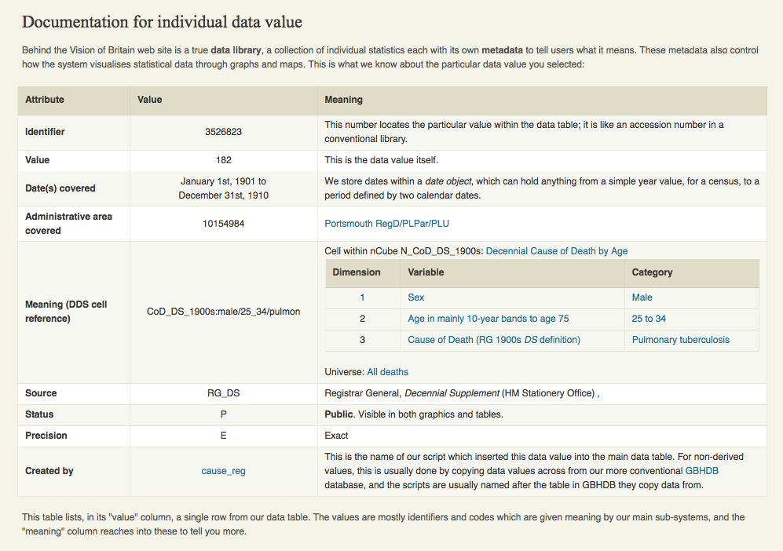
Sample VoB data value page

Slide 9
Sample Data Cube RDF
What kind of Data Feed? http://www.w3.org/TR/vocab-data-cube/
eg:dataset-le1 a qb:DataSet; rdfs:label "Life expectancy"@en; rdfs:comment "Life expectancy within Welsh Unitary authorities - extracted from Stats Wales"@en; qb:structure eg:dsd-le ; . eg:o1 a qb:Observation; qb:dataSet eg:dataset-le1 ; eg:refArea ex-geo:newport_00pr ; eg:refPeriod <http://reference.data.gov.uk/ id/gregorian-interval/ 2004-01-01T00:00:00/P3Y> ; sdmx-dimension:sex sdmx-code:sex-M ; sdmx-attribute:unitMeasure <http://dbpedia.org/resource/Year> ; eg:lifeExpectancy 76.7 ; . eg:o2 a qb:Observation; qb:dataSet eg:dataset-le1 ; eg:refArea ex-geo:cardiff_00pt ; eg:refPeriod <http://reference.data.gov.uk/ id/gregorian-interval/ 2004-01-01T00:00:00/P3Y> ; sdmx-dimension:sex sdmx-code:sex-M ; sdmx-attribute:unitMeasure <http://dbpedia.org/resource/Year> ; eg:lifeExpectancy 78.7 ; .
NB links to external ontologies esp. admin units
Notes:
SKIP

Slide 10
Phase 1: Dumping all the data as RDF
Completed autumn 2014
Defining basic format
Broadly based on W3C Data Cube Vocabulary
Additional details follow Irish census gateway http://data.cso.ie/index.html
Main issue is choosing vocabularies to link to:
RDFS Schema (W3C)
SDMX (Statistical Data Metadata eXchange)
GB Historical GIS (we need to implement this!)
NB this stage is of limited usefulness by itself, as result is a single file of > 100 Gb

Slide 11
Sample GBHGIS RDF
@prefix sdmx-subject: <http://purl.org/linked-data/sdmx/2009/subject#> .
@prefix qb: <http://purl.org/linked-data/cube#> .
@prefix sdmx-measure: <http://purl.org/linked-data/sdmx/2009/measure#> .
@prefix gbhgis-ontogly: <http://data.pastplace.org/ontogly#> .
@prefix rdf: <http://www.w3.org/1999/02/22-rdf-syntax-ns#> .
@prefix marcrel: <http://id.loc.gov/vocabulary/relators/> .
@prefix rdfs: <http://www.w3.org/2000/01/rdf-schema#> .
@prefix gbhgis: <http://data.pastplace.org/> .
@prefix admingeo: <http://data.ordnancesurvey.co.uk/ontology/admingeo/> .
@prefix sdmx-dimension: <http://purl.org/linked-data/sdmx/2009/dimension#> .
@prefix foaf: <http://xmlns.com/foaf/0.1/> .
@prefix dc: <http://purl.org/dc/elements/1.1/> .
<Observation-1110279>
a qb:Observation ;
gbhgis-ontogly:PastP_Unit "http://data.pastplace.org/unit/10076810" ;
gbhgis-ontogly:hasUnitType "MOD_DIST" ;
gbhgis-ontogly:ref-period "1951" ;
qb:dataset "WORKING_AGE:male/total" ;
sdmx-measure:obsValue "37949"^^<http://www.w3.org/2001/XMLSchema#decimal> .
<Observation-990403> a qb:Observation ;
gbhgis-ontogly:PastP_Unit "http://data.pastplace.org/unit/10076810" ;
gbhgis-ontogly:hasUnitType "MOD_DIST" ;
gbhgis-ontogly:ref-period "1881" ;
qb:dataset "INDUSTRY_GEN:ag" ;
sdmx-measure:obsValue "1832"^^<http://www.w3.org/2001/XMLSchema#decimal> .
<Observation-853267> a qb:Observation ;
gbhgis-ontogly:PastP_Unit "http://data.pastplace.org/unit/10188982" ;
gbhgis-ontogly:hasUnitType "MOD_DIST" ;
gbhgis-ontogly:ref-period "1881" ;
qb:dataset "AGESEX_85UP:male/75_79" ;
sdmx-measure:obsValue "161"^^<http://www.w3.org/2001/XMLSchema#decimal> .
http://data.pastplace.org/datacube?units=10188982,10076810

Slide 12
Phase 2: Adding a sub-setting mechanism
Currently implemented:
Geography:
One or more specific unit IDs (reporting areas)
One or more unit types (broadly, GIS coverages)
nCubes references
All components of a classification or cross-classification
Cell references
Specific measures, e.g. TOT_POP:now or AGESEX_85UP:male/70_74, Or ‘Sheep’
Date range
To be added:
Rates
I.E. extracting pairs of data values which we have associated in a rate definition, e.g. TOT_POP:now / AREA_HECTARES:total
Notes:
Expand the API page for details on these esp. unit types
Add call URI for each

Slide 13
Phase 3: Adding a discovery mechanism
So you can find out relevant nCubes, cells, unit types and units!
Broader queries based on date ranges, statistical keywords and “geography”
Geography can be queried by:
Bounding box: specific units which overlap
Point: specific units containing
Name: units named after place
Geography problems:
We have nearly 200 “kinds” of unit in system!
22% of our units with statistics have point but no polygon
Units named after place don’t always contain it!

Slide 14
Phase 3: Discovery mechanism
Spatial strategy
The API takes a point coordinate and a broad statistical theme, the system returning the set of reporting units whose boundary polygons cover the point, with thematically relevant nCubes.
Themes are: Population, Industry, Social Structure, Learning & Language, Agriculture & Land Use, Life & Death, Work & Poverty, Housing, Roots & Religion, Political Life
http://data.pastplce.org/search?q=50.8193761,-0.3765256&theme=T_POP&format=json
{"gUnit”:10056524, "uName":"WORTHING", "uType":"District", "nCubeId":"N_AGESEX_85UP", "nCubeTitle":"Redistricted Age & Sex Structure", "startYear":"2001", "endYear":"2001”…
Data values selected via themes or nCubes and units:
http://data.pastplace.org/datacube?theme=T_POP&units=10056524
http://data.pastplace.org/datacube?ncubes=N_AGESEX_85UP&units=10056524
Notes:
by moving down a topic hierarchy or

Slide 15
Phase 3: Discovery mechanism
Thematic strategy
allows the user to reach nCubes through free-text searching of labels and descriptions within the metadata.
http://data.pastplce.org/search?metadata=SHEEP&format=json
{
"nCube": "N_AGCEN_SHEEP_GEN",
"nLabel": "Generalised Sheep Categories as reported by the Agricultural Census.",
"score": 36
} ...
{
"nCube": "N_OCC_RAW1881",
"nLabel": "Detailed 1881 occupational statistics, by gender",
"score": 6
},
{
"nCube": "N_OCC_RAW1841",
"nLabel": "Unclassified occupations, categorised by sex & age",
"score": 6
},
{
"nCube": "N_AGCEN_ANIMALS",
"nLabel": "Types of Animal reported by the Agricultural Census",
"score": 6
Notes:
by moving down a topic hierarchy or

Slide 16
Geospatial Ontology of Places
Search API for places matching “Portsmouth” reveals places which are associated with units
http://data.pastplace.org/search?q=portsmouth&format=n3
@prefix place: <http://data.pastplace.org/place/> .
place:72259 a gbhgis-ontogly:PastP_Place ;
rdfs:comment "Portsmouth.-- parl. and mun. bor., naval station, seaport..."^^xsd:string ;
rdfs:label "PORTSMOUTH"^^xsd:string ;
rdfs:seeAlso http://www.wikidata.org/entity/Q72259 ...
gbhgis-ontogly:hasNearbyPlace place:776556 , place:985594, …, ;
gbhgis-ontogly:hasUnit unit:12833027 , unit:10214877 , unit:10187084 …> ;
geo:lat "50.795277777778"^^xsd:double ;
geo:lon "-1.0888888888889"^^xsd:double ;
owl:sameAs <http://dbpedia.org/resource/Portsmouth> , <http://sws.geonames.org//about.rdf> .
Update to latest Pelagios https://github.com/pelagios/pelagios-cookbook/wiki/Pelagios-Gazetteer-Interconnection-Format

Slide 17
Geospatial Ontology of reporting units
Or you can search for units directly by name
http://data.pastplace.org/search?q=portsmouth&format=n3&type=unit
@prefix unit: <http://data.pastplace.org/unit/> .
unit:10200246 a gbhgis-ontogly:unit ;
rdfs:label "PORTSMOUTH"^^xsd:string ;
gbhgis-ontogly:hasUnitStatus "AP/CP"^^xsd:string ;
gbhgis-ontogly:isPartOf unit:10543411 , unit:10187084 , unit: ... .
gbhgis-ontogly:hasName
a owl:ObjectProperty ;
rdfs:comment "A name for the queried place."^^xsd:string ;
rdfs:domain gbhgis-ontogly:PastP_Place ;
rdfs:label "has name"^^xsd:string ;
gbhgis-ontogly:hasUnitStatus
a owl:ObjectProperty ;
rdfs:comment "The status the assc. unit has in the Past Place gazetteer."^^xsd:string ;

Slide 18
API examples
Everything about the modern Portsmouth unit
http://data.pastplace.org/datacube?units=10168181
Combine Search and Data:
Units named after a place(including narrowing to a specific unit type)http://data.pastplace.org/datacube?q=portsmouth&unittypes=ADM_CNTY
Population of Portsmouth aged 70-74
http://data.pastplace.org/datacube?units=10168181&cellref=AGESEX_85UP:male/70_74
Single data value 1881 cenus:
http://data.pastplace.org/datacube?units=10168181&cellref=AGESEX_85UP:male/70_74&yearfrom=1881&yearto=1881

Slide 19
Software
http://data.pastplace.org/datacube & http://data.pastplace.org/seach
Java accessing PostgreSQL/PostGIS DB via Mybatis for creating Java Objects
Jena for RDF representation and serialization
www.pastplace.org
Mobile first responsive Web App built on
Nginx
NodeJS,
Webpack
Babal for ES6
ReactJS
Not currently using LD formats from API, need to investigate Jena’s 30% overhead compared to gson serialization.
Notes:
Screen shot

Slide 20
What’s Next?
Improve the unpacking of the data into more detailed DataCube Vocabulary. We would like to use the HASSET thesaurus (ELSST) but we have currently a sticking point on specific license terms
http://www.data-archive.ac.uk/find/hasset-thesaurus
Enhance the ontology,
Link countries to FAO Ontolgy http://www.fao.org/
The 200 Unit types and status value. Scope for linking unit types to wikidata entry.
Experiment with the Linked Data API in the PastPlace Web App
Experiment with the API to create Client JS visualizations for the nCube statistics
Notes:
More detail on terms: Page 13 http://www.iassistdata.org/downloads/2013/2013_f1_bell.pdf

Slide 21
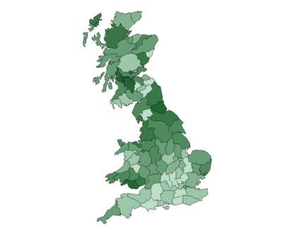
Web sites, etc
Great Britain Historical GIS Project Geography Department, University of Portsmouth, UK
GBHGIS Project website: http://www.port.ac.uk/research/gbhgis/
Vision of Britain website: http://www.visionofbritain.org.uk
PastPlace www.pastplace.org ( not launched)
Research funded by the:
Arts and Humanities Research Council: “Frameworks and tools for statistical big data in the humanities”
Contact us: gbhgis@port.ac.uk
Notes:
History, time series of data, complex sets of geog 1 st year only – what we have done

Slide 22
Revisiting the earlier API examples & any question? gbhgis@port.ac.uk
Discover themes data.pastplce.org/search?q=50.8193761,-0.3765256&theme=T_POP&format=json
Portsmouth data.pastplace.org/
datacube?units=10168181
Search and access Datadata.pastplace.org/datacube?q=portsmouth&unittypes=ADM_CNTY
Celref data.pastplace.org/datacube?units=10168181&cellref=AGESEX_85UP:male/70_74
Single data value data.pastplace.org/datacube?units=10168181&cellref=AGESEX_85UP:male/70_74&yearfrom=1881&yearto=1881
Discovering ranked nCubes from metadata search:
data.pastplce.org/search?metadata=SHEEP&format=json
Discovering nCubes from location and thematic search:
data.pastplce.org/search?q=50.8193761,-0.3765256&theme=T_POP&format=json

Slide 23
Notes:
THE END ONLY NOTES FOLLOWS

Slide 24
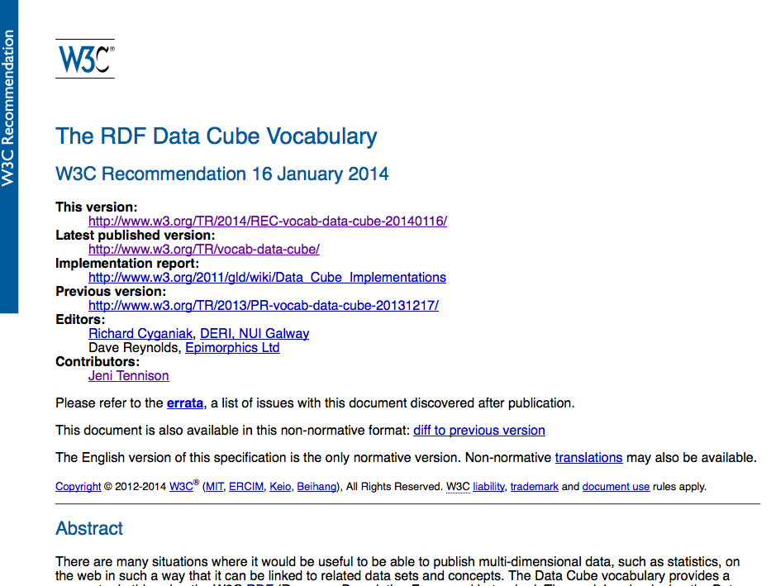
Data cube vocab spec
Notes:
THE END ONLY NOTES FOLLOWS

Slide 25
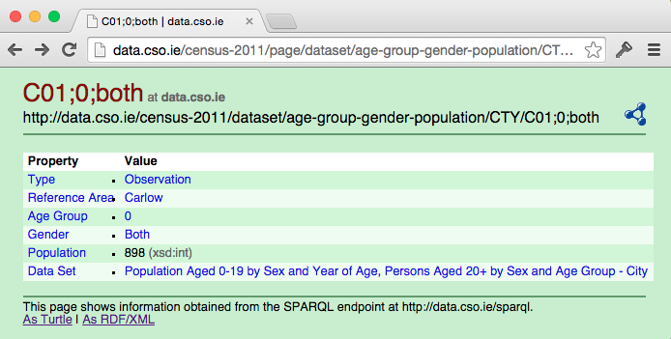
Other work on statistical APIs:
World Wide Web Consortium (W3C)’s RDF Data Cube Vocabulary
http://www.w3.org/TR/vocab-data-cube/
Provides framework rather than full specification
Irish government census gateway
http://data.cso.ie/index.html
Dutch CEDAR project
http://www.cedar-project.nl/
Live server at: http://lod.cedar-project.nl/
Notes:
THE END ONLY NOTES FOLLOWS
Review these and write up for a paper

