Slide 1

Introducing the CESSDA Metadata Management Project
Wolfgang Zenk-Möltgen, GESIS - Leibniz Institute for the Social Sciences
Mari Kleemola, Finnish Social Science Data Archive
Anne Etheridge, UK Data Archive
Anne Sofie Fink Kjeldgaard, Dansk Data Arkiv
EDDI15 – 7th Annual European DDI User Conference, Copenhagen (Denmark), Dec 2-3, 2015

Slide 2
Outline
About CESSDA
Objectives
Members
Current projects
The CMM project
Objective and output
Tasks and partners
Deliverables
Timeline
Working on Metadata Management
What will the Portfolio do?
What advantages does the Portfolio give?
How are we using DDI?

Slide 3
About CESSDA
Objectives
Members
Current projects

Slide 4
CESSDA Objectives
CESSDA provides large scale, integrated and sustainable data services to the social sciences. It brings together social science data archives across Europe, with the aim of promoting the results of social science research and supporting national and international research and cooperation.
http://cessda.net

Slide 5
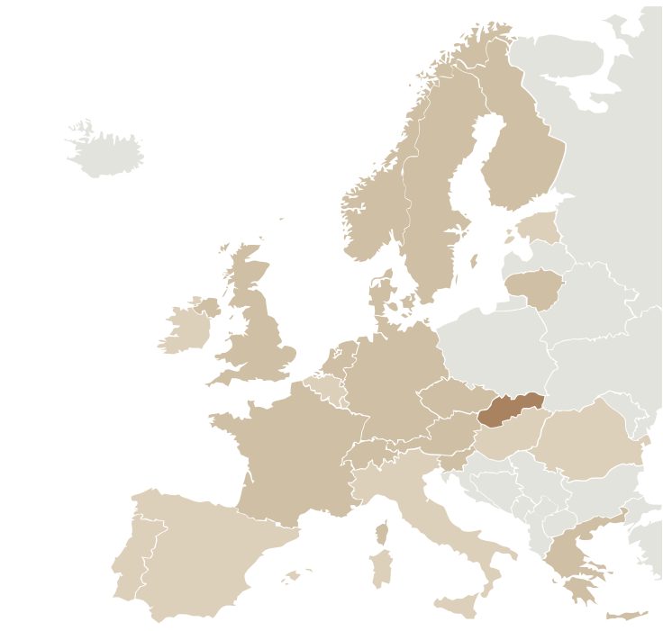
CESSDA Members
14 CESSDA members
Austria - WISDOM
Czech Republic - CSDA
Denmark - DDA
Finland - FSD
France – PROGEDO/ Quetelet
Germany – GESIS
Greece – So.Da.Net
Lithuania - LiDA
Netherlands - DANS
Norway - NSD
Slovenia - ADP
Sweden - SND
Switzerland - FORS
UK - UKDA
1 observer
Slovakia - SASD

Slide 6
CESSDA Current projects
Metadata are essential for all SPs’ operations and for CESSDA’s key services so there are several interdependencies with other Work Plan Tasks and also with projects beyond CESSDA
Examples:
CESSDA Product and Service Catalogue
CESSDA Metadata Harvesting Tool
Multi-lingual thesaurus
Secure Direct Access Portal
DDI Alignment and Versioning
Authentication and authorization
Euro Question Bank
Harmonisation
Persistent Identifier Services
Data Access and Dissemination Policy activity
DDI CVG group
Making Nordic Health Data Visible
DDI Alliance / Moving Forward project
DataCite
CESSDA SaW and SERISS projects

Slide 7
The CMM Project
Objective and Output
Tasks and Partners
Deliverables
Timeline

Slide 8
CMM Objective and output
Objective: to develop, promote and implement a standardised metadata design, content and practice for all CESSDA data assets
Output: CESSDA Metadata Standards Portfolio Version 1
will become the standard for all SPs
will encompass support for resource discovery, question banks, preservation and data access (subject to prioritising) and help all SPs achieve the DSA certification requirements related to metadata issues.

Slide 9
Why ”only” version 1 of Portfolio?
The ambitions and demands outlined in the Work Plan Task description are extremely high
When preparing the bid, we felt that the ambition level was right but that the available funding did not reflect it
CMM proposes moving forward in two phases:
Phase 1 = CMM = solid but basic solution
Phase 2 = building Portfolio version 2 that will meet the majority of needs and enable the implementation of innovative functionality

Slide 10
CMM Tasks and task leaders
Task 1. Management and Promotion (FSD)
Task 2. Service Providers’ current metadata practices and metadata needs (FSD)
Task 3. Core metadata portfolio (GESIS)
Task 4. Controlled vocabularies portfolio (UKDS)
Task 5. Impact analysis and user experience (ADP)

Slide 11
CMM Partners
Partner | Contact Person(s)
ADP | Irena Vipavc Brvar
ADP | Janez Štebe
CASD | Kamel Gadouche
CASD | Anita Mazur
DDA | Anne Sofie Fink
FSD | Mari Kleemola
FSD | Outi Törnblom
FSD | Katja Moilanen
FSD | Taina Jääskeläinen
GESIS | Wolfgang Zenk-Möltgen
GESIS | Kerrin Borschewski
NSD | Dag Kiberg
SND | Iris Alfredsson
SND | Malin Lundgren
SND | Daniel Knezevic
SND | Sara Svensson
UKDS | Anne Etheridge
Project Leader:
Mari Kleemola, FSD
mari.kleemola@uta.fi
...and other contact persons:
Partner 1 FSD
Partner 2 ADP
Partner 3 CASD
Partner 4 DDA
Partner 5 GESIS
Partner 6 NSD
Partner 7 SND
Partner 8 UKDS

Slide 12
CMM Deliverables
Report on current metadata practices/needs
Report on controlled vocabularies and their use/needs
CESSDA Metadata Standards Portfolio Part A (Core metadata)
CESSDA Metadata Standards Portfolio Part B (Controlled vocabularies)
Impact Analysis
Final Project Report

Slide 13
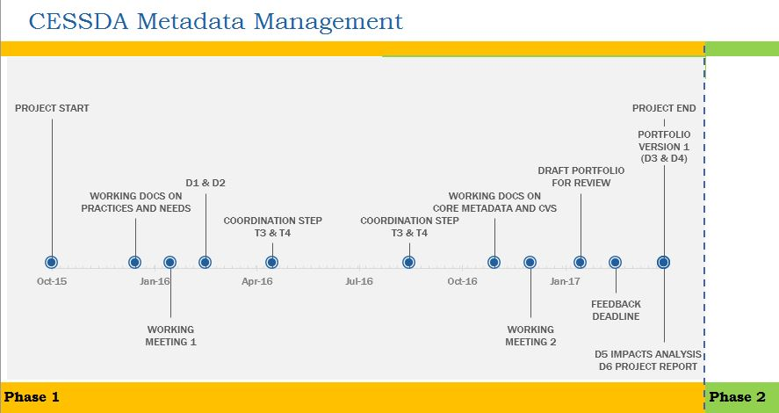
CMM Project timeline
to be adjusted since the start of the project was delayed by one month
Duration 18 months, November 1 2015 – April 30, 2017

Slide 14
Working on Metadata Management
What will the Portfolio do?
What advantages does the Portfolio give?
How are we using DDI?

Slide 15
What will the Portfolio do?
Support the description of data from social sciences, but also from other disciplines, e.g. humanities and health sciences
Incorporate work from previous projects like PPP, DwB, DASISH etc.
Cover study-level metadata and variable/question-level metadata
Enable Service Providers to retain independence yet interact with an integrated CESSDA service
Be extensible so that it can be adapted to changing functional requirements over time
Use qualified controlled vocabularies
Include a proposal for updating and extending procedures

Slide 16
What advantages does the Portfolio give?
Enable the harvesting of SPs’ resource discovery metadata and other relevant metadata for inclusion in the CESSDA data portal
Support multilingual searches and data discovery, reflecting the needs of both Service Providers and researchers
Using the same metadata portfolio makes the metadata more commensurable to build a well-functioning data discovery system
CVs enable the implementation of cross-language information retrieval systems

Slide 17
How are we using DDI?
The CESSDA Metadata Standards Portfolio will be standards based
The Portfolio will be compliant with DDI.
Portfolio will include controlled vocabularies.
Whenever possible, existing CVs will be used.
If needed, new multilingual CVs will be developed in collaboration with relevant external initiatives (for example, the DDI CVG).

Slide 18

Thank you!

