Slide 1

Connecting Researchers with Data: Discovery, Documentation, Access and Security
Cornell Institute for Social and Economic Research (CISER);
German Institute for Employment Research (IAB);
and the Cornell Labor Dynamics Institute (LDI)

Slide 2




Researchers Searching for Data

Slide 3
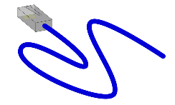
Connecting Researchers with Data
CED²AR
CRADC
FDZ, IAB

Slide 4
Connecting Researchers with Data
CED²AR
CRADC
FDZ, IAB
DDI

Slide 5
Discovering Data File – Do Data Exist??
First barrier to research:
A research question is formulated, but are their existing data files to address the question?
Discovering data files by searching descriptions of studies, files, and variables
The first barrier is discovery

Slide 6
Restricted Data – What’s in that Dataset??
Second barrier to research with restricted data:
Researchers need to examine the metadata of a dataset in order to prepare a research plan for the data application
Data Providers want research plans to specify why restricted data files are necessary, and how the variables will be analyzed
Enclaves and libraries want to assist researchers to search and discover what relevant data files exist in greater detail than abstracts
The second barrier of restricted data research is to discover what’s in the file!

Slide 7
Searching Restricted Labor Market Data
Labor market datasets for longitudinal employment data
National Longitudinal Surveys (NLSY)
Longitudinal Employer-Household Dynamics (LEHD)
Sample of Integrated Labor Market Biographies (SIAB)
That was the study level, but how do we compare the variables?
Searching across variables of restricted data is painful
Codebooks
Abstracts
Having seen the dataset during a prior project
The majority of these resources are not machine readable
There needs to be an accessible discovery tool

Slide 8
CED2AR
Comprehensive Extensible Data Documentation and Access Repository
Developed by the Cornell Node of the NSF Census Research Network (NCRN)
Enables search and browsing across codebooks
Designed to improve the discoverability of both public and restricted data
Lightweight, DDI driven web application
Based upon leading metadata standards
Ingests data from a variety of sources
Study levels include the
Abstract
Variables
Values
Citation
Terms of Use, as applicable

Slide 9
Utilizing CED2AR to Locate SIAB Variables
The addition of IAB SUF SIAB metadata to CED2AR
will enable researchers to search across
multiple labor market data series*
CISER is currently collaborating with IAB to develop the DDI necessary to add the SIAB metadata to CED2AR
Promote use of the SIAB data through discoverable documentation
Facilitate ease in research plan creation
*https://www2.ncrn.cornell.edu/ced2ar-web/about

Slide 10
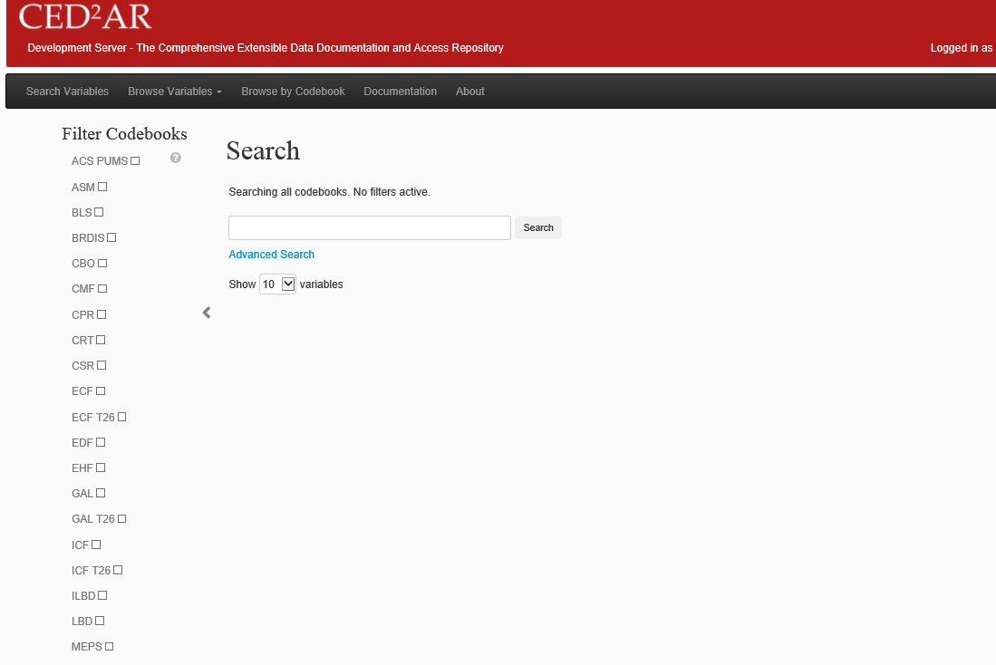

Slide 11
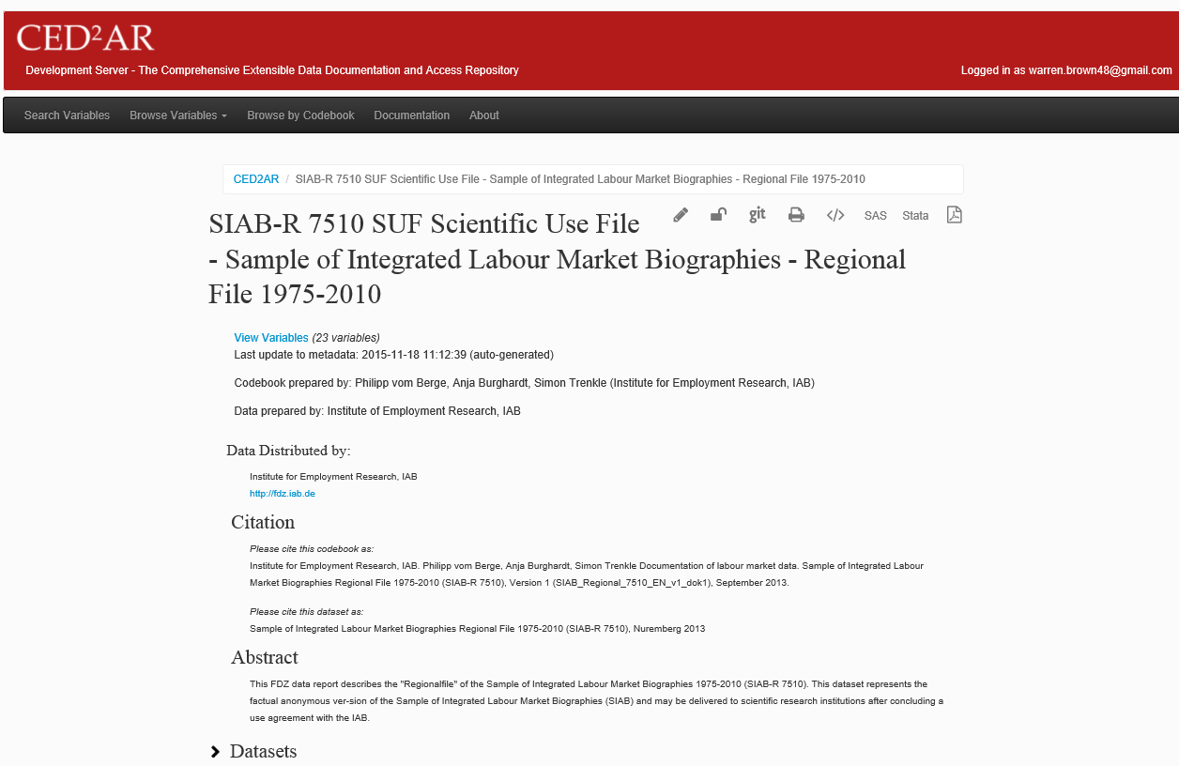

Slide 12
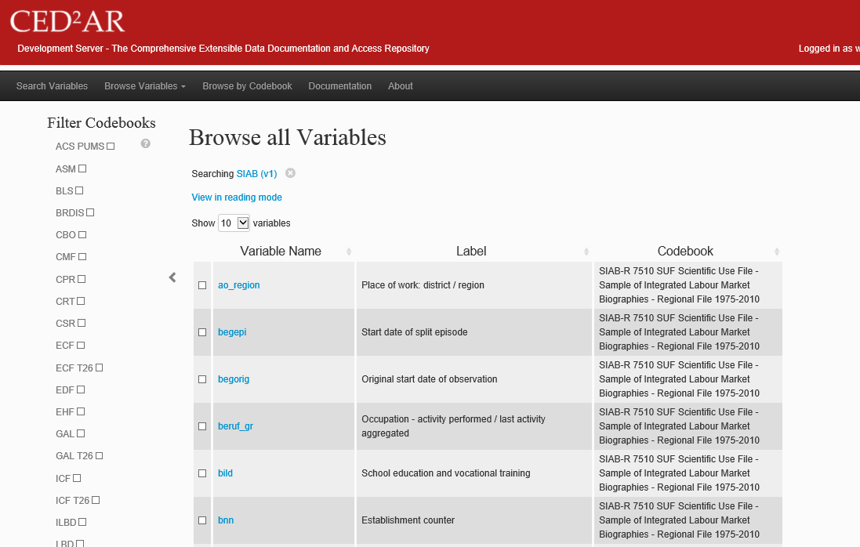

Slide 13
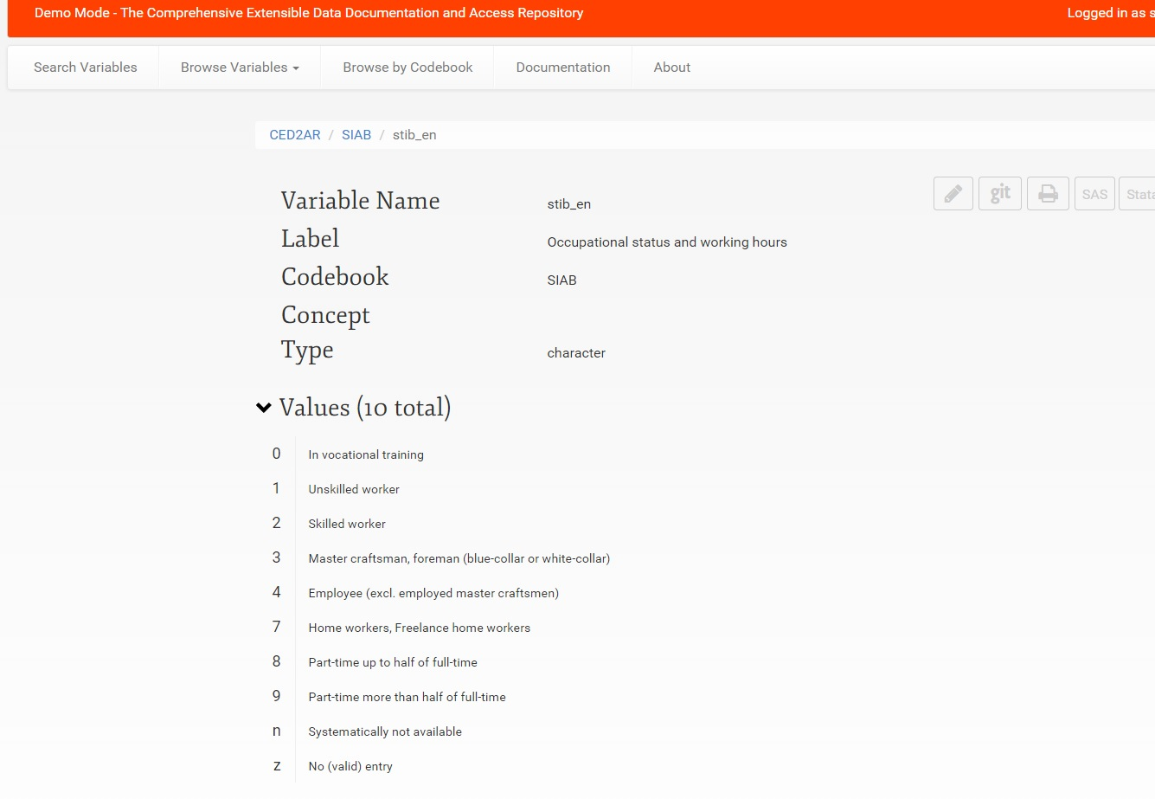

Slide 14
Restricted Data Access
The big barrier to restricted data access
is balancing researcher access
with data security
It’s ideal when data is housed within a controlled environment
It’s also ideal when researchers have the most flexible, secure access to the data

Slide 15
IAB SUF Access and Data Security
IAB Highly Restricted Data
Originally only accessible at Nuremberg, Germany
Implemented a Research Data Center – in – Research Data Center (RDC-in-RDC) approach
Allowed for a controlled remote access environment from the established Nuremberg research data center to comparably secure research data centers using Citrix-thin client technology
IAB SUF Data
Designed specifically by IAB for off-site access
Originally sent to authorized researchers in CD format, later by transmission, to be destroyed at the end of the project
These methods provided access, but posed a security threat via individual accountability and system back-ups
Needed a new, more secure off-site access mode - CRADC

Slide 16
Cornell Restricted Access Data Center (CRADC)
Cornell Institute for Social and Economic Research (CISER)’s remote access virtual data enclave
Controlled remote access environment accessible worldwide
As a secure computing environment with remote access, CRADC exists to:
House and protect restricted research data
Help PIs comply with requirements of Data Providers
Provide a computing platform as flexible as data use agreements permit
Any approved researcher can securely access restricted project files
Restricted data is available to the researcher on the CRADC server
Restricted data is held on a drive with only read and execute permissions
A project work space is provided on a separate drive, with access to analysis applications
No access is given to email, internet, clipboard, printer sharing, or disk mapping, and analysis can only be saved within the project work space

Slide 17
Institute for Employment Research (IAB) Scientific Use Files (SUF)
Contain confidential administrative microdata on labor markets:
Employment
Unemployment benefit receipts
Participation in labor market programs and registered job search
A large number of socio-economic characteristics
Similar in origin to the highly restrictive files but have been factually anonymized, enabling wider access
The highly restrictive files can only be accessed through a thin client connection directly to the IAB servers in Nuremberg, Germany
SUF file access through CISER’s remote access virtual data enclave (CRADC) through secure computing accounts using Remote Desktop Connection or Terminal Service Client
SUF access is available to any researcher approved by IAB worldwide
No affiliation with Cornell is required – any researcher approved by IAB can remotely access the files

Slide 18
CRADC – SIAB Data
Access the IAB SUF data worldwide
CRADC currently supports SIAB researchers in
Canada
Germany
Spain
United Kingdom
United States
CRADC provides the controlled environment for each researcher and project based on IAB’s terms
IAB no longer needs to send restricted data CDs or transmissions
Researchers are permitted SFTP access from their project work space to their campus office via static IP address
CRADC can confirm that all project data and analysis files are securely destroyed at the end of any IAB data use agreement

Slide 19
Discovering SIAB through CED2AR, Accessing on CRADC
Labor Market Datasets for longitudinal employment data
Discover the study and variables using CED2AR
Search and browse across codebooks
Compare public and restricted dataset versions
Select SIAB
Create a SIAB research plan using CED2AR variables and values
Review the terms of use to confirm that the planned analysis will be accepted (the data security plan is already covered)
IAB approves the longitudinal employment data project
Gain access to the SIAB data through CRADC
Complete SIAB analysis, notify IAB of project completion
CRADC will close the restricted project
Browse or search CED2AR for new project variables

Slide 20
Our Team
IAB
Dana Muller
David Schiller
Joerg Heining
CISER
Ben Perry
Michelle Edwards
Stephanie Jacobs
Warren Brown

Slide 21
Data Security
Researcher Access
Promoting Data through Discoverability

Slide 22

Thank you for your time and attention!
Warren Brown
Stephanie Jacobs
cradc@cornell.edu
ciser.cornell.edu

