Slide 1
Metadata in a Thousand Files: Bringing it all Together
Claude Gierl
Jon Johnson

Slide 2
Metadata in a Thousand Files: Bringing it all Together
Where we are at
The repository loader
The input files and the benefits of working with DDI-L
Some other lessons learned

Slide 3
The CLOSER Project
www.closer.ac.uk
Aims to maximise use of the UK longitudinal studies
Eight participating studies
100 000s variables
CLOSER Search Platform: discovery.closer.ac.uk

Slide 4
The CLOSER Search Platform Development
Capture Metadata
Load Repository
Develop
Web Portal

Slide 5
The Repository Loader
Loads DDI-L(3.2) input files and integrates the components
Creates links from the mapping files
Written in C#
Colectica SDK library
Microsoft SQL Server
In development phase

Slide 7
Loader Input
Concepts
Questionnaire Metadata
Variables Metadata
Top Level (Study) Metadata
Mapping and Linking Files

Slide 8
Concepts
Used in the portal to provide one of the routes to variable discovery
Concepts as broad topics
Concept hierarchy
Level 1: e.g. Education
Level 2: e.g. Schooling, Qualifications
Concepts.txt
To ddi32
Concepts.xml
Loader
ConceptScheme

Slide 9
Questionnaires
Metadata team enters questionnaire into CADDIES
A few hundred questionnaires or instruments
Output is DDI-L(3.2) files, one per questionnaire
CADDIES xml
Instrument
CADDIES xml
Instrument
CADDIES xml
Loader
Instrument

Slide 10
Variables
Parsed from the SPSS datafiles
SledgeHammer and Python scripts
Output is DDI-L(3.2) files, one per datafile
CADDIES xml
Instrument
CADDIES xml
Instrument
Variables xml
Loader
VariableScheme

Slide 11
Toplevel
Metadata entered into Colectica Designer
Output is DDI-L(3.2) files, one per study
One study corresponds to multiple questionnaires and variable sets
Instrument
Instrument
Instrument
Toplevel xml
Loader
Group + StudyUnits
Instrument
Instrument
Variables (LogProd, PhysDP, PhysInst)

Slide 12
Mapping Files
IDs, Names or Labels?
alspac_00_ays-qc-000003
qc_A2_b_i
A2 b(i)

Slide 13
Variable Source Map
QuestionConstruct to Variable mapping file
Collected via in-house Mapper software
Loader sets Variable Source to QuestionItem or QuestionGrid
QuestionConstruct
QuestionItem/Grid
QC - Variable
Loader
Variable

Slide 14
Variable/Question to Concept maps
Variable to Concept map and
QuestionConstruct to Concept map
Collected via in-house Mapper software
Loader builds VariableGroups and QuestionConstructGroups
ConceptScheme
Variable - Concept
Loader
VariableGroups

Slide 15
Derived Variable-Source Variable Map
DerivedVariable to Variable mapping file
Collected via in-house Mapper software
Loader sets SourceVariableReference
DV - Variable
Loader
Variables

Slide 16
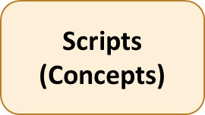
Conclusion: They all talk DDI-L(3.2)
Colectica Designer
(Top Level)
Loader
[Colectica SDK]
Repository
CADDIES (Questionnaires)
SledgeHammer (Variables)
Mapper (Mapping files)

Slide 17
More Conclusions
Consistent Inputs
Pragmatic Incremental Design
Knowing when to stop

Slide 18
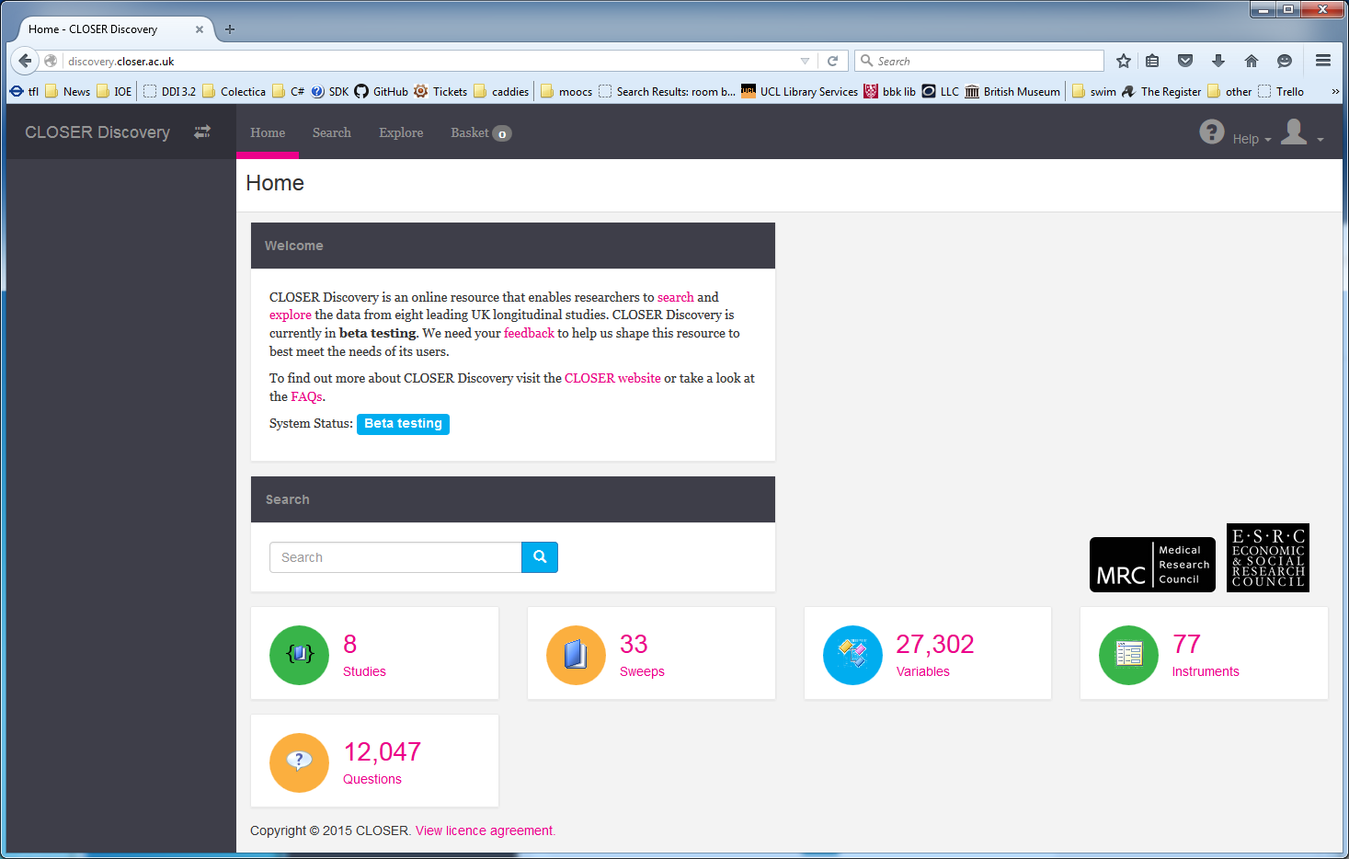
discovery.closer.ac.uk

