Slide 1


DDI - FlatDB
Claus-Peter Klas
Oliver Hopt
Wolfgang Zenk-Möltgen
Alexander Mühlbauer
GESIS – Leibniz Institute for Social Sciences

Slide 2
Overview
Why DDI in a DB?
Main idea of DDI-FlatDB
GESIS tools
Variable Report
Editor
Question and Variable Search

Slide 3
Why store DDI in a DB?
Complex data structure
No direct mapping possible
Extremly expensive wrt resources
Different DDI Versions (upcoming 4.0)
Different semantic interpretations
Application specific and non-reusable models

Slide 4
Our idea
Keep everything in the DDI XML File
Follow a stricly functional driven implementation approach
Do as much for efficiency for the users!

Slide 5
DDI - FlatDB
What is the DDI – FlatDB architecture?
Abstracting, efficient, functional driven and rest-full access to studies in DDI format.
Main features
Efficient access of entities via REST
StudyUnit, Question, Item, …
Keep things configurable to avoid reprogramming
Efficient searching for all entities
Flexible usage for all study related portals and functionalities

Slide 6
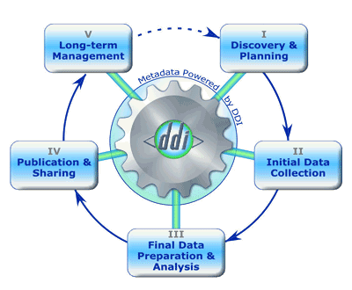
DDI Lifecycle

Slide 7
DDI Lifecycle & DDI Codebook
DDI-Lifecycle
StudyUnit
Othermaterial
Creator
Abstract
Subject
SpatialCoverage
DataCollection
Access
DDI-Codebook
Codebook
AuthEnty
TopcClass
geogCover
dataColl
dataAccs
relMat

Slide 8
DDI Lifecycle & DDI Codebook Variables
DDI-Lifecycle
VariableGroup
VariableScheme
QuestionScheme
CategoryScheme
DDI-Codebook
varGrp
var
qstn
catgry

Slide 9
Architecture DDI-FlatDB
Access
get list
get element list
get/set element
delete element list
Admin
indexAll
indexNew
REST-API
DDI-Files
Import
Export/Store
DDI-FlatDB Service
GIT
HUB
Entity Setup
for each DDI Version
Entity:XPath
DDI
FlatDB
Revision
Version
DDIStore Table
Key | Element Id | Entity Type | Element Order | XML Content | DDI dialect | Study Id

Slide 10
DDI-FlatDB: Split-Process
DDI Files
Split according Config
Insert to FlatDB
Parse XML File
# Attention: Order is important due to DDI Sequence
ddiinstance.note = /DDIInstance/ResourcePackage/Note
ddiinstance.variablescheme.variable = /DDIInstance/ResourcePackage/VariableScheme/Variable
ddiinstance.variablescheme = /DDIInstance/ResourcePackage/VariableScheme
ddiinstance.questionscheme.item = /DDIInstance/ResourcePackage/QuestionScheme/QuestionItem
ddiinstance.questionscheme= /DDIInstance/ResourcePackage/QuestionScheme
ddiinstance = /DDIInstance

Slide 11
Integration
Reporting Tool
DBK Edit
DSDM
DDI-Entities
Editor
GLES
Question
&
Items
DDI-FlatDB
DBK Portal
Variable Search
CBE

Slide 12
Configurable DDI Entity
gesis31.StudyUnit.ID.path=//StudyUnit/@id
gesis31.StudyUnit.Title.path=//StudyUnit/Citation/Title[@lang='%lang%']/text()
gesis31.StudyUnit.UserId.path=//StudyUnit/UserID/text()
gesis31.StudyUnit.UserIdType.path=//StudyUnit/UserID/@type
gesis31.StudyUnit.Creator.path=//Citation/Creator
gesis31.StudyUnit.Creator.Name.path=text()
gesis31.StudyUnit.Creator.Affiliation.path=@affiliation
gesis31.StudyUnit.Creator.Role.path=@role
gesis31.StudyUnit.Contributor.path=//Citation/Contributor
gesis31.StudyUnit.Contributor.Name.path=text()
gesis31.StudyUnit.Contributor.Affiliation.path=@affiliation
gesis31.StudyUnit.Contributor.Role.path=@role
gesis31.StudyUnit.Publisher.ldep=false
gesis31.StudyUnit.Publisher.multi=false
gesis31.StudyUnit.Publisher.path=//Publisher/text()
gesis31.StudyUnit.PublicationYear.path=//PublicationDate/SimpleDate/text()
gesis31.StudyUnit.Content.path=//StudyUnit/Abstract/Content[@lang='%lang%']/text()

Slide 13
Current Softwaretools
Variable Reporttool (Evaluation Phase)
DDI Editor (Prototypes)
Question and Variable Search (Prototypes)
GLES Question Designer and Editor

Slide 14
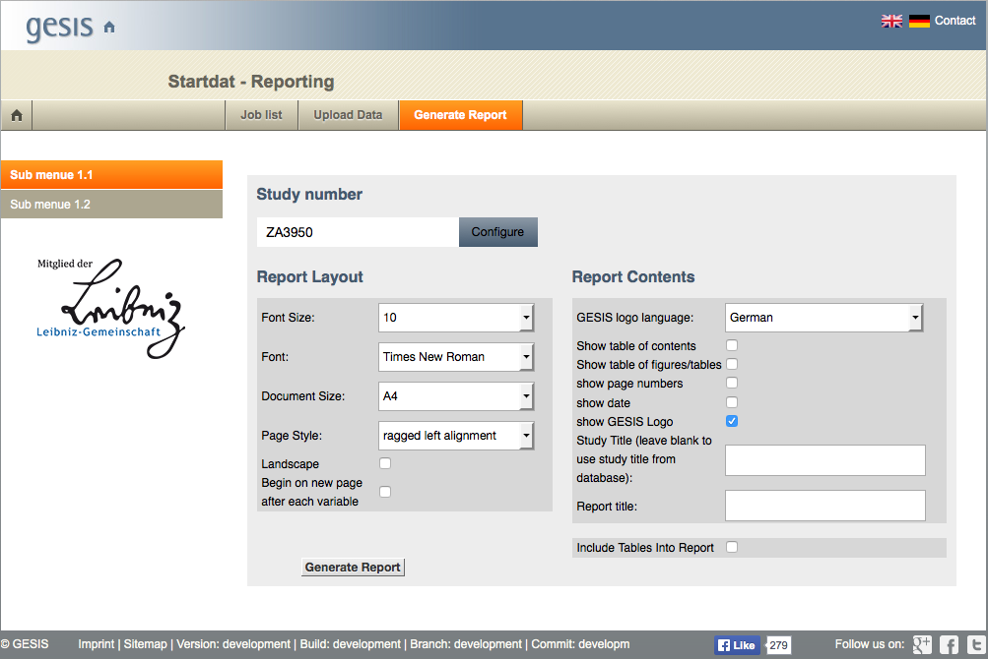
Report Tool

Slide 15
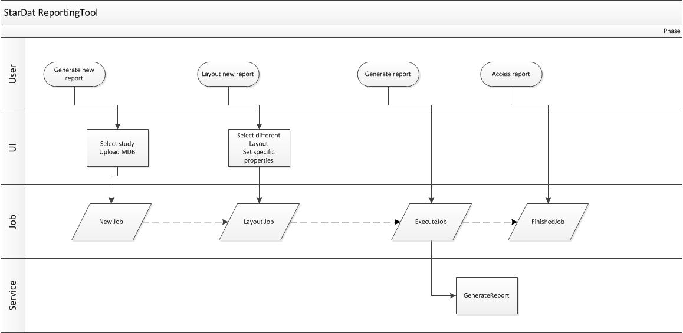
Reporting Tool: Workflow
Fetch Variables
Fetch QuestionItems
Convert to Latex
Fetch Table (CBE)
Fetch Cards (CBE)
PDFLatex

Slide 16
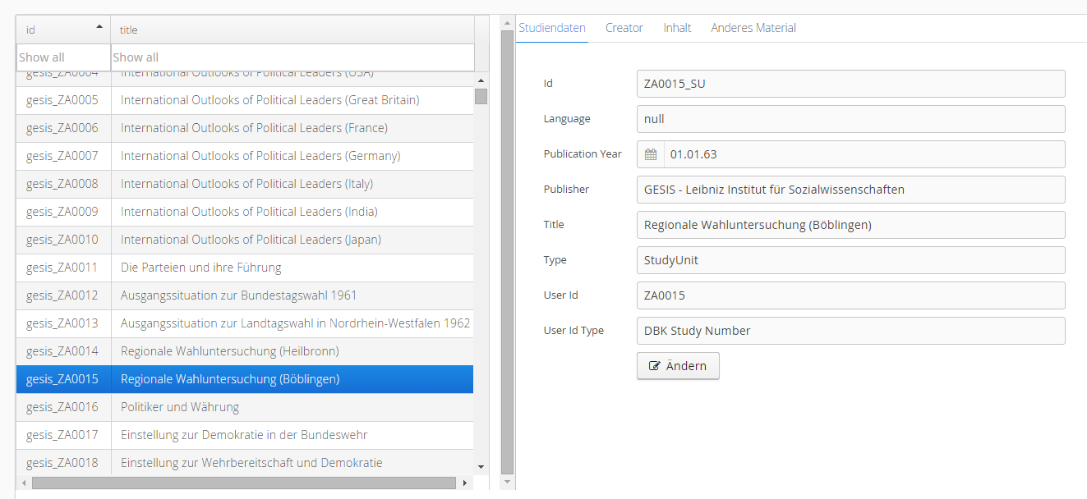
Editor: Studydescription

Slide 17
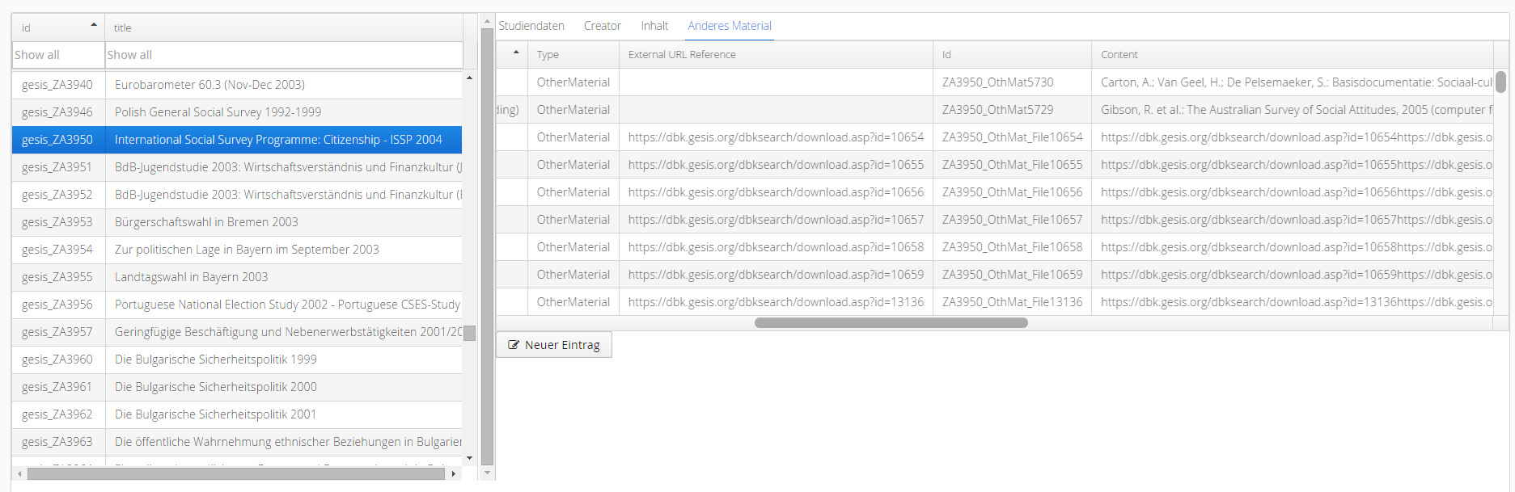
Editor: Other content

Slide 18
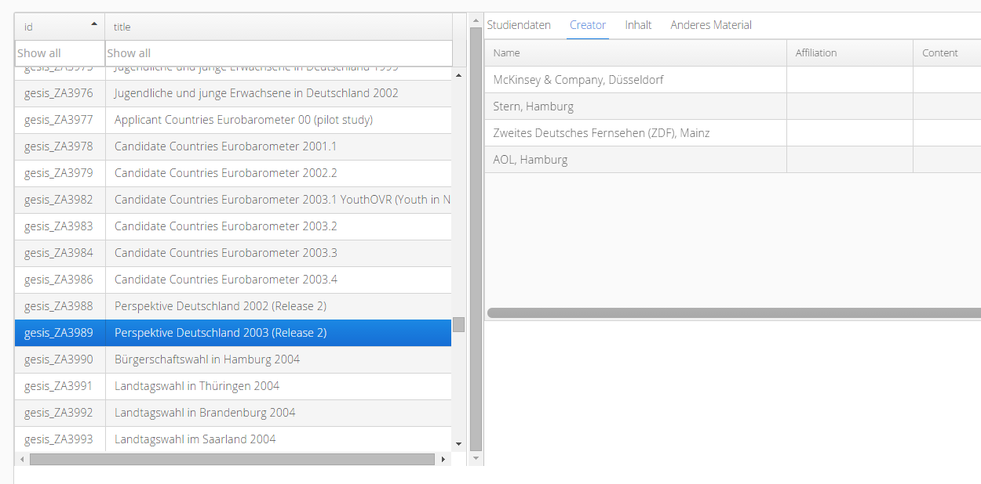
Editor: Creator

Slide 19
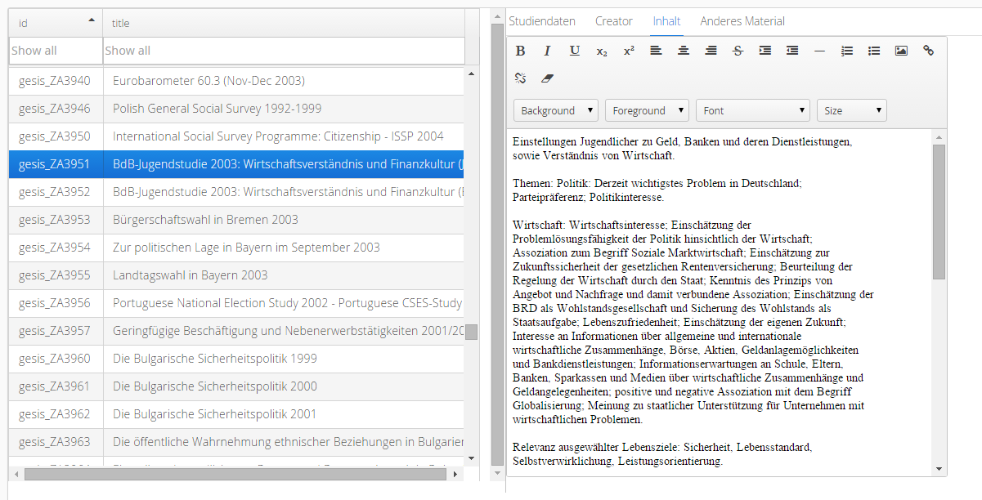
Editor: Content

Slide 20
Editor: Edit and Store
Load
Entity
Edit Entity
Store
Store
Set FlatDB
Serialize DDI File
New Revision
New Version
git –m „new revision“
git tag –a v1.6 –m „new version“

Slide 21
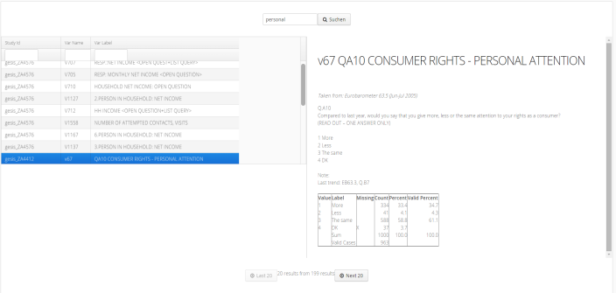
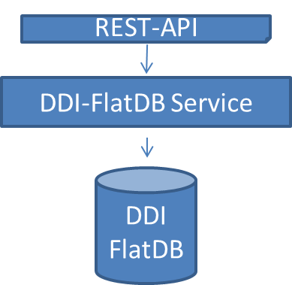
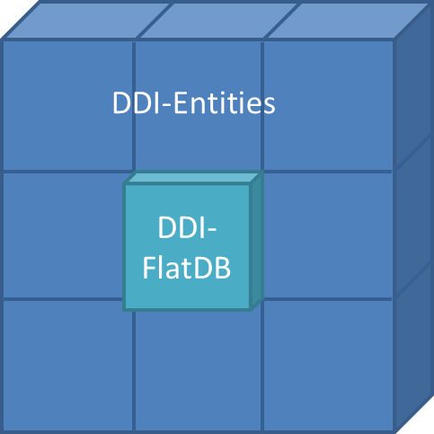
Question & Variable Search
Load/Split Entities
Format/Prepare
Indexing
Upload to
Search engine
Search Interface
Elastic Search Index

Slide 22

Variable Search

Slide 23
Summary
Up to now architecture holds
Can be adapted, if functional requirement comes up
Overcomes DDI formats and dialects

