Slide 1
A generic production environment - use of GSIM in Statistics Sweden
Klas Blomqvist

Slide 2
Vision
GPM-project
The central metadata repository
Harmonization

Slide 3
Vision 2020
Reduce respondant burden
Meet new demands
Harmonized statstics
A coordinated efficient statistical system that meets the needs and demands of the customers
The statistical information is well structured in order to promote new outputs
By analysing the statistcal material the quality and usability can be improved
Notes:
Statistics Sweden has launched a new program for creating a production environment for “enterprise wide, process based”-statistical services.
One of necessary the preconditions for this initiative to provide metadata that can be used “actively” through the production process from design to dissemination. These metadata have to be well-structured and of good quality in order to be used for building services in a new platform for processing and analyzing.
Statistics Sweden is therefore creating and implementing a method for concept harmonization and also making use of the recently developed GSIM based model for a central metadata repository (presented at EDDI 2014) for handling Statistical programs, information management and data structure as well as for defining concepts and variables.

Slide 4
SCB’s strategy on coordinated statistics production
Evaluate and feed back
Specify
needs
Design
and plan
Build
and test
Collect
Process
Analyse
Disseminate and
communicate
Support and infrastructure
Platform / service layer
Data
Metadata
Publishing
Direct data
collection
Input data
Micro Data
Macro Data
Observation data
Target data
Presentation data
Dissemination
Administrative
data
Base
register
Process Data
Notes:
LG

Slide 5
Common Production Environment (GPM-project)
Active metadata – Design driven production
Existing:
Production environment for data collection
Production environment for dissemination
Developing:
Production environment for process and analyse

Slide 6
Ongoing
Incorporating in/with the Common Production Environment
Prototype – statistical program database
National accounts
Short term statistics (5 products) - KLON

Slide 7

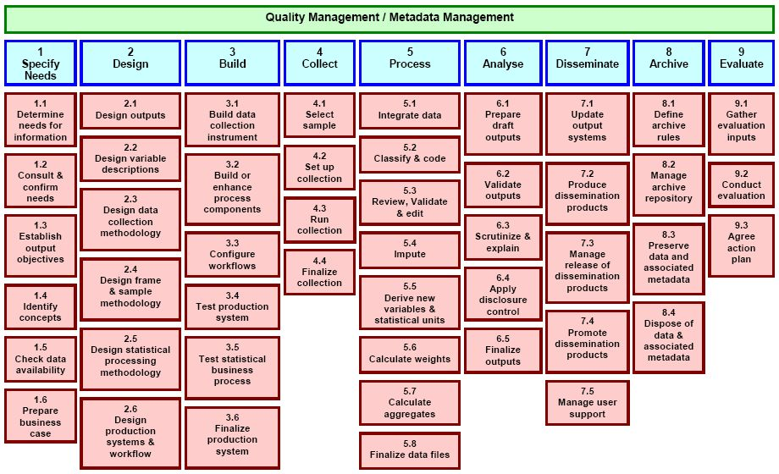

Active metadata – how?
GSBPM
GSIM

Slide 8
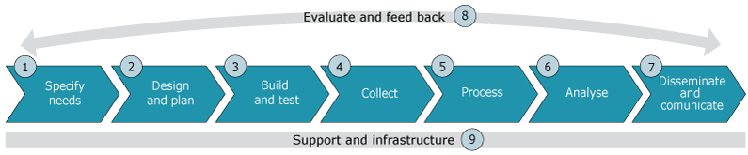
Statistical program DB
Statistical program
Statistical program
Statistical program cycle
Statistical Support Program
Business Process (Collect)
Business Process
(Process/Analyse)
Business Process
(Dissemination)
Business Process (Evaluate)

Slide 9
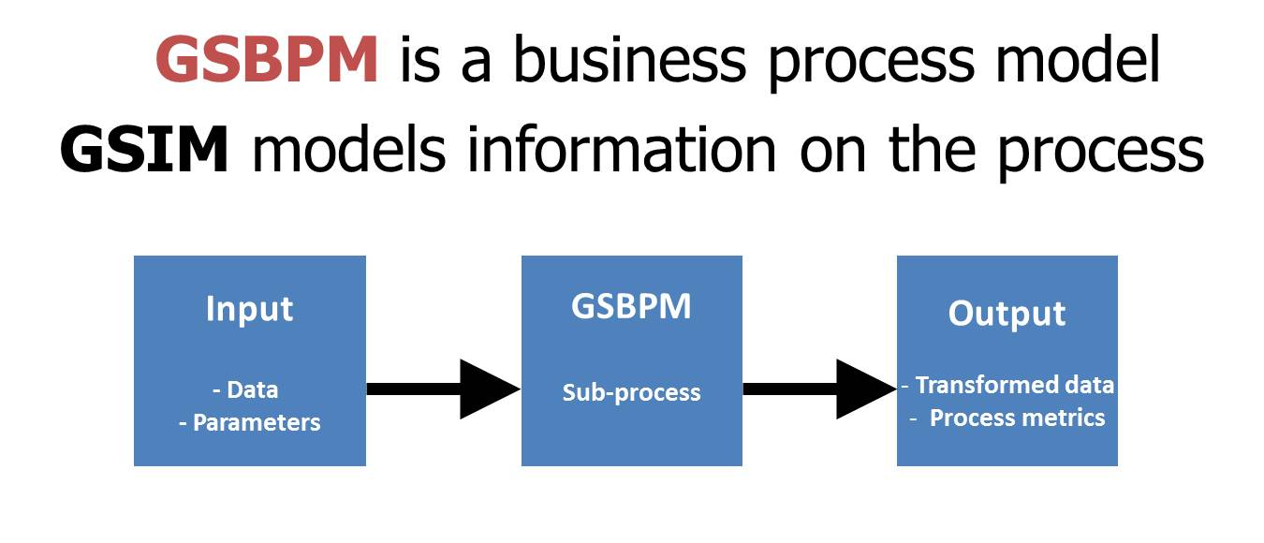
GSIM complements GSBPM
Describes information objects and flows within the statistical business process
Notes:
Achieving (i) & (ii) also requires a consistent approach to information flowing in and out of functions
DDI and SDMX can provide a standard way of representing and “carrying” (at least some of) the required information

Slide 10
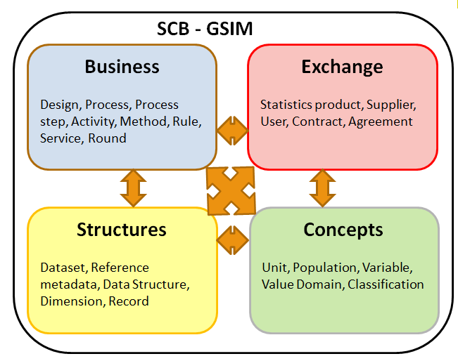
GSIM in Statistics Sweden
SCB GSIM

Slide 11
Content harmonization
One of the goals of the new production environment is to enable content harmonization
Metadata to provide reusability in order to increase efficiency and quality
Enable fusion of sources
Reduce respondent burden

Slide 12
Number of emplyees

Slide 13
Industrial Company A
Number of employees: 159
Monthly surveys
Kortperiodisk sysselsättningsstatistik - Marie
Intrastat - Marianne
KonjInd – Stefan och Ylva
Ksju - Marie
Konjunkturstatistik över vakanser - Jonas
KLP - Marie
PPI
Quarterly surveys
Kvartalsvis bränslestatistik - Claes
Investeringsenkäten - Stefan
Industrins lager - Stefan
UHT - Stefan
Yearly surveys
SLP
BONUS - Jonas
FEK - Ylva
Företagens utgifter för IT - Ylva
ISEN - Ylva
IVP - Stefan
Utlandsägda företag - Stefan
Notes:
Johnson Metall 062-0196
159 anställda

Slide 14
Common and specific metadata
Evaluate and feed back
Specify
needs
Design
and plan
Build
and test
Collect
Process
Analyse
Disseminate and
communicate
Common metadata definitions
Support and infrastructure
Common to the entire statistics production process
Process step
Service catalogue
Variable
Classification
Definitions of occurrences specific to a production round
Individual product implementation
Process step within a round
Service within a round
Value domain
Instance variable
Frame unit data
Sample unit data
Report unit data
Observation unit data
Statistical data collection
Process data
Data Store
Actual occurrences
Notes:
Eva

Slide 16
GSIM - variables
Concept systems
Concepts
Unit type
Variable
Represented variable
Value domain
Instance variable

Slide 17
Swedish version of GSIM - variables
Concept systems
Concepts
Relation to Unit type
Unit type
Conceptual variable
Represented variable
Value domain
”variable” unit
Context variable
Source
Time
Instance variable

Slide 18
Concept systems
Conceptual models
Variables
Unit types
Value domains

Slide 19
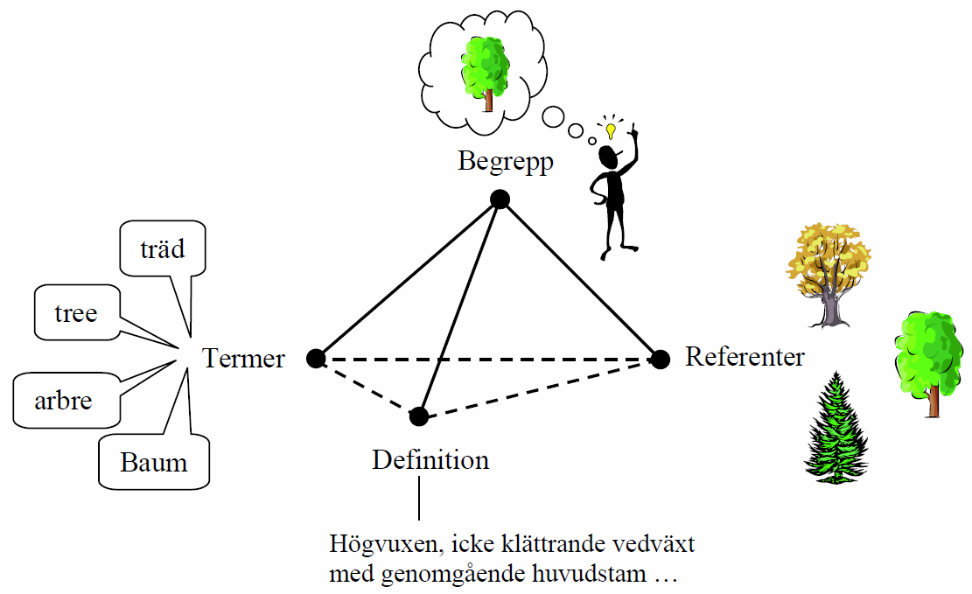
Concept, Term, Definition, Characteristics
Concept
Term
Referent
Characteristics
Has a trunk
Is tall
Is non climbing
Is a wood plant
Definition
Wood plant which is tall and non-climbing, and which has a continuous main trunk
Notes:
Ogden's Triangle

Slide 20
Concepts - Population register

Slide 21
Concepts – Unit types and varialbles
Population register
Unit type | Variables
Person | Gender
Birth | Person ID-number
Live birth | Number of
Immigration | Non Swedish/Swedish background
Degree | Age
National registration | Counry
Education | County
Citizenship | Congregation
Emigration | Municipality
Father | Year
Adoptive father | Civil status
Mother | Property ID
Adoptive mother
Property

Slide 22
Concepts - Short term statistics

Slide 23
Concepts – Unit types and varialbles
KLON – Short term statistics
Unit type | Variables
Business | Number of employees
Industry | Number of worked hours
 | Value added
 | capacity utilization
 | Stock
 | Salary
 | Monthly salary
 | Hourly salary
 | Industrial activity
 | Turnover
 | Order
 | Price indices
 | Identity
 | ID-number
 | Category number
 | Name
 | Organization number

Slide 24
Conclusions
Standards help
Can be interpreted in different ways
Foundation for harmonization

Slide 25
Examples

Slide 26
GSIM
Concept systems
Concepts
Unit type
Represented variable
Value domain
Instance variable

Slide 27
Concepts and Variables
Concept
Variable
Represented variable
Instance variable

Slide 28
Represented variable
Conbining concepts for
Unit type
Variable
Value domain

Slide 29

Concepts and Variables
Concept
Variable
Conceptual variable
Represented variable
Conceptual variable
Instance variable

Slide 30
Examples
Concept systems
Concepts
Relation to Unit type
Unit type
Conceptual variable
Represented variable
Value domain
Context variable
Instance variable

Slide 31
Examples
Swedish population register
Population register 2014: Age
Statistical unit: Person
Variable: Age
Value domain: One year classes
Represented variable: Person Age 2014 in one year classes

Slide 32
Age, population register 2014
Concept systems
Concepts
Person
Age
Relation to Unit type
Unit type
Conceptual variable
Age
Person
Represented variable
Value domain
One year classes
Person Age One year classes
Context variable
Instance variable

Slide 33
Examples
Swedish population register
Deaths 2014: Age at the event
Statistical unit: Death (Person related event)
Variable: Age
Value domain: One year classes
Represented variable: Person Age at Death 2014 in one year classes

Slide 34
Mothers age population register 2014
Concept systems
Concepts
Person
Age
Relation to Unit type
Unit type
Conceptual variable
Age
Death
Represented variable
Value domain
One year classes
Age at death one year classes
Context variable
Instance variable

Slide 35
Examples
Short term business statistics 2014
Statistical unit: Enterprise
Variable: Turnover
Value domain: Thousands SEK
Represented variable: Enterprise 2014 in Thousands SEK

Slide 36
Turnover short term business statistics 2014
Concept systems
Concepts
Enterprise
Turnover
Relation to Unit type
Unit type
Conceptual variable
Turnover
Enterprise
Represented variable
Value domain
Thousand SEK
Turnover in thousand SEK
Context variable
Instance variable

Slide 37
Examples
Business register 2014
Statistical unit: Enterprise
Variable: Industrial activity
Value domain: SNI 2007 5-digit
Represented variable: Enterprise Industrial activity 2014 by SNI 2007 5-digit

Slide 38
Industrial activity, business register 2014
Concept systems
Concepts
Enterprise
Industrial activity
Relation to Unit type
Unit type
Conceptual variable
Industrial activity
Enterprise
Represented variable
Value domain
SNI, 5 digit
Enterprise industrial activity by
SNI 5-digit
Context variable
Instance variable

