Slide 1

Management of GSIM Statistical Classifications with DDI 3.2

Slide 2

In This Talk
Brief overview of Statistical Classifications
Brief overview of current Copenhagen Mapping
DDI 3.2 and GSIM
Colectica 5.2 demo
Statistical Classification Management
Classifications in future DDI versions

Slide 3
Tell me about Classifications

Slide 4
Background - Neuchâtel
In 1999, Neuchâtel group meets to discuss standardization of Statistics Classifications
In 2002, The Neuchâtel terminology model 2.0 was released (2.0)
Updated to version 2.1 in 2004

Slide 5
Background - GSIM
The GSIM Classification model was drawn from the terminology in the Neuchâtel model
In 2012, the first GSIM model including classifications was released. Version 1.0.
In December 2013, a version 1.1 update to GSIM was released
The Neuchâtel model is now an annex to the GSIM model, and released with it

Slide 6
Background – Copenhagen Mapping
In December 2013, a workshop was held in Copenhagen
A mapping was created between the newly released DDI 3.2 and GSIM 1.1 standards
Created Controlled Vocabulary for DDI 3.2
In 2014, a second workshop was held to expand the mapping
In December 2015, software to manage Classifications using DDI 3.2 and the mapping was made available

Slide 7
What are Classifications

Slide 8
Classification Family
A topical grouping mechanism for similar Classification Series
Pairs a list of Classification Series with a common concept, such as economic activity
Specialized CodeListGroup in DDI 3.2
Classification Family (CodeListGroup)

Slide 9
Classification Series
A group of Classifications that are published in an interval
ISCO, ISIC, NAICS
Specialized CodeListGroup in DDI 3.2
Classification Family (CodeListGroup)
Classification Series (CodeListGroup)

Slide 10
Statistical Classification
Composed of Classification Items
Categories and Codes
Has Levels
Can be hierarchical
Is a CodeList in DDI 3.2
Classification Family (CodeListGroup)
Classification Series (CodeListGroup)
Statistical Classification (CodeList)

Slide 11
Correspondence Table
Document comparisons between Statistical Classifications
Lists of Maps
Specialized CategoryGroup in DDI 3.2
Correspondence Table (CategoryGroup)

Slide 12
Map
Comparison of a Classification item with another
Can be 1..1 or 1..many
Specialized CateogoryGroup in DDI 3.2
Correspondence Table (CategoryGroup)
Map (CategoryGroup)

Slide 13
Correspondence Table and Map

Slide 14
Points of Interest
GSIM Classification model specifies many text fields
Some are computable
Some are enhanced using a relationship
Added relationships and more specific type information
Example: Predecessor, Successor, Derived From
Allows automatic computation of many fields
This approach was followed in DDI4 as well

Slide 15
Demonstration!

Slide 16
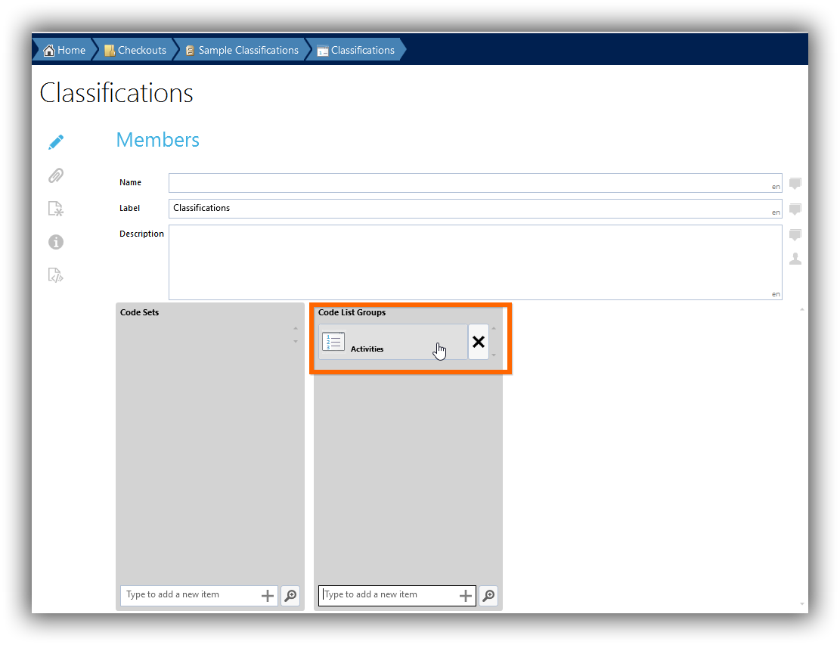
Demo – Classification Family
Create a CodeListGroup

Slide 17
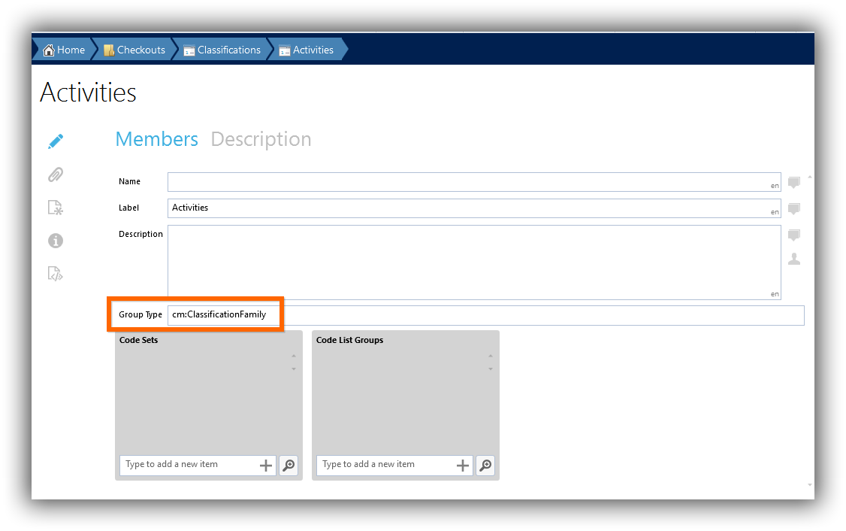
Demo – Classification Family
Mark it as a Classification Family

Slide 18
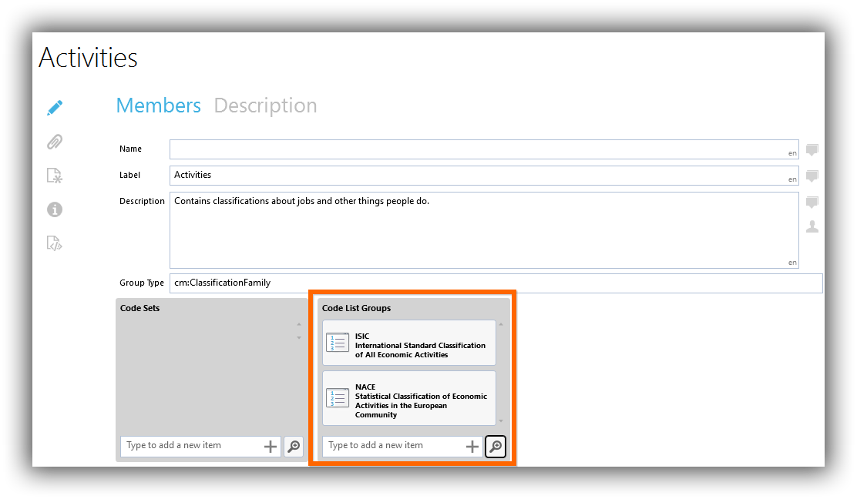
Demo – Classification Series
Add a CodeListGroup for Classification Series

Slide 19
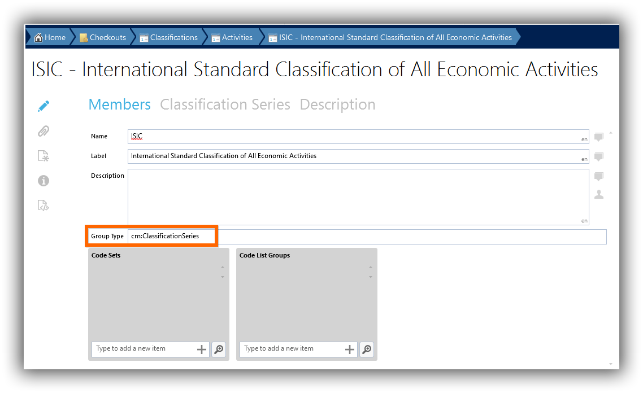
Demo – Classification Series
Mark it as a Classification Series

Slide 20
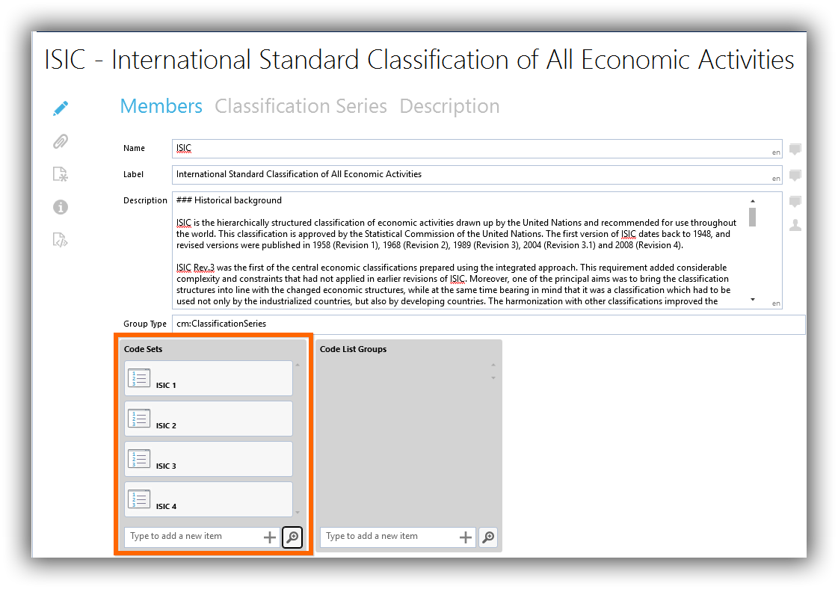
Demo – Statistical Classifications
Add CodeLists for Statistical Classifications

Slide 21
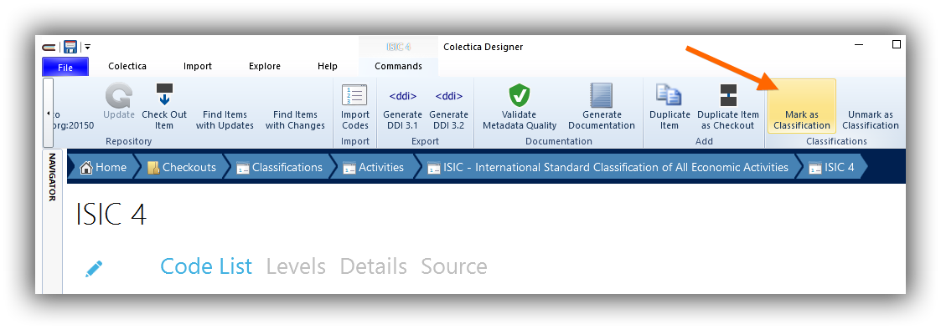
Demo – Statistical Classifications
Mark the CodeList as a Statistical Classifications

Slide 22
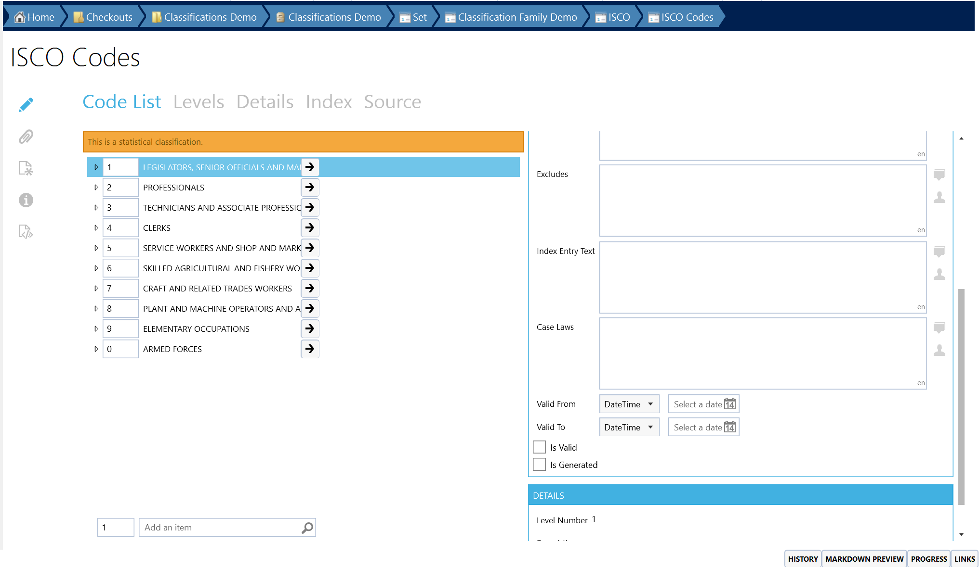
Demo – Statistical Classifications
New attributes are revealed in the editor

Slide 23
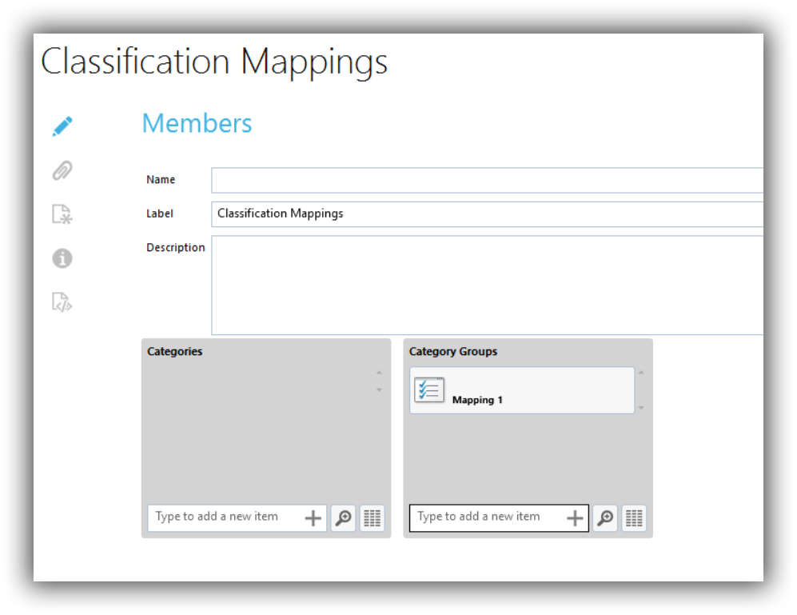
Demo – Correspondence Table
Create a CategoryGroup

Slide 24
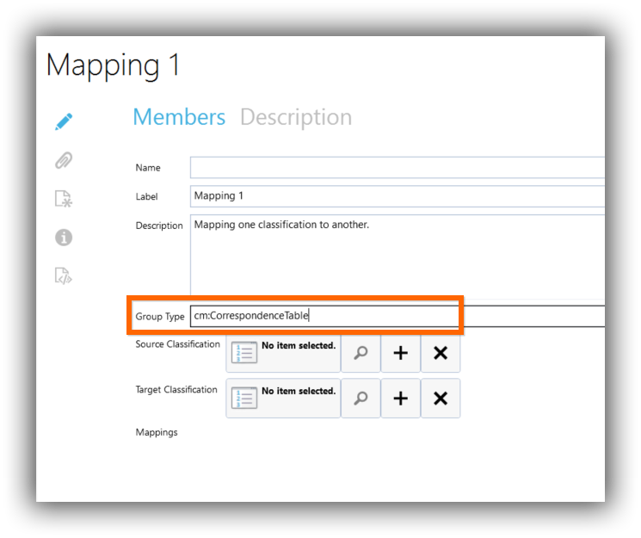
Demo – Correspondence Table
Mark it as a Correspondence Table

Slide 25
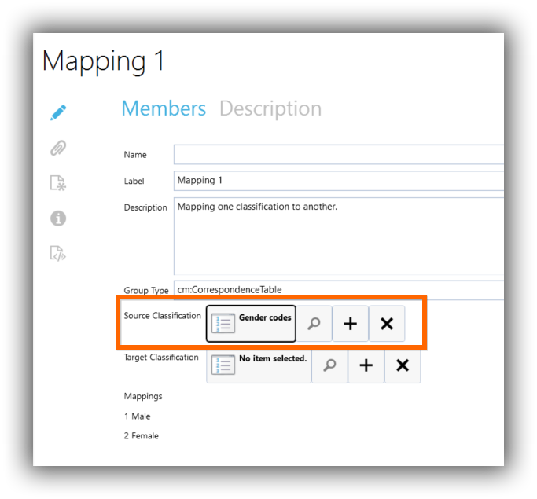
Demo – Correspondence Table
Select source Statistical Classification

Slide 26
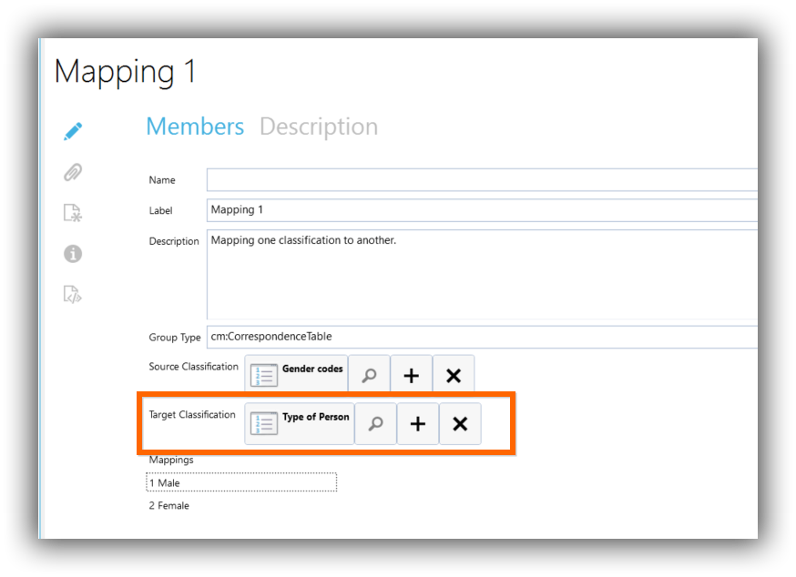
Demo – Correspondence Table
Select target Statistical Classification

Slide 27
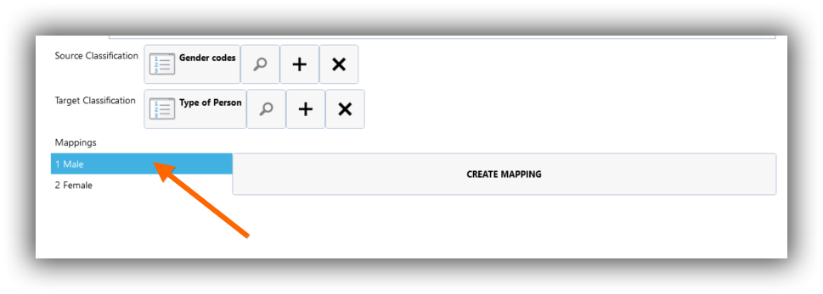
Demo – Correspondence Table
Choose source Classification Item

Slide 28
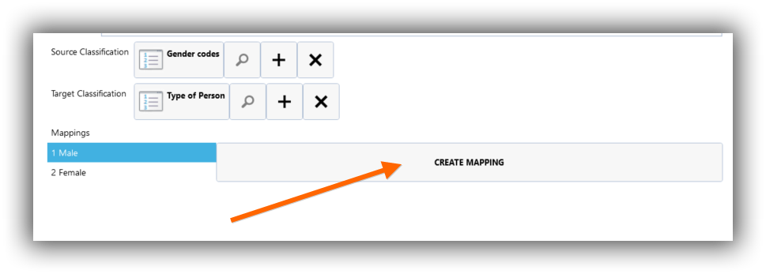
Demo – Correspondence Table
Click Create Mapping

Slide 29
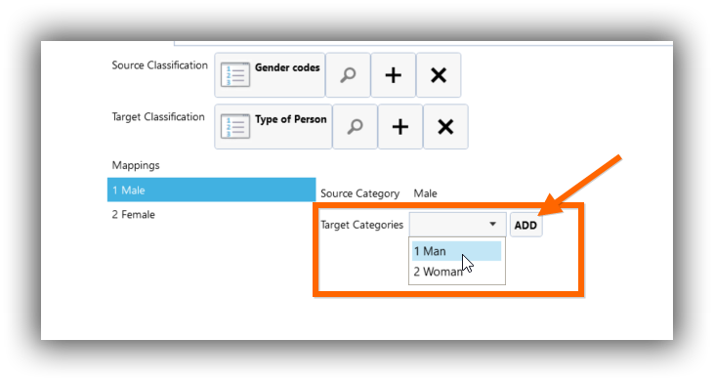
Demo – Correspondence Table
Choose target Classification Item

Slide 30
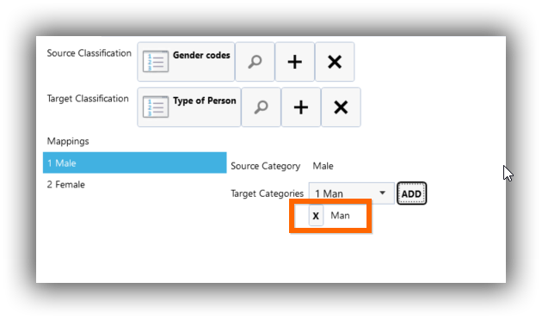
Demo – Correspondence Table
The mapping is recorded in the Correspondence

Slide 31

Takeaway
DDI Lifecycle 3.2 is well suited for implementing GSIM Classifications
Use DDI for the Physical Specification
Colectica now provides support for managing Statistical Classifications in DDI

Slide 32



Thank you
 | Web | colectica.com
 | Blog | blogs.colectica.com
 | Twitter | @Colectica
 | YouTube | youtube.com/colectica

