Slide 1



RAIRD Remote Access Infrastructure for Register Data Documenting the life-cycle of every data point Ørnulf Risnes, Norwegian Social Science Data Services (NSD) <ornulf.risnes@nsd.uib.no> EDDI 2015 Copenhagen 3 December 2015
Notes:
RAIRD attempts to solve similar problems as the previous project
But takes a different and complementary approach.
Before we start, I should give a short introduction to RAIRD
and its context in the Norwegian research landscape

Slide 2
Context of talk
RAIRD
(See http://raird.no)
NORD-i
(Data Curation Platform)
DDI Moving Forward
(Data Description)

Slide 3
Goal of RAIRD: Increase research on data from administrative registers
Statistics Norway’s
Events
DB
National Education
DB
Civil
Regist
Tax/
Income
Notes:
The Norwegian Statistical act gives Statisctics Norway the right to acquire
Data from administrative registers
In order to produce official statistics
The data that Stats Norway use, can also be used for research purposes
Here you can see some of the registers relevant for RAIRD.

Slide 4
Initial exposure to the problem
50-60 SAS-files
and a PDF

Slide 5


Slide 6
A better understanding
More abstractions
or
Deeper understanding?

Slide 7
File-based vocabulary

Slide 8

GSIM had «Datum»
Datum

Slide 9
GSIM had «Datum»
Datum
- the key to understanding (all?) data

Slide 10
Datums are everywhere
Multi-level event-history data
Longitudinal
Cross-sectional
Aggregate

Slide 11
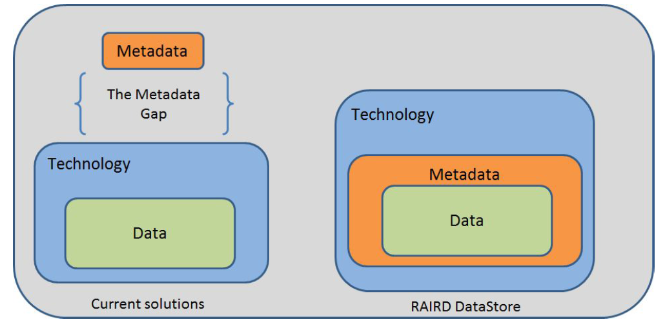
DDI Data Description to the Datum-level?

Slide 12
Bottom-up approach

Slide 13
How Datums are related

Slide 14
42

Slide 15
Ørnulf
WHO
42

Slide 16
2015
Ørnulf
WHEN
WHO
42

Slide 17
2015
1201
Ørnulf
WHEN
WHERE
WHO
42

Slide 18
2015
1201
Ørnulf
WHEN
WHERE
WHO
42
X25
HOW

Slide 19
2015
1201
Ørnulf
WHEN
WHERE
WHO
42
X25
HOW
WHY
Health survey

Slide 20
2015
1201
Ørnulf
WHEN
WHERE
WHO
42
X25
HOW
Age
WHAT
WHY
Health survey

Slide 21
2015
1201
Ørnulf
WHEN
WHERE
WHO
42
X25
HOW
Age
WHAT
WHY
Health survey

Slide 22
1201
WHERE
16%

Slide 23
1201
WHO
WHERE
16%

Slide 24
2015
12
1201
WHEN
WHERE
WHO
WHERE
16%
Pub-Rep
HOW
WHY
Regu-lation 124

Slide 25
2015
12
1201
WHEN
WHERE
WHO
WHERE
16%
Pub-Rep
HOW
Tax rate
WHAT
WHY
Regu-lation 124

Slide 26
Datums and metadatums
Every Datum needs context
Every Datum is a potential Metadatum

Slide 27
Datums and metadatums
Conceptual Variable
Conceptual Variable
Conceptual domain
Represented Variable
Represented Variable
Value domain
Instance Variable
Instance Variable

Slide 28
Conclusion
DDI Data Description
can bridge the metadata gap
A consistent, logical model for data AND metadata

Slide 29
Power to data curators and users
Datum-level revision control
Git-like collaborative workflows
Automated testing
Continuous delivery
Audit trails and activity reports
Flexible query capabilities…

Slide 30
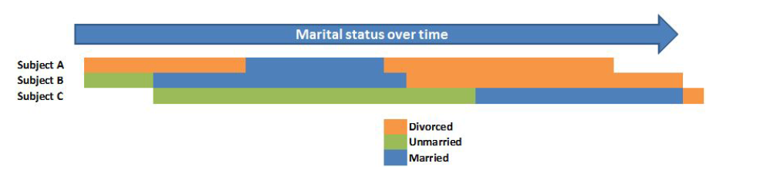
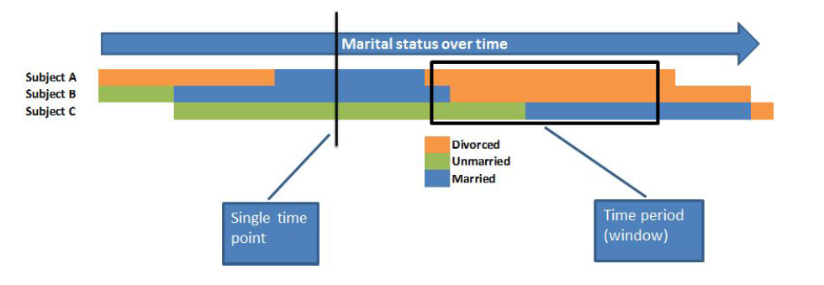

Slide 31
import mar_stat 2011-01-01
import mar_stat
2016-01-01 to 2009-04-01

