Slide 1



Semantic categorization of DDI metadata
EDDI12 – 4th Annual European DDI User Conference
Bergen 3-4 December 2012
Vasily Bunakov, STFC, United Kingdom
vasily.bunakov@stfc.ac.uk

Slide 2



Science and Technology Facilities Council
One of Europe's largest multidisciplinary research organisations
Operates large-scale research facilities in the United Kingdom and gives access to similar facilities world-wide
Funds university research in physics, astronomy and space
See also: www.stfc.ac.uk

Slide 3
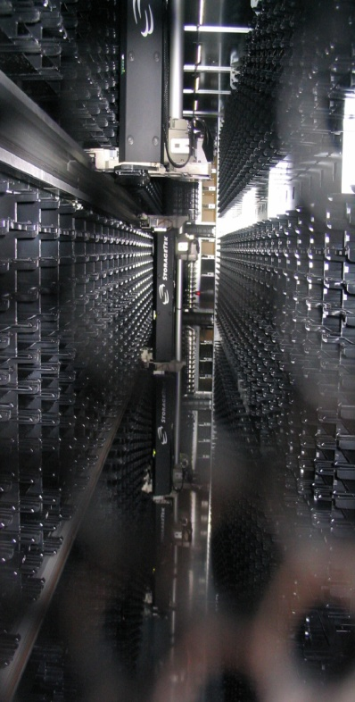
STFC Scientific Computing Department
High performance computing including the UK’s most powerful computer
The UK hub for CERN LHC data
Data archives: - ISIS: ~ 25 years, 3 mln files - Diamond: ~ 5 years, 100 mln files
Data modeling, including mature metadata framework for facilities research lifecycle
DOIs for data via DataCite / British Library
Data access policy: promoting open access
The StorageTek tape robot
100PB Capacity
See also: www.stfc.ac.uk/scd
Notes:
Add some notes to these
PB – petabytes of storage, 1 PB is enough for 13 years of continuous high definition digital television, or 10 billion pictures on Facebook
Facility Archives
All ISIS data (~25 years) > 3,000,000 files CHECK
All Diamond Data (~5 years) > ~270TB in 115 million files
LHC Tier 1
UK hub for LHC data (11PB) (5PB on disc, the rest in tape robot)
Other Research Councils
NERC JASMIN+CEMS super data cluster (£4.5M)
BBSRC Institutes data archive since 2006 TEN YEAR SLA
MRC Data Support service, access to long term human population studies, NEW SERVICE DEVELOPED BY eSCIENCE
MRC Psycholinguistic Database – very small, unfunded, zero cost, 100 publications per year from users
JISC
JISCmail (1Million users)
National Grid Service - enables access to national and international compute and data resources - COMPUTE GRID NOT ELECTRICITY GRID !!
Univeristies
Imperial College - National Service for Computational Chemistry Software - EPSRC funded, 100 publications per year from users
Oxford, UCL, Southampton Bristol, Emerald GPU cluster (£1M) (EPSRC)
Others:
The SCARF compute cluster for RAL facilities
The STFC Publications Archive
The CCPs (Collaborative Computational Projects)
The Chemical Database Service
The IBM Blue Gene/Q ICE-CSE DESERVES A SEPERATE SLIDE!!
Reasons for Data Storage:
Researchers access their own data (1-3 years after experiment)
Other researchers validate published results (3-5 years after experiment)
Set experimental parameters and test new computational models ( 5-50 years after experiment)
Used for new science not yet considered (5 years – forever, e.g. Historical data now used for climate change prediction)
Defend patents on innovations derived from science (5-75 years after experiment)
Evidence based policy making (5 years to forever)

Slide 4

ENGAGE business case
National and local governments, as well as other public bodies are publishing lots of data on the Web
European infrastructure is needed
To provide Public Source Information (PSI) to research communities and citizens
Data linking with Social Science archives is important and very welcome
www.engage-project.eu

Slide 5
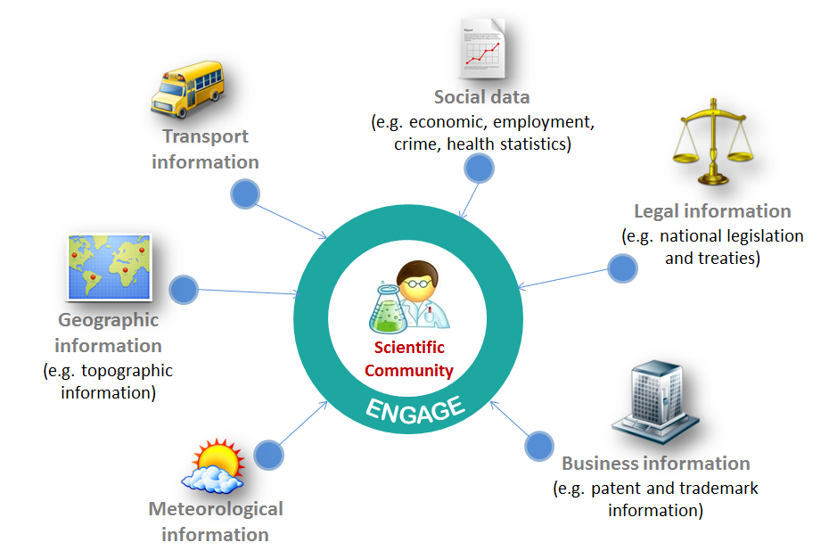
ENGAGE vision of linked data across different domains

Slide 6
To make research data linkable, we need to reasonably model research activity
Keep the model generic enough
Keep it simple for better adoption and “opportunistic” application
Aim it not at humans only but at machines / software agents, too, e.g. care about automated semantic inference

Slide 7
On models: our view of a research “cell” activity
Research effects (positive, negative, neutral, ...)
Short-term perspective
Research inputs
(previous research, funding, ...)
Research Activity
Research outputs
(publications, datasets, ...
Research environment (infrastructure, regulation, ...)
Long-term perspective

Slide 8
More than one research activity in one DDI record
Research funding
Research per se
Research distribution
Study title
Study description
Contributor (author)
Temporal coverage
Spatial coverage
Subject coverage
Contributor (distributor)
Copyright
Access type
Access description
Access contact
Funding agency
Grant ID
(A newer) DDI has been designed to cover the entire research lifecycle in specific branches of science but when we speak of a common infrastructure, we have to consider different information needs, and different modes of information re-use

Slide 9
Research decomposed in cells, with examples of entities for each
Research proposal
Funding
Research per se
Results processing
Results dissemination
Results consumption
Ontology class | Funding | Research per se | Results processing | Results dissemination | Results consumption
Input | Research proposal | Award (grant) | Dataset | DDI record | DDI record or its manifestation
Output | Award (grant) | Dataset | DDI record | Web service | Feedback
Actor | Researcher candidate | Contributor (author) | Data archive | Dissemination service | Web service user
Effect | Researcher’s department budget | Whatever is claimed in proposal | Economical effect of processing | Economical effect of distribution | Impact on further research
Condition | Funding body rules & regs | Microdata regulation | Data processing guidelines | Data access regulation | Research purpose statement
Scope | Certain branch of science | Certain geolocations | National research | International research | Certain HASSET keywords

Slide 10
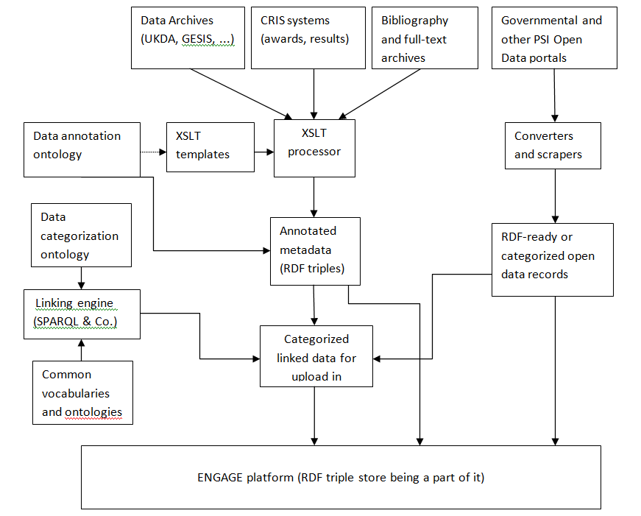
Ontologies in the context of ENGAGE data processing

Slide 11
Technology stack for experiments with DDI metadata
OAI protocol and harvesters
Tomcat, Sesame, OWLIM, ARQ
XSLT, SPARQL
Web workbench
Command line tool (ARQ)
SPARQL
Tomcat
container
Sesame triple store
OWLIM inference engine
Harvester
XSLT engine
OAI store
Just enough to support “RDFS Plus” data modeling

Slide 12
Data sources and models tried out and planned
UK Data Archive
GESIS
European Values Study
and
Eurobarometer
RELU
and
CENSUS
UK ESPRC Research Catalogue
Can give links to well-structured research outputs descriptions
Categorization ontology
SKOS-HASSET thesaurus
Can give links to controlled vocabulary and inference based on it
Geonames
DBPedia
Locations, maps
CERIF ontology
Can be a gateway to CRIS data
Web links

Slide 13
“Shallow” categorizations possible against DDI metadata
Inputs and Outputs Defined via Categorization Ontology to facilitate data discovery and data provenance tracking
Geolocations For research scope, for actors, ...
Subjects At least, their types: HASSET, ZA-Categories, ...
Actors At least, their types: investigators, distributors...
Any deeper categorizations will require Subject Matter Experts powered by data refinement & linking tools (Google Refine, LOD2 Silk, ...)

Slide 14
Why we need semantics?
Location | No. of references to Location | Part Of (parent) | Same As
"UNITED KINGDOM" | 16 |  | "GB United Kingdom"
"ENGLAND" | 14 | "GREAT BRITAIN"
"SCOTLAND" | 13 | "GREAT BRITAIN"
"WALES" | 10 | "ENGLAND AND WALES"
"GREAT BRITAIN" | 8 | "UNITED KINGDOM" | "GB-GBN Great Britain"
"ENGLAND AND WALES" | 6 | "GREAT BRITAIN"
"GB-GBN Great Britain" | 5 |  | "GREAT BRITAIN"
"GB-NIR Northern Ireland" | 5 |  | "NORTHERN IRELAND"
"NORTHERN IRELAND" | 5 | "GREAT BRITAIN" | "GB-NIR Northern Ireland"
"PEAK DISTRICT" | 4 | "ENGLAND"
"GB United Kingdom" | 3 |  | "UNITED KINGDOM"
"SOUTH WEST ENGLAND (REGION)" | 3 | "ENGLAND"
"EAST MIDLANDS (REGION)" | 1 | "MIDLANDS"
"MIDLANDS" | 1 | "ENGLAND"
UK Data Archive
GESIS

Slide 15
Good news about Linked Data
Easy to create new entities... | CONSTRUCT {?study engage:hasScope ?location . ?location a ukda:Location . ?location engage:name ?name . } WHERE {?study a ukda:Study . ?study ukda:locationKeyword ?name . BIND (URI(CONCAT("http://example.org/stuff/engage#",str(?study),ENCODE_FOR_URI(?name) )) AS ?location) }
...and generalize them... | ukda:Location rdfs:subClassOf engage:Location . gesis:Location rdfs:subClassOf engage:Location . select ?study where {?study engage:hasScope ?location . ?location a engage:Location . }
...as well as properties... | ukda:locationKeyword rdfs:subPropertyOf engage:locationKeyword . gesis:locationKeyword rdfs:subPropertyOf engage:locationKeyword . select ?study where {?study engage:locationKeyword “Nothern Europe" . }
...also make “sameness” claims | gesis: GB-NIR_Northern_Ireland owl:sameAs ukda:NOTHERN_IRELAND .
Then it is fairly easy to link data to the “cloud” | gesis:EurobarometerSeries owl:sameAs dbpedia:<http://dbpedia.org/resource/Eurobarometer> . ukda:University_of_Essex rdfs:seeAlso geonames:<http://sws.geonames.org/6690170> .

Slide 16
Not so good news (challenges)
Someone has to contribute to Linked Data cloud before you link to it, or re-use parts of it
That someone may not have enough incentives for contribution
Intellectual property, copyright and regulation can be “natural” limitations
Data practitioners need a proper discussion on the above, as well as their best practices shared

Slide 17
Research data as “cloud of clouds”
Research data cloud
Something for DDI professionals?
ENGAGE “ecological niche”
Research proposals data cloud
Data access policies and interfaces cloud
Data re-use data cloud
Funding data cloud
Raw and derived data cloud
Metadata, vocabularies and ontologies data cloud
Research proposal
Funding
Research per se
Results processing
Results dissemination
Results consumption
See also: Tim Berners-Lee on “bag of chips”

Slide 18
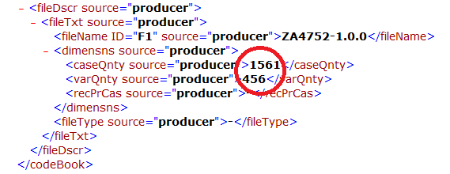
A challenge of Linked Data processing on a granular level
A) One European Values Study dataset may result in hundreds of thousands RDF triples
B) “A rule of thumb” is that an average triple store instance can handle 1,000,000,000 triples
A + B => granular Linked Data processing of just a dozen European Values Study datasets may require a dedicated triple store

Slide 19
Open questions and suggestions
Use cases for linking DDI (meta)data with .gov and other PSI (meta)data are very welcome
Insufficient openness of DDI data sources may hinder Linked Data developments for them
Linked Data on granular level is Big Data so we in natural sciences are out there with a computer power
www.engage-project.eu
www.stfc.ac.uk

Slide 20
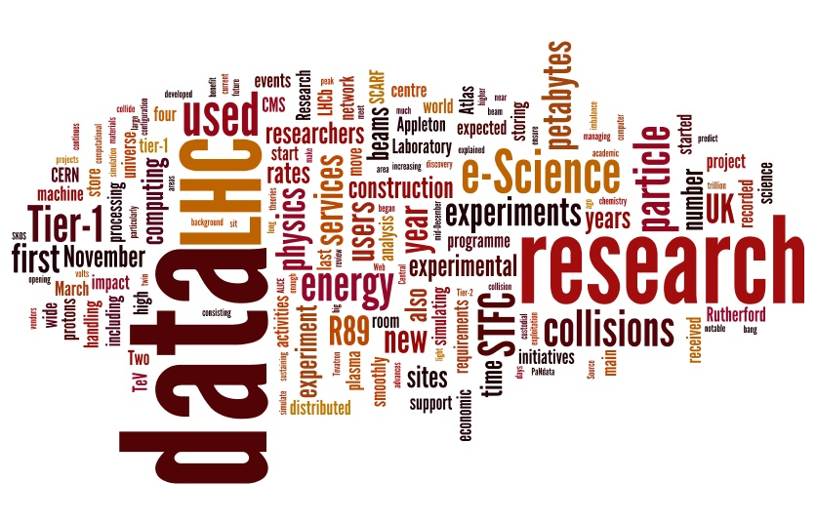
Thank you!

