Slide 1



RAIRD Remote Access Infrastructure for Register Data Beyond Discovery – Technical Solutions Ørnulf Risnes, Norwegian Social Science Data Services (NSD) <ornulf.risnes@nsd.uib.no> EDDI 2015 Copenhagen 2 December 2015
Notes:
RAIRD attempts to solve similar problems as the previous project
But takes a different and complementary approach.
Before we start, I should give a short introduction to RAIRD
and its context in the Norwegian research landscape

Slide 2
Goal of RAIRD: Increase research on data from administrative registers
Statistics Norway’s
Events
DB
National Education
DB
Civil
Regist
Tax/
Income
Notes:
The Norwegian Statistical act gives Statisctics Norway the right to acquire
Data from administrative registers
In order to produce official statistics
The data that Stats Norway use, can also be used for research purposes
Here you can see some of the registers relevant for RAIRD.

Slide 3
Background: The «Norwegian situation»
Strengths:
Full population registers may be used for research
Approved researchers get copies of data sets
Weaknesses:
Approval process is complicated
Involves data inspectorate, register owners
The «Need to know»-principle prevents data exploration
Can take 6-12 months
Data preparation (by SSB) is resource intensive
SSB not funded for this - researchers foot the bill
Approved researchers get copies of data sets
Notes:
The «Norwegian Situation» is special in several ways
It has some notable strengths in that it’s quite liberal
But it also has quite a few weaknesses.
The weaknesses are primarily related to time and cost of the application process

Slide 4
Solution – reduce cost and lead-time
Option 1:
Scale up resources in approval process
Scale up resources in data preparation
Register owner resources?
Data inspectorate?
Data still copied?
Option 2:
Simplify approval process
Only possible if
Output remains anonymous
No download
No LIST DATA
No indirect identification
Notes:
To address the weaknesses and to meet the goal
To increase research, we had basically two major options –
adding people or adding technology
Option 1: Further strengthening and streamlining of today’s approach
This would involve adding more people to the problem, and would still involve
Handing out copies of data – or a Remote Access solution.
Option 2: Take advantage of technological possibilities and
give data access from day 1
This could only be made possible if the following constraints were upheld:

Slide 5


Solution – fundamental principle
Researcher cannot see data
Metadata*) is the interface to data
*) Metadata includes analytical output
Metadata
Notes:
We decided to try and make an Interactive Solution
«Interactive» doesn’t sound particularly impressive these days.
But we are here talking about allowing researchers to interacting with DATA
From day 1
(New workflow – extremely high demands for functionality
Handling event-histories
Data processing and analysis must be on par with existing packages
Metadata must be integrated and much more accessible)

Slide 6
RAIRD as a research platform
Remote data preparation and analysis
Explore
Process
Visualize
Analyze
Merge
Notes:
We wanted to create a system that was almost as powerful
as if the researcher had ALL the data locally in their own network
…but that was safe to use

Slide 7
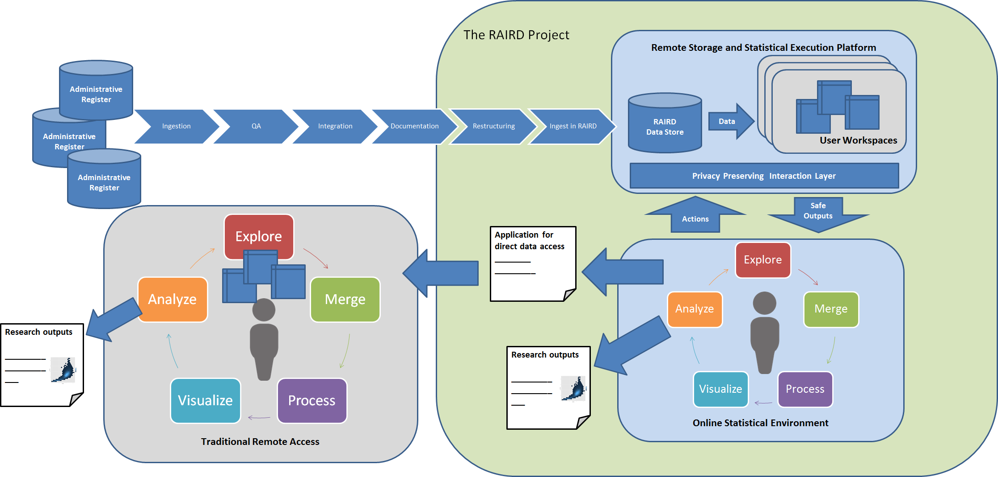
Notes:
In order to create the interactive solution,
…we had to develop sophisticated models (those I will talk about tomorrow)
We also needed to develop a set of components that I will talk about today
On this illustration which you probably cannot see very well,
…the RAIRD project is concentrated within the big box to the right
The RAIRD technology interfaces and strengthens existing upstream processes
…and may potentially have several downstream applications, including
transfer of bespoke researcher data to a more traditional Remote Access Platform

Slide 9
Notes:
Today I will focus on three of the components
The DataStore
The Statistical Execution Platform
The Online Statistical Environment

Slide 10
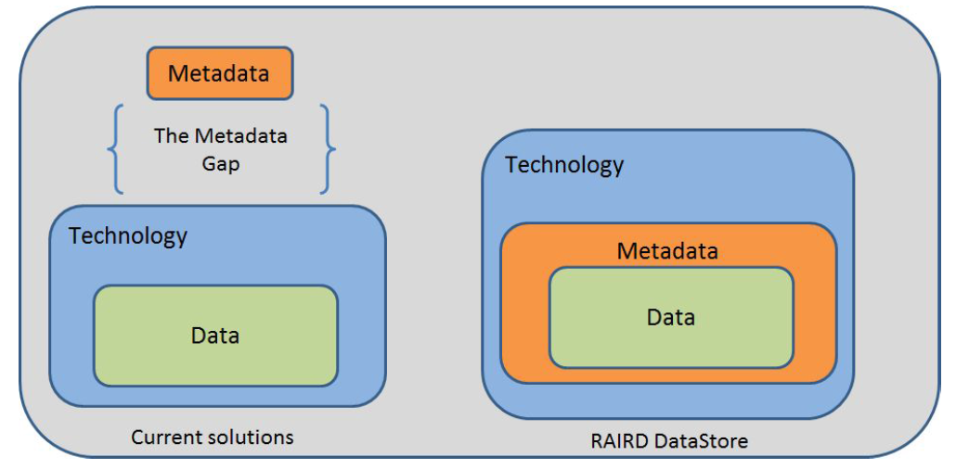
Notes:
First – The DataStore
The RAIRD DataStore integrates data and metadata, and can be seen as a mix of
A query endpoint (with in-band metadata)
Git
A temporal database

Slide 11



DataStore implementation
Clojure and Datalog
Datomic
Notes:
The DataStore is implemented
using an immutable database system
called «Datomic» and the current
Data Description model in the «DDI Moving Forward» project

Slide 12
AsOf-queries
Notes:
The immutable characteristics of Datomic
…makes it possible to issue so-called «AsOf» queries
…where you query the database in the state it HAD on a given point in time

Slide 13
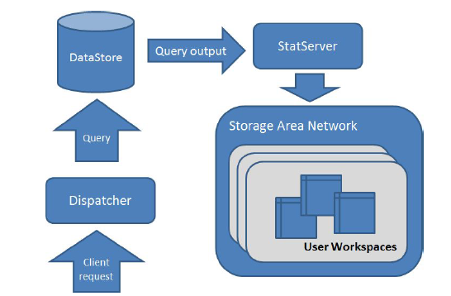
Notes:
In RAIRD, data get copied from the DataStore
…into the user’s workspace as a result of
…commands issued by the user in the web environment
The interface to the user’s bespoke workspace data sets is StatServer,
the number-crunching microservice

Slide 14
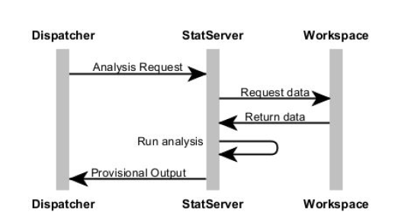
StatServer implementation
Notes:
The StatServer supports imports from the DataStore, of course,
But its main job is to transform, merge and analyze data
… on behalf of the user
….and return results and reports to downstream processing and rendering

Slide 15

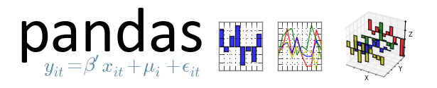


StatServer implementation
Notes:
In order to find an optimal platform for StatServer
…we evaluated many things, including Java and R.
We ended up with Python which has a rich and growing set
…of libraries for data transformations and analyses

Slide 16
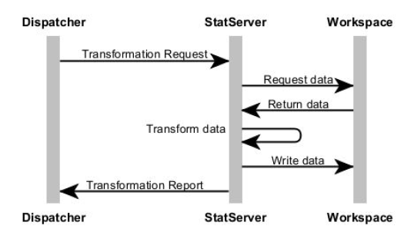
StatServer is 100% stateless
Notes:
StatServer is completely stateless
…and operates on files on a Storage Area Network (SAN)
It has absolutely no idea what it’s doing, and for whom
And all modifying operations result in a NEW data file on disk
This has many advantages,
It becomes very very simple and performant
It becomes possible to set up many StatServer nodes for horizontal scalability

Slide 17
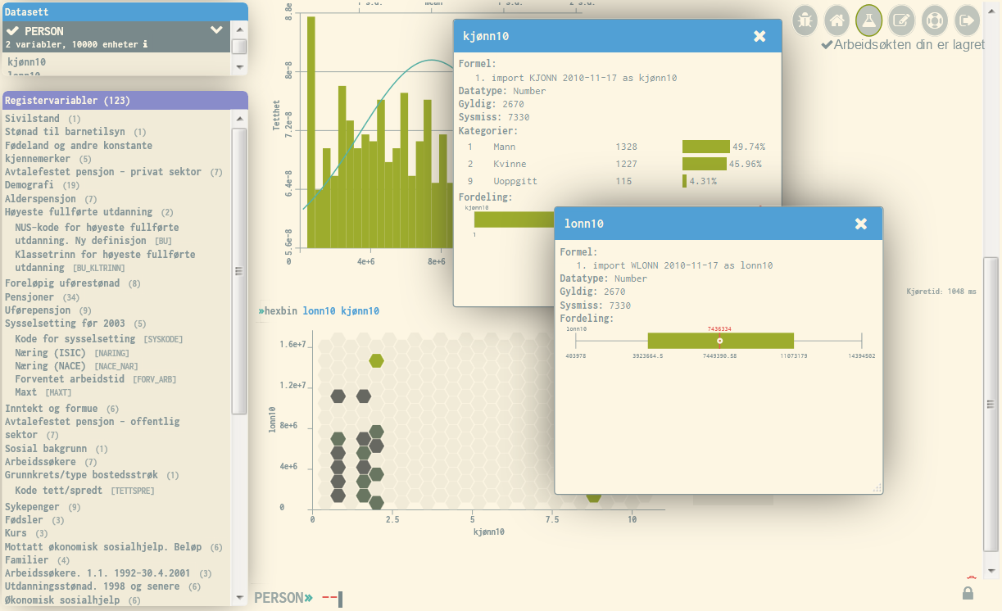
Notes:
The most important component is of course the user-facing one
The Online Statistical Environment
, which is where the user INTERACTS with data
By issuing commands that result in queries, data transformations and analyses

Slide 18
Online Statistical Environment (ROSE)
Inspired by
Stata
Workflow, power
IDEs (Eclipse, etc)
Intellisense
Google Docs
Forgiving interface

Slide 19



ROSE Implementation
ClojureScript + Om

Slide 20
Questions
http://raird.no
ornulf.risnes@nsd.no

